Slide 1
AIORI HACKATHON 3 • CATEGORY: CYBERSECURITY
PERSONAL-DATA
DISCOVERY & EVIDENCE INVENTORY
PS-019 | A configurable scanner for privacy evidence
PRESENTED BY
Infoshield • Prerna sharma, Pranav arora
Mentor : Sachin sir

Slide 2
01 • OVERVIEW
Abstract
A practical scanner to discover candidate personal-data fields and surface documentation gaps.
INPUT
PROCESS
OUTPUT
Configurable detection rules
Five predefined data classes
Purpose & retention mapping
Structured evidence inventory
Missing-metadata report
Per-class precision & recall
Synthetic CSV files
SQL database
AIORI HACKATHON 3 | CYBERSECURITY
PS-019 • 02

Slide 3
02 • PROBLEM
Problem Description
SCATTERED DATA
MISSING CONTEXT
RETENTION GAPS
Personal-data fields may be spread across unindexed tables and spreadsheets.
Fields may not be linked to a declared business purpose.
Retention schedules may be missing or difficult to verify.
CORE CHALLENGE
Build a scanner that identifies candidate personal-data fields, maps them to available purpose and retention metadata, and flags missing information for human review.
AIORI HACKATHON 3 | CYBERSECURITY
PS-019 • 03

Slide 4
03 • CONTEXT
Background & Regulatory Context
KEY CONCEPTS
WHY IT MATTERS
• Personal-data discovery: finding fields that may relate to individuals.
• Classification: grouping fields into five predefined data classes.
• Purpose metadata: why a field is collected or processed.
• Retention metadata: how long data is scheduled to be retained.
• Evidence inventory: records findings and missing documentation.
• Data may accumulate across files and database tables.
• Manual review can be slow and inconsistent.
• Disconnected metadata makes gaps harder to see.
• A structured inventory supports repeatable review.
• Human reviewers remain responsible for interpretation.
AIORI HACKATHON 3 | CYBERSECURITY
PS-019 • 04

Slide 5
04 • EXISTING WORK
Literature & Standards Review
RULE-BASED DISCOVERY
METADATA MANAGEMENT
PRIVACY FRAMEWORKS
Transparent patterns can flag candidate fields, but rules need configuration and testing.
Purpose and retention records provide context, but may be disconnected or incomplete.
Data protection frameworks inform governance; the scanner should not interpret the law automatically.
IDENTIFIED PRACTICAL GAP
A unified workflow is needed to combine CSV/SQL discovery, five-class classification, metadata mapping, and evidence-gap reporting.
AIORI HACKATHON 3 | CYBERSECURITY
PS-019 • 05

Slide 6
05 • SOLUTION
Proposed Solution: Privacy Evidence Scanner
01
02
03
Multi-source scan
Rule-based detection
Five-class classification
Read synthetic CSV files and one SQL database.
Apply configurable rules to identify candidate personal-data fields.
Assign detected fields to predefined classes.
04
05
06
Metadata linking
Gap detection
Evidence reporting
Connect fields to declared purpose and retention metadata.
Flag missing purpose or retention information.
Produce an inventory and evidence-gap report for human review.
AIORI HACKATHON 3 | CYBERSECURITY
PS-019 • 06

Slide 7
06 • IMPROVEMENT
Workflow Optimization
AREA
CURRENT APPROACH
PROPOSED SCANNER
Discovery
Manual spreadsheet audits
Configurable rule-based scanning
Mapping
Disconnected metadata
Purpose and retention linked to fields
Gap analysis
Manual, reactive checks
Automatic flags for missing metadata
Evaluation
Informal review
Per-class precision and recall
Reporting
Raw findings
Structured inventory and evidence-gap report
AIORI HACKATHON 3 | CYBERSECURITY
PS-019 • 07

Slide 8
07 • DESIGN
Solution Architecture
Synthetic CSV
Data Ingestion
Module
Detection &
Classification
Metadata Mapping
& Gap Checks
SQL Database
Evidence Inventory & Reports
Labelled Test Set
Evaluation Module
Human Review
AIORI HACKATHON 3 | CYBERSECURITY
PS-019 • 08

Slide 9
08 • DATA FLOW
Data Flow Diagram
1
2
3
4
5
6
INGEST
DETECT
CLASSIFY
MAP
VALIDATE
REPORT
Load synthetic CSV and SQL data.
Apply configurable rules.
Assign one of five data classes.
Link purpose and retention metadata.
Flag missing metadata.
Generate inventory and gap report.
Manual labels → Precision & recall
Final output → Human review
AIORI HACKATHON 3 | CYBERSECURITY
PS-019 • 09

Slide 10
09 • DELIVERY
Deployment Timeline
PHASE 1
PHASE 2
PHASE 3
PHASE 4
Repository & setup
Core scanner
Metadata & reports
Testing & demo
Evaluate precision/recall; demonstrate prototype and document limitations.
Initialize GitHub repository; define schema, five classes, and test data.
Link purpose/retention metadata; flag gaps and generate inventory.
Implement CSV/SQL ingestion and configurable detection rules.
AIORI HACKATHON 3 | CYBERSECURITY
PS-019 • 10

Slide 11
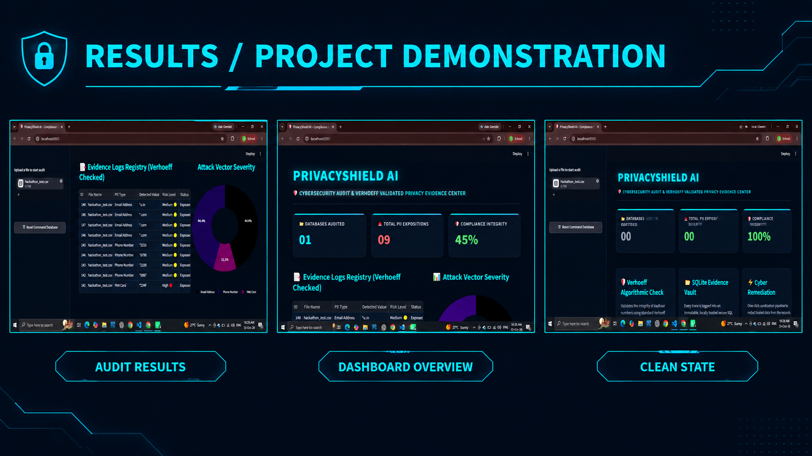

Slide 12
10 • REFERENCES
Bibliography
REFERENCES
• Ministry of Electronics and Information Technology (MeitY), Government of India. Data Protection Framework.
• AIORI Hackathon 3 Guidelines (2026). PS-019: Personal-Data Discovery and Privacy Evidence Inventory.
• Technical documentation for the CSV parser and selected SQL database, to be added based on the implementation.
AIORI HACKATHON 3 | CYBERSECURITY
PS-019 • 11

Slide 13
THANK YOU
Personal-Data Discovery & Evidence Inventory
Discover personal data. Identify evidence gaps.
Enable better privacy reviews.
AIORI HACKATHON 3 | PS-019

