Slide 1
Predictors of Opioid Prescription Rates
October 5, 2017

Slide 2
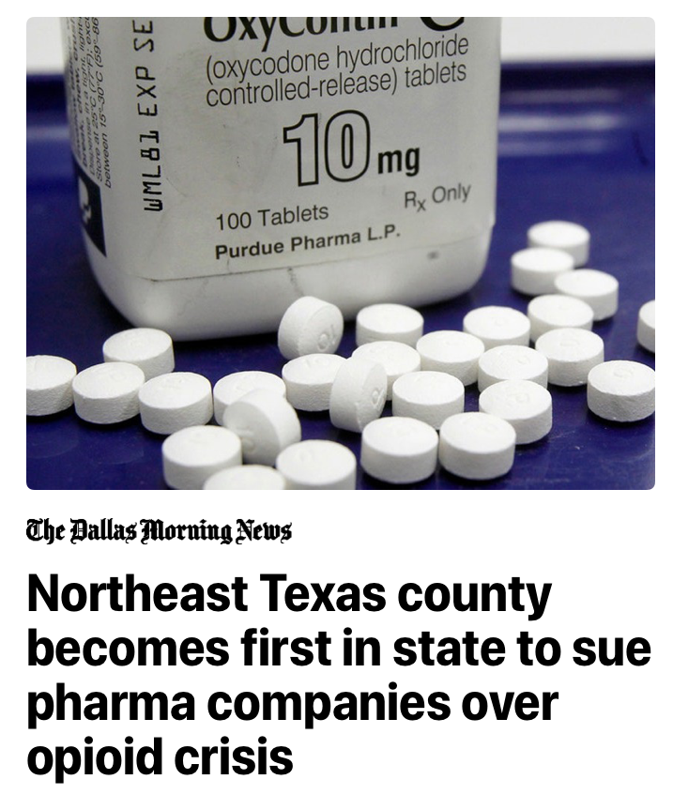


Opioid Epidemic

Slide 3
Data & Study Population
Centers for Medicare and Medicaid Services Medicare Fee-For Service Provider Utilization & Payment Data, Part D Prescriber, Public Use File
https://www.cms.gov/Research-Statistics-Data-and-Systems/Statistics-Trends-and-Reports/Medicare-Provider-Charge-Data/Physician-and-Other-Supplier.html
Information on prescription drug events incurred by Medicare beneficiaries with a Part D prescription drug plan over calendar year 2015
Beneficiary counts, claim counts, total drug costs, average age
Provider information (sex, complete address, medical specialty)
Outcome: Opioid Prescriber Rates (opioid claim count / total claim count)
Exclusion Criteria applied to dataset
Providers outside of the US states and D.C.
Missing total number of beneficiaries with at least one claim for a drug
Missing information on sex of the provider
Non-surgical medical specialties
Opioid prescriber rate of zero
Analytic sample size = 60,992
Medical specialty | Opioid Prescriber Rate
Hand Surgery | 60.2
Obstetrics & Gynecology | 22.9
Acupuncturist | 0.0
Notes:
1.1 Million prescribers in the dataset
Opioid prescriber rate = percent of total claim count represented by opioid claim counts

Slide 4
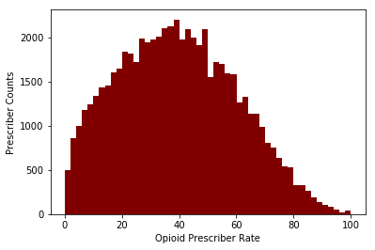
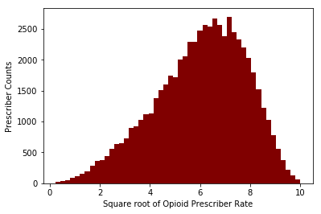
Outcome Distribution
Untransformed
Square Root Transformation

Slide 5
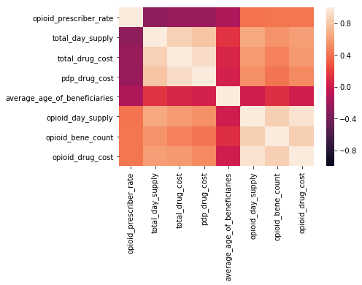
Spearman Correlations with Continuous Variables

Slide 6
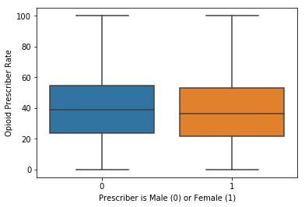
Opioid Prescriber Rates by Sex
Sex | Median Opioid Prescriber Rate
Male | 38.94
Female | 36.54
Wilcoxon Rank-Sum test:
Statistic = -302.25
P-value < 0.0001

Slide 7
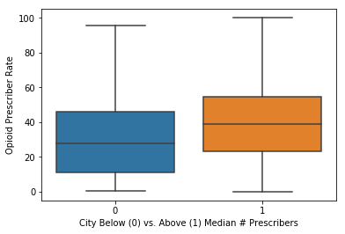
Opioid Prescriber Rates by Number of Prescribers within City
Providers per City | Median Opioid Prescriber Rate
Below median | 27.72
Above median | 38.78
Wilcoxon Rank-Sum test:
Statistic = -300.60
P-value < 0.0001

Slide 8
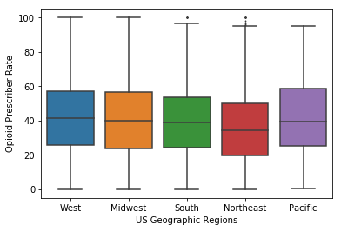
Opioid Prescriber Rates by US Geographic Region
Geographic Region | Median Opioid Prescriber Rate
Midwest | 39.90
Northeast | 34.35
Pacific | 39.39
South | 38.96
West | 41.40
One-way ANOVA
Statistic = 141.60
P-value = 1.07 x 10⁻¹²⁰

Slide 9
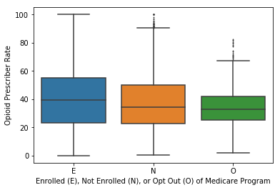
Opioid Prescriber Rates by Prescriber Enrollment in Medicare
Medicare Enrollment | Median Opioid Prescriber Rate
Enrolled | 39.29
Not Enrolled | 34.56
Opt Out | 32.91
One-way ANOVA
Statistic = 68.38
P-value = 2.17 x 10⁻³⁰

Slide 10
Random Forest Regression
Feature | Importance
Average age of beneficiaries | 0.688103
Northeast US region | 0.068517
Not enrolled in Medicare | 0.053567
West US region | 0.046261
Female sex | 0.045582
South US region | 0.032562
Above median # prescribers | 0.030792
Opt out of Medicare | 0.023253
Pacific US region | 0.011364
Out-of-bag R² score = 0.05
Average RMSE = 20.08

Slide 11
Limitations
Not representative of the general US population
Skewed to older individuals
Data covers only 70% of all Medicare beneficiaries
Single year of data may not capture changes over time
Current analysis limited to Surgical specialties
All opioid drugs were grouped into a single outcome

