Slide 1
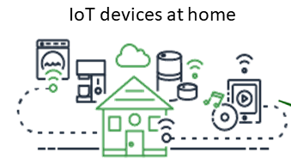
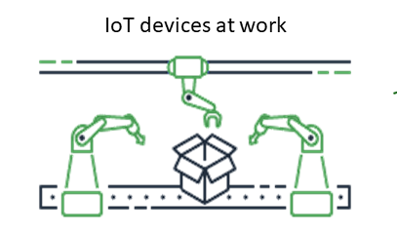
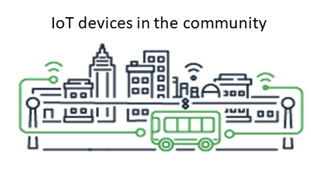
Edge Monitor
Edge Server
Snort IDS
EdgeX Foundry
Additional Services
Core Services
Application Services
Alerts & Notifications
Core Data
Command
Meta data
Registry
Device Services
REST
Add Device Services
MQTT

