Slide 1
DBMS LAB PROJECT
E-Commerce Website
(ECCOM)
-1911

Slide 2
Introduction
This is small e-commerce website which has two templates, the customer and the admin.
The customer can view the products, adds products to cart, order the products.
The admin manages the website,the products, orders and the customers.

Slide 3
Features of the Website

Slide 4
Customer Features
Log in/Log out/Sign up
View products
Add products to cart
View the products in the cart
Order the products
View Orders
View personal details
All these features are implemented in the project.

Slide 5
Admin Features
Manage users, products, orders
View/Add/Delete/Update products
View all the orders, user details, products based on category
Dashboard with insights
The admin features that are implemented are:
View products, orders, user details, cart details
Dashboard with insights

Slide 6
Requirements
Technology Software Stack
VS Code
MySQL Server
MySQL Workbench
Dia Diagram
Languages: Python, HTML, CSS, JavaScript, Jinja, SQL

Slide 7
Packages used in Python
Flask: Flask, render_template, request, session,redirect, url_for, flash
Mysql: mysql, mysql.connector
Functiontools: wraps
Passlib.hash: mysql41

Slide 8
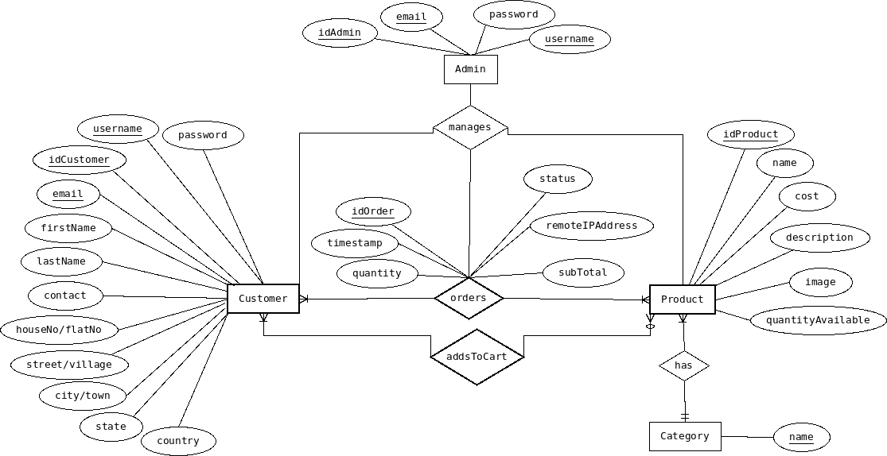
ERD

Slide 9
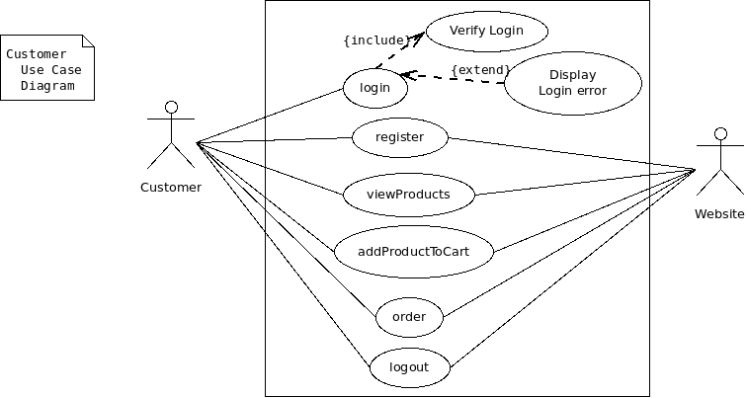
Use Case Diagram

Slide 10
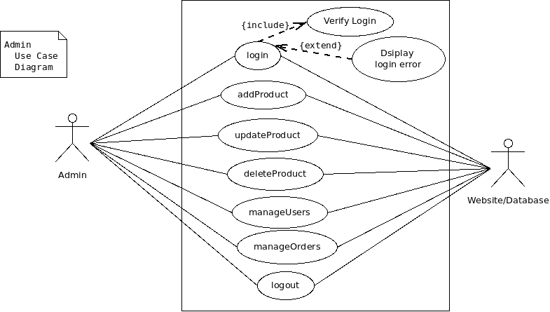

Slide 11
Implementation and Results for Customer

Slide 12
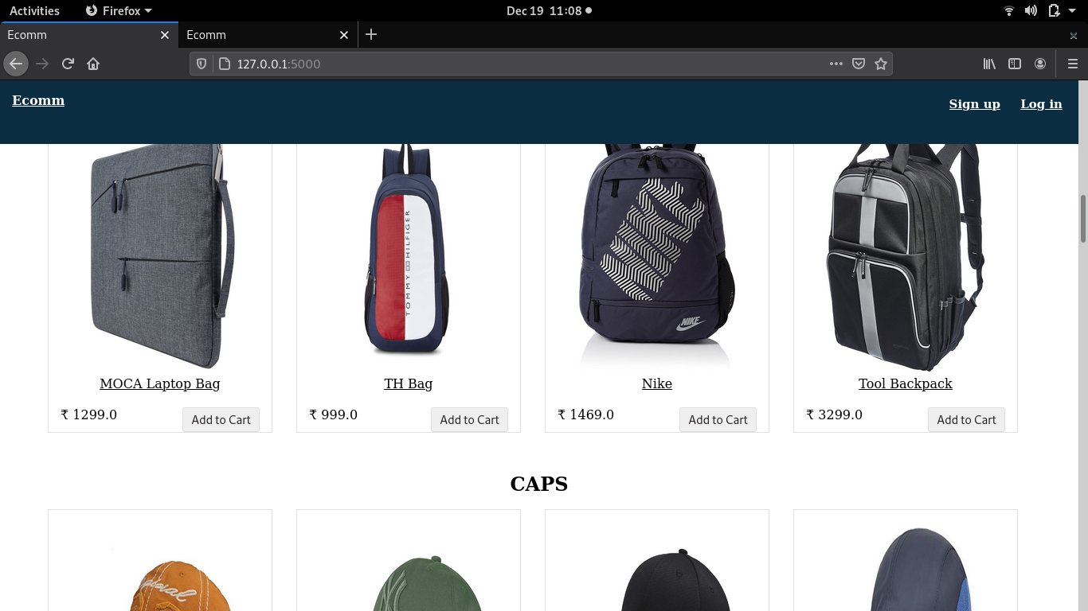
Main page before login

Slide 13
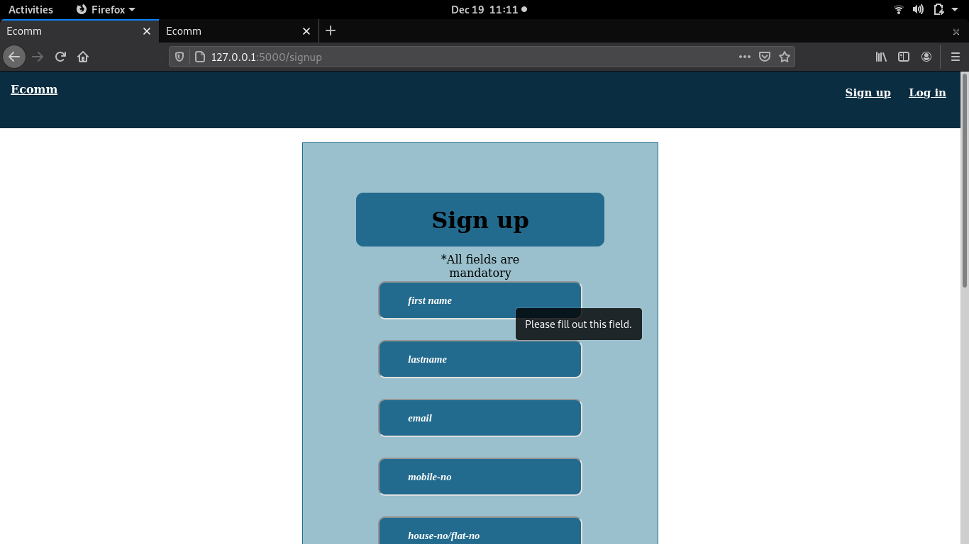
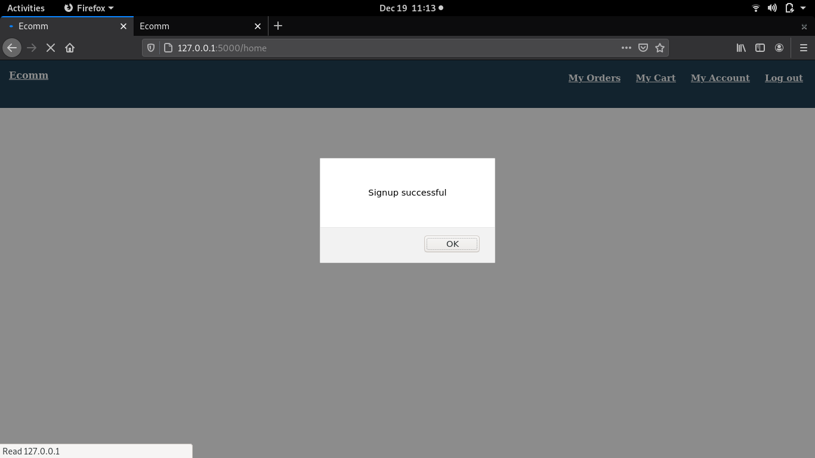
Sign Up Form
Sign Up Message

Slide 14
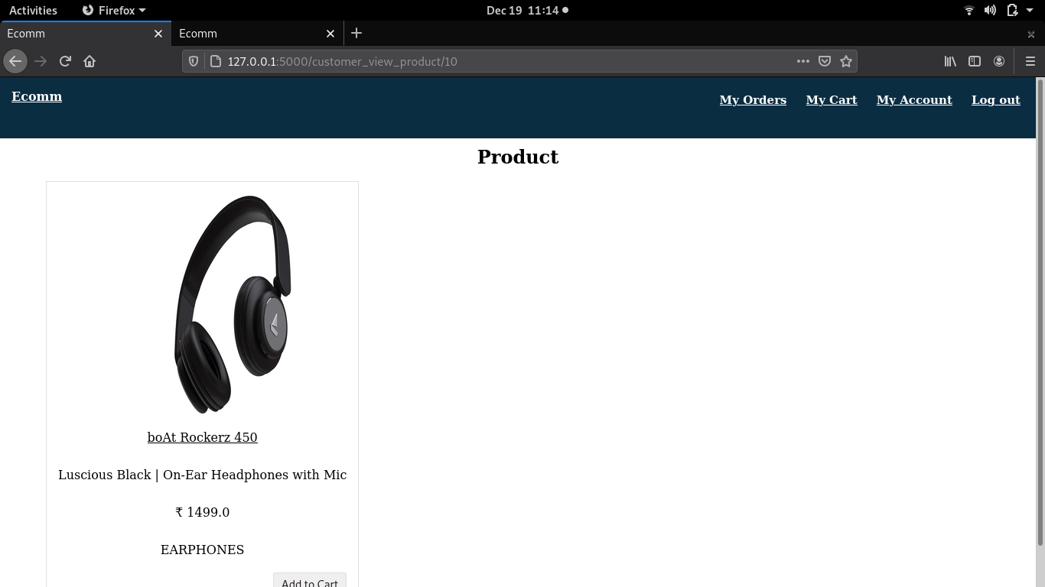
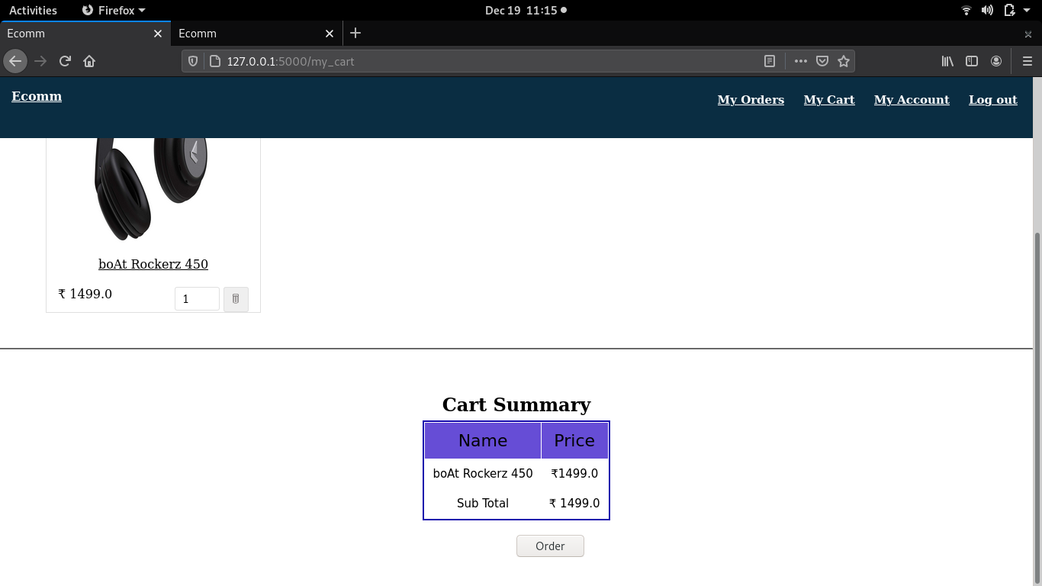
View Product
View Cart

Slide 15

Remove Item from Cart

Slide 16

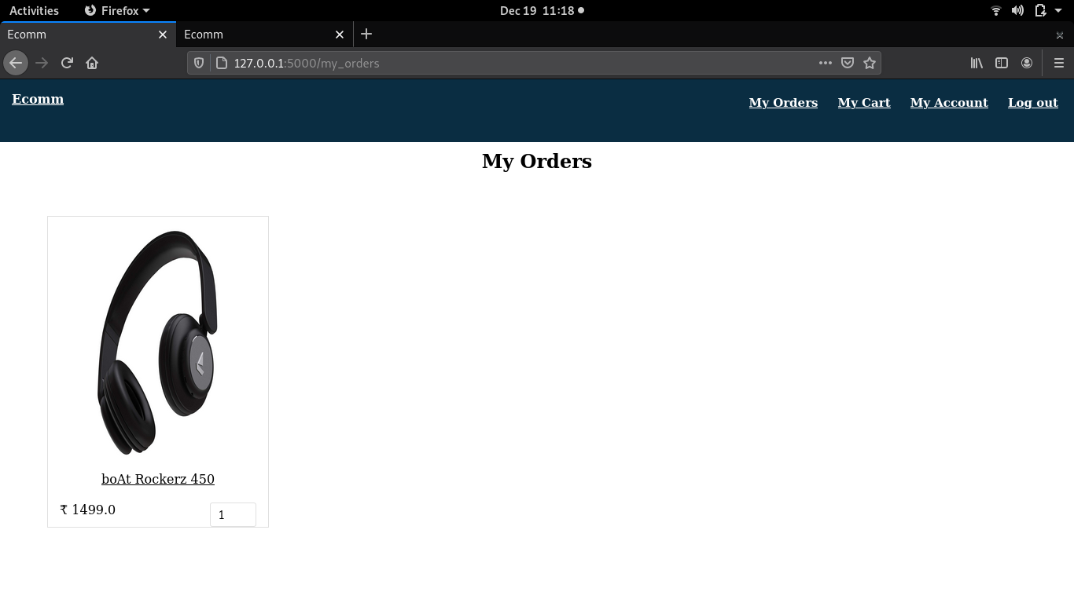
Order Products
View Orders

Slide 17
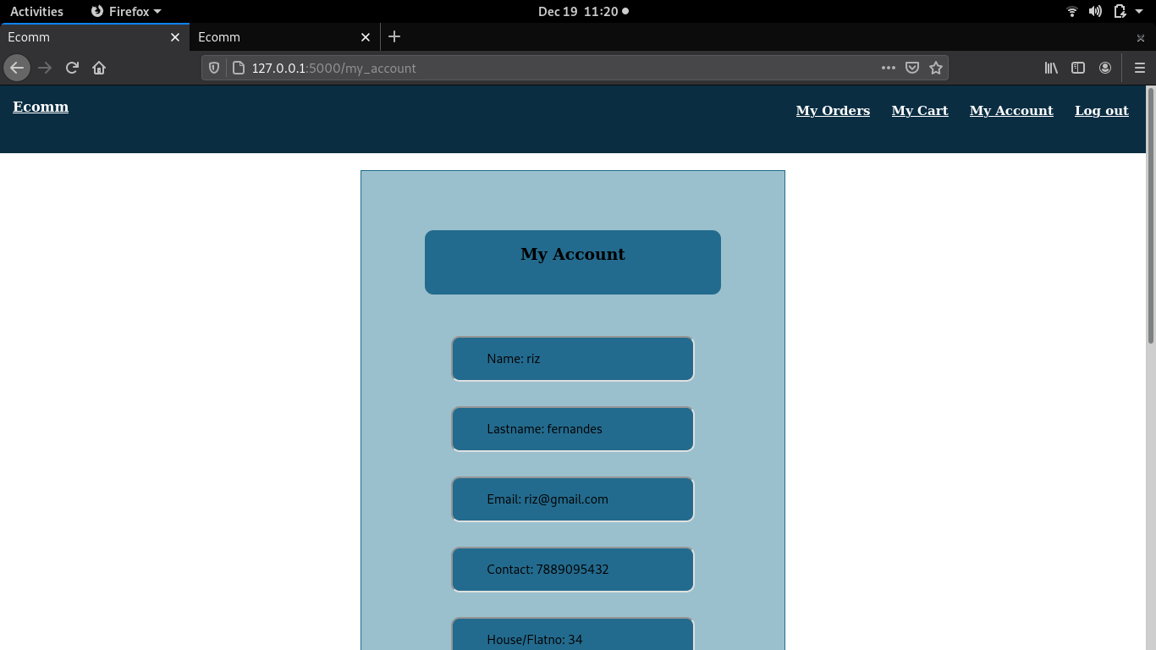
View Personal Details

Slide 18

Log out

Slide 19
Implementation and Results for Admin

Slide 20
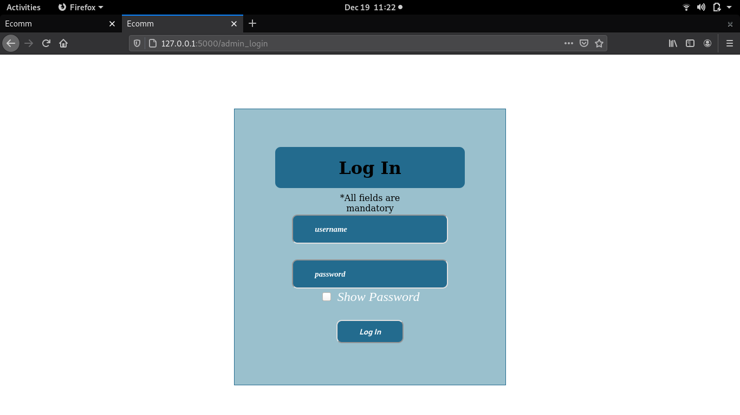
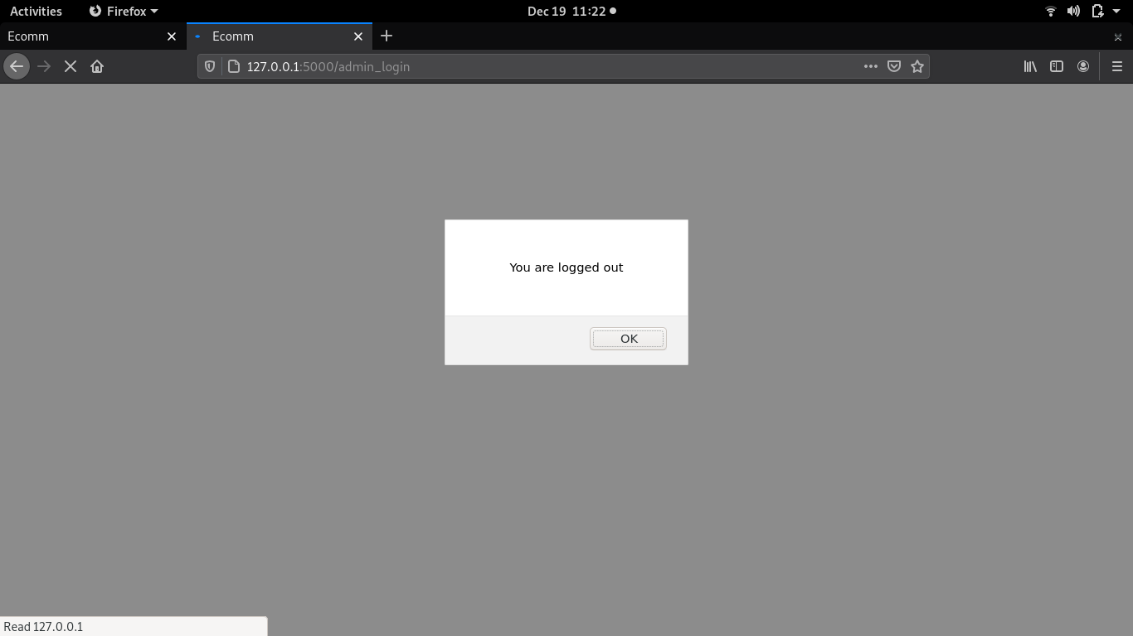
Login
Log out

Slide 21
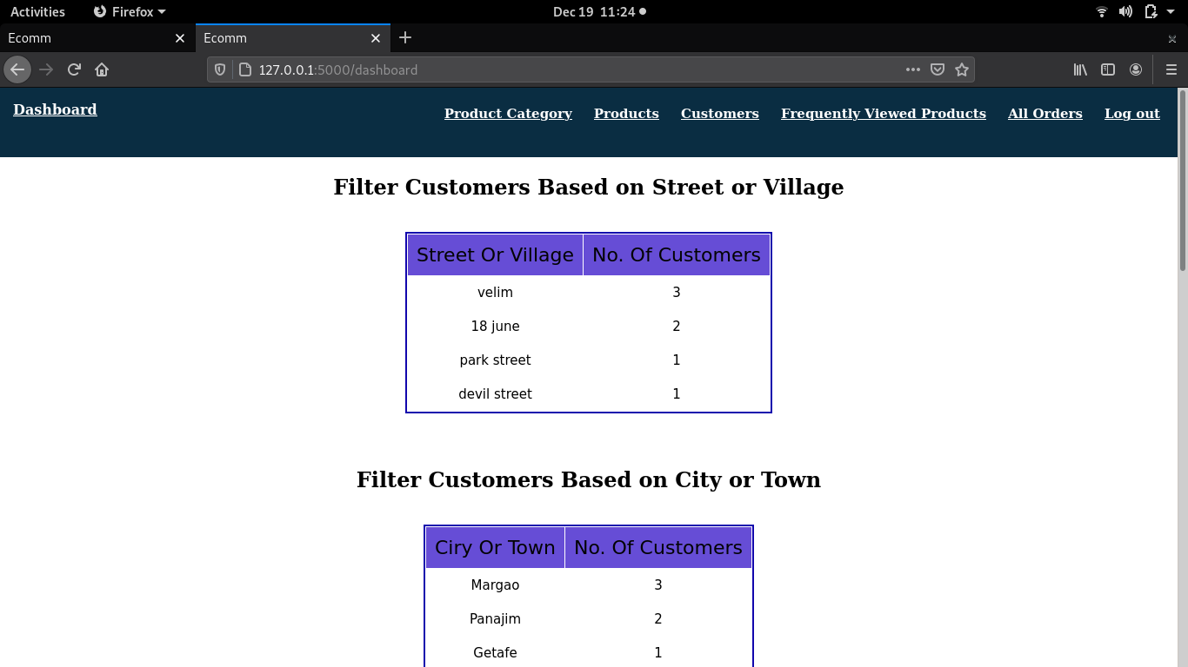
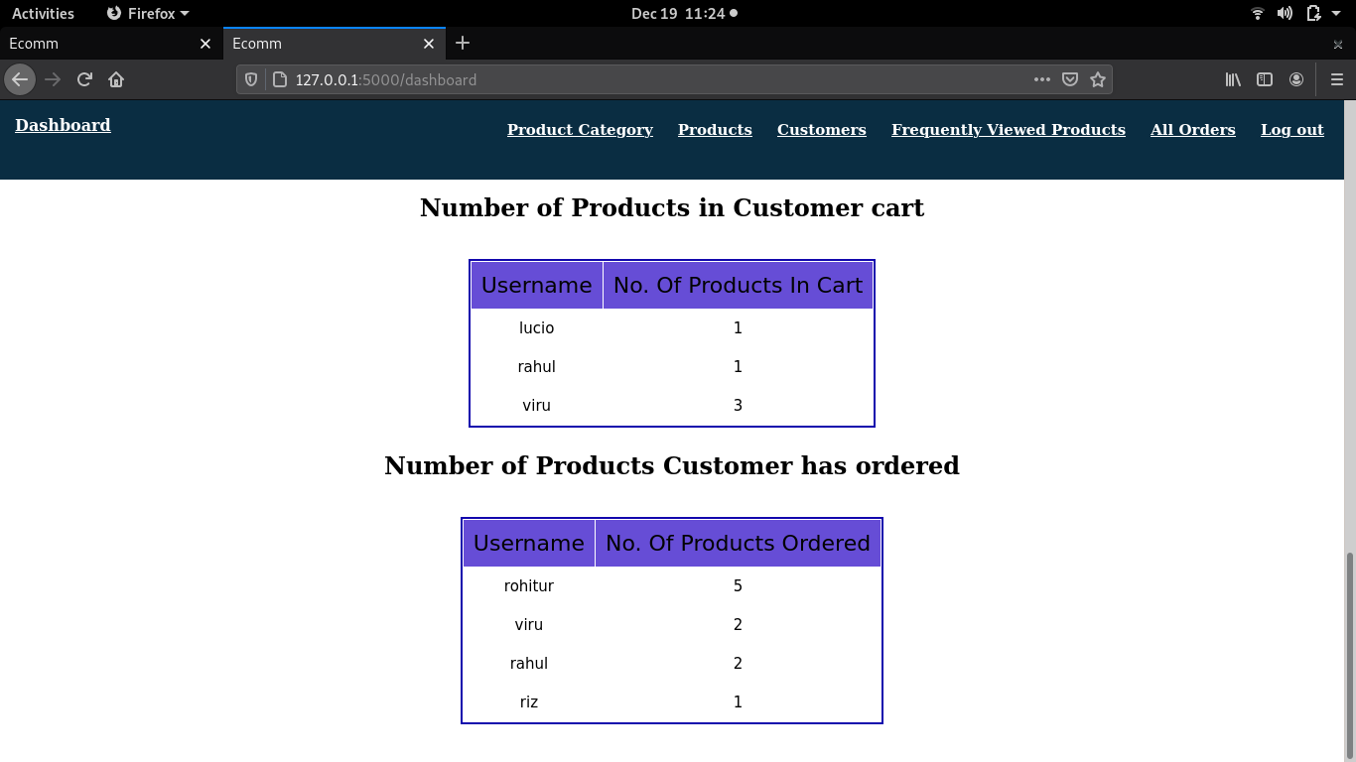
Dashboard

Slide 22
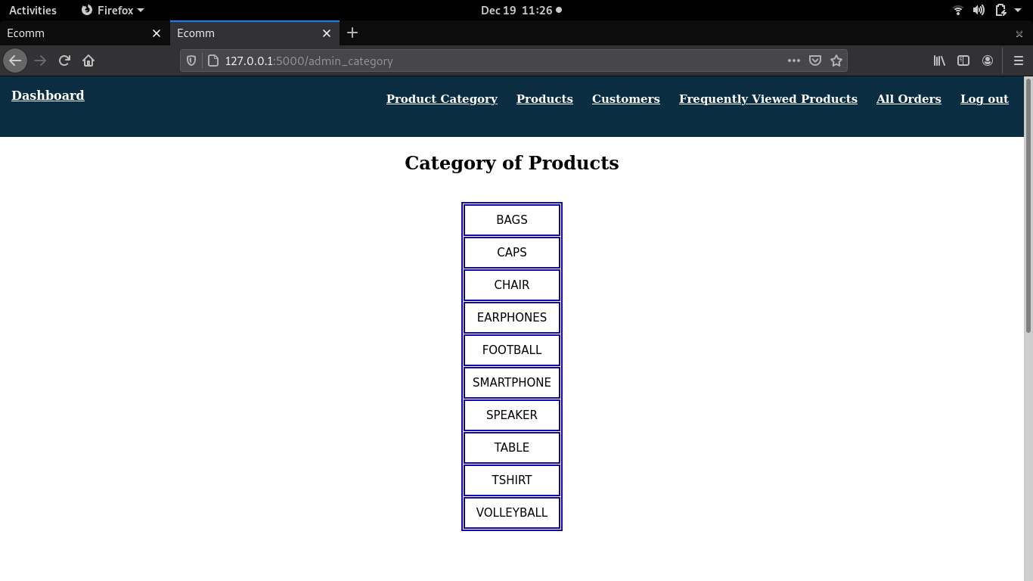
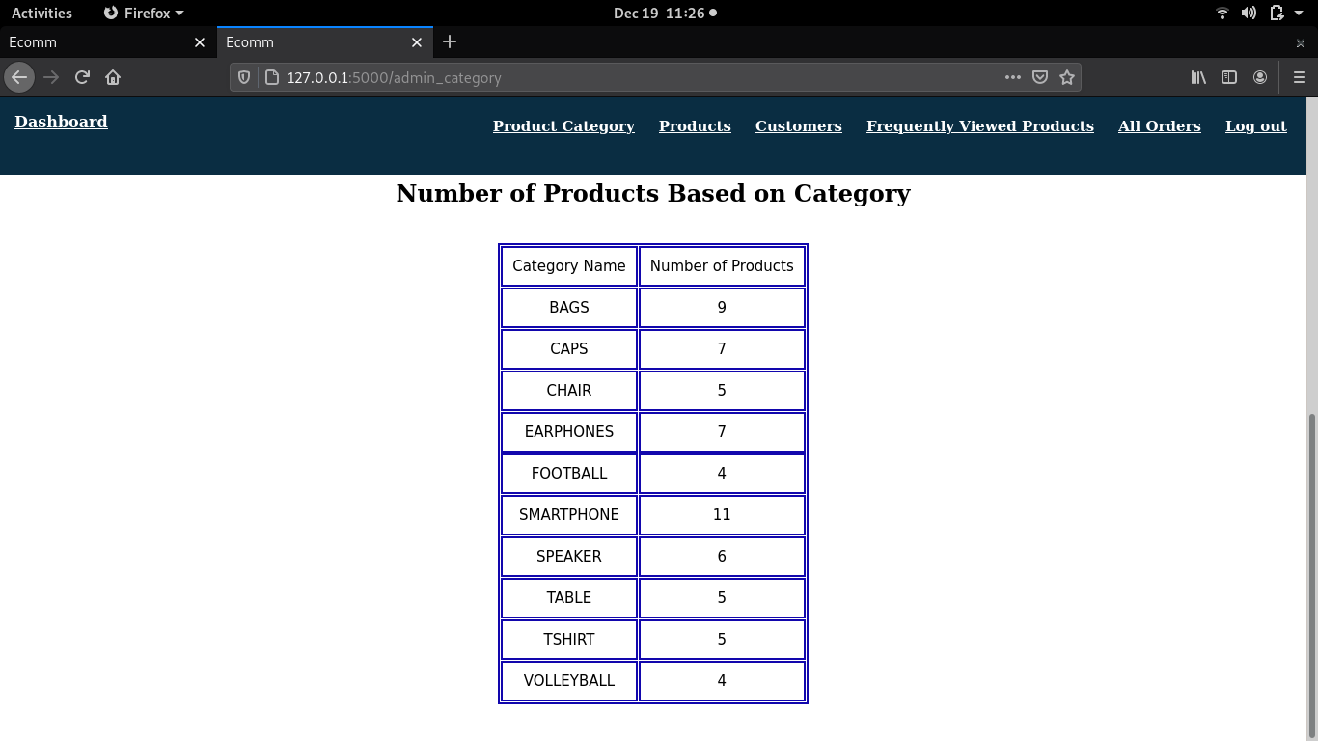
View Category of Products

Slide 23
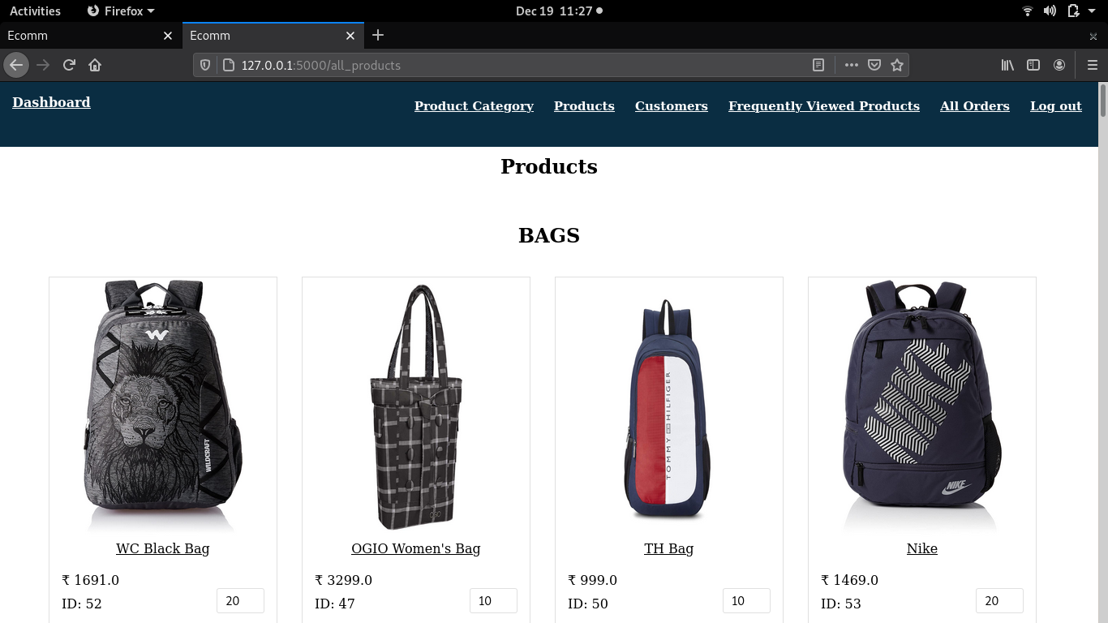
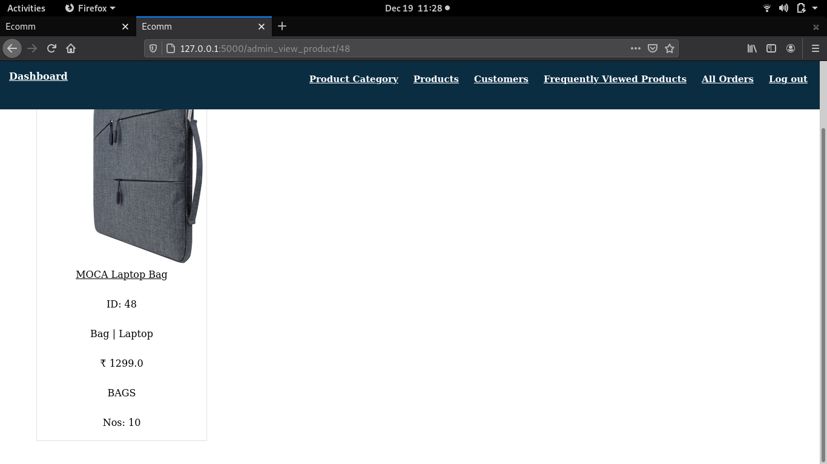
View Products

Slide 24
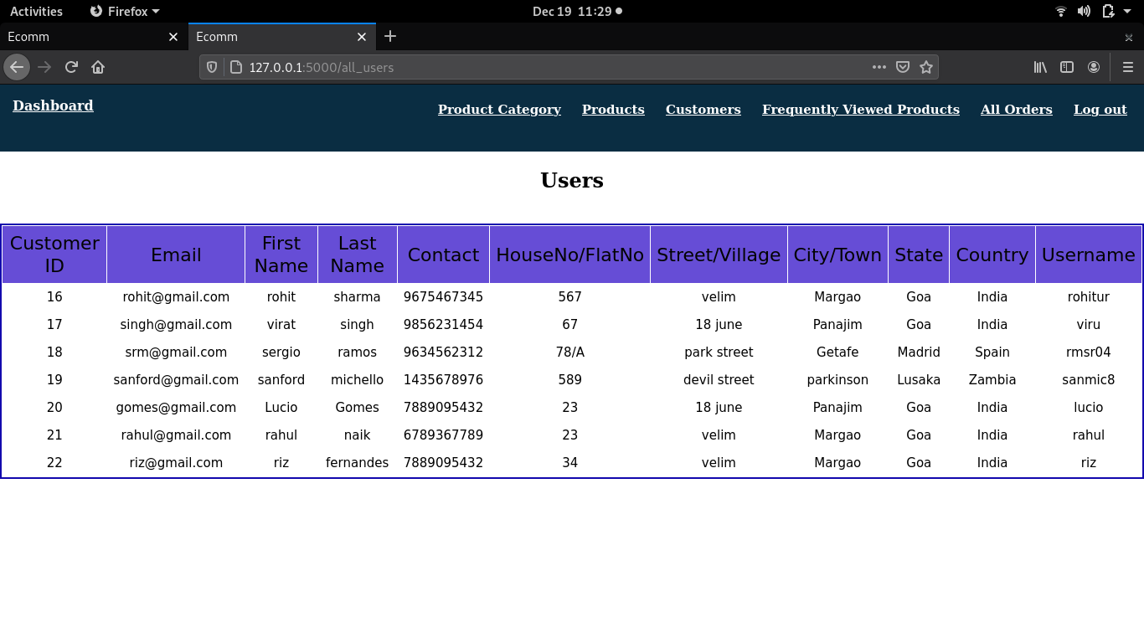
View Customer Details

Slide 25
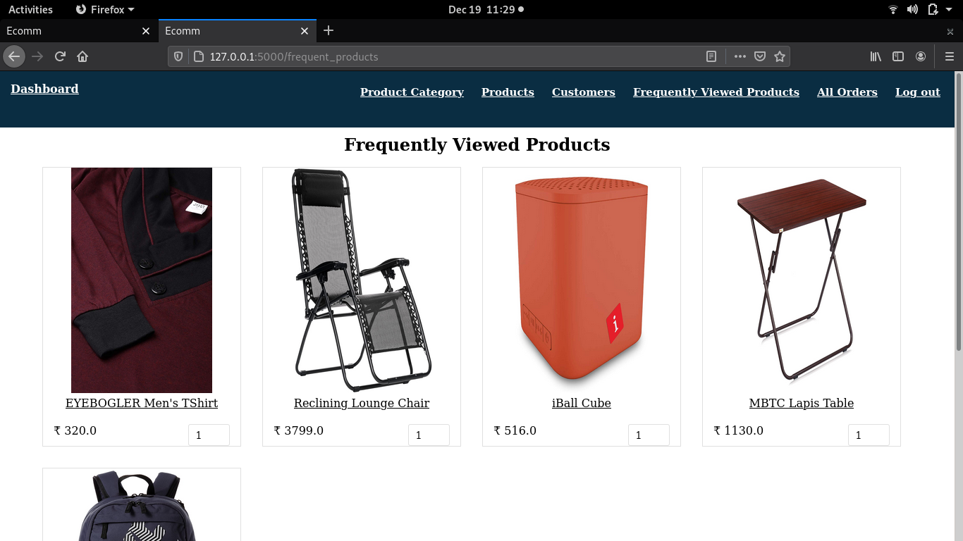
View Frequently Viewed Products

Slide 26
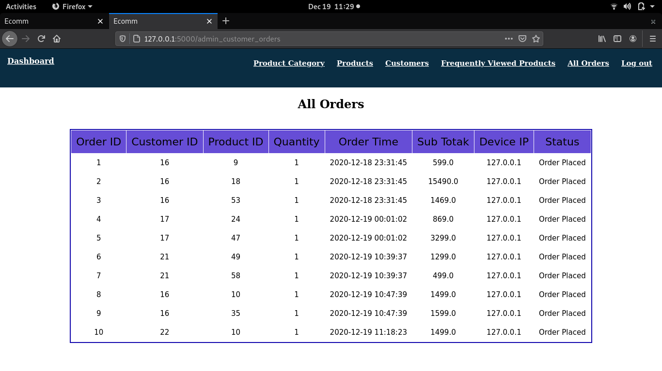
View all Orders

Slide 27
Reports

Slide 28
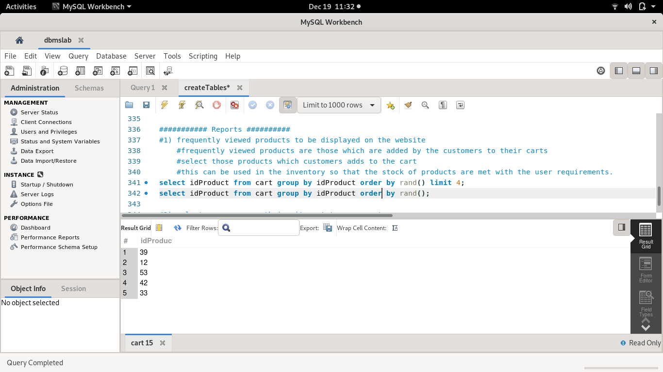
1) Find Products that are in customer carts

Slide 29
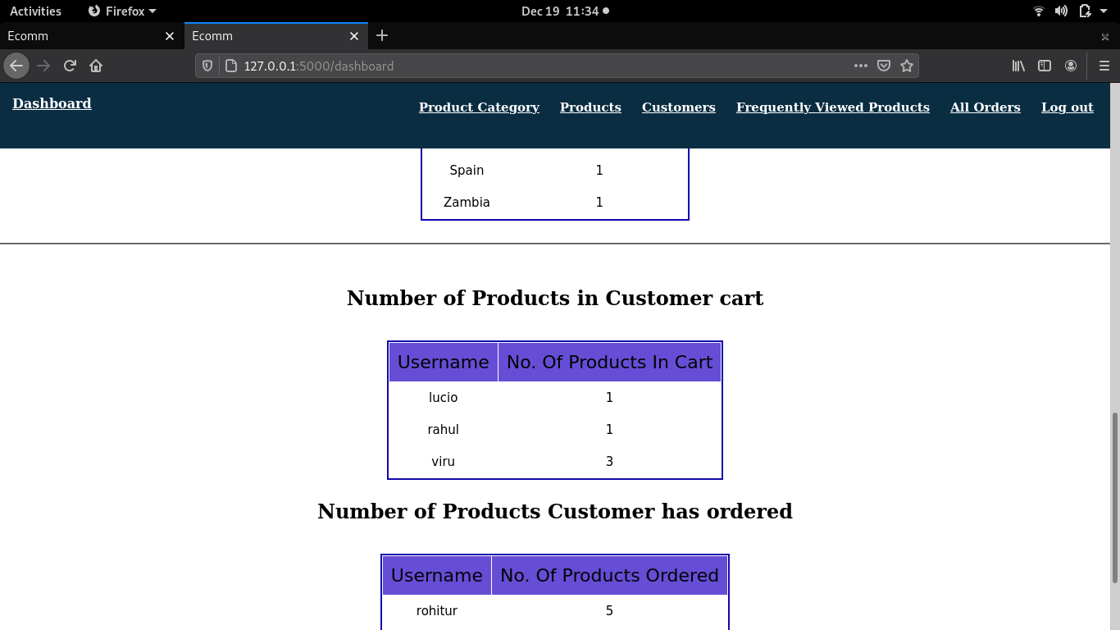

Slide 30
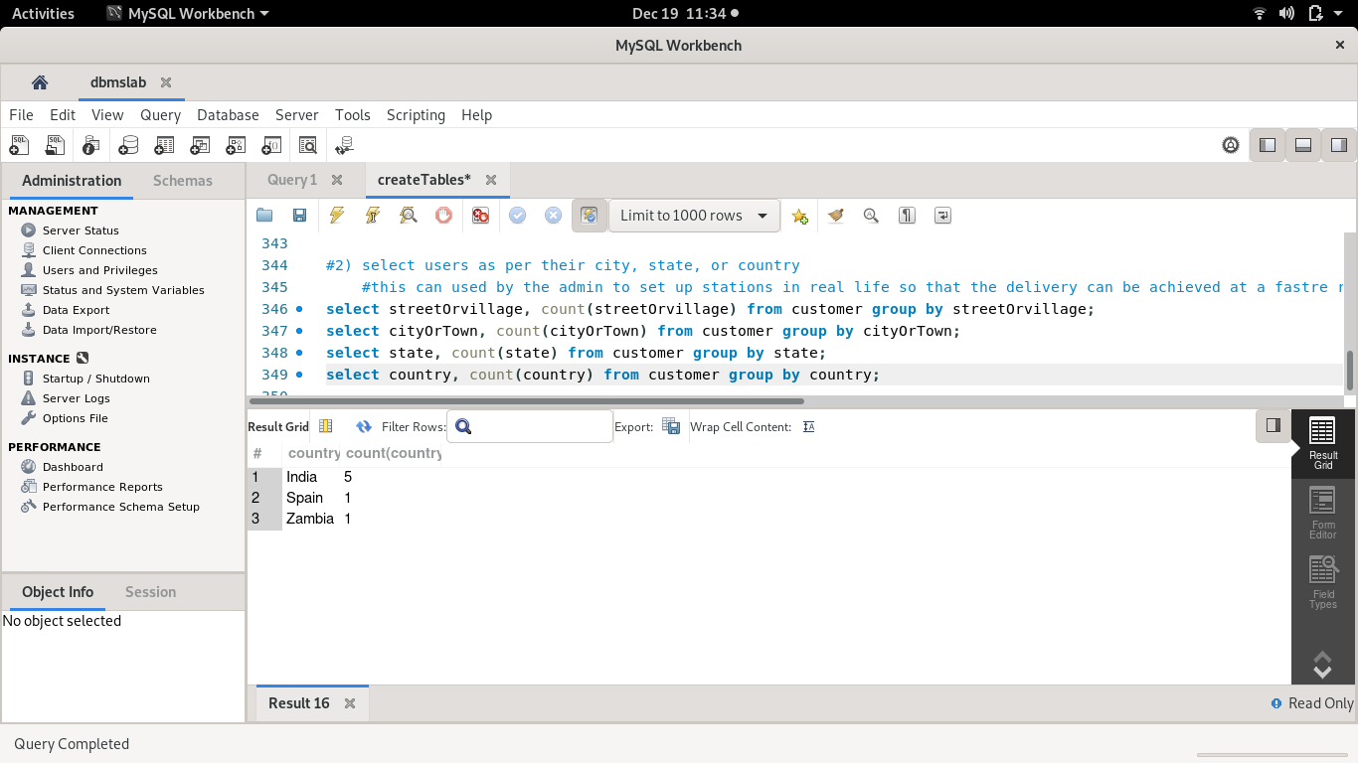
2)Filter customers based on their address

Slide 31
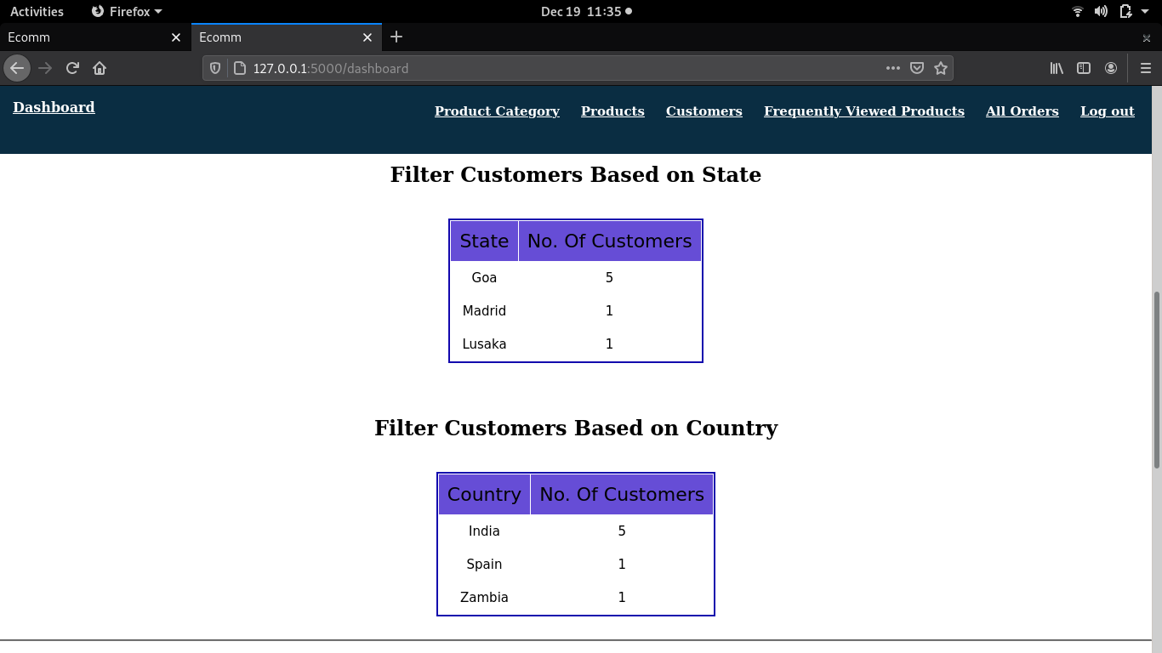

Slide 32
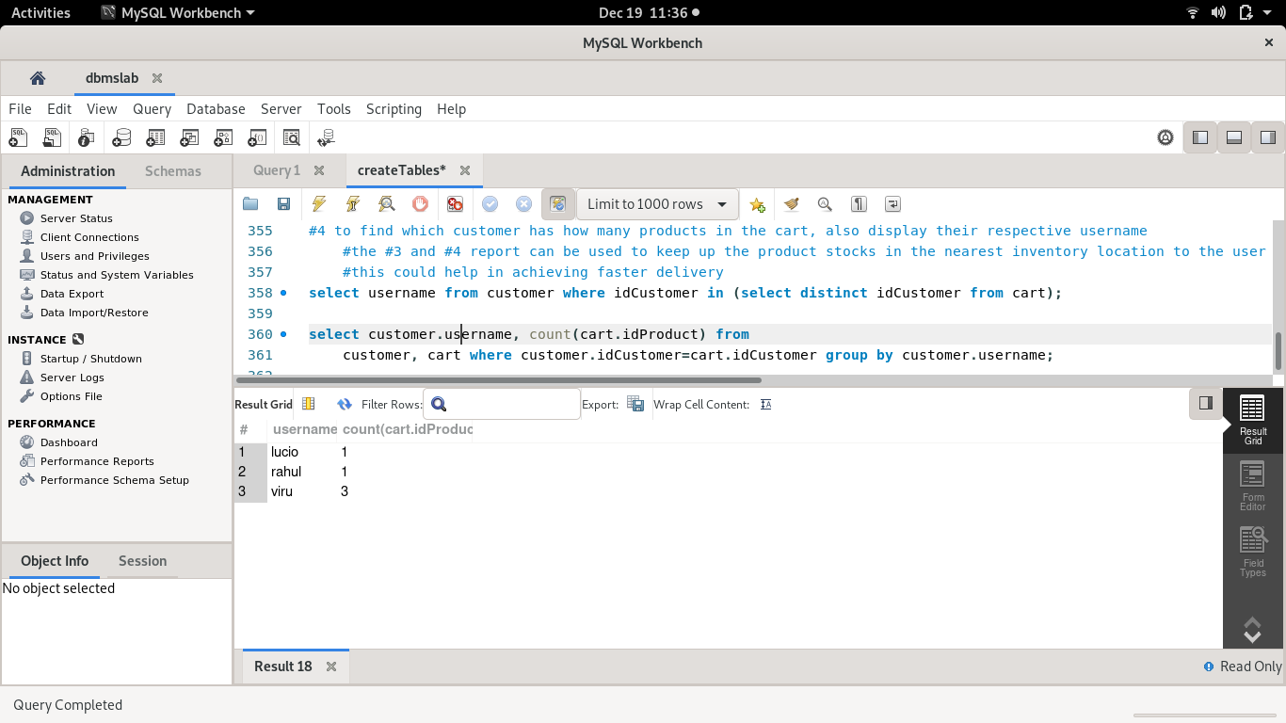
3)Find number of products in customer cart
Based on 1)

Slide 33
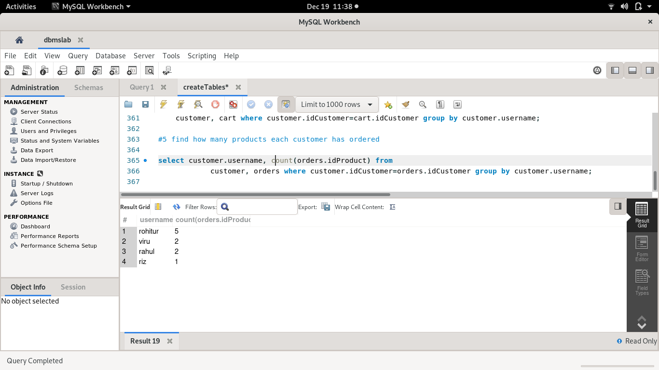
4)Find number of products the customer has ordered

Slide 34


Slide 35
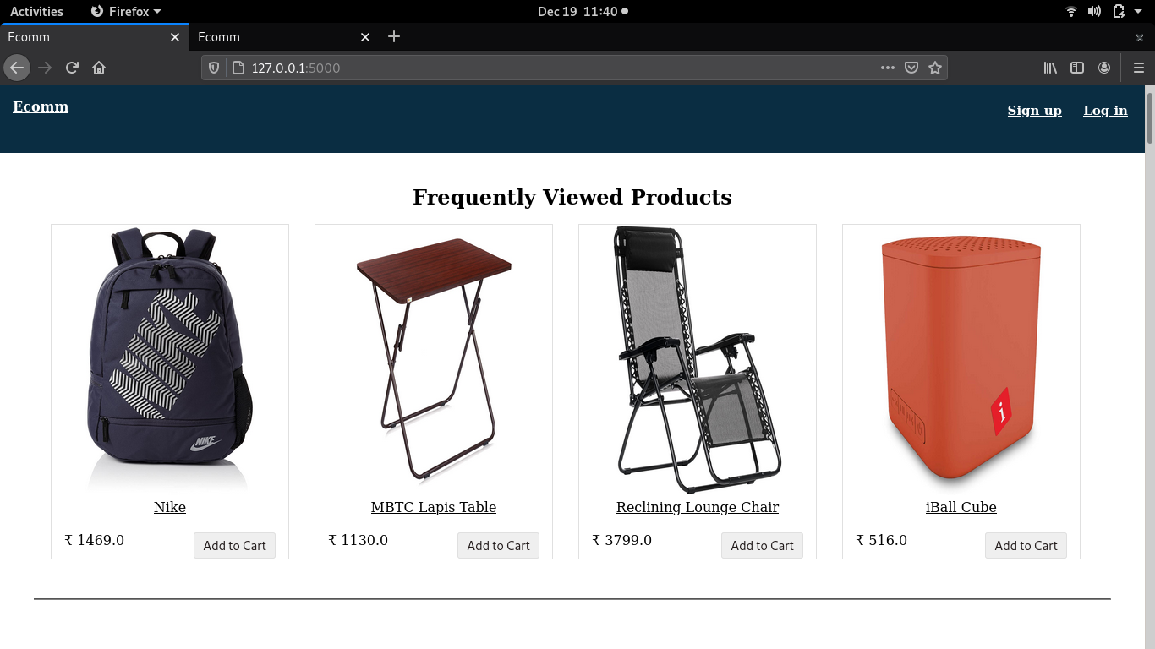
5) Frequently Viewed Products

Slide 36
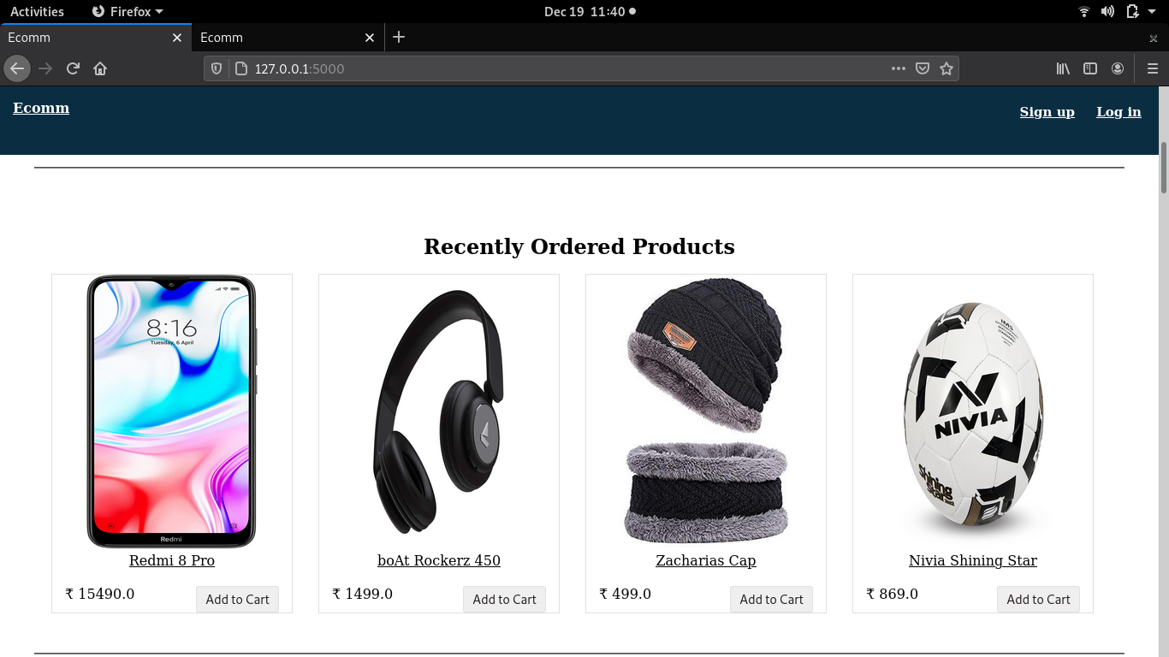
6)Recently Ordered Products

Slide 37
Future Scope
Complete the project
Add all the functionalities of the admin
Add payment method
Increase functionalities of the website based on the requirement

Slide 38
Thank You

