Slide 1
E-Commerce Website
--1911

Slide 2
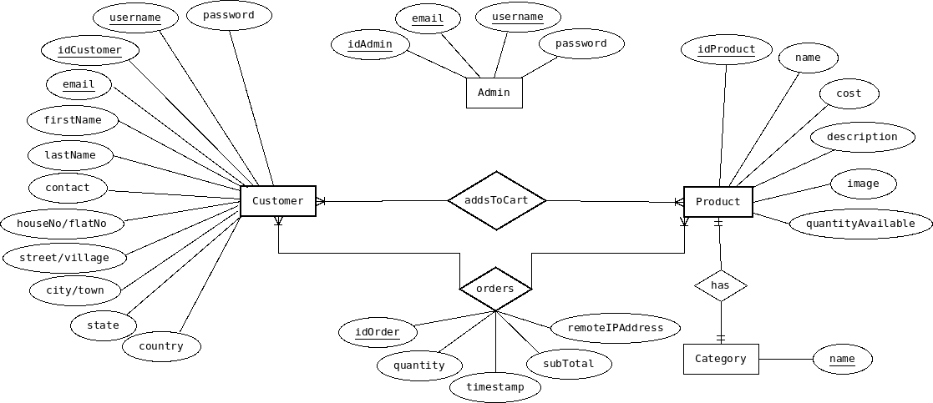
ERD

Slide 3
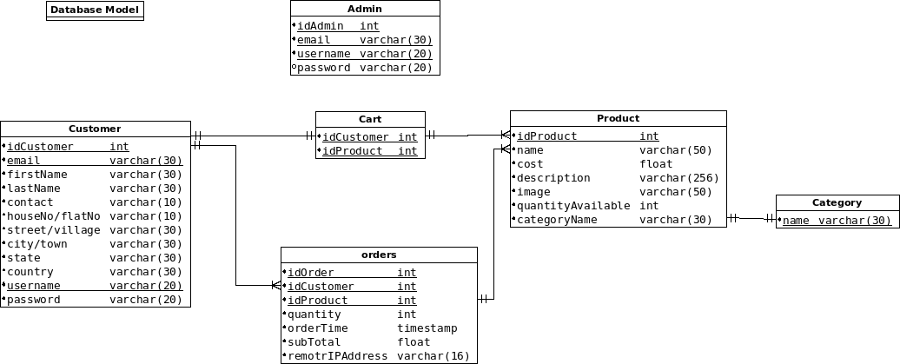
Database Model

Slide 4
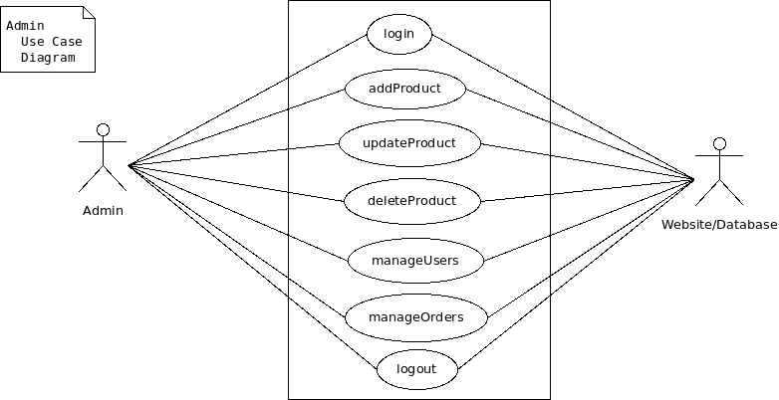
Admin Use Case Diagram

Slide 5
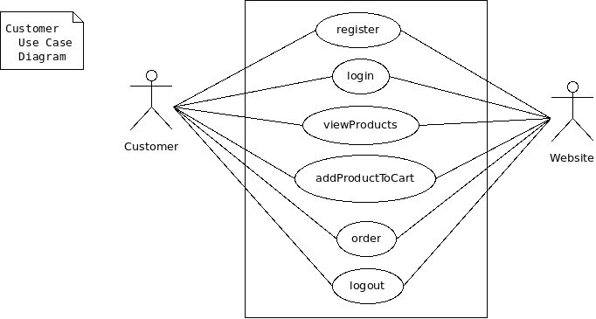
Customer Use Case Diagram

