Slide 1
Module 3: Perceptron Learning
Mary Divya Shamili D

Slide 2
Perceptron are artificial neurons
Neurons are information messengers.They use electrical and chemical signals to send information between diﬀerent areas of the brain, as well as between the brain, the spinal cord, and the entire body.

Slide 3
Biological Neurons vs Perceptron
Biological Neuron
Perceptron
Input- dendrites
Establish Connection
Synapses
Production an output signal
Nucleus
The output signal is carried away by the axon.
Input Neurons
Establish Connection
Weights –measures the importance of input
Activation Function
Axon in a perceptron is the output value

Slide 4
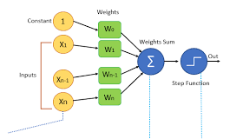
Perceptron

Slide 5



Slide 6
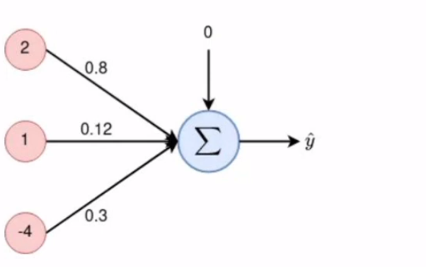
Numerical

Slide 8

Activation Functions
They basically decide whether a neuron should be activated or not. Whether the information that the neuron is receiving is relevant for the given information or should it be ignored.
The activation function is the non linear transformation that we do over the input signal. This transformed output is then sent to the next layer of neurons as input.
A neural network without an activation function is essentially just a linear regression model. The activation function does the non-linear transformation to the input making it capable to learn and perform more complex tasks.

Slide 9
The Activation Functions can be basically divided into 2 types-
Linear Activation Function
Non-linear Activation Functions

Slide 10
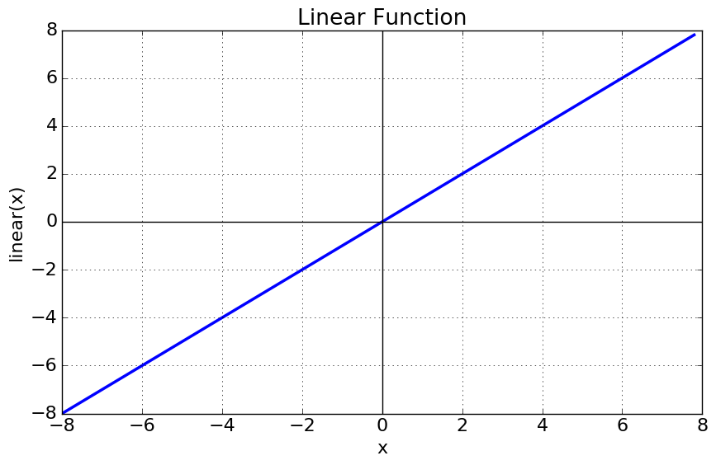
Linear Activation Function
the output of the functions will not be confined between any range.
Equation : f(x) = x
Range : (-infinity to infinity)
It doesn’t help with the complexity or various
parameters of usual data that is fed to the
neural networks.

Slide 11
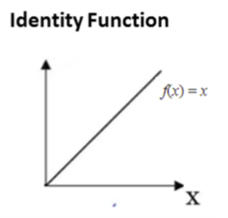
Identity Activataion Function

Slide 12
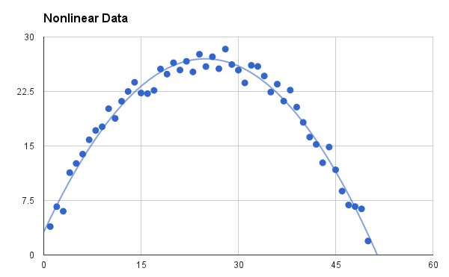
Non-linear Activation Function
The Nonlinear Activation Functions are the most used activation functions.
It makes it easy for the model to generalize or adapt with variety of data and to differentiate between the output
The Nonlinear Activation Functions are mainly divided on the basis of their range or curves

Slide 13
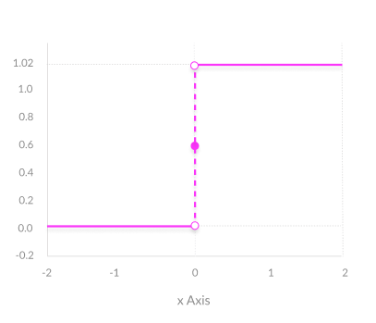
Binary Step Function
A binary step function is a threshold-based activation function. If the input value is above or below a certain threshold, the neuron is activated and sends exactly the same signal to the next layer.
Activation function
A = “activated” if Y > threshold else not
A = 1 if y> threshold, 0 otherwise

Slide 14
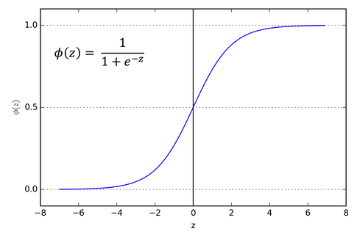
Sigmoid or Logistic Activation Function
Sigmoid Function
Range(0,1)
It is differentiable, non-linear
produces non-binary activations
It not a zero-centric function.
Disadvantages-vanishing gradients

Slide 15
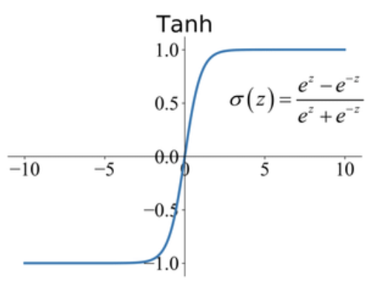
Hyperbolic Tangent Function or Tanh
Range(-1,1)
Bipolar Sigmoid Function
Tanh Convergence is usually faster
advantage is that the negative inputs will be mapped strongly negative and the zero inputs will be mapped near zero in the tanh graph.

Slide 16
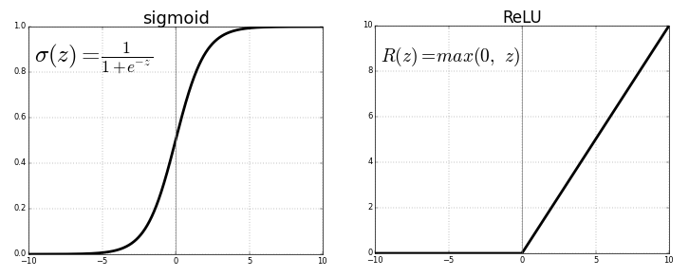
RELU Function
ReLu stands for the rectified linear unit
F(x)=max(0,x)
The name of the ramp function is
derived from the appearance
of its graph.
Advantage:sparsity
Disadvantage:exploding
gradients

Slide 17
Leaky ReLU
It is an attempt to solve the dying ReLU problem
The leak helps to increase the range of the ReLU function. Usually, the value of a is 0.01 or so
When a is not 0.01 then it is called Randomized ReLU.
Therefore the range of the Leaky ReLU is (-infinity to infinity).

Slide 18
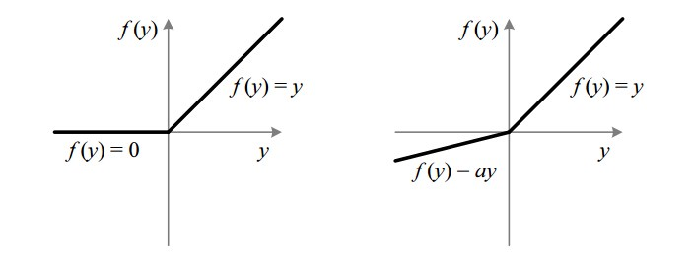
Fig : ReLU v/s Leaky ReLU

Slide 19
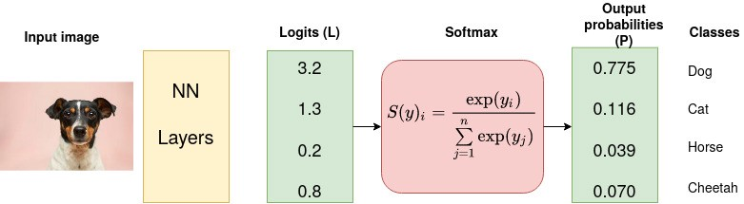
Softmax

Slide 20
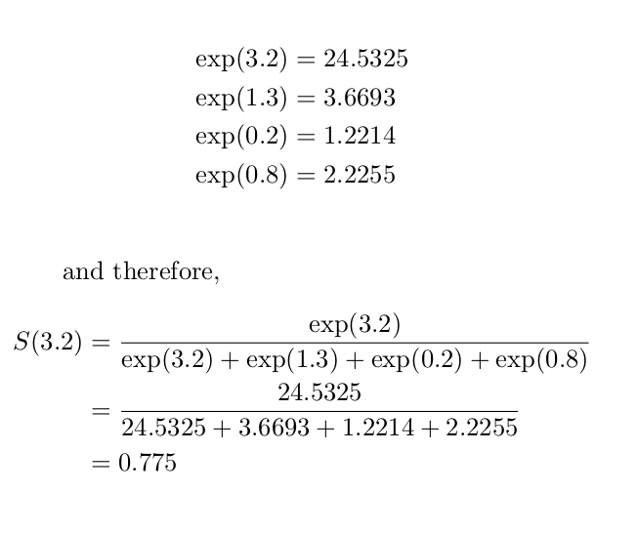

Slide 21
The softmax function is used as the activation function in the output layer of neural network models that predict a multinomial probability distribution.
This function returns the probability for a datapoint belonging to each individual class.
While building a network for a multiclass problem, the output layer would have as many neurons as the number of classes in the target.
These represent the probability for the data point belonging to each class. Note that the sum of all the values is 1.

Slide 22
Choosing the right Activation Function
Sigmoid functions and their combinations generally work better in the case of classifiers
Sigmoids and tanh functions are sometimes avoided due to the vanishing gradient problem
ReLU function is a general activation function and is used in most cases these days. ReLu is less computationally expensive than tanh and sigmoid because it involves simpler mathematical operations
If we encounter a case of dead neurons in our networks the leaky ReLU function is the best choice
Always keep in mind that ReLU function should only be used in the hidden layers. At current time, ReLu works most of the time as a general approximator

Slide 23
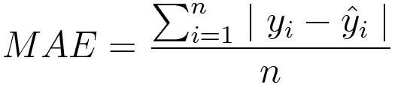
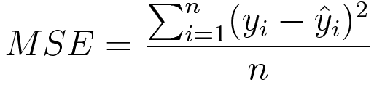
The loss function in a neural network quantifies the difference between the expected outcome and the outcome produced by the machine learning model. From the loss function, we can derive the gradients which are used to update the weights. The average over all losses constitutes the cost.
Different types of Loss functions are there.
1. MAE(Mean Absolute Error)=
2. MSE(Mean Squared Error)=

Slide 24
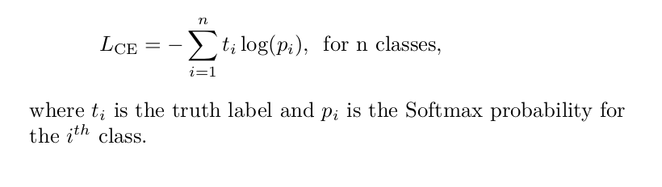
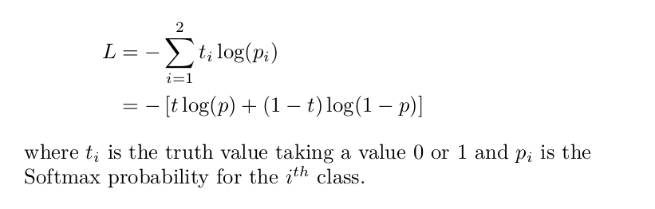
3.Cross Entropy Loss=
4. Binary Cross-Entropy Loss

Slide 25
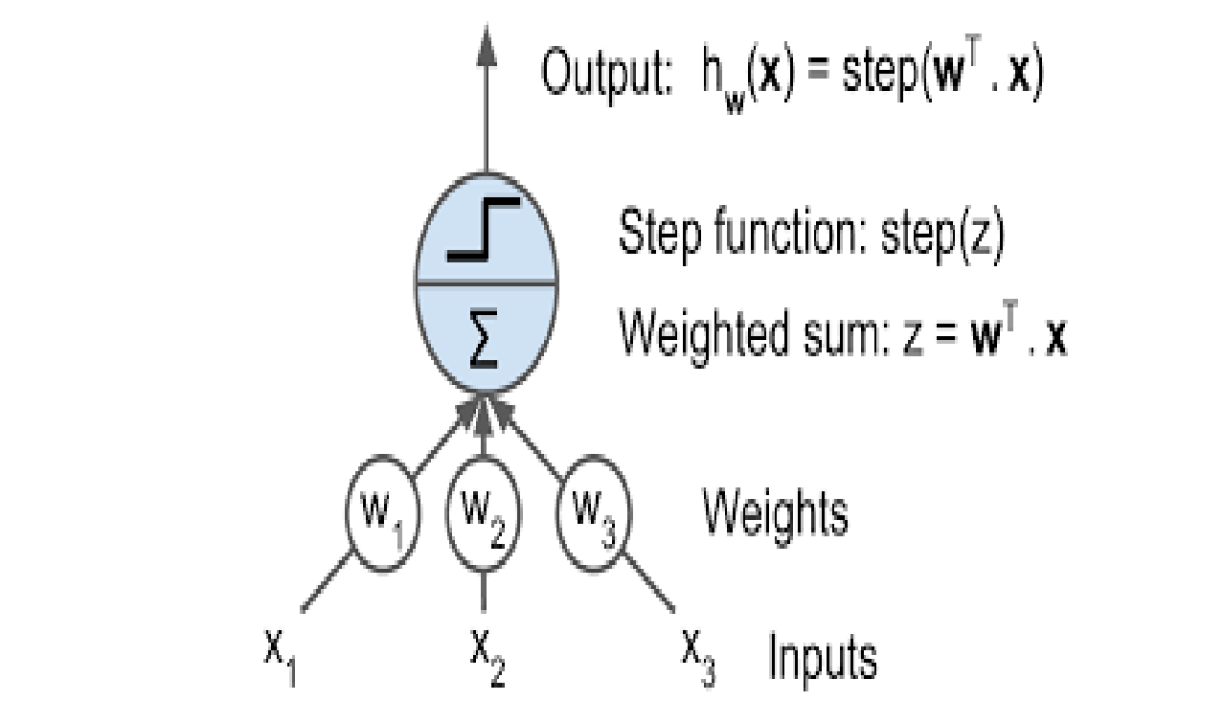
Linear Threshold Unit

Slide 26
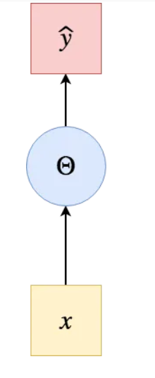
Logical Computations in perceptron(NOT)
X | Y
0 | 1
1 | 0
W=-1,b=0.5 and threshold=0
X | Weighted_sum=(w*X)+b | Y=step_function(weighted_sum
0 | (-1*0)+0.5=0.5 | Y=f(0.5)=1
1 | (-1*1)+0.5=-0.5 | Y=f(-0.5)=0

Slide 27
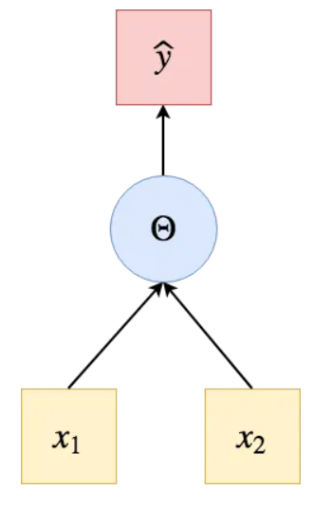
Logical Computations in perceptron(AND)
X1 | X2 | Y
0 | 0 | 0
1 | 0 | 0
0 | 1 | 0
1 | 1 | 1
W1=1, W2=1,b=-1.5 and threshold=0
X1 | X2 | Weighted_sum=(w1*x1)+(w2*x2)+b | Y=step_function(weighted_sum
0 | 0 | Y=(1*0)+(1*0)-1.5=-1.5 | Y=f(-1.5)=0
1 | 0 | Y=(1*1)+(1*0)-1.5=-0.5 | Y=f(-0.5)=0
0 | 1 | Y=(1*0)+(1*1)-1.5=-0.5 | Y=f(-0.5)=0
1 | 1 | Y=(1*1)+(1*1)-1.5=0.5 | Y=f(0.5)=1

Slide 28
Logical Computations in perceptron(OR)
X1 | X2 | Y
0 | 0 | 0
1 | 0 | 1
0 | 1 | 1
1 | 1 | 1
W1=1, W2=1,b=-0.5 and threshold=0
X1 | X2 | Weighted_sum=(w1*x1)+(w2*x2)+b | Y=step_function(weighted_sum
0 | 0 | Y=(1*0)+(1*0)-0.5=-0.5 | Y=f(-0.5)=0
1 | 0 | Y=(1*1)+(1*0)-0.5= 0.5 | Y=f( 0.5)=1
0 | 1 | Y=(1*0)+(1*1)-0.5= 0.5 | Y=f( 0.5)=1
1 | 1 | Y=(1*1)+(1*1)-0.5=1.5 | Y=f(1.5)=1

Slide 29
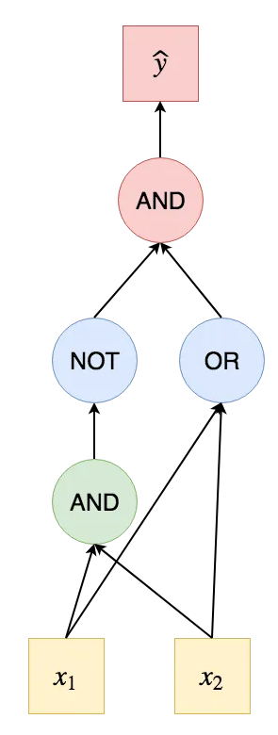

Logical Computations in perceptron(XOR)
X1 | X2 | Y
0 | 0 | 0
1 | 0 | 1
0 | 1 | 1
1 | 1 | 0

Slide 30
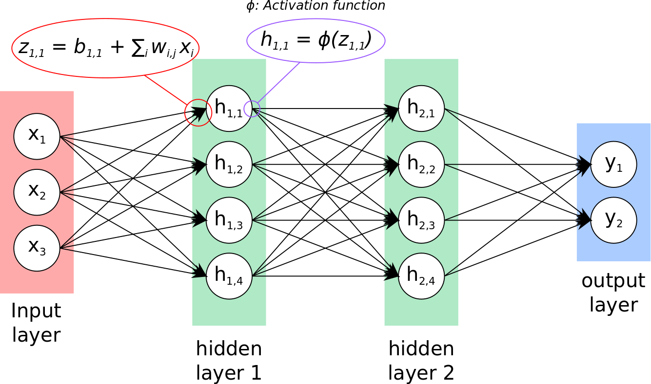
Multi-layer Perceptron

Slide 31
The Backpropagation algorithm using Gradient Descent.

