Slide 1
DBSCAN

Slide 2

Nested Data

Slide 3
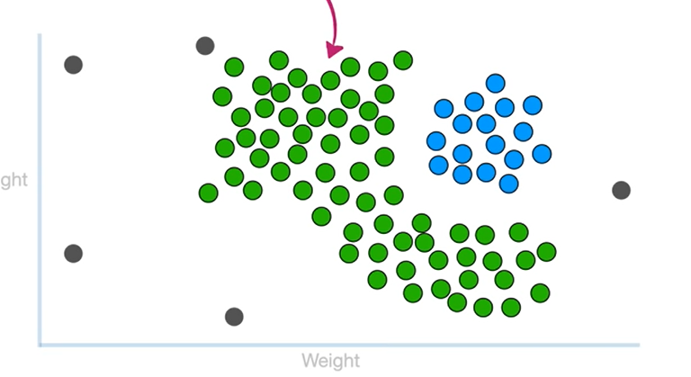

Slide 4
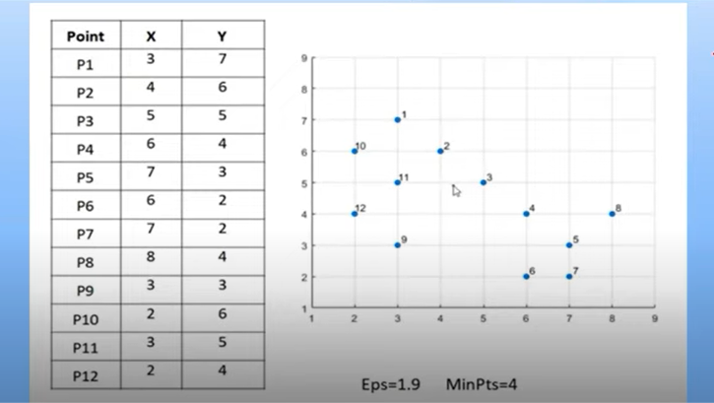

Slide 5
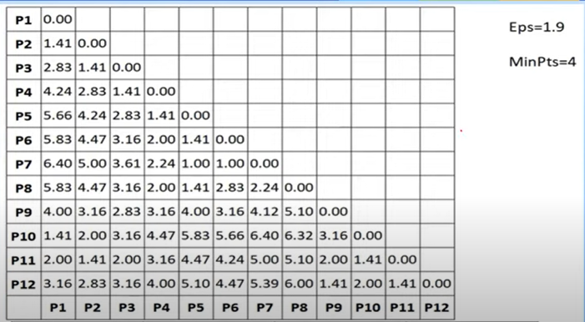

Slide 6
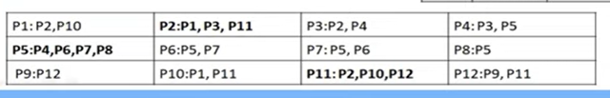

Slide 7
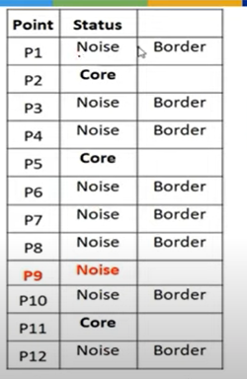

Slide 8
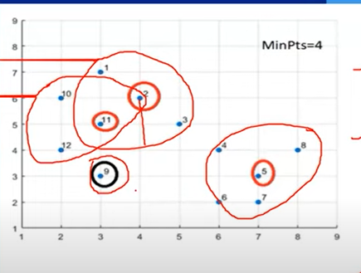

Slide 9
K – means ++
Consider the points 1,2,3,5,8,7,15,20,11,18
K=3
Select one random centroid 5
Find the distance between centroid and other data points and square the distance
Euclidean distance=sqrt(xi-ci)2

Slide 10
Points | Distance 2 | probability
1 | 4 | 4/573 =0.007
2 | 9 | 9/573 =0.01
3 | 4 | 4/573 = 0.007
5 | -
8 | 9 | 9/573 =0.01
7 | 4 | 4/573 =0.007
15 | 100 | 100/573=0.17
20 | 225 | 225/573=0.39 Maximum Probabilty
12 | 49 | 49/573=0.08
18 | 169 | 169/573 = 0.29
 | Total =573

Slide 11
Consider 20 as the centroid
Points | Distance 2 | probability
1 | 361 | 361/1154 =0.31 Maximum Probabilty
2 | 121 | 121/1154 =0.10
3 | 289 | 289/1154 = 0.25
5 | -
8 | 121 | 121/1154=0.10
7 | 169 | 169/1154 =0.14
15 | 25 | 25/1154=0.02
20 | - | -
12 | 64 | 64/1154=0.05
18 | 4 | 4/1154 = 0.003
 | Total =1154

Slide 12
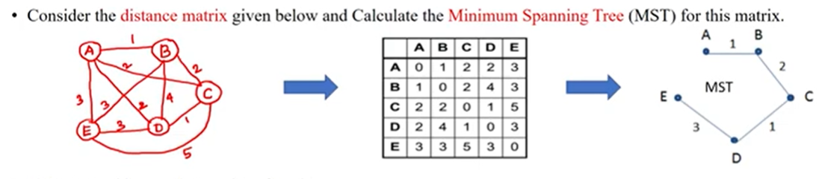
MST Clustering

Slide 13
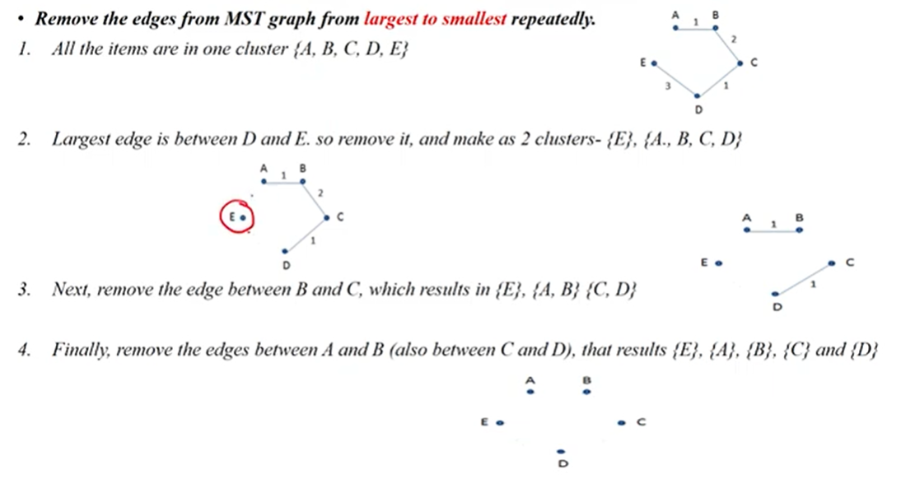

Slide 14
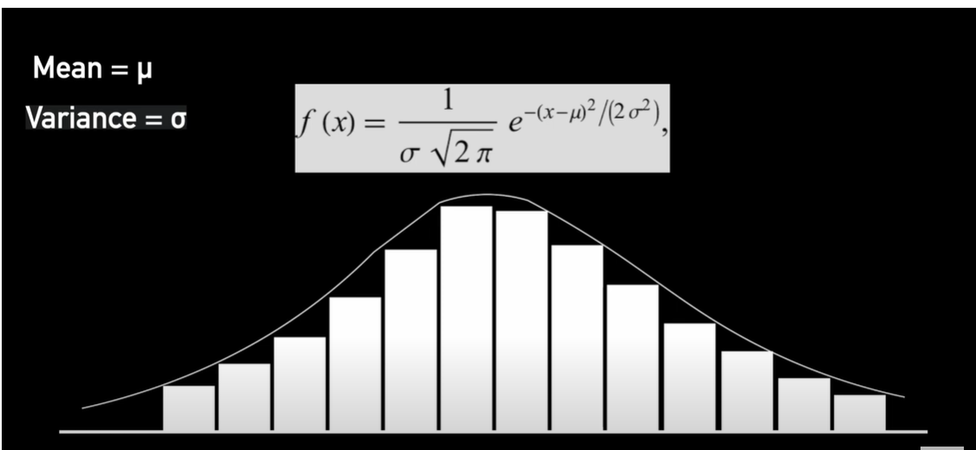
Guassian Mixture Models

Slide 15
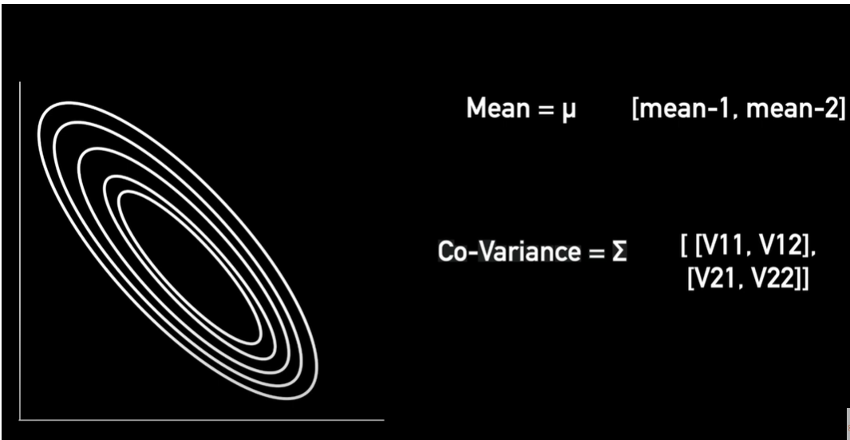

Slide 16


Slide 17
