Slide 1
Module 2
CSE3011 Reinforcement Learning
Credit Structure : 2-2-3

Slide 2
Module 2 : Monte-Carlo (MC) methods
Topics : Monte Carlo methods, prediction and control tasks, Monte Carlo prediction: algorithm, types of MC prediction, examples, incremental mean updates, Monte Carlo Control: algorithm, on-policy MC control, MC with epsilon-greedy policy, off-policy MC control. Limitations of MC method.

Slide 3
Introduction
Model-free methods do not require the model dynamics of the environment to compute the value and Q functions in order to find the optimal policy.
One such popular model-free method is the Monte Carlo (MC) method.
The Monte Carlo method is a statistical technique used to find an approximate solution through sampling.

Slide 4

Introduction
For instance, the Monte Carlo method approximates the expectation of a random variable by sampling, and when the sample size is greater, the approximation will be better.
Let's suppose we have a random variable X and say we need to compute the expected value of X; that is E(X), then we can compute it by taking the sum of the values of X multiplied by their respective probabilities as follows:

Slide 5

Introduction
We can estimate the expected value of X by just sampling the values of X for some N times and compute the average value of X as the expected value of X as follows:
When N is larger our approximation will be better. Thus, with the Monte Carlo method, we can approximate the solution through sampling and our approximation will be better when the sample size is large.

Slide 6
Introduction
In reinforcement learning, we perform two important tasks, and they are:
• The prediction task
• The control task

Slide 7
Prediction Task
In the prediction task, a policy 𝜋 is given as an input and we try to predict the value function or Q function using the given policy.
Our goal is to evaluate the given policy. That is, we need to determine whether the given policy is good or bad.
If the agent obtains a good return using the given policy then we can say that our policy is good. Thus, to evaluate the given policy, we need to understand what the return the agent would obtain if it uses the given policy. To obtain the return, we predict the value function or Q function using the given policy.

Slide 8
Control Task
Unlike the prediction task, in the control task, we will not be given any policy as an input. In the control task, our goal is to find the optimal policy.
So, we will start off by initializing a random policy and we try to find the optimal policy iteratively. That is, we try to find an optimal policy that gives the maximum return.

Slide 9

Monte Carlo Prediction
First, let's recap the definition of the value function. The value function or the value of the state s can be defined as the expected return the agent would obtain starting from the state s and following the policy 𝜋. It can be expressed as:

Slide 10

Monte Carlo Prediction
In a nutshell, in the Monte Carlo prediction method, we approximate the value of a state by taking the average return of a state across N episodes instead of taking the expected return.

Slide 11
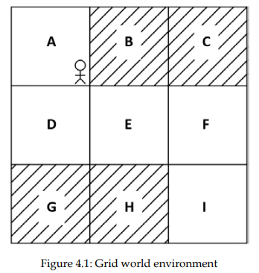
Grid world environment example
Our goal is to reach the state I from the state A without visiting the shaded states, and the agent receives +1 reward when it visits the unshaded states and -1 reward when it visits the shaded states:

Slide 12
Grid world environment example
Let's say we have a stochastic policy 𝜋. Let's suppose, in state A, our stochastic policy 𝜋 selects action down 80% of time and action right 20% of the time, and it selects action right in states D and E and action down in states B and F 100% of the time.
First, we generate an episode 𝜏1 using our given stochastic policy 𝜋 as Figure shows:

Slide 13
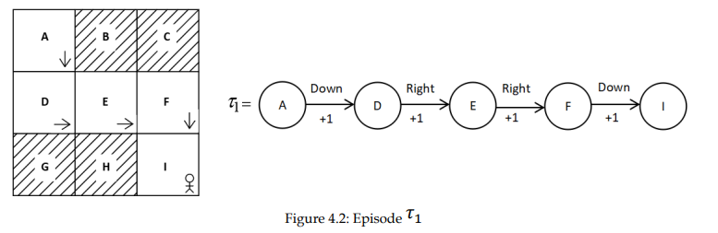
Grid world environment example

Slide 14
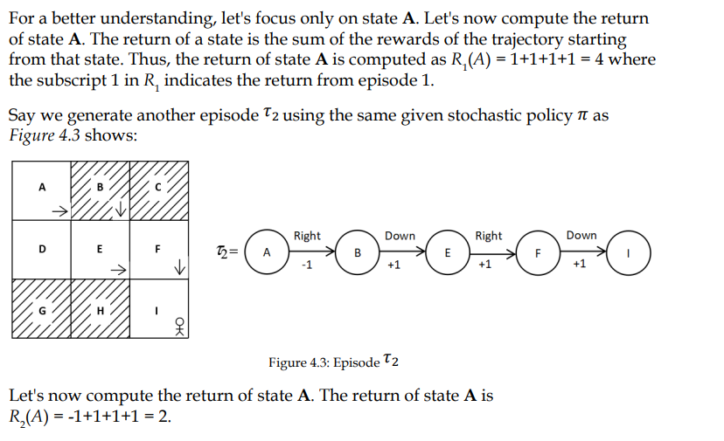
Grid world environment example

Slide 15
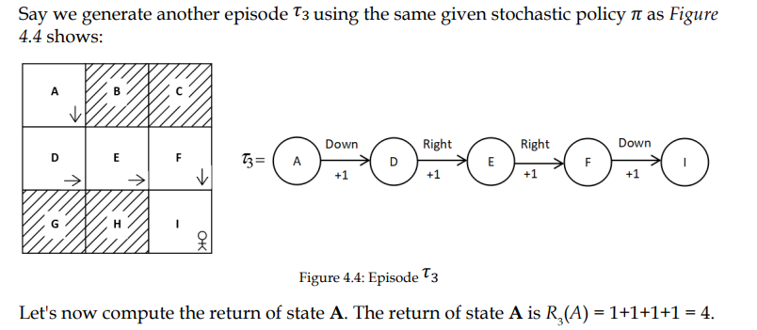
Grid world environment example

Slide 16
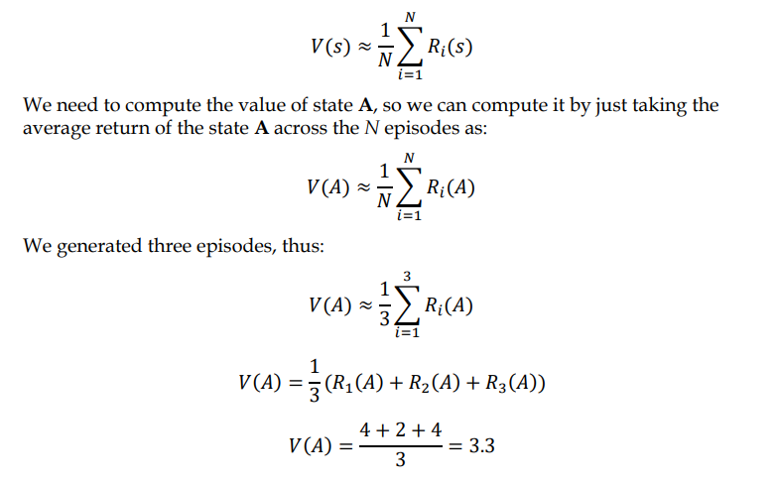
Grid world environment example
The value of a state can be approximated by computing the average return of the state across some N episodes (trajectories):

Slide 17
Monte Carlo Prediction
Thus, in the Monte Carlo prediction method, to predict the value of a state (value function) using the given input policy 𝜋, we generate some N episodes using the given policy and then we compute the value of a state as the average return of the state across these N episodes.

Slide 18
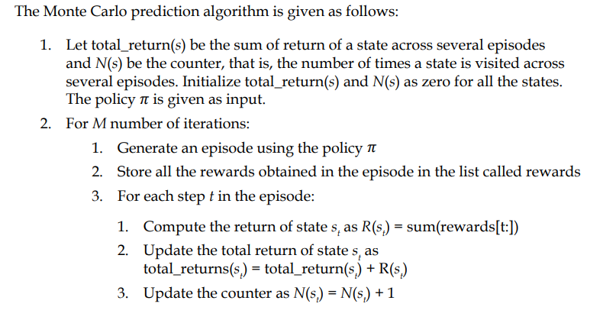
MC prediction algorithm

Slide 19
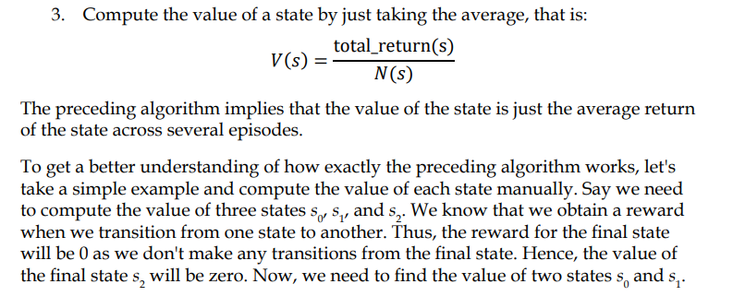
MC prediction algorithm

Slide 20
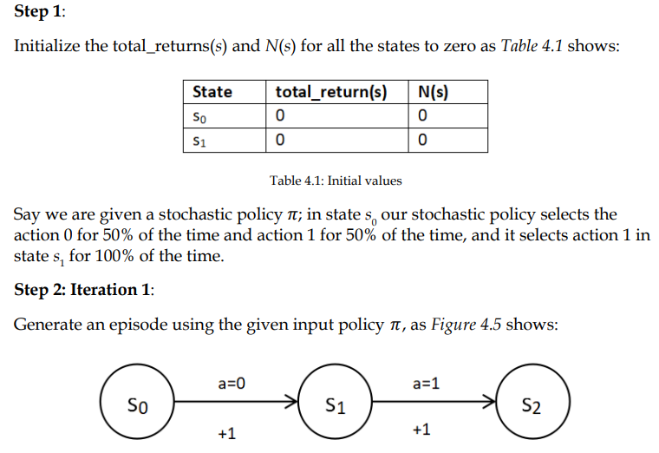
MC prediction algorithm

Slide 21
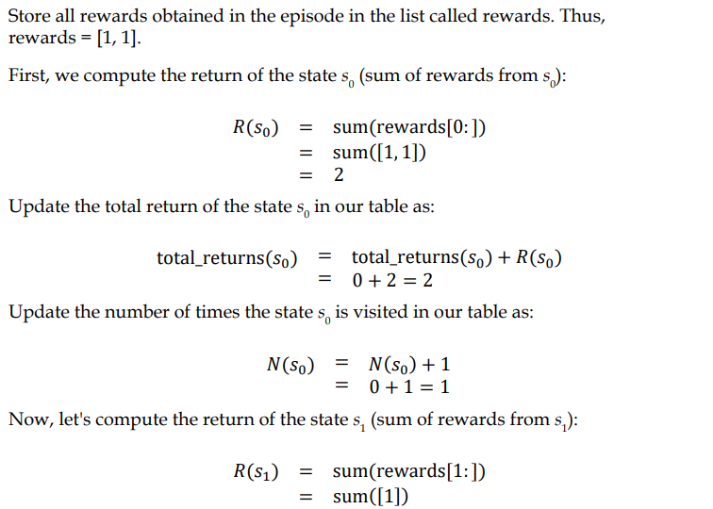
MC prediction algorithm

Slide 22
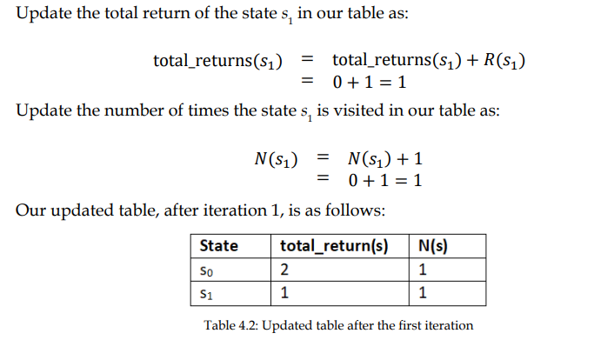
MC prediction algorithm

Slide 23
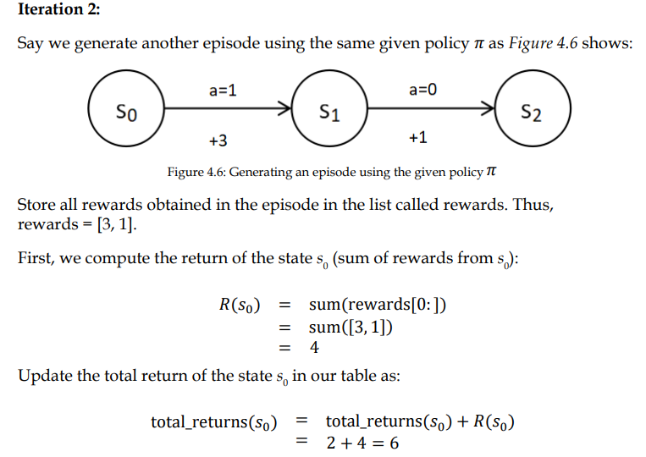
MC prediction algorithm

Slide 24
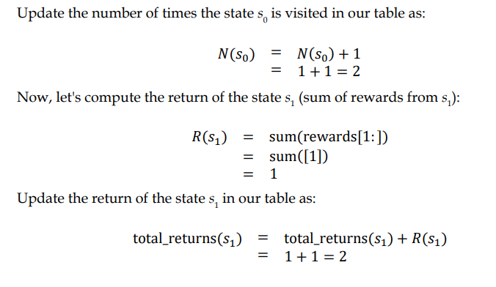
MC prediction algorithm

Slide 25
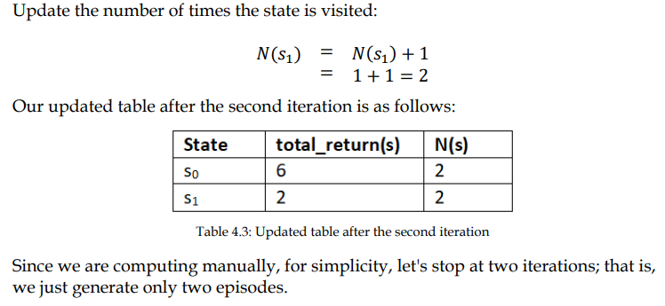
MC prediction algorithm

Slide 26
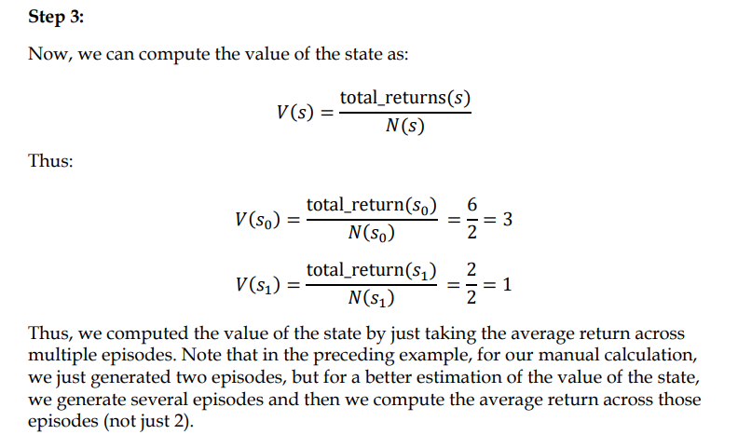
MC prediction algorithm

Slide 27
Types of MC prediction
First-visit Monte Carlo
Every-visit Monte Carlo

Slide 28
First-visit Monte Carlo
In the first-visit Monte Carlo method, if the same state is visited again in the same episode, we don't compute the return for that state again.
For example, consider a case where an agent is playing snakes and ladders. If the agent lands on a snake, then there is a good chance that the agent will return to a state that it had visited earlier. So, when the agent revisits the same state, we don't compute the return for that state for the second time.

Slide 29
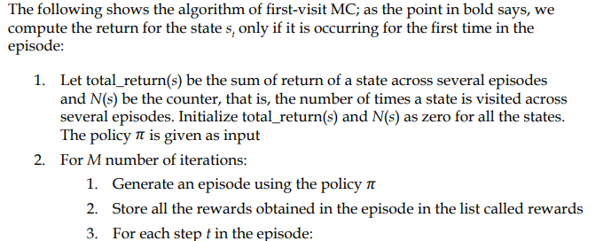
First-visit Monte Carlo Algorithm

Slide 30
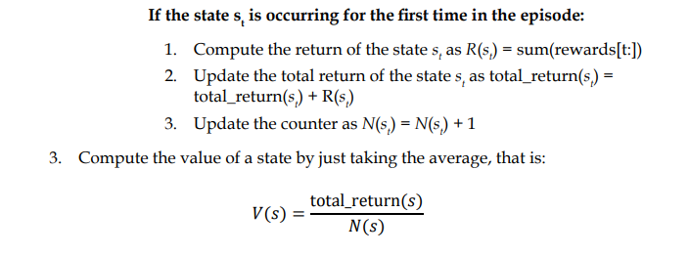
First-visit Monte Carlo Algorithm

Slide 31
Every-visit Monte Carlo Algorithm
Here, we compute the return every time a state is visited in the episode. The algorithm of every-visit Monte Carlo is the same as the one we saw earlier at the beginning of this section and it is as follows:
1. Let total_return(s) be the sum of the return of a state across several episodes and N(s) be the counter, that is, the number of times a state is visited across several episodes. Initialize total_return(s) and N(s) as zero for all the states. The policy 𝜋 is given as input

Slide 32
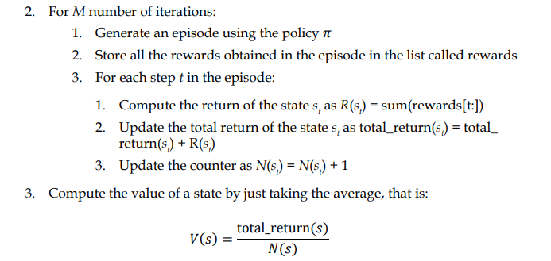
Every-visit Monte Carlo Algorithm

Slide 33
Remember that the only difference between the first-visit MC and every-visit MC methods is that in the first-visit MC method, we compute the return for a state only for its first time of occurrence in the episode but in the every-visit MC method, the return of the state is computed every time the state is visited in an episode.

Slide 34

Incremental mean updates
In both first-visit MC and every-visit MC, we estimate the value of a state as an average (arithmetic mean) return of the state across several episodes as shown as follows:

Slide 35
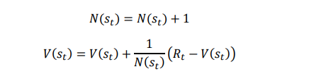
Incremental mean updates
Instead of using the arithmetic mean to approximate the value of the state, we can also use the incremental mean, and it is expressed as:

Slide 36
Incremental mean updates
Consider our environment as non-stationary. In that case, we don't have to take the return of the state from all the episodes and compute the average.
As the environment is non-stationary we can ignore returns from earlier episodes and use only the returns from the latest episodes for computing the average. Thus, we can compute the value of the state using the incremental mean as shown as follows:

Slide 37

Incremental mean updates

Slide 38

MC prediction (Q function)
We generate several episodes using the given policy 𝜋, then, we calculate the total_return(s, a), the sum of the return of the state-action pair across several episodes.
We calculate N(s, a), the number of times the state-action pair is visited across several episodes. Then we compute the Q function or Q value as the average return of the state-action pair as shown as follows:

Slide 39
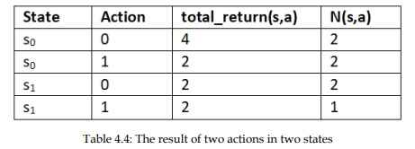
MC prediction (Q function)
For instance, let consider a small example. Say we have two states s0 and s1 and we have two possible actions 0 and 1. Now, we compute total_return(s, a) and N(s, a). Let's say our table after computation looks like Table 4.4:

Slide 40
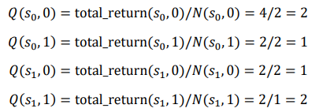
MC prediction (Q function)
Thus, we can compute the Q value for all state-action pairs as:

Slide 41
MC prediction (Q function) algorithm
The algorithm for predicting the Q function using the Monte Carlo method is as follows.
1. Let total_return(s, a) be the sum of the return of a state-action pair across several episodes and N(s, a) be the number of times a state-action pair is visited across several episodes. Initialize total_return(s, a) and N(s, a) for all state-action pairs to zero. The policy 𝜋 is given as input

Slide 42
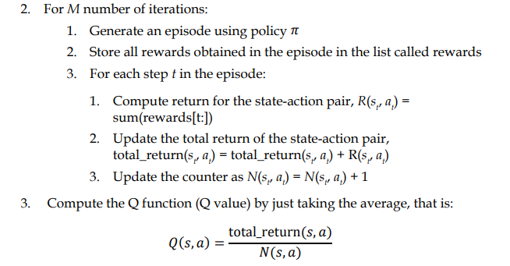
MC prediction (Q function) algorithm

Slide 43
MC prediction of the Q function
We have two types of MC— first-visit MC and every-visit MC.
In first-visit MC, we compute the return of the state-action pair only for the first time the state-action pair is visited in the episode and in every-visit MC we compute the return of the state-action pair every time the state-action pair is visited in the episode.

Slide 44

Incremental mean
We can compute the Q value using the incremental mean as shown as follows:

Slide 45

Monte Carlo control
In the control task, our goal is to find the optimal policy. Unlike the prediction task, here, we will not be given any policy as an input. So, we will begin by initializing a random policy, and then we try to find the optimal policy iteratively. That is, we try to find an optimal policy that gives the maximum return.
That is, if we have a Q function, then we can extract policy by selecting an action in each state that has the maximum Q value as the following shows:

Slide 46
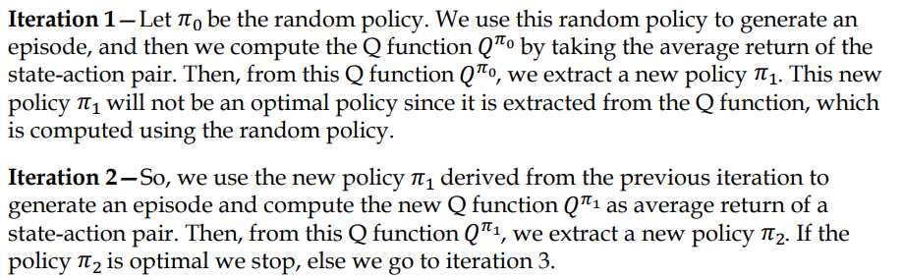
Monte Carlo control
From the new Q function, we extract a new policy. We repeat these steps iteratively until we find the optimal policy.

Slide 47
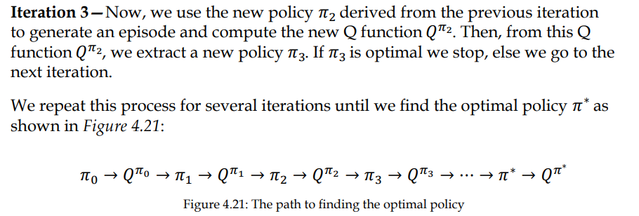
Monte Carlo control

Slide 48
MC control algorithm
Once we have the Q function, we extract a new policy by selecting an action in each state that has the maximum Q value. In the next iteration, we use the extracted new policy to generate an episode and compute the new Q function (Q value) as the average return of the state-action pair.
We repeat these steps for many iterations to find the optimal policy.

Slide 49
MC control algorithm
One more thing, we need to observe that just as we learned in the first-visit MC prediction method, here, we compute the return of the state-action pair only for the first time a state-action pair is visited in the episode

Slide 50
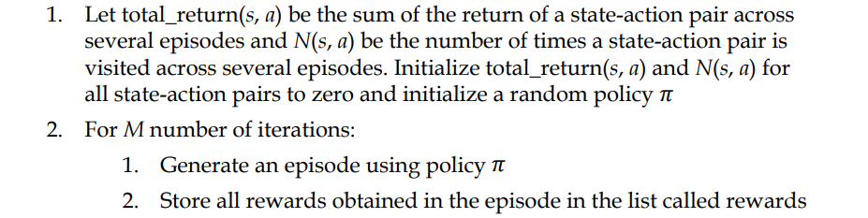
MC control algorithmic steps

Slide 51
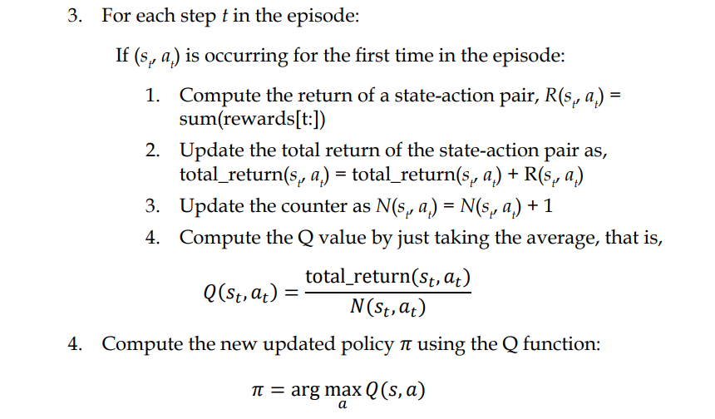
MC control algorithmic steps

Slide 52
MC Control methods
On-policy control—In the on-policy control method, the agent behaves using one policy and also tries to improve the same policy. That is, in the on-policy method, we generate episodes using one policy and also improve the same policy iteratively to find the optimal policy. For instance, the MC control method, which we just learned above, can be called on-policy MC control as we are generating episodes using a policy 𝜋, and we also try to improve the same policy 𝜋 on every iteration to compute the optimal policy.

Slide 53
MC Control methods
Off-policy control—In the off-policy control method, the agent behaves using one policy b and tries to improve a different policy 𝜋. That is, in the off-policy method, we generate episodes using one policy and we try to improve the different policy iteratively to find the optimal policy.

Slide 54
on-policy Monte Carlo control
There are two types of on-policy Monte Carlo control methods:
• Monte Carlo exploring starts
• Monte Carlo with the epsilon-greedy policy

Slide 55
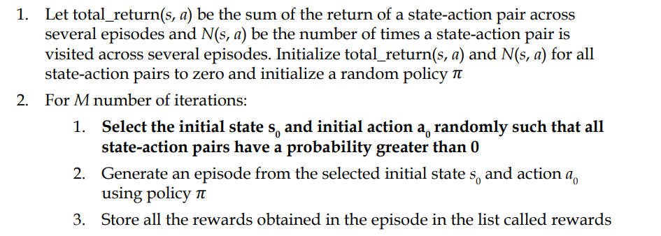
Monte Carlo exploring starts algorithm

Slide 56
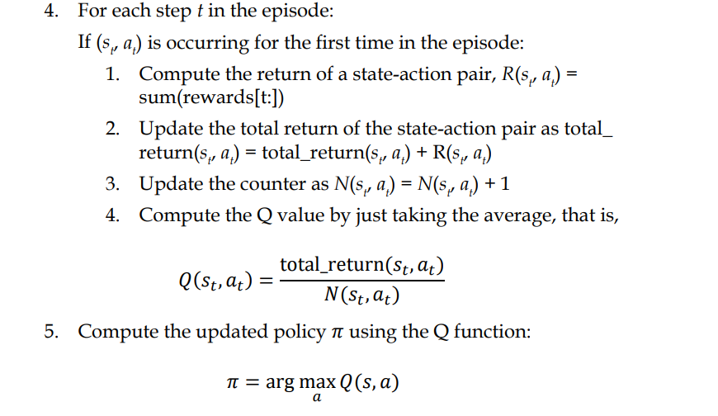
Monte Carlo exploring starts algorithm

Slide 57
Monte Carlo exploring starts algorithm
One of the major drawbacks of the exploring starts method is that it is not applicable to every environment. That is, we can't just randomly choose any state-action pair as an initial state-action pair because in some environments there can be only one state-action pair that can act as an initial state-action pair. So we can't randomly select the state-action pair as the initial state-action pair.

Slide 58
Monte Carlo exploring starts algorithm
For example, suppose we are training an agent to play a car racing game; we can't start the episode in a random position as the initial state and a random action as the initial action because we have a fixed single starting state and action as the initial state and action.

Slide 59
Monte Carlo with the epsilon-greedy policy
So, now the question is whether the agent should explore all the other actions in the state and select the best action as the one that has the maximum Q value or exploit the best action out of already-explored actions. This is called an exploration-exploitation dilemma.

Slide 60
Monte Carlo with the epsilon-greedy policy
To avoid this dilemma, we introduce a new policy called the epsilon-greedy policy. Here, all actions are tried with a non-zero probability (epsilon). With a probability epsilon, we explore different actions randomly and with a probability 1-epsilon, we choose an action that has the maximum Q value.
That is, with a probability epsilon, we select a random action (exploration) and with a probability 1-epsilon we select the best action (exploitation).

Slide 61
Monte Carlo with the epsilon-greedy policy
In the epsilon-greedy policy, if we set the value of epsilon to 0, then it becomes a greedy policy (only exploitation).
when we set the value of epsilon to 1, then we will always end up doing only the exploration.
So, the value of epsilon has to be chosen optimally between 0 and 1.

Slide 62
Monte Carlo with the epsilon-greedy policy
Say we set epsilon = 0.5; then we will generate a random number from the uniform distribution and if the random number is less than epsilon (0.5), then we select a random action (exploration).
if the random number is greater than or equal to epsilon then we select the best action, that is, the action that has the maximum Q value (exploitation).

Slide 63
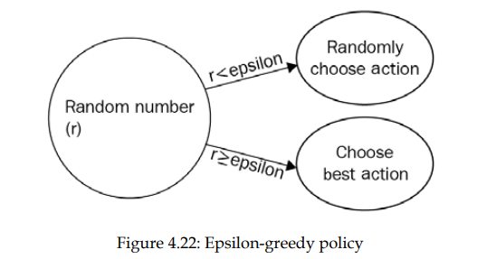
Monte Carlo with the epsilon-greedy policy

Slide 64
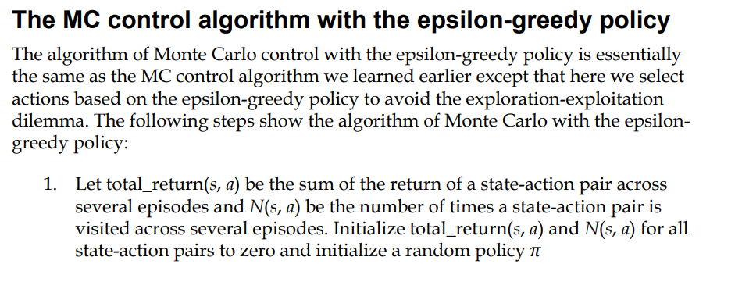
MC control algorithm with the epsilon-greedy policy

Slide 65
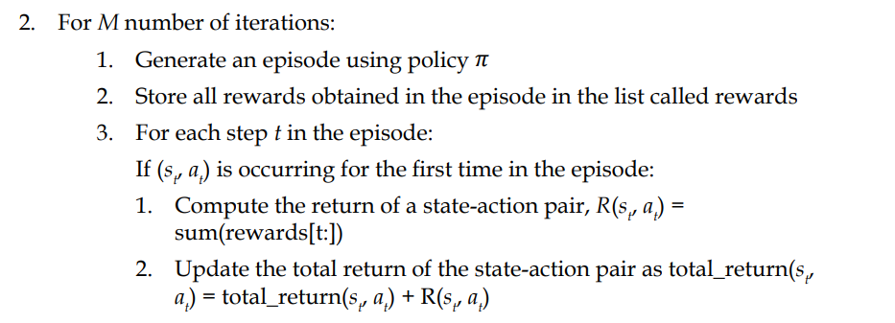
MC control algorithm with the epsilon-greedy policy

Slide 66
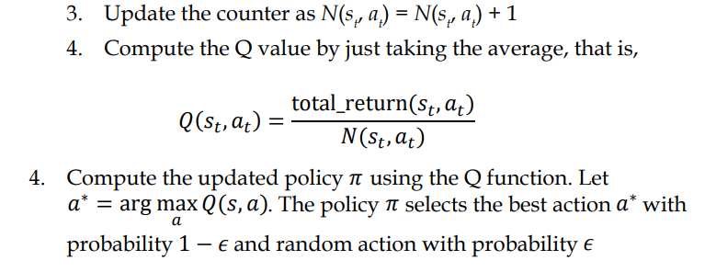
MC control algorithm with the epsilon-greedy policy
As we can observe, in every iteration, we generate the episode using the policy 𝜋 and also we try to improve the same policy 𝜋 in every iteration to compute the optimal policy.

Slide 67
Off-policy Monte Carlo control
Off-policy Monte Carlo is another interesting Monte Carlo control method. In the off-policy method, we use two policies called the behavior policy and the target policy. As the name suggests, we behave (generate episodes) using the behavior policy and we try to improve the other policy called the target policy.

Slide 68
Off-policy Monte Carlo control
In the on-policy method, we generate an episode using the policy 𝜋 and we improve the same policy 𝜋 iteratively to find the optimal policy. But in the off-policy method, we generate an episode using a policy called the behavior policy b and we try to iteratively improve a different policy called the target policy 𝜋.

Slide 69
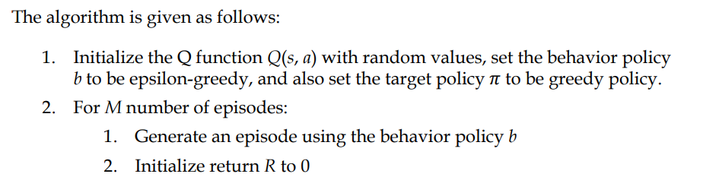
Off-policy Monte Carlo control algorithm

Slide 70
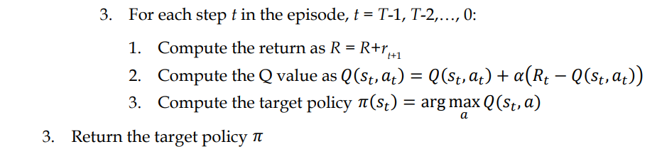
Off-policy Monte Carlo control algorithm

Slide 71
Need of importance sampling
We are finding the target policy 𝜋 from the Q function, which is computed based on the episodes generated by a different policy called the behavior policy, our target policy will be inaccurate. This is because the distribution of the behavior policy and the target policy will be different.
So, to correct this, we introduce a new technique called importance sampling. This is a technique for estimating the values of one distribution when given samples from another.

Slide 72


Importance sampling types:
• Ordinary importance sampling
Here, the importance sampling ratio will be the ratio of the target policy to the behavior policy
• Weighted importance sampling
Here, the importance sampling ratio will be the weighted ratio of the target policy to the behavior policy

Slide 73
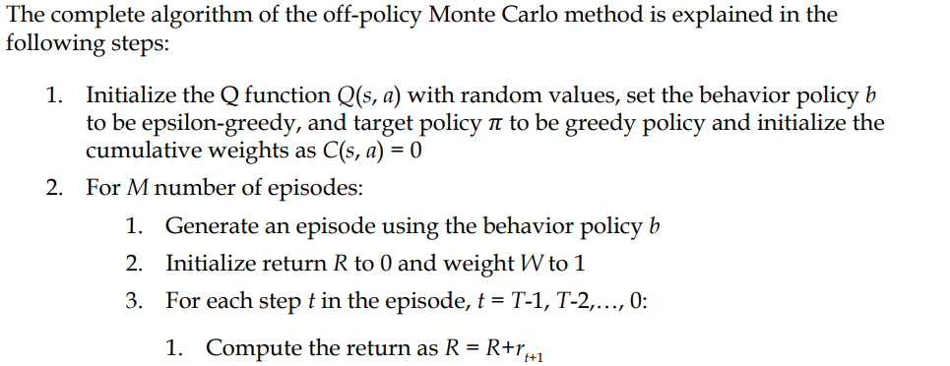
Off-policy Monte Carlo control algorithm

Slide 74
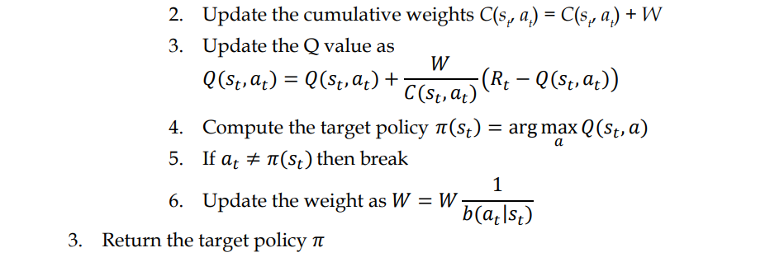
Off-policy Monte Carlo control algorithm

Slide 75
MC limitation
Issue with the Monte Carlo method is that it is applicable only to episodic tasks. We learned that in the Monte Carlo method, we compute the value of the state by taking the average return of the state and the return is the sum of rewards of the episode.
But when there is no episode, that is, if our task is a continuous task (non-episodic task), then we cannot apply the Monte Carlo method.

