Slide 1
Module 4
CSE3011 Reinforcement Learning
Credit Structure : 2-2-3

Slide 2
Case Study – The MAB Problem
Topics : The MAB problem, The epsilon-greedy method, Softmax exploration, The upper confidence bound algorithm, The Thompson sampling algorithm, Applications of MAB, Finding the best advertisement banner using MAB, Contextual bandits.

Slide 3
Introduction
Model-free methods do not require the model dynamics of the environment to compute the value and Q functions in order to find the optimal policy.
One such popular model-free method is the Monte Carlo (MC) method.
The Monte Carlo method is a statistical technique used to find an approximate solution through sampling.

Slide 4
The MAB Problem
The MAB problem is one of the classic problems in reinforcement learning. A MAB is a slot machine where we pull the arm (lever) and get a payout (reward) based on some probability distribution.
A single slot machine is called a one-armed bandit and when there are multiple slot machines it is called a MAB or k-armed bandit, where k denotes the number of slot machines.

Slide 5
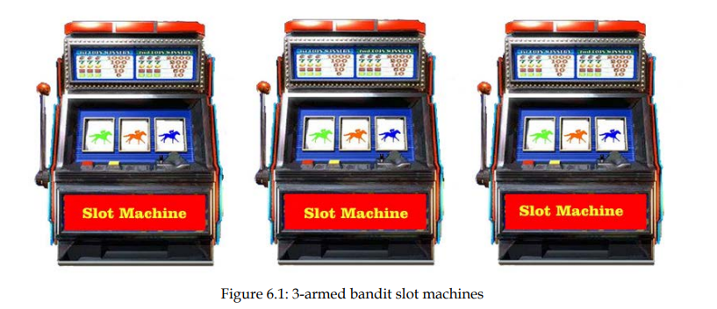
Introduction

Slide 6
Introduction
Each arm has its own probability distribution indicating the probability of winning and losing the game.
For example, let's suppose we have two arms. Let the probability of winning if we pull arm 1 (slot machine 1) be 0.7 and the probability of winning if we pull arm 2 (slot machine 2) be 0.5.

Slide 7
Introduction
Thus, we can say that pulling arm 1 is desirable as it makes us win the game 70% of the time. However, this probability distribution of the arm (slot machine) will not be given to us.
We need to find out which arm helps us to win the game most of the time and gives us a good reward.

Slide 8
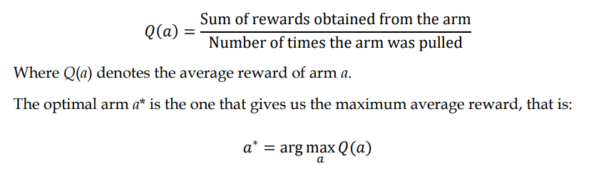
Introduction
Let's denote the arm by a and define the average reward by pulling the arm a as:
The arm that gives the maximum average reward is the optimal arm.

Slide 9
Introduction
Along with finding the best arm, our goal should be to minimize the cost of identifying the best arm, and this is usually referred to as regret.
Thus, we need to find the best arm while minimizing regret. That is, we need to find the best arm, but we don't want to end up selecting the arms that make us lose the game in most of the rounds.

Slide 10
Exploration strategies
To overcome exploration-exploitation dilemma in the MAB problem, we use the following exploration strategies:
Epsilon-greedy
Softmax exploration
Upper confidence bound
Thomson sampling

Slide 11
Epsilon-greedy
With epsilon-greedy, we select the best arm with a probability 1-epsilon and we select a random arm with a probability epsilon.
Say we have two arms—arm 1 and arm 2. Suppose with arm 1 we win the game 80% of the time and with arm 2 we win the game 20% of the time. So, we can say that arm 1 is the best arm as it makes us win the game 80% of the time.

Slide 12
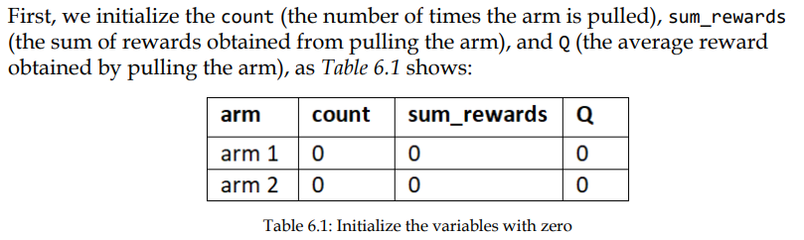
Epsilon-greedy method

Slide 13
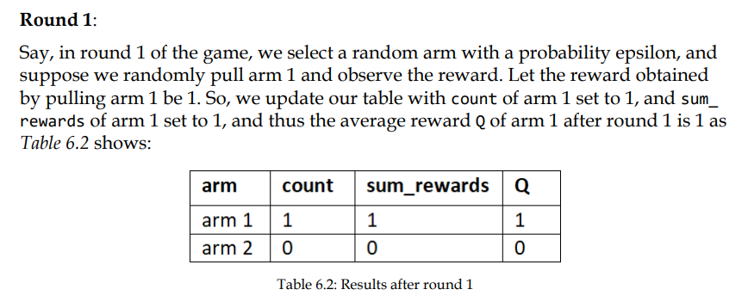
Epsilon-greedy method

Slide 14
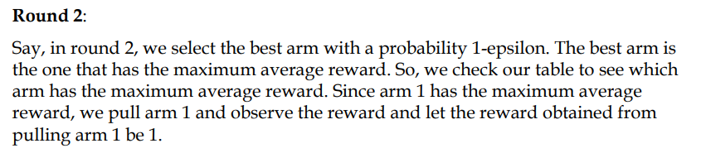
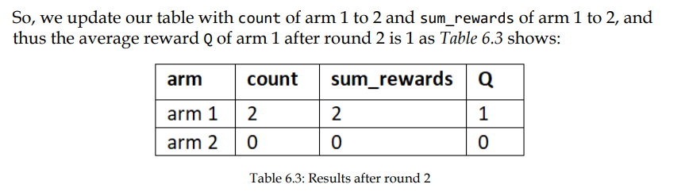
Epsilon-greedy method

Slide 15
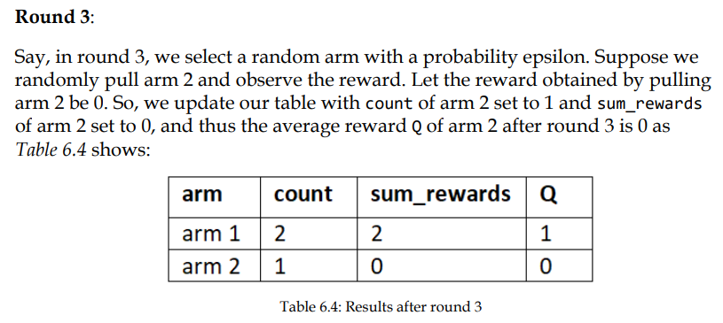
Epsilon-greedy method

Slide 16
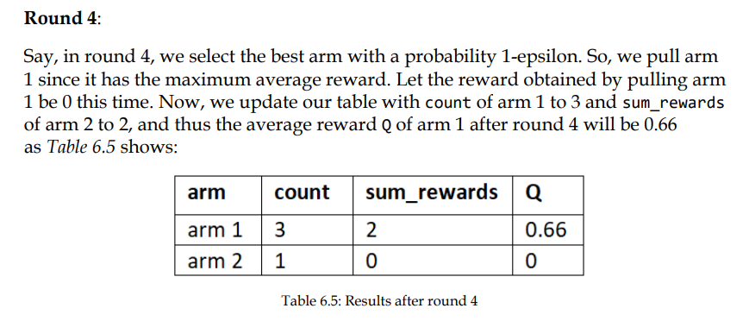
Epsilon-greedy method

Slide 17
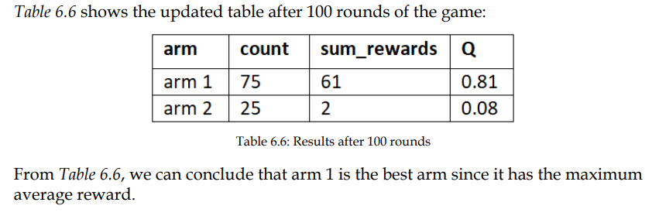
Epsilon-greedy method
We repeat this process for several rounds; that is, for several rounds of the game, we pull the best arm with a probability 1-epsilon and we pull a random arm with probability epsilon.

Slide 18
Softmax exploration
Softmax exploration, also known as Boltzmann exploration, is another useful exploration strategy for finding the optimal arm.
In the epsilon-greedy policy, all the non-best arms are explored equally. That is, all the non-best arms have a uniform probability of being selected.

Slide 19
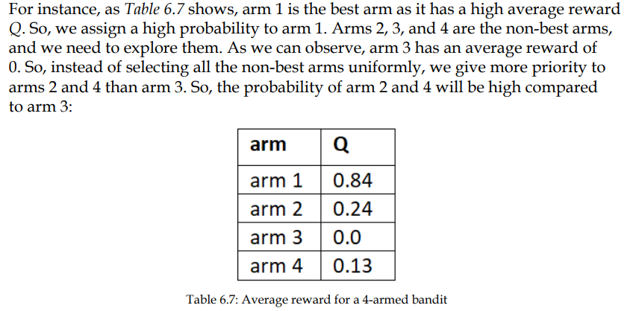
Softmax exploration

Slide 20
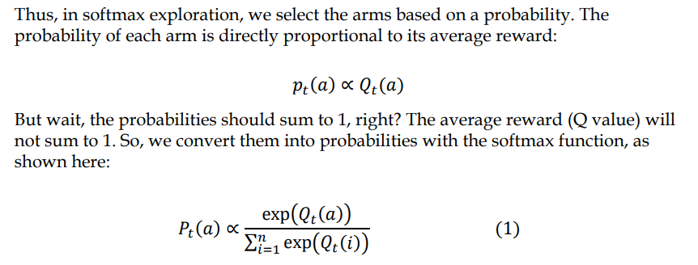
Softmax exploration

Slide 21
Softmax exploration
So, now the arm will be selected based on the probability. However, in the initial rounds we will not know the correct average reward of each arm, so selecting the arm based on the probability of average reward will be inaccurate in the initial rounds.
To avoid this, we introduce a new parameter called T. T is called the temperature parameter.

Slide 22
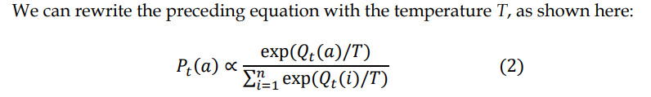
Softmax exploration
When T is high, all the arms have an equal probability of being selected and when T is low, the arm that has the maximum average reward will have a high probability.
So, we set T to a high number in the initial rounds, and after a series of rounds we reduce the value of T. This means that in the initial round we explore all the arms equally and after a series of rounds, we select the best arm that has a high probability.

Slide 23
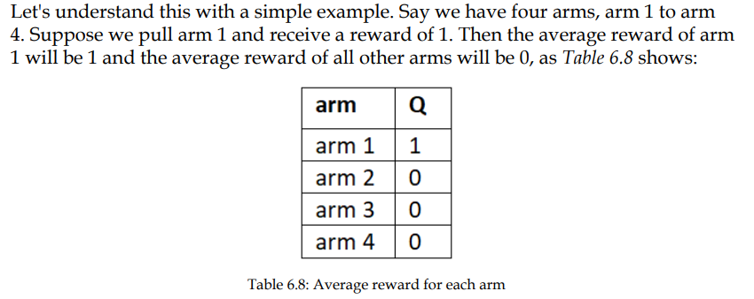
Softmax exploration example

Slide 24
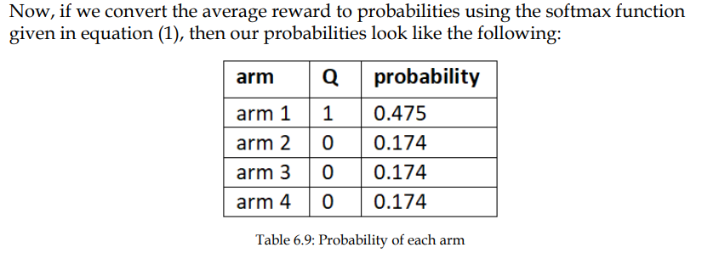
Softmax exploration example
As we can observe, we have a 47% probability for arm 1 and a 17% probability for all other arms. But we cannot assign a high probability to arm 1 by just pulling arm 1 once.

Slide 25
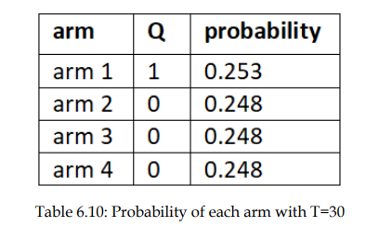
Softmax exploration example
So, we set T to a high number, say T = 30, and calculate the probabilities based on equation (2). Now our probabilities become:
As we can see, now all the arms have equal probabilities of being selected. Now we explore the arms based on this probability and over a series of rounds, the T value will be reduced, and we will have a high probability to the best arm.

Slide 26
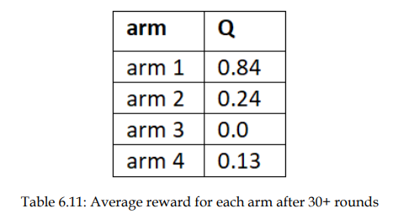
Softmax exploration example
Let's suppose after some 30 rounds, the average reward of all the arms is

Slide 27
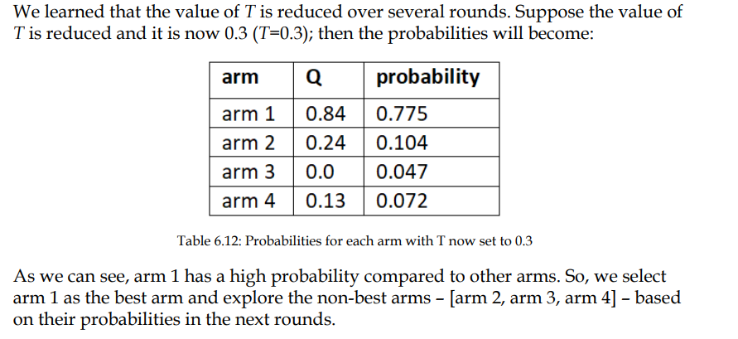
Softmax exploration example

Slide 28
Softmax exploration example
Thus, in the initial round, we don't know which arm is the best arm. So instead of assigning a high probability to the arm based on the average reward, we assign an equal probability to all the arms in the initial round with a high value of T and over a series of rounds, we reduce the value of T and assign a high probability to the arm that has a high average reward.

Slide 29
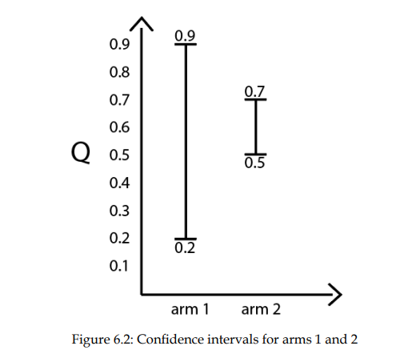
Upper confidence bound
The confidence interval denotes the interval within which the true value lies. So, in our setting, the confidence interval denotes the interval within which the true mean reward of the arm lies.

Slide 30
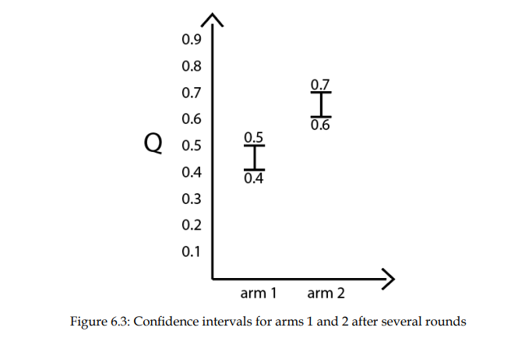
Upper confidence bound

Slide 31
Upper confidence bound
As we play the game for several rounds by selecting the arm that has a high UCB, our confidence interval of both arms will get narrower and denote a more accurate mean value.
For instance, as we can see in Figure 6.3, after playing the game for several rounds, the confidence interval of both the arms becomes small and denotes a more accurate mean value.
The confidence interval of both arms is small and we have a more accurate mean, and since in UCB we select arm that has the highest UCB, we select arm 2 as the best arm.

Slide 32
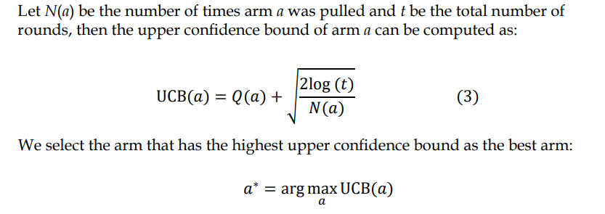
Upper confidence bound

Slide 33
Upper confidence bound
The algorithm of UCB is given as follows:
1. Select the arm whose upper confidence bound is high
2. Pull the arm and receive a reward
3. Update the arm's mean reward and confidence interval
4. Repeat steps 1 to 3 for several rounds

Slide 34
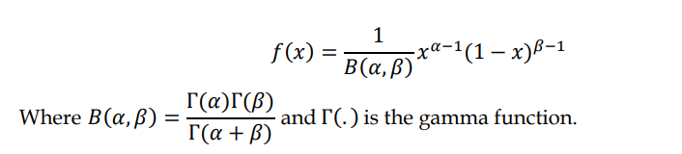
Thompson sampling
Thompson sampling (TS) is another interesting exploration strategy to overcome the exploration-exploitation dilemma and it is based on a beta distribution.
So, before diving into Thompson sampling, let's first understand the beta distribution. The beta distribution is a probability distribution function and it is expressed as:

Slide 35
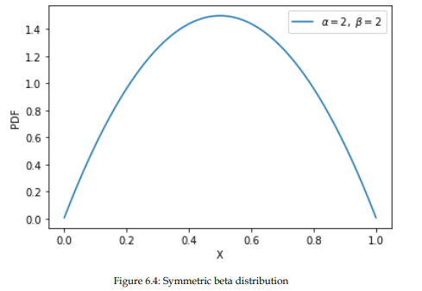
Beta distribution
The shape of the distribution is controlled by the two parameters 𝛼 and 𝛽. When the values of 𝛼 and 𝛽 are the same, then we will have a symmetric distribution.

Slide 36
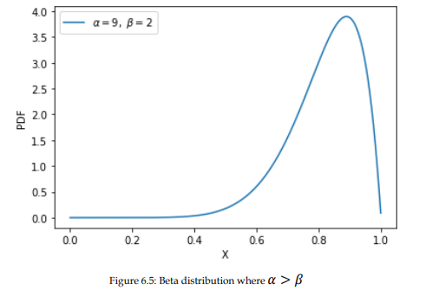
Beta distribution
When the value of 𝛼 is higher than 𝛽 then we will have a probability closer to 1 than 0. For instance, as Figure 6.5 shows, since the value of 𝛼=9 and 𝛽=2, we have a high probability closer to 1 than 0:

Slide 37
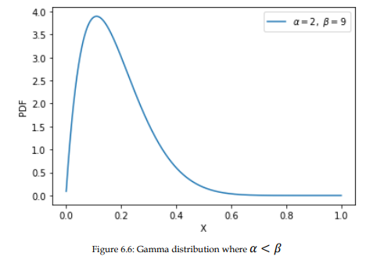
Beta distribution
When the value of 𝛽 is higher than 𝛼 then we will have a high probability closer to 0 than 1. For instance, as shown in the following plot, since the value of 𝛼=2 and 𝛽=9, we have a high probability closer to 0 than 1:

Slide 38
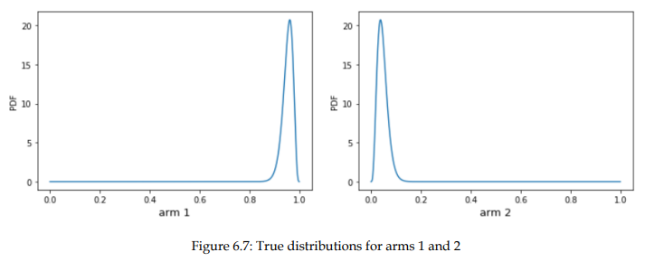
Beta distribution

Slide 39
Beta distribution
From Figure 6.7, we can see that it is better to pull arm 1 than arm 2 because arm 1 has a high probability close to 1, but arm 2 has a high probability close to 0.
So, if we pull arm 1, we get a reward of 1 and win the game, but if we pull arm 2 we get a reward of 0 and lose the game. Thus, once we know the true distribution of the arms then we can understand which arm is the best arm.

Slide 40
Thompson sampling
Thompson sampling is a probabilistic method and it is based on a prior distribution.
Here, we use the beta distribution as a prior distribution. Say we have two arms, so we will have two beta distributions (prior distributions), and we initialize both 𝛼 and 𝛽 to the same value, say 3, as Figure 6.10 shows:

Slide 41
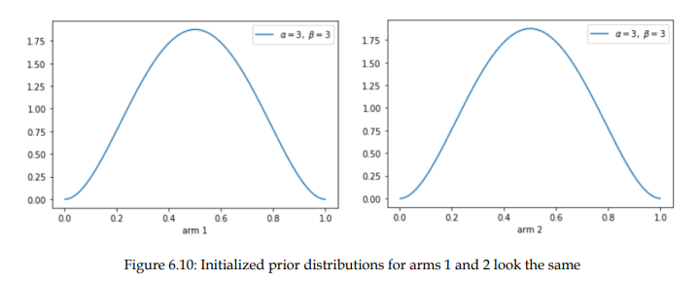
Thompson sampling

Slide 42
Thompson sampling
In the first round, we just randomly sample a value from these two distributions and select the arm that has the maximum sampled value. Let's say the sampled value of arm 1 is high, so in this case, we pull arm 1.
Say we win the game by pulling arm 1, then we update the distribution of arm 1 by incrementing the alpha value of the distribution by 1; that is, we update the alpha value as 𝛼=𝛼+1.

Slide 43
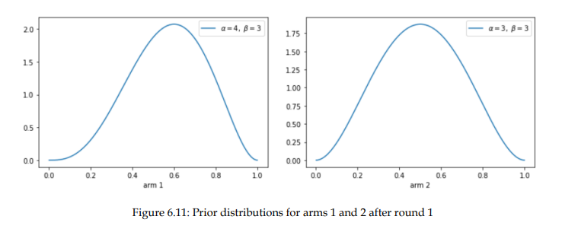
Thompson sampling
As Figure 6.11 shows, the alpha value of the distribution of arm 1 is incremented, and as we can see, arm 1's beta distribution has slightly high probability closer to 1 compared to arm 2:

Slide 44
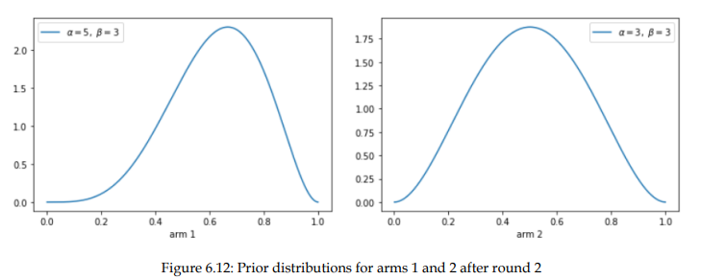
Thompson sampling
As Figure 6.12 shows, the alpha value of arm 1's distribution is incremented, and arm 1's beta distribution has a slightly high probability close to 1

Slide 45
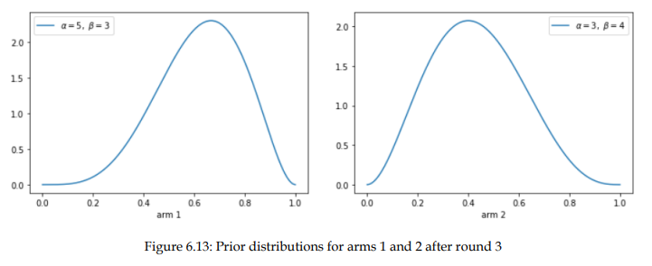
Thompson sampling
As Figure 6.13 shows, the beta value of arm 2's distribution is incremented and the beta distribution of arm 2 has a slightly high probability close to 0

Slide 46
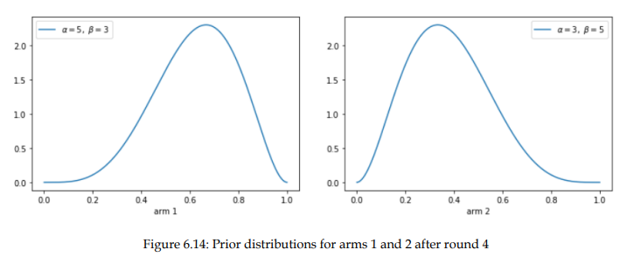
Thompson sampling
As Figure 6.14 shows, the beta value of arm 2's distribution is incremented by 1 and also arm 2's beta distribution has a slightly high probability close to 0:

Slide 47
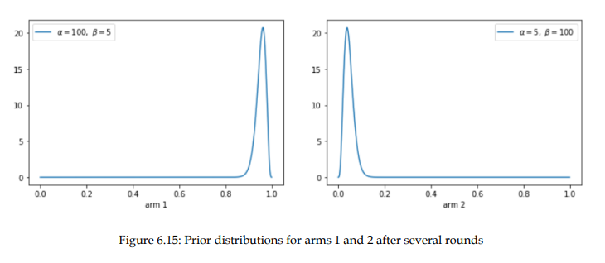
Thompson sampling
If we do this repeatedly for several rounds, then we can learn the true distribution of the arm. Say after several rounds, our distribution will look like Figure 6.15. As we can see, the distributions of both arms resemble the true distributions:

Slide 48
Thompson sampling
Now if we sample a value from each of these distributions, then the sampled value will always be high from arm 1 and we always pull arm 1 and win the game.
The steps involved in the Thomson sampling method are given here:
1. Initialize the beta distribution with alpha and beta set to equal values for all k arms
2. Sample a value from the beta distribution of all k arms
3. Pull the arm whose sampled value is high
4. If we win the game, then update the alpha value of the distribution to 𝛼= 𝛼+1
5. If we lose the game, then update the beta value of the distribution to 𝛽= 𝛽 +1
6. Repeat steps 2 to 5 for many rounds

Slide 49
Applications of MAB
Bandits are widely used for:
Website optimization
Maximizing conversion rates
Online advertisements
Campaigning

Slide 50
Contextual bandits
In the MAB problem, we just perform the action and receive a reward. But with contextual bandits, we take actions based on the state of the environment and the state holds the context.
For instance, in the advertisement banner example, the state specifies the user behavior and we will take action (show the banner) according to the state (user behavior) that will result in the maximum reward (ad clicks).
Contextual bandits are widely used for personalizing content according to the user's behavior. They are also used to solve the cold-start problems faced by recommendation systems. Netflix uses contextual bandits for personalizing the artwork for TV shows according to user behavior.

