Slide 1
MRG-ViT–Mamba Architecture
Reliability-Guided ViT + Mamba Temporal Modeling for Student Engagement Recognition
DAiSEE Benchmark • Subject-Disjoint Pipeline • 38/38 Unit Tests Passed

Slide 2
MRG-VIT–MAMBA SYSTEM PRESENTATION
1. Executive Summary: Problem & Solution
The Real-World Problem
The MRG-ViT–Mamba Solution
• Webcam Noise: Motion blur, head tilt, dark rooms, and hand occlusions distort video frames.
• False AI Predictions: Standard models mistake poor video frames for 'disengagement.'
• Subject Overfitting: Models often memorize face identities instead of true engagement cues.
• Motion Reliability (MRS): Evaluates observation quality r_t ∈ [0, 1] per frame without bias.
• Frozen ViT Spatial Encoder: ImageNet ViT-B/16 extracts 768-dim visual features per frame.
• Mamba S6 Temporal Model: 2-layer Mamba selective state scan models sequence dynamics.
• MediaPipe Expression Branch: Fuses 28 geometric metrics + 52 ARKit blendshapes (240 dims).

Slide 3
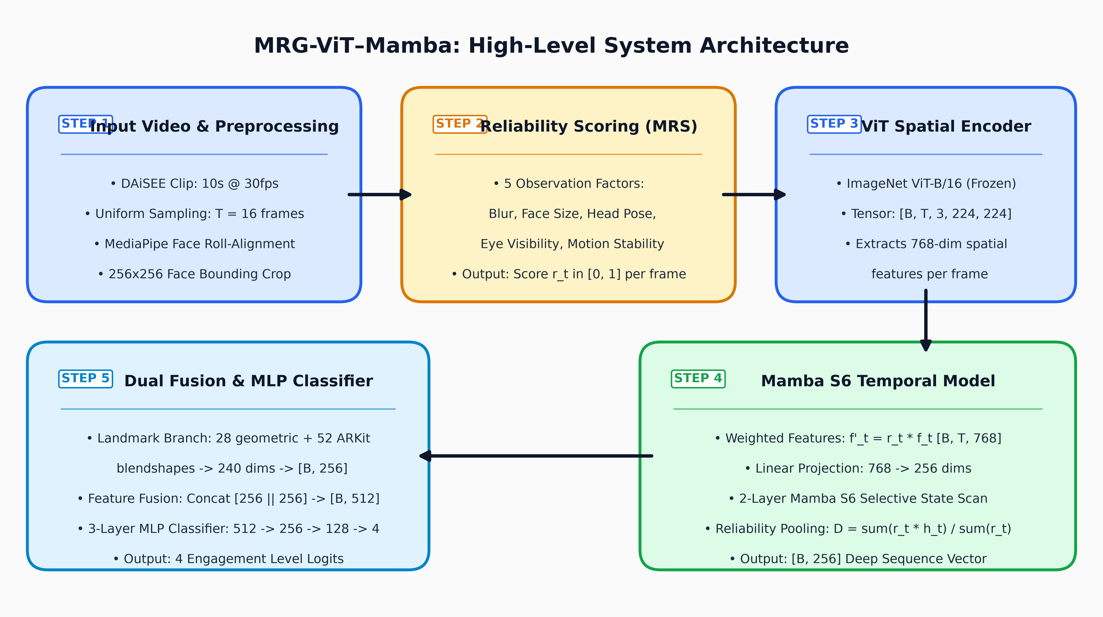
MRG-VIT–MAMBA SYSTEM PRESENTATION
2. System Flow Architecture (High-Level Overview)

Slide 4
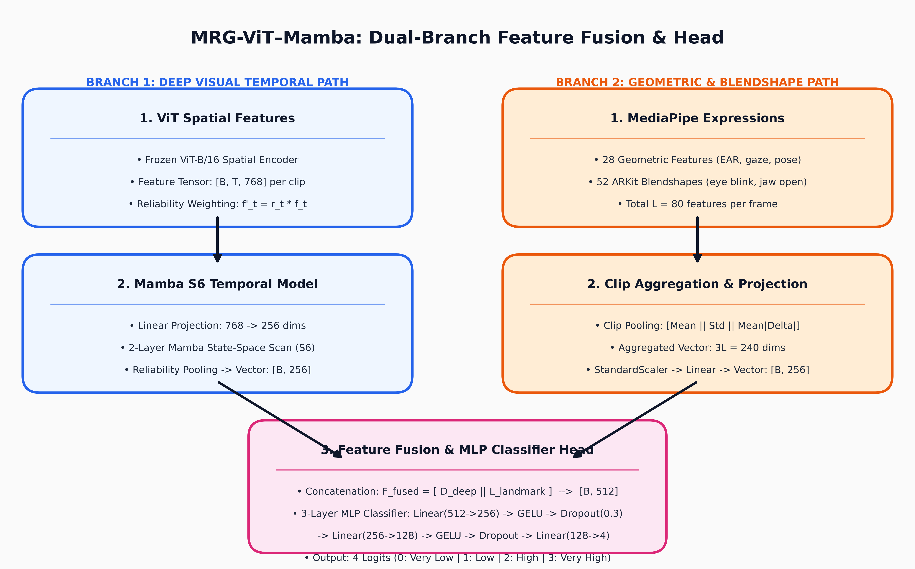
MRG-VIT–MAMBA SYSTEM PRESENTATION
3. Dual-Branch Feature Fusion Architecture

Slide 5
MRG-VIT–MAMBA SYSTEM PRESENTATION
4. Motion Reliability Score (MRS) Details
MRS Formula: MRS_t = 0.2·Blur + 0.2·FaceSize + 0.2·Pose + 0.2·Eyes + 0.2·Motion
Calculates frame quality score r_t in [0, 1] purely from observation quality without touching engagement labels.
5 Core Reliability Metrics
• Blur (B): Laplacian variance on face crop mapped through train percentiles (percentile bounds [2.54, 4.54]).
• Face Size (F): Detector confidence multiplied by face area fraction (train bounds [0.041, 0.139]).
• Head Pose (H): 1.0 below 15° yaw/pitch; penalizes extreme head rotation above 60°.
• Eye Visibility (E): Fraction of key eye/iris points localizable in frame (does not penalize blinking).
• Motion (M): Inter-ocular landmark displacement velocity (falls back to Zero-Mean Normalized Cross-Correlation ZNCC).

Slide 6
MRG-VIT–MAMBA SYSTEM PRESENTATION
5. Pipeline Verification Gates & Test Results
100% Verified Codebase (38 Unit Tests Passed)
Gate / Test Checkpoint | Status | Verified Result Details
Unit Test Suite (tests/test_units.py) | PASS | 38/38 unit tests passed cleanly in 12.67 seconds.
Dataset & Split Audit | PASS | 108/108 decodable clips; 0 subject overlap across splits.
Face & Landmark Pipeline | PASS | 100% face detection across test frames, 99.48% across corpus.
Motion Reliability Score (MRS) | PASS | MRS in [0.2976, 0.9880], std=0.1272. No NaNs or Infs.
ViT Spatial & Mamba Temporal | PASS | ViT [B,T,768]; Mamba S6 causality verified (0.0 change at t < 8).
Full Pipeline & Overfit Gate | PASS | Gradient updates on 35 tensors; tiny overfit loss -> 0.0000.

Slide 7
MRG-VIT–MAMBA SYSTEM PRESENTATION
6. Key Conclusions & Next Steps
Key Strengths
Recommendations for Scaling
✔ Verified Codebase: Delivers a completely verified, reproducible deep learning pipeline.
✔ Expression Branch Signal: MediaPipe blendshapes are vital—removing them (no_landmarks) drops Macro-F1 from 0.214 -> 0.170.
✔ MRS Reliability Filtering: Successfully quantifies observation quality without label bias.
➔ Scale to Full DAiSEE: Expand from 108 clips to the full 9,068-clip release across 112 subjects.
➔ Learn Subject Invariance: Training across 112 subjects allows 1.37M parameters to generalize without memorizing face identities.
➔ Data Augmentations: Apply landmark jittering, temporal frame dropout, and higher weight decay.

