Slide 1

B.Tech. Computer Science and Engineering
BCSE497J - Project-I
A RELIABILITY-GUIDED VIT–MAMBA FRAMEWORK WITH FACIAL LANDMARK FUSION FOR STUDENT ENGAGEMENT RECOGNITION
Team members:
ILAKKIYA S 23BCE2012
ADHVAITH N A 23BCE2064
DON GEORGE 23BDS0006
Faculty guide:
DEEPIKA J

Slide 2
Approval Mail From Guide

Slide 3
Aim
To recognise student engagement from webcam video by measuring how reliable each observation is, and weighting frames accordingly - without ever discarding them - so that the temporal model receives an intact, uniformly spaced sequence.
Reliability is treated as an observation-quality signal, never as an engagement cue: a turned head means the evidence is weaker, not that the learner is disengaged.

Slide 4
Abstract
Problem: Student engagement recognition from webcam video is affected by unreliable observations such as blur, occlusion, poor face visibility, and faces moving out of the frame. Giving every frame equal importance can allow these unreliable observations to negatively influence the model's ability to recognize student engagement.
Conventional fix: A common approach is to identify and discard low-quality frames before sending the video sequence to a temporal model. However, removing frames changes the original temporal sequence and can also remove useful behavioral information that may contribute to recognizing engagement.
This work: We propose a per-frame Motion/Observation Reliability Score (MRS) based on five observation-quality signals to estimate how reliable each frame is. Instead of removing unreliable frames, the MRS is used as a soft weight on the ViT features, reducing the influence of unreliable observations while preserving every frame's original temporal position.
Architecture: ViT-B/16 extracts spatial features → MRS weighting → Mamba captures temporal patterns → MediaPipe extracts facial geometry → feature fusion → 4-class MLP predicts engagement.
Novelty: The main novelty is the reliability-guided temporal modeling: instead of discarding unreliable webcam frames, the proposed MRS softly weights their ViT features while preserving their temporal positions. The model also combines these reliability-weighted deep temporal features with complementary MediaPipe facial geometric features, allowing the classifier to use both learned visual-temporal information and explicit facial behavior.
Result: On the 216-clip balanced development dataset, the model achieved 38.75% validation accuracy, compared with the 25% chance baseline for four classes. Under controlled degradation, the average MRS decreased from 0.657 to 0.484, indicating that the proposed reliability score responds to degraded observation quality.

Slide 5
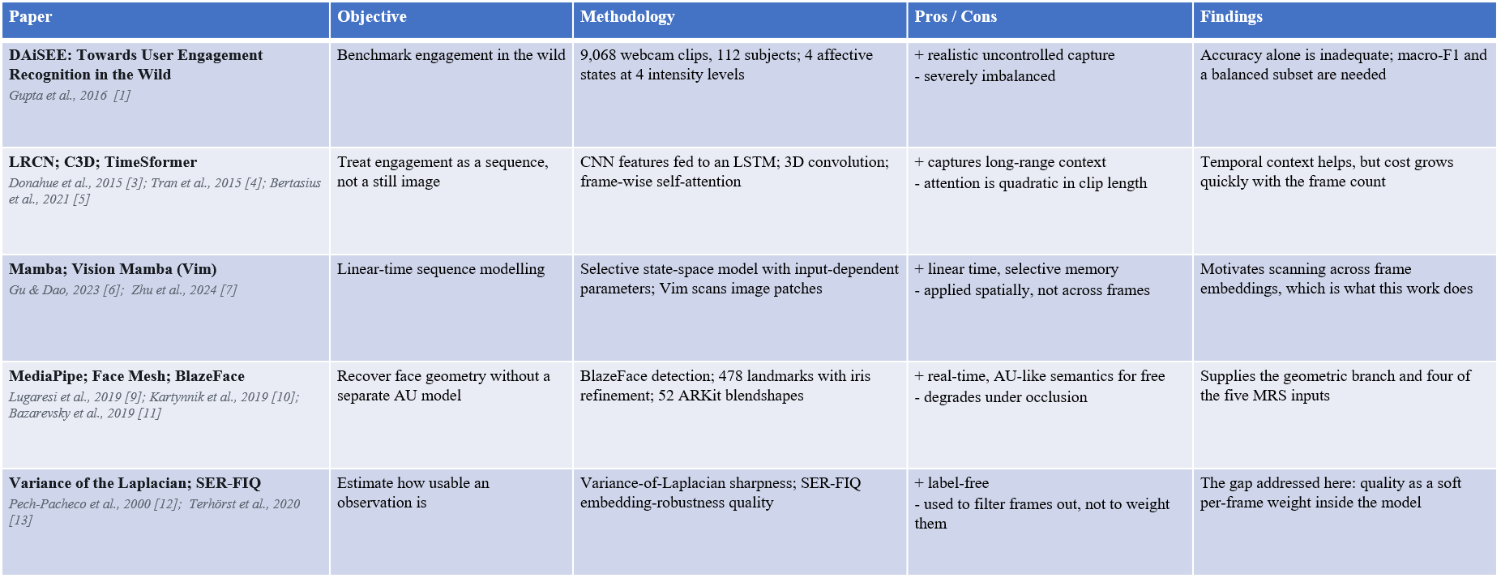
Literature Review

Slide 6
Research Gap
1. Reliability is used as a gate, not a weight. Existing quality-aware pipelines threshold frame quality and delete frames below it. For a temporal model this is self-defeating: the sequence length changes, the gaps close, and a degraded clip is no longer comparable to a clean one.
2. Reliability weights are asserted, not learned. Where multi-factor quality scores exist, the relative importance of the factors is fixed by hand - usually uniform. Whether blur, occlusion, head rotation and motion deserve equal influence is an empirical question that is rarely asked.
3. Reliability and behaviour are conflated. Head rotation and eye closure are often read as disengagement. A turned head means the frontal evidence is weaker; a blink is normal behaviour. A score contaminated by the label is no longer a reliability score.

Slide 7


Objectives
O1 Verified DAiSEE pipeline - official split, subject disjointness measured and confirmed zero.
O2 Five-component MRS in [0,1], computed only from observation quality.
O3 Integrate MRS into ViT + Mamba so temporal positions are provably preserved.
O4 Learn the five MRS weights from a 0.20 initialisation instead of fixing them.
O5 Fuse a MediaPipe geometric/behavioural branch; fit all statistics on train only.
O6 Evaluate against explicit chance and majority baselines with significance testing.
O7 SHAP attribution grouped into interpretable facial feature families.
Identified: 4 | TRL - 3

Slide 8
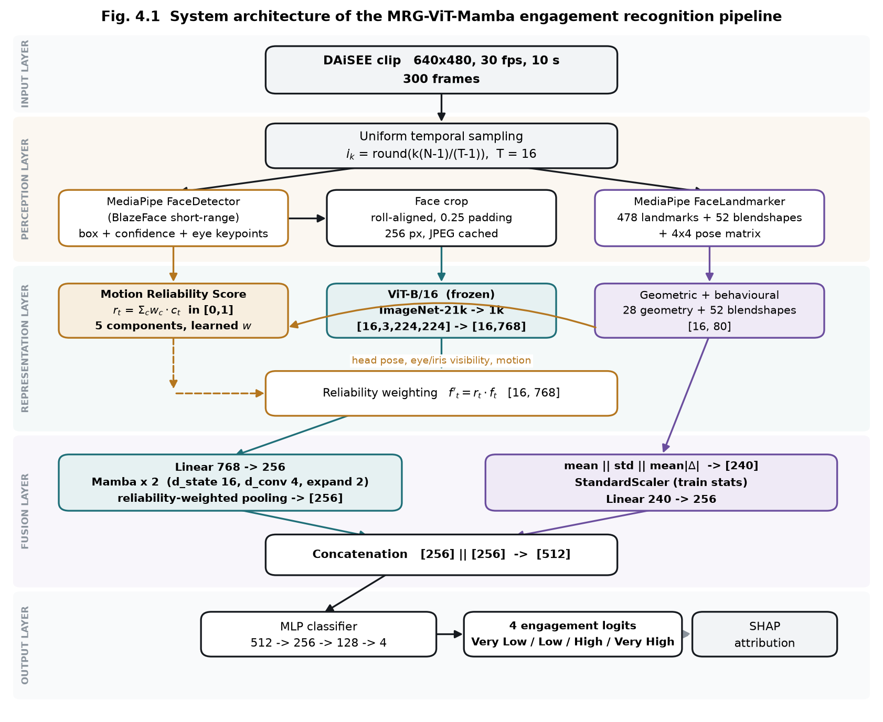
Framework/Architecture/Block Diagram
Frozen ViT-B/16 per frame | MRS weighting | 2 x Mamba temporal encoder | MediaPipe branch | fusion -> 4-class MLP

Slide 9
Functional Requirements
FR-1 to FR-5 Dataset audit: parse labels, join every clip, decode-probe each video, derive subject IDs, and refuse to proceed on any split overlap.
FR-6 to FR-8 Sampling: T uniformly spaced frames per clip (T configurable over 8/16/32/64), deterministic, always exactly T frames returned.
FR-9 to FR-12 Face processing: detect, roll-align on eye keypoints, pad and resize; on detection failure fall through a recorded chain - never drop the frame.
FR-13 to FR-17 Reliability: five components each in [0,1]; calibration fitted on the training split only; no engagement label may participate.
FR-18 to FR-21 Features: frozen ViT embedding (dimension discovered, not assumed); 478 landmarks + 52 blendshapes + head pose -> fixed-width vector.
FR-22 to FR-26 Model: apply MRS without altering temporal order; Mamba encoder; pool; fuse after separate normalisation; output 4 logits.
FR-27 to FR-32 Learning: MRS weights initialised at 0.20 and learned; checkpoint selected on validation macro-F1, never on test.

Slide 10
Modules
M1 Dataset index and audit - resolves clips, joins labels, verifies subject disjointness.
M2 Video sampling - uniform index rule, full sequential decode (seeking returns wrong frames).
M3 Face processing - MediaPipe BlazeFace detection, roll alignment, padded crop.
M4 Landmark extraction - 478 points, 52 blendshapes, 4x4 pose -> 28 geometric + 52 = 80/frame.
M5 Reliability scoring - five components; blur and face-size percentile-calibrated on train.
M6 ViT encoder - frozen backbone, batched [B,T,C,H,W] -> [B,T,768], cached to disk.
M7 Temporal encoder - vendored Mamba reference; MRS weighting + reliability-weighted pooling.
M8 Fusion and classifier - per-branch normalise, project to 256, concat 512 -> MLP -> 4.
M9 Evaluation and explainability - metrics, baselines, significance, SHAP attribution.

Slide 11
Experiments and Results
Setup - 216 DAiSEE clips, class-balanced (54 per class), subject-disjoint. 120 train / 80 validation / 16 test, from 48 / 17 / 11 distinct participants. All 216 decode; subject overlap between every pair of splits is zero.
Training - 64 epochs, AdamW, lr 3e-4 cosine, batch 8, class-weighted cross-entropy. MRS weights on a separate lr of 2e-2. Checkpoint chosen by validation macro-F1 (epoch 11).
Baseline - every split is balanced, so chance accuracy is exactly 25%.
Split | Clips | Accuracy | Weighted F1 | Macro F1 | Chance
Validation | 80 | 0.3875 | 0.3714 | 0.3714 | 0.2500
Test | 16 | 0.3750 | 0.3915 | 0.3915 | 0.2500
Validation: 31/80 correct, one-sided binomial p = 0.0046 (significant). Test (16 clips) p = 0.19 - directionally consistent but underpowered.

Slide 12
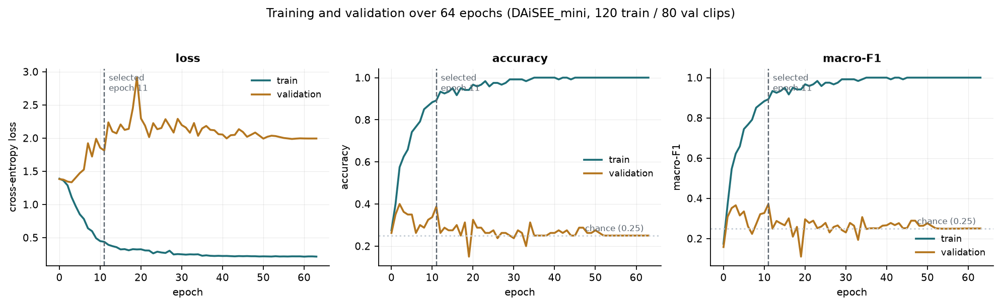
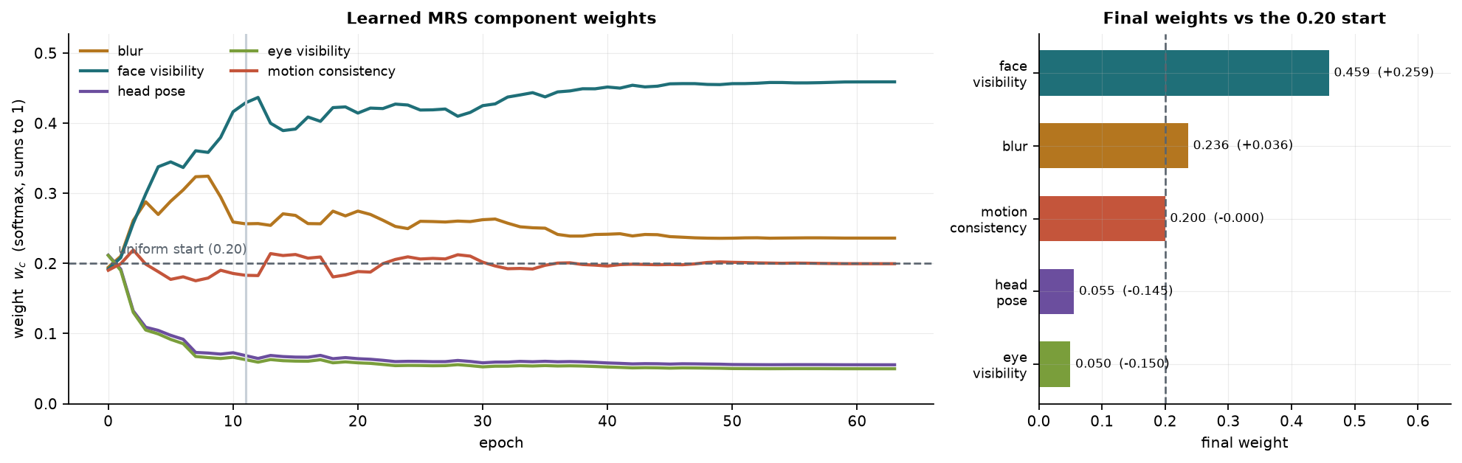
Experiments and Results - Training Behaviour
Training and validation across 64 epochs. Train accuracy saturates at 1.000; validation loss rises from about epoch 5 - overfitting on 120 training clips.
The five MRS weights start at 0.20 and converge to: face visibility 0.459, blur 0.236, motion 0.200, head pose 0.056, eye visibility 0.050.

Slide 13
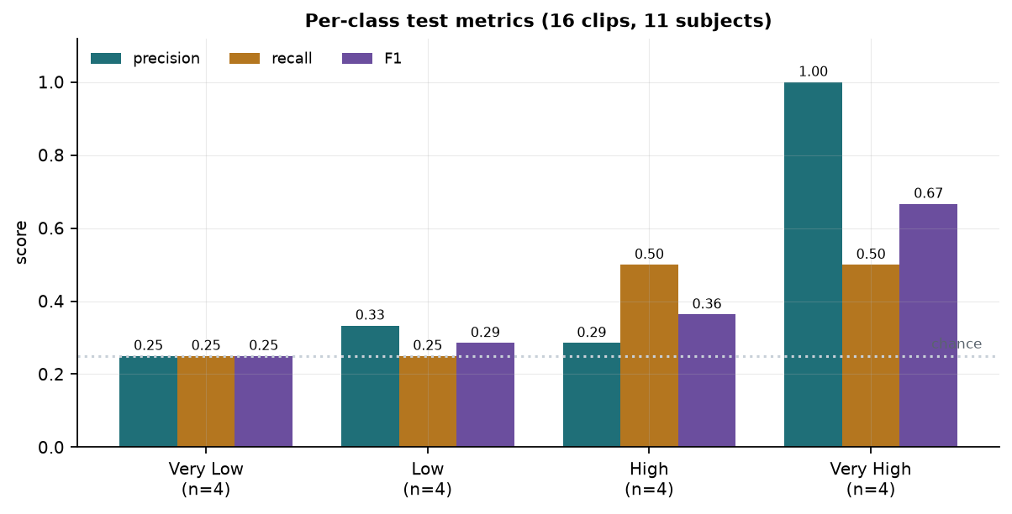
Experiments and Results - Per-Class Performance
Per-class precision / recall / F1. All four classes are predicted.
Low is the hardest class (F1 0.188): 12 of its 20 validation clips are absorbed into High - adjacent intensities are visually similar even for human annotators.

Slide 14
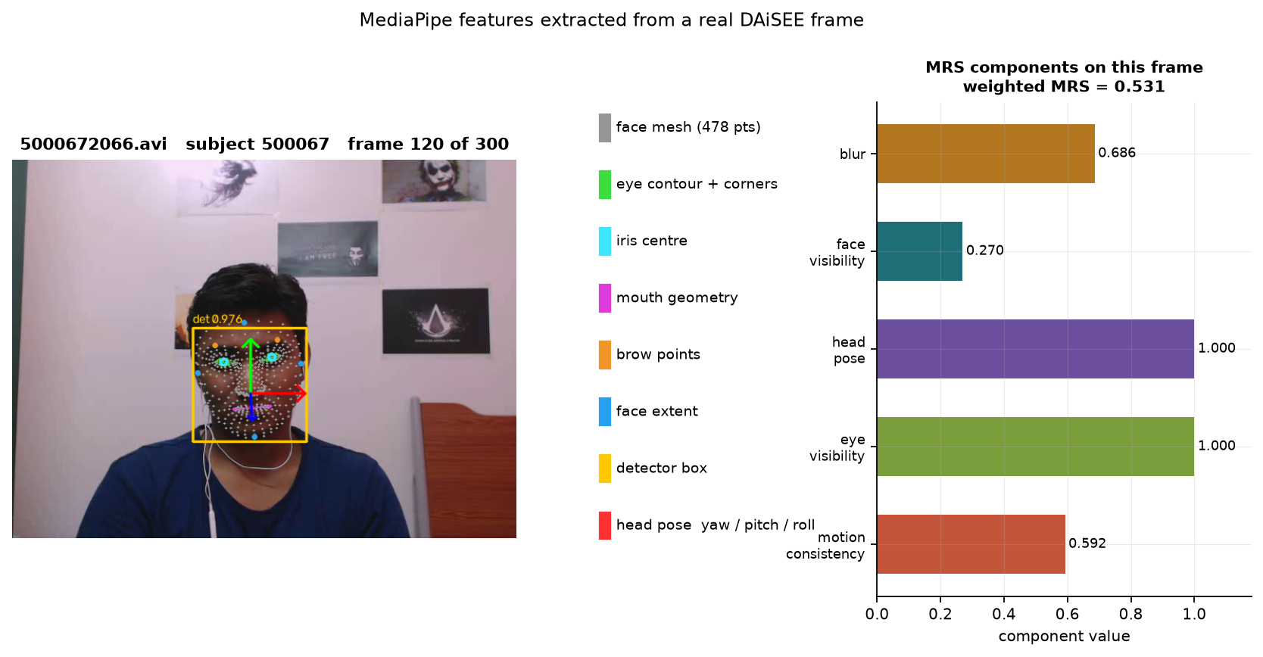
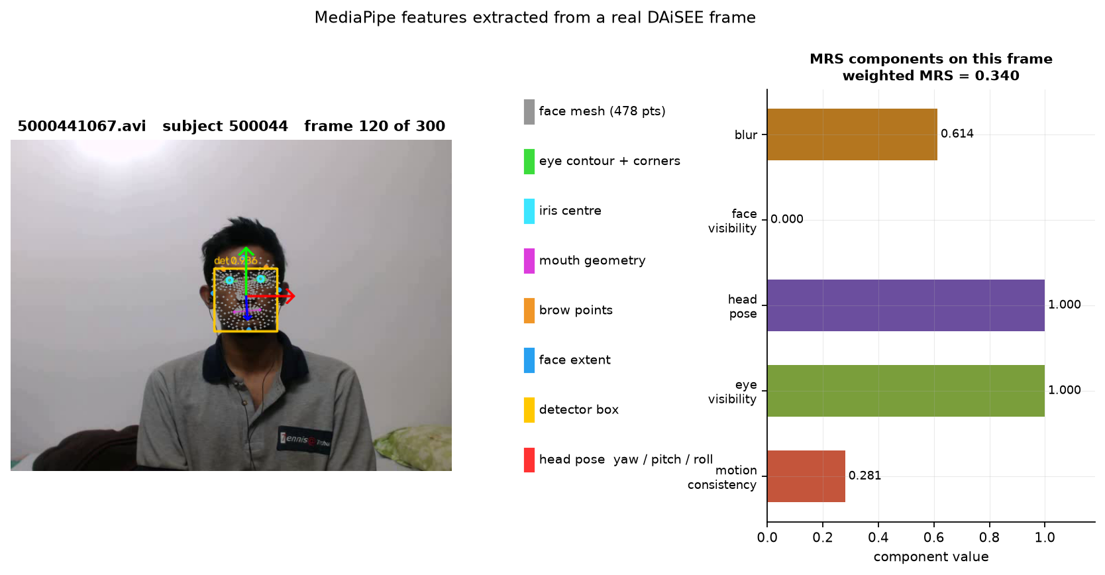
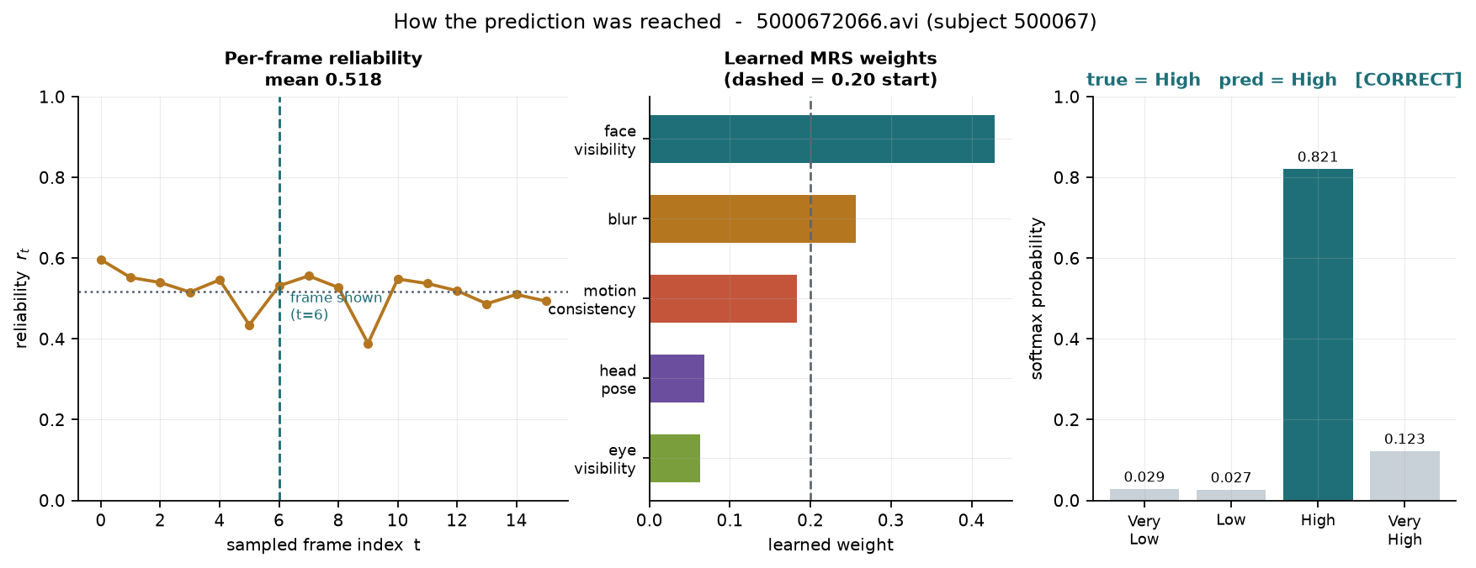
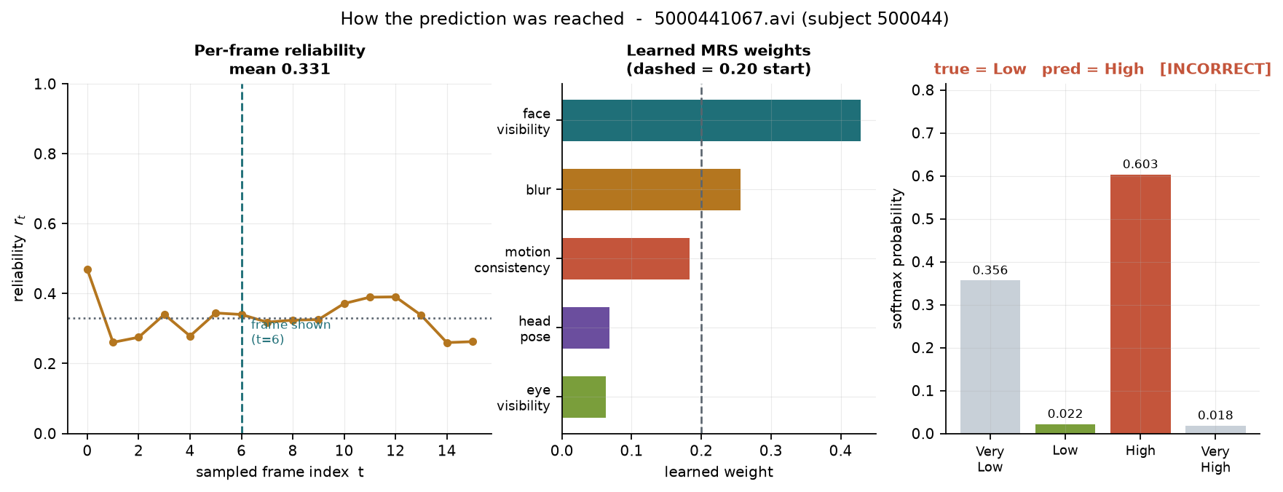
Experiments and Results - Worked Examples
Clip 5000672066 (subject 500067) - detector 0.976, clip MRS 0.518. True High, predicted High (p = 0.821). CORRECT
Clip 5000441067 (subject 500044) - clip MRS 0.331. True Low, predicted High (p = 0.603). INCORRECT
The misclassified clip has markedly lower reliability (0.331 vs 0.518): MRS independently flagged it as poorly observed, and the prediction on it was wrong.

Slide 15
Conclusion
Built and verified. A complete DAiSEE pipeline: audit, sampling, face and landmark extraction, reliability scoring, frozen ViT, Mamba temporal encoder, fusion, classification and SHAP. All 216 clips process without failure.
Reliability as a weight works. Frames are never dropped; the sequence length and spacing are identical for every clip regardless of degradation. Under controlled degradation the score falls as expected (0.657 clean -> 0.484 at 25% occlusion), so it measures what it claims to.
Learned weights agree with independent analysis. From a 0.20 start the optimiser concentrated on face visibility (0.459) and blur (0.236) and suppressed head pose (0.056) and eye visibility (0.050) - the same two components a separate variance analysis found to be near-constant. Head pose fell rather than rose, so no engagement cue leaked into the reliability term.
Above chance, with the caveat stated. 38.75% validation accuracy vs 25% chance, p = 0.0046. The 16-clip test split is not statistically powered.
Next: scale to the full 9,068-clip DAiSEE release, run multi-seed ablations, and fit the reliability weights against degradation severity so that no label influences MRS at all.

Slide 16
References
[1] A. Gupta, A. D’Cunha, K. Awasthi, and V. Balasubramanian, "DAiSEE: Towards user engagement recognition in the wild," arXiv:1609.01885, 2016.
[2] J. Whitehill, Z. Serpell, Y.-C. Lin, A. Foster, and J. R. Movellan, "The faces of engagement: Automatic recognition of student engagement from facial expressions," IEEE Trans. Affective Computing, vol. 5, no. 1, pp. 86–98, 2014.
[3] A. Gu and T. Dao, "Mamba: Linear-time sequence modeling with selective state spaces," arXiv:2312.00752, 2023.
[4] L. Zhu, B. Liao, Q. Zhang, X. Wang, W. Liu, and X. Wang, "Vision Mamba: Efficient visual representation learning with bidirectional state space model," in Proc. ICML, 2024.
[5] A. Dosovitskiy et al., "An image is worth 16x16 words: Transformers for image recognition at scale," in Proc. ICLR, 2021.
[6] C. Lugaresi et al., "MediaPipe: A framework for building perception pipelines," arXiv:1906.08172, 2019.
[7] Y. Kartynnik, A. Ablavatski, I. Grishchenko, and M. Grundmann, "Real-time facial surface geometry from monocular video on mobile GPUs," in Proc. CVPR Workshops, 2019.
[8] V. Bazarevsky, Y. Kartynnik, A. Vakunov, K. Raveendran, and M. Grundmann, "BlazeFace: Sub-millisecond neural face detection on mobile GPUs," arXiv:1907.05047, 2019.
[9] J. L. Pech-Pacheco, G. Cristóbal, J. Chamorro-Martínez, and J. Fernández-Valdivia, "Diatom autofocusing in brightfield microscopy: A comparative study," in Proc. ICPR, 2000, pp. 314–317.
[10] P. Terhörst, J. N. Kolf, N. Damer, F. Kirchbuchner, and A. Kuijper, "SER-FIQ: Unsupervised estimation of face image quality based on stochastic embedding robustness," in Proc. IEEE CVPR, 2020, pp. 5651–5660.
[11] S. M. Lundberg and S.-I. Lee, "A unified approach to interpreting model predictions," in Proc. NeurIPS, 2017, pp. 4765–4774.
[12] I. Loshchilov and F. Hutter, "Decoupled weight decay regularization," in Proc. ICLR, 2019.

