Slide 1
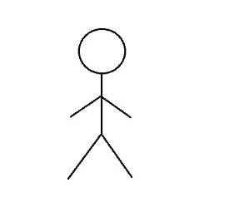
Form
Network
Press ‘Delete’button
RemoveComponent(splitter)
Remove element from the list
Return ‘true’
Notes:
Remove splitter

Slide 2
Form
Network
Component
Select merger and click on a spot on the screen
AddComponent(M)
GetLocation()
CheckOverlapComponent(M)
Return ‘true’
GetImage()
Notes:
Add merger

Slide 3
Form
Network
Press ‘Save’ button
Save()
Return ‘true’
Notes:
Save file

Slide 4
Form
Network
Pump
Change pump flow
GetComponent(Point p)
SetMaxFlow(int flow)
Notes:
Change pump’s flow

