Slide 1
Aerial Urban Taxi
By
Derek Larson
Jesse Morzel
Abedin Sherifi

Slide 2
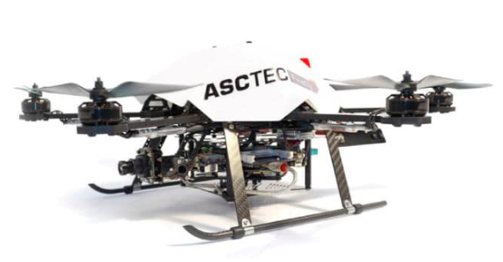
Project Scope
Implementation of simulation environment
Development of world model
Global path planning to avoid static obstacles
Local path planning to avoid dynamic obstacles
Trajectory generation and consideration of non-holonomic constraints suitable for the AscTec Firefly hexrotor vehicle
Motion controller development

Slide 3

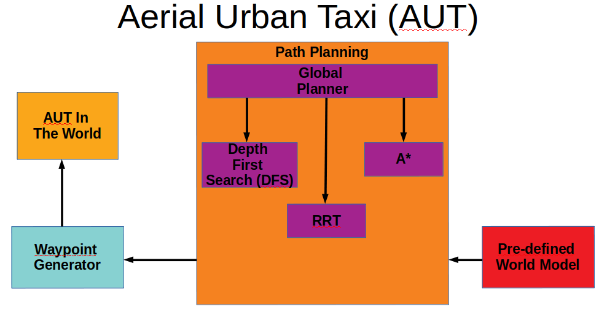
System Diagram

Slide 4
Simulation and Software Tools
Robot Operating System (ROS)
Gazebo
RViz
RotorS
Octomap
Octovis
MAVROS
Github

Slide 5
A* Algorithm Description
A* Algorithm Node Class
  Initialization of Open and Closed Lists
  Add Start Node to Open List
  Perform While Loop Until Goal Reached
    Retrieve current node from open list
    If goal found, generate recursive path and provide it out
    Check for all directions that a new node can be chosen from
    Get new node
    Verify new node position within range
    Obstacle detection
    G, h and f values of new node
      Compare g value of new node to current nodes
      Append new node
      Add new node to Closed List
  Three kinds of heuristics utilized:
    Straight line
    2D diagonal
    3D diagonal

Slide 6
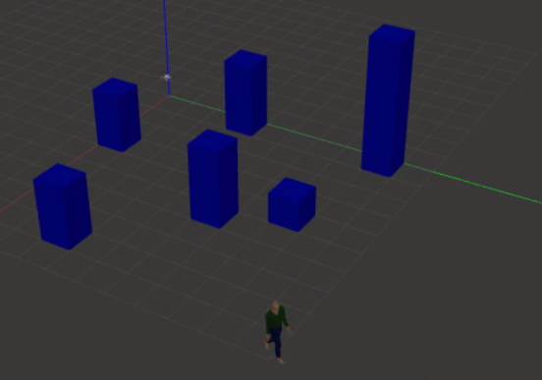
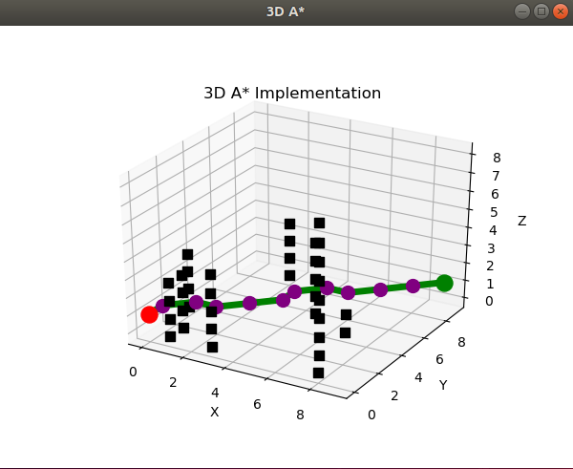
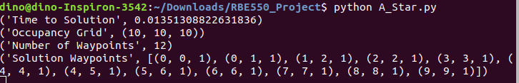
A* Algorithm Results

Slide 7
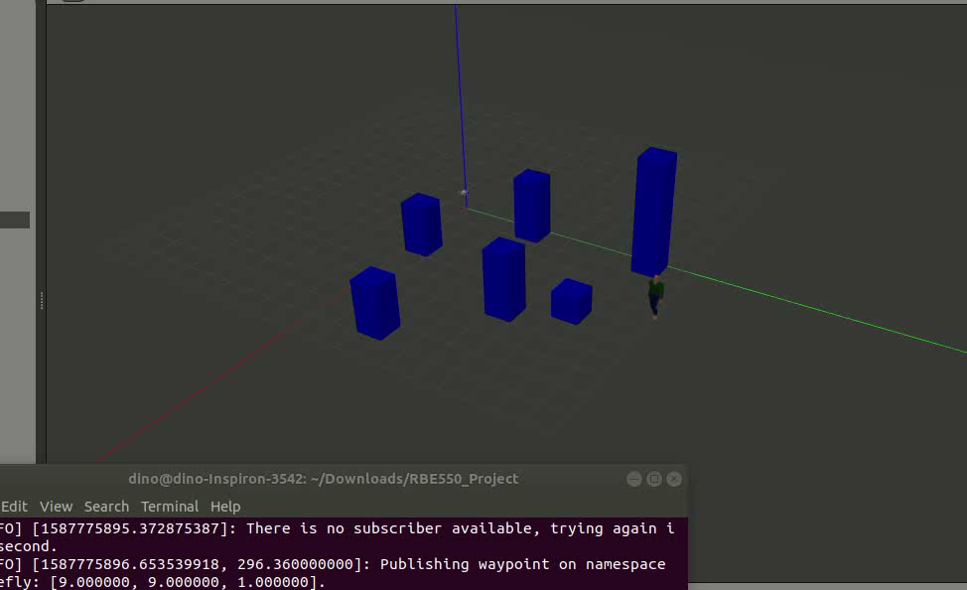
A* Algorithm Video

Slide 8
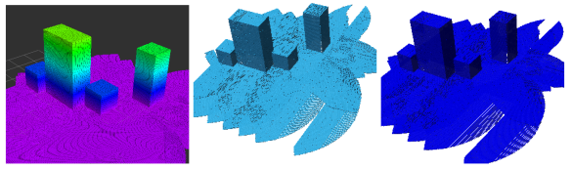
Task Breakdown
Global Path Planning
Simulation Setup (ALL)
  Ubuntu, ROS, Gazebo, RotorS, rViz, Github
  Control Integration
World Model (Jesse)
  With dynamic obstacles
Localization and octomap (Abedin)
  3D Map of the World Model
  Contains occupancy information of each node
  Path Planning algorithms will run on a fully created Octomap
  Octomap files will be saved as OcTree or Bonsai Tree
Global Path Planning (ALL)
  A*
Local Path Planning (Derek)
  Dynamic obstacle avoidance
Notes:
Figure taken from Reference [1]

Slide 9
Benchmarking Metrics
Global Path Planner Evaluation:
  Heuristic used for A* algorithm will be straight-line distance to goal
  Global path planner will be evaluated for time to return a solution
  A* execution time goal will be no longer than 3-5 minutes, or approximately the time required to unload and load a new set of passengers
Runtime Performance Evaluation:
  Time to execute a single frame of a mission will be tracked and evaluated
  Following tasks must be performed quickly enough as to not degrade overall mission performance:
    Perception of simulated environment
    Dynamic obstacle detection
    Local path planning
    Low-level motion control execution

Slide 10
References
[1] V. Coleman, C. Shatney, S. Biaz, and R. Chapman, “UAV 3D Path Planning Simulation for Obstacle Avoidance.” September 23, 2019.
[2] B. Zhou, F. Gao, L. Wang, C.Liu, and S. Shed, “Robust and Efficient Quadrotor Trajectory Generation for Fast Autonomous Flight.” July 3, 2019
[3] F. Duchoe, A. Babinec, M. Kajan, P. Beeo, M. Florek, T. Fico, and L. Jurisica, “Path planning with modified A star algorithm for a mobile robot.” 2014

