Slide 1
Magist Analysis
The viability of leveraging Magist’s infrastructure to expand into the Brazilian market
Notes:
Cover page

Slide 2
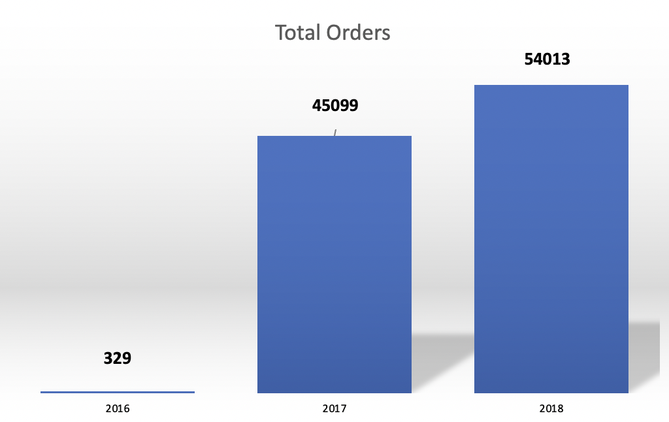
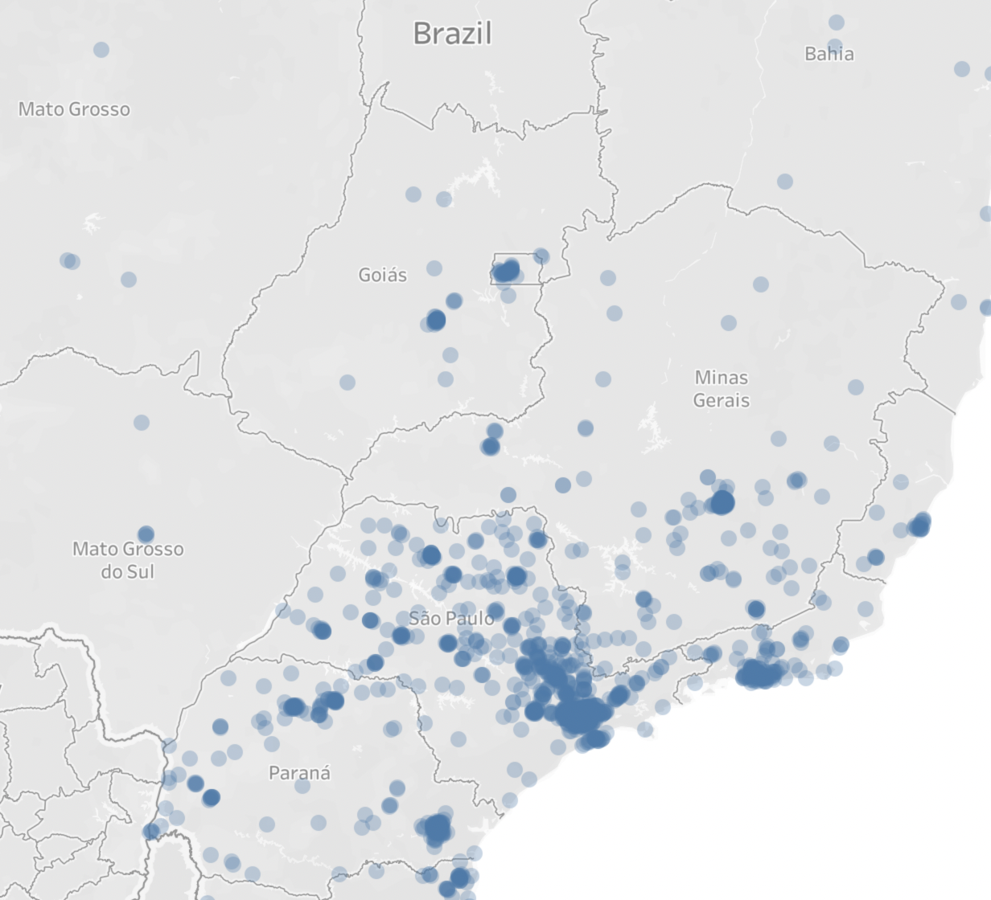
Market Distribution
Total no of Sellers: 3095
Product Categories 74
Tech Categories 7
Top Selling Categories bed_bath_table
Health_beauty
Sports_leisure
Furniture_decor
Computers_accessories
Notes:
Intro

Slide 3
Tech Product Categories | No of Avail Products | No of Products Sold
Computers Accessories | 1639 | 7827
Electronics | 517 | 2767
Consoles Games | 317 | 1137
Audio | 58 | 364
Computers | 30 | 203
Tablets Printing Image | 9 | 83
PC Gamer | 3 | 9
About 7.8% of all available products on Magist are tech products
About 11% of all products sold are in the tech categories
Notes:
Tech

Slide 4
Tech Products Price Categories | No of Products Sold
Very Cheap (<= R$100) | 8338
Cheap (<= R$300) | 3277
Moderate (<= R$1000) | 601
Expensive (> R$1000) | 174
Approximately 93.7% of all tech products sold fall in the very cheap and cheap categories
Only 1.4% of tech products sold are expensive
Average monthly revenue of all sellers on Magist is R$828.1
Average monthly revenue of tech sellers is R$801.06
Notes:
Tech

Slide 5
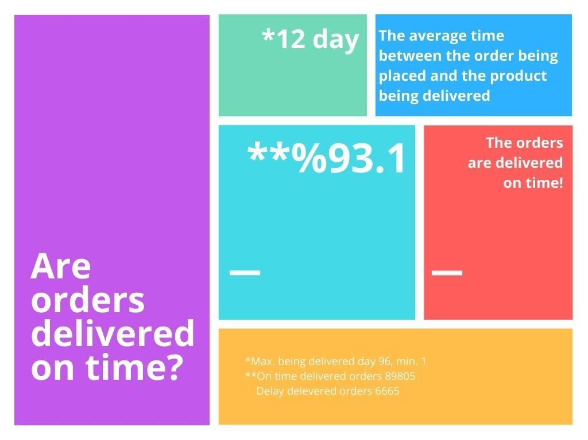
Notes:
Delivery

Slide 6
Conclusion
Questions we are trying to explore
Is Magist a good fit for high-end tech products?
Are orders delivered on time?
Based on the information presented in previous slides, Magist is not a good fit for Eniac to expand into the Brazilian market
The percentage of high-end tech products sold is very low
There are major delays in deliveries

