Slide 1
Applying Frequent Pattern Mining to Multimodal Behaviour in Interaction
Katharina Rohlfing Marcel Ruland Sascha Henzgen

Slide 2
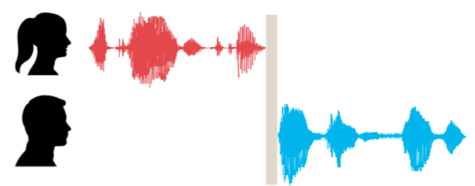
Basic Concepts
turn
turn-taking
uni- vs multimodal

Slide 3
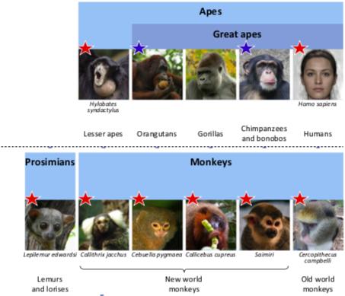
Turn-Taking – Why do we care?
language universal
present in related species
present in early infancy
Notes:
some models assume language and gesture to originate in the same system

Slide 4
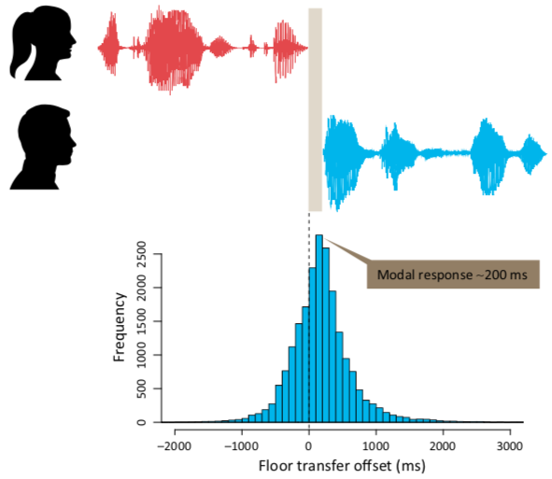
Turn-Taking – Why do we care?
Why impose such a restriction?
cognitive load?
output signal distorts input signal?
But:
simultaneous reception and production is not an issue
TT equally present in sign languages

Slide 5
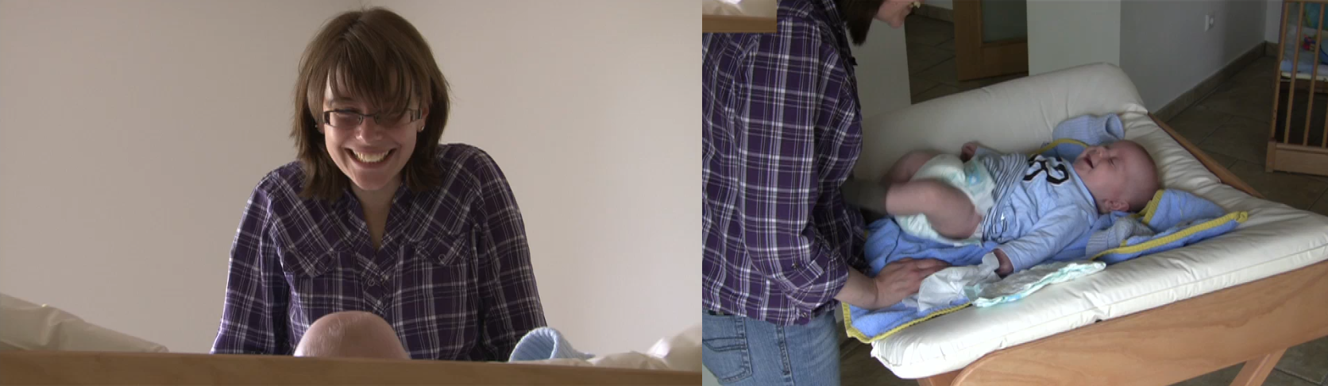
Video Material
Notes:
Why diaper routine?
activity known to mother and infant
interaction over a relatively long period of time without change of location etc
data recorded in family’s home, only introduced changing table (change unit)
NEXT: 15sec example video
Tell people what to pay attention to!

Slide 6
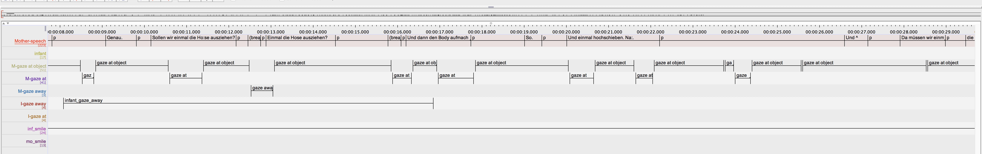
Annotating the Videos
Notes:
timeline
annotation with start and end time point

Slide 7
Annotating the Videos
intervals
intervals of different modalities
modalities of different sources
Notes:
data interesting because: intervals, intervall from different modalities, modalities of different sources

Slide 8
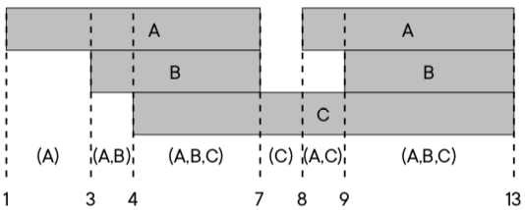
What counts as a rule?^{[1]}
A → B represents one of two cases:
interval of A starts before interval of B
interval of A and B start at the same time
and A ends after B begins (= overlap)
^{[1]}Rohlfing, Katharina; Leonardi, Giuseppe; Hüllermeier, Eyke; Raczaszek-Leonardi, Johanna; and Nomikou, Iris (under review):
“Multimodal turn-taking: Motivations, methodical challenges and first approaches.” IEEE Transactions on Cognitive and Developmental Systems.
Notes:
example shows {A} -> {B}, {A} -> {A, B} but not {B} -> {A}
NEXT: rule example video

Slide 9
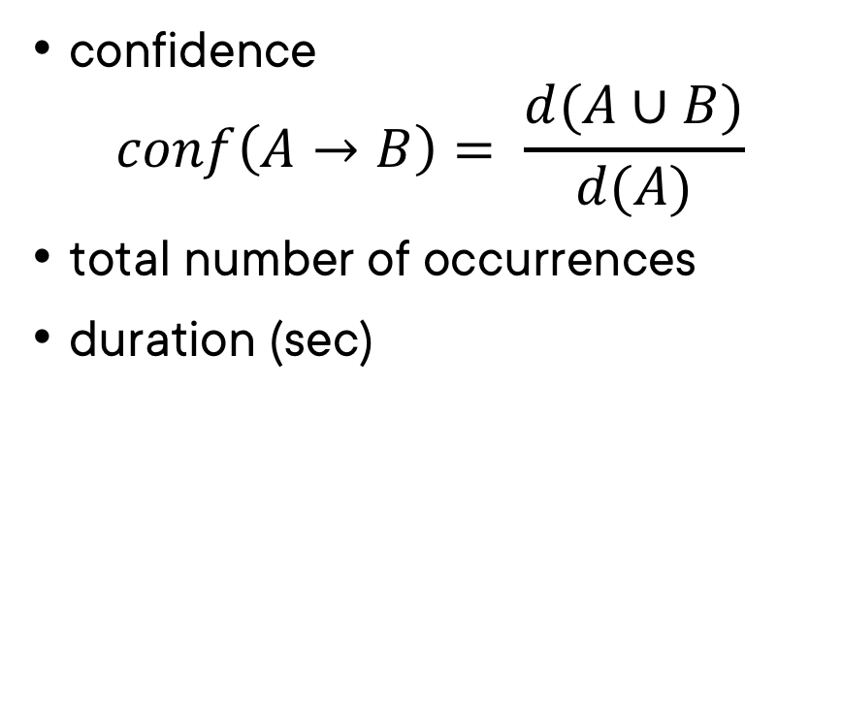
Metrics
confidence $conf\left(A→B\right)= \frac{d(A∪B)}{d(A)}$
total number of occurrences
duration (sec)
Notes:
confidence: duration of occurrence of the rule divided by duration of occurrence of the premise

Slide 10
Why Significance?
qualitative quantitative
Notes:
choosing interesting rules: quantitative support for qualitative task

Slide 11
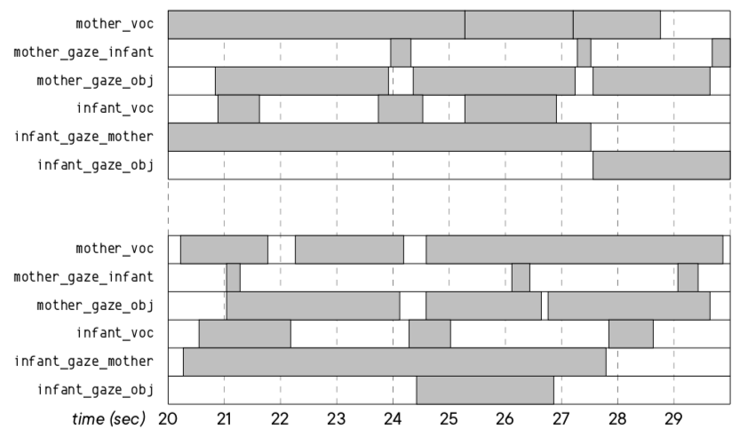
Significance – How?
create 100 null distributions for every real sequence
take batches of 10: 1 null distributions from each real distribution
create distribution for every rule
check real observation for significance against null observation distribution
Notes:
Why null distributions? finding regularities
when shuffling: make sure people only look one way
show illogical null distribution first, highlight mistakes, then show logical one

Slide 12
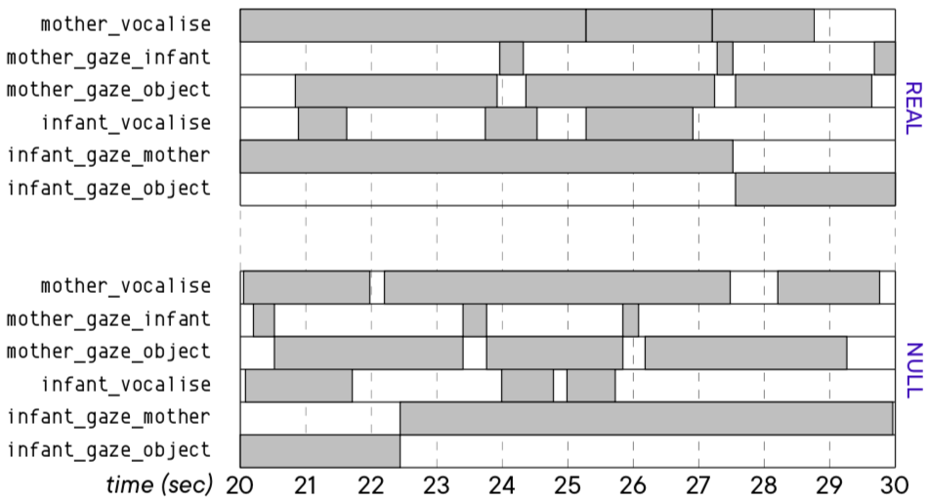
Significance – How?
create 100 null distributions for every real sequence
take batches of 10: 1 null distributions from each real distribution
create distribution for every rule
check real observation for significance against null observation distribution
Notes:
Why null distributions? finding regularities
when shuffling: make sure people only look one way
show illogical null distribution first, highlight mistakes, then show logical one

Slide 13
Interpretation – Things to Keep in Mind
Notes:
all 3 metrics
mothers always talk

Slide 14
Interpretation – Things to Look for
Notes:
confirming existing research
new interesting rules

