Slide 1
Applying Frequent Pattern Mining to Multimodal Behaviour in Interaction
Katharina Rohlfing Marcel Ruland Sascha Henzgen

Slide 2
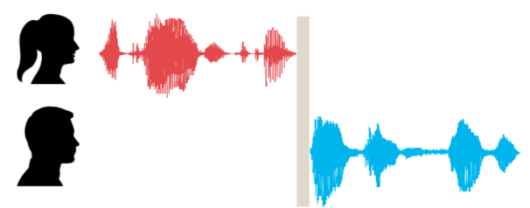
Basic Concepts
turn
turn-taking
uni- vs multimodal

Slide 3
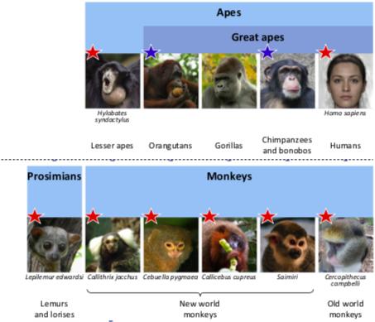
Turn-Taking – Why do we care?
language universal
present in related species
present in vocal and gestural modality

Slide 4
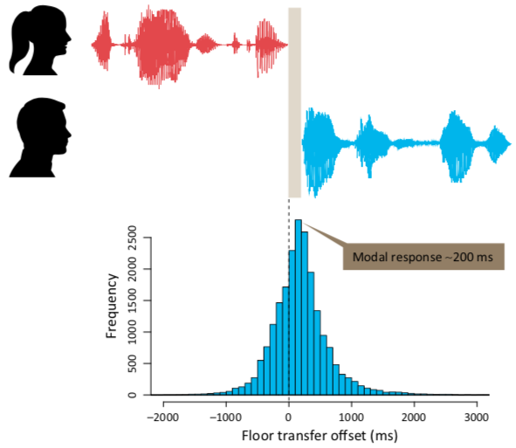
Turn-Taking – Why do we care?
Why impose such a restriction?
cognitive load?
output signal distorts input signal?
But:
simultaneous reception and production is not an issue
TT equally present in sign languages

Slide 5
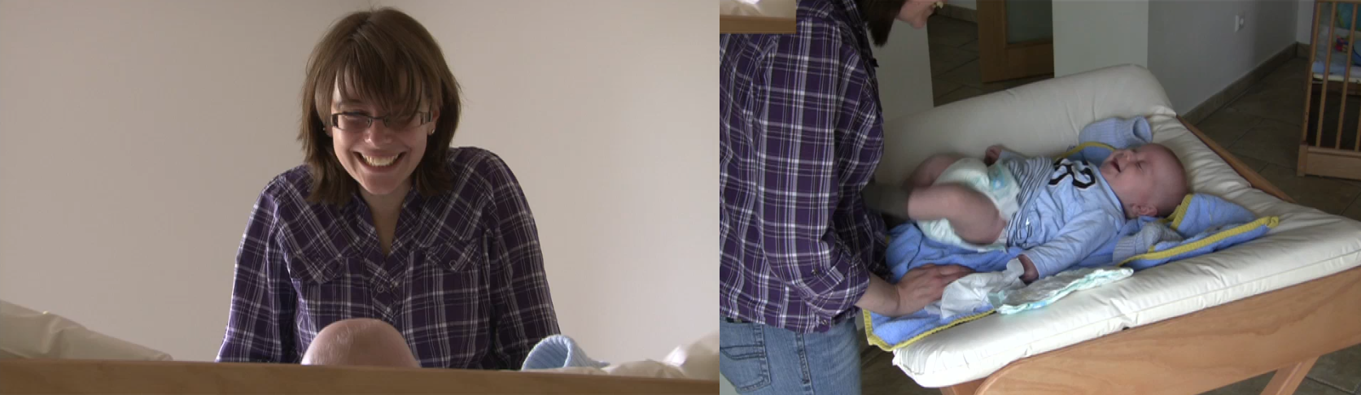
Video Material

Slide 6
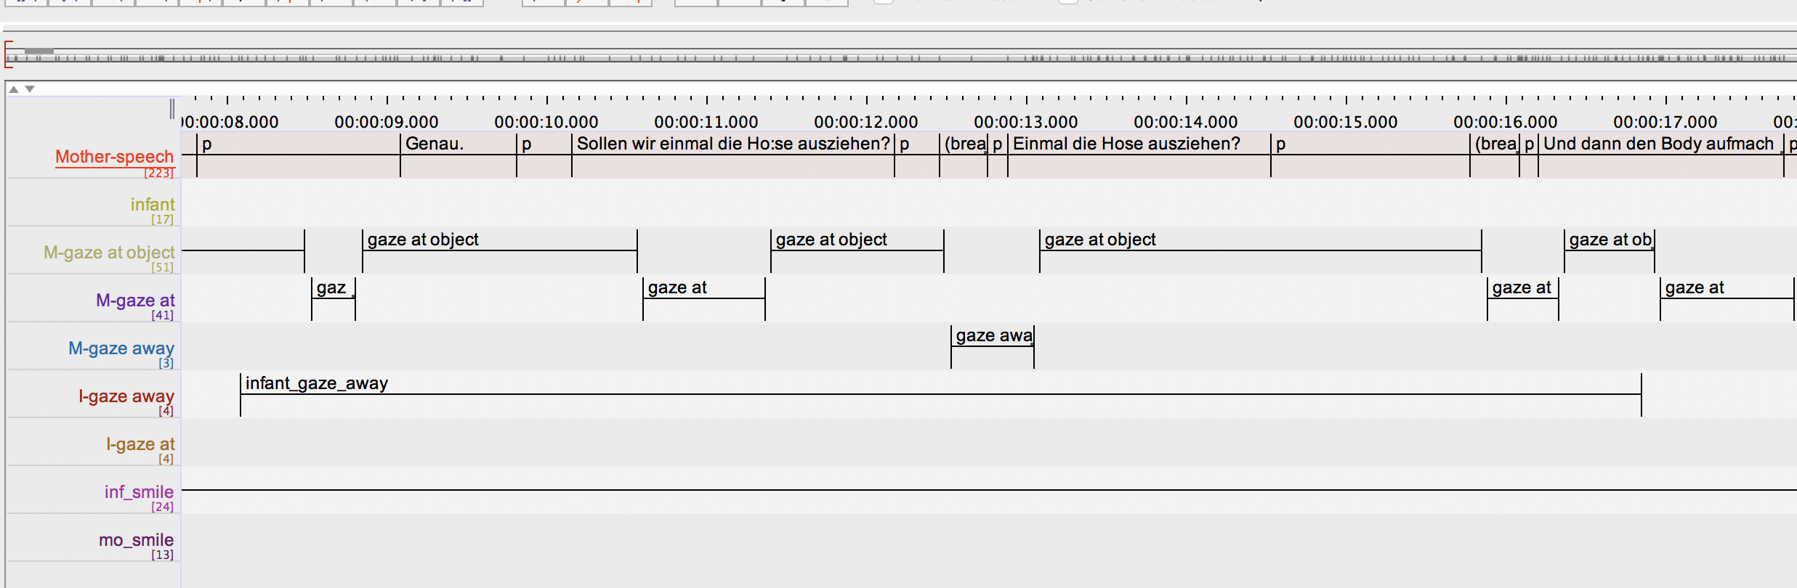
Annotating the Videos

Slide 7
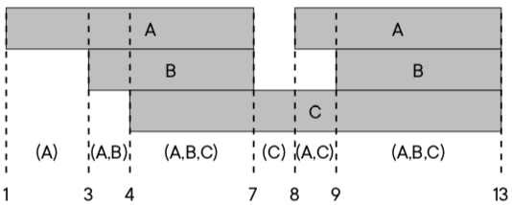
What counts as a rule?
A → B represents one of two cases:^{[1]}
interval of A starts before interval of B
interval of A and B start at the same time
and A ends after B begins (= overlap)
^{[1]}Rohlfing, Katharina; Leonardi, Giuseppe; Hüllermeier, Eyke; Raczaszek-Leonardi, Johanna; and Nomikou, Iris (under review):
“Multimodal turn-taking: Motivations, methodical challenges and first approaches.” IEEE Transactions on Cognitive and Developmental Systems.
Notes:
add reference

Slide 8
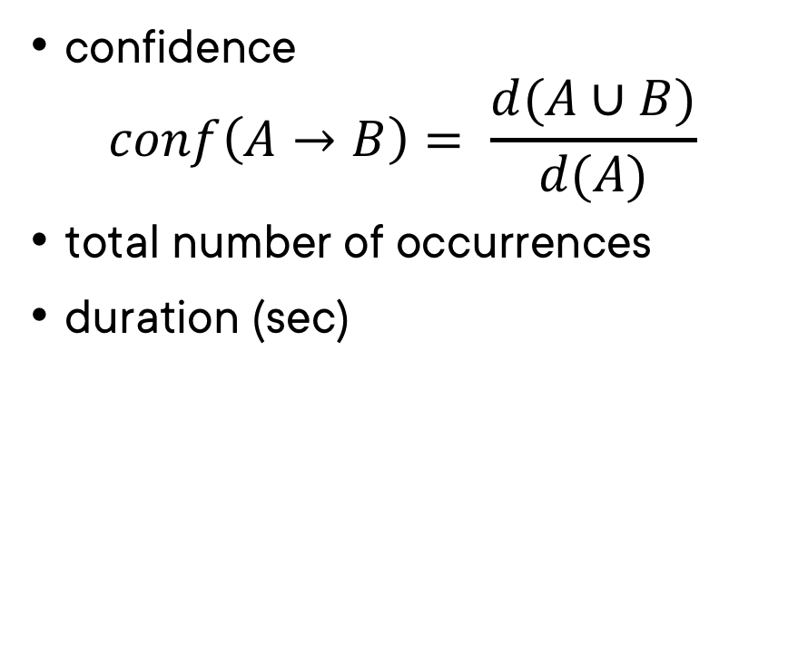
Metrics
confidence $conf\left(A→B\right)= \frac{d(A∪B)}{d(A)}$
total number of occurrences
duration (sec)

Slide 9
Why Significance?
qualitative quantitative

Slide 10
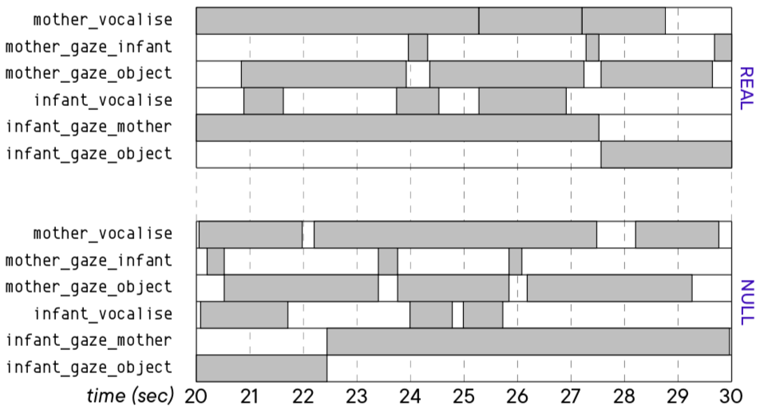
Significance – How?

Slide 11
Interpretation – Things to Keep in Mind

Slide 12
Interpretation – Things to Keep in Mind
numerical vs applied significance
rules confirming existing research
new ”interesting” rules (whatever that means)
possible hypotheses generated from new rules

