Slide 1
Applying Frequent Pattern Mining to Multimodal Behaviour in Interaction
Katharina Rohlfing Marcel Ruland Sascha Henzgen

Slide 2
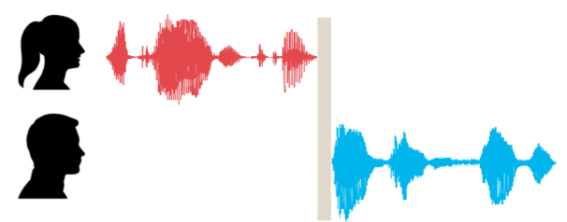
Basic Concepts
turn
turn-taking
uni- vs multimodal

Slide 3
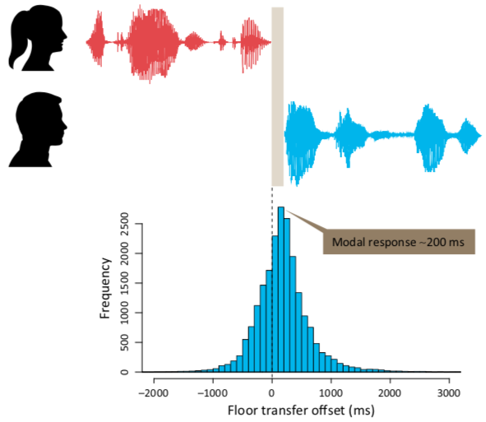
Turn-Taking – Why do we care?
Why impose such a restriction?
cognitive load?
output signal distorts input signal?
But:
simultaneous reception and production is not an issue
TT equally present in sign languages

Slide 4
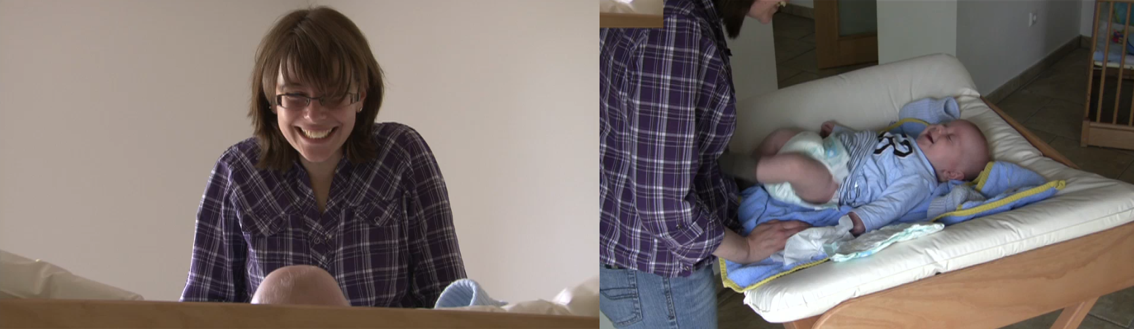
Video Material

Slide 5
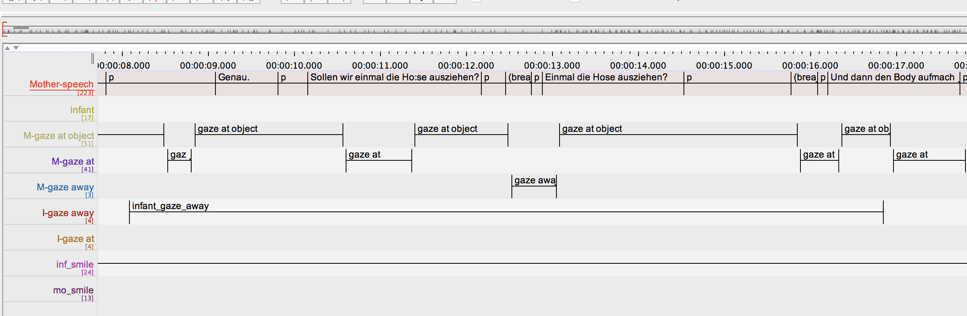
Annotating the Videos

Slide 6
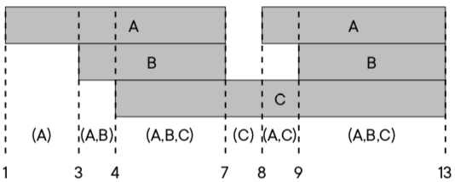
What counts as a rule?
A → B represents one of two cases:
interval of A starts before Interval of B
interval of A and B start at the same time
and A ends after B begins (= overlap)
Notes:
add reference

Slide 7
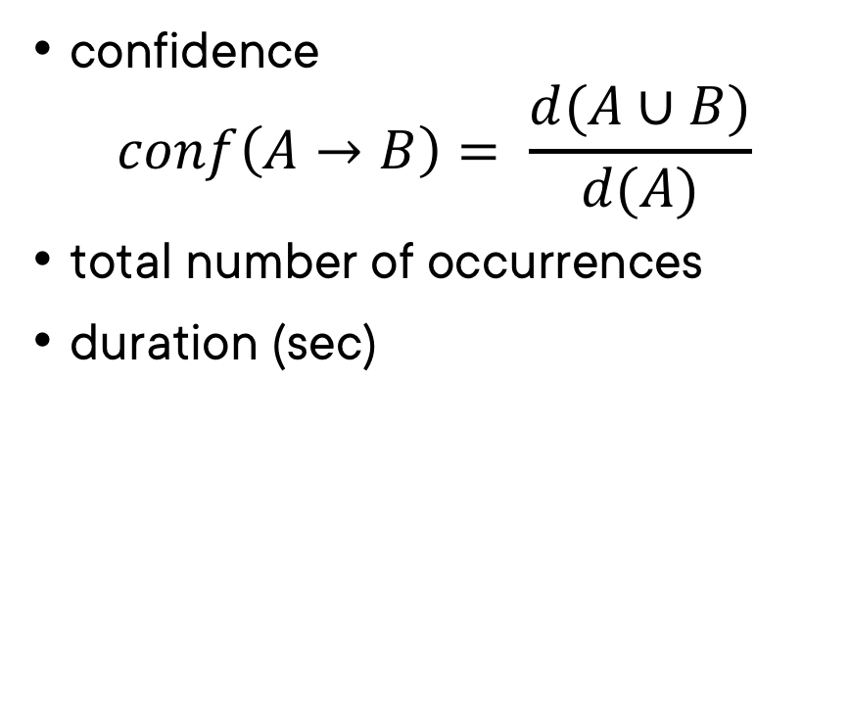
Metrics
confidence $conf\left(A→B\right)= \frac{d(A∪B)}{d(A)}$
total number of occurrences
duration (sec)

Slide 8
Why Significance?
qualitative quantitative

Slide 9
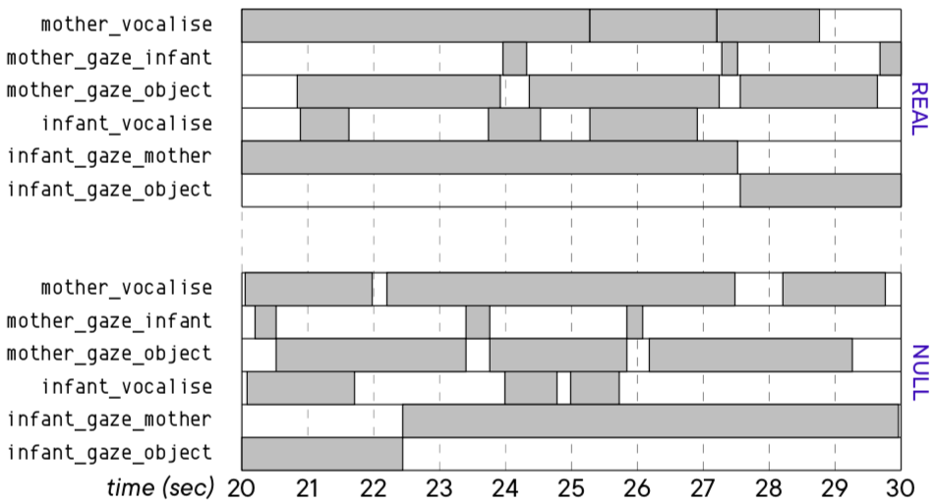
Significance – How?

Slide 10
Results
numerical vs applied significance
rules confirming existing research
new ”interesting” rules (whatever that means)
possible hypotheses generated from new rules

