Slide 1
Applying Frequent Pattern Mining to Multimodal Behaviour in Interaction

Slide 2
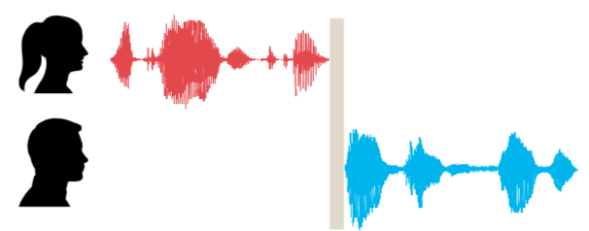
Basic Concepts
turn
turn-taking
uni- vs multimodal

Slide 3
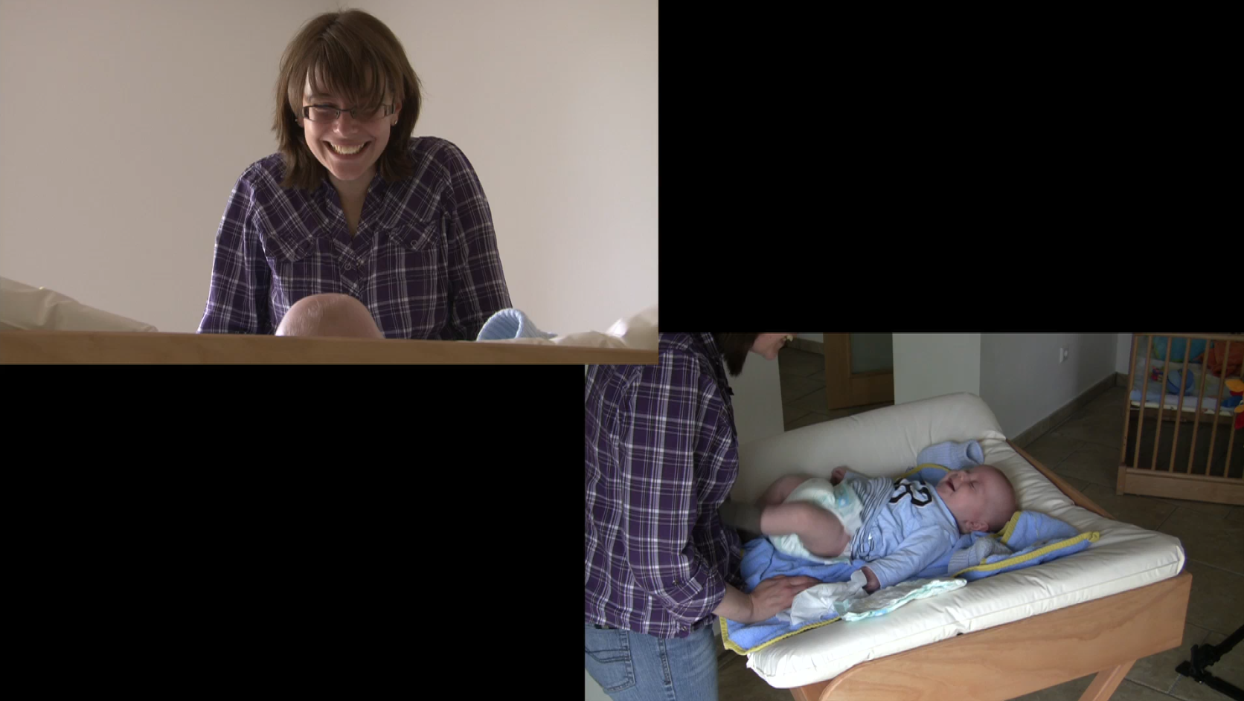
Method

Slide 4
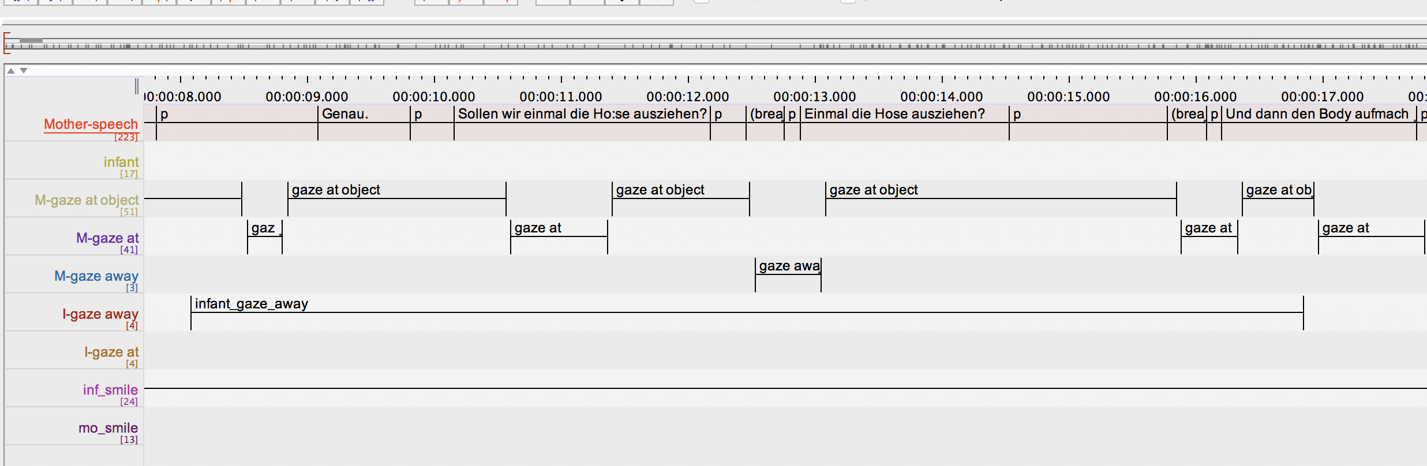
Method

Slide 5
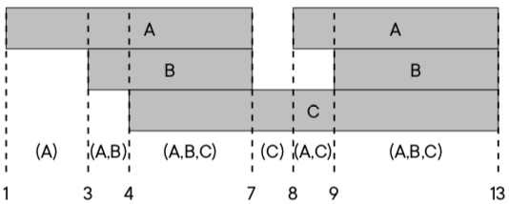
Method – What counts as a rule?
A → B represents one of two cases:
interval of A starts before Interval of B
interval of A and B start at the same time
and A ends after B begins (= overlap)
Notes:
add reference

Slide 6
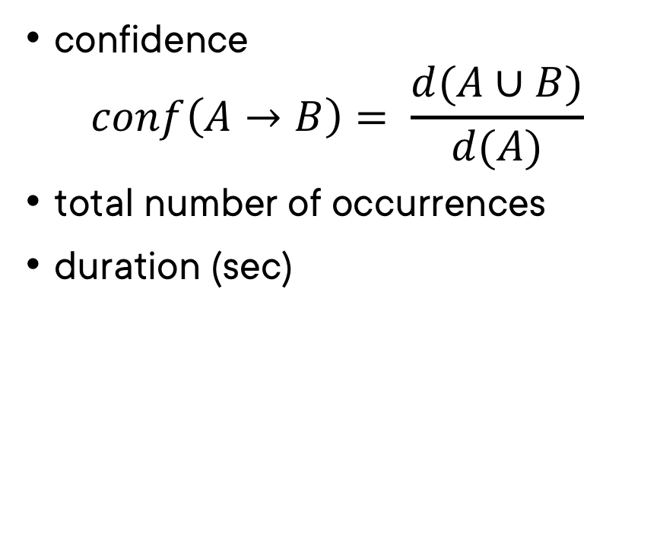
Method – Metrics
confidence $conf\left(A→B\right)= \frac{d(A∪B)}{d(A)}$
total number of occurrences
duration (sec)

Slide 7
Significance – Why?
Before
After
”Why did you choose this rule?”
“Because it looked interesting to me.”
”Why did you choose this rule?”
“Because it looked interesting to me. Also, the numbers support this claim.”

Slide 8
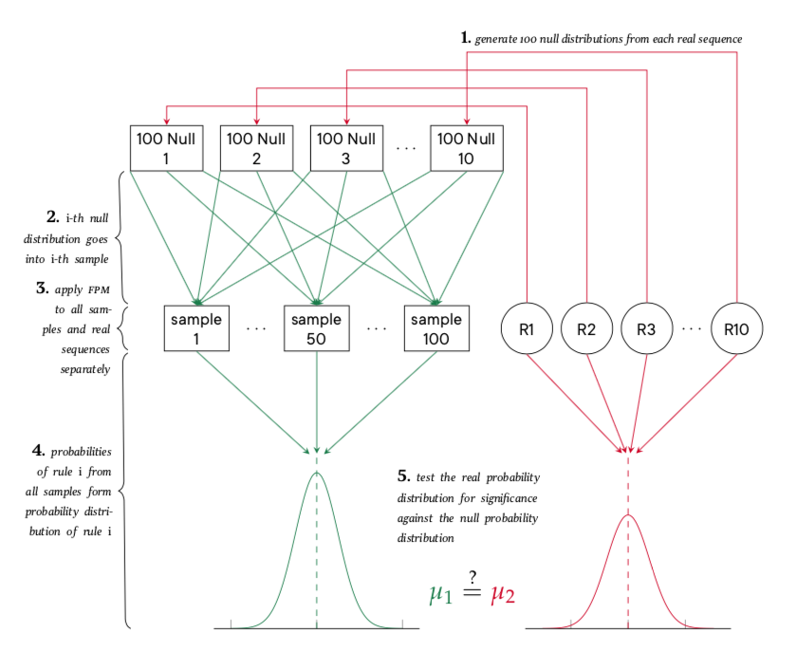
Significance – How?
Notes:
Beamer resolution high enough?

Slide 9
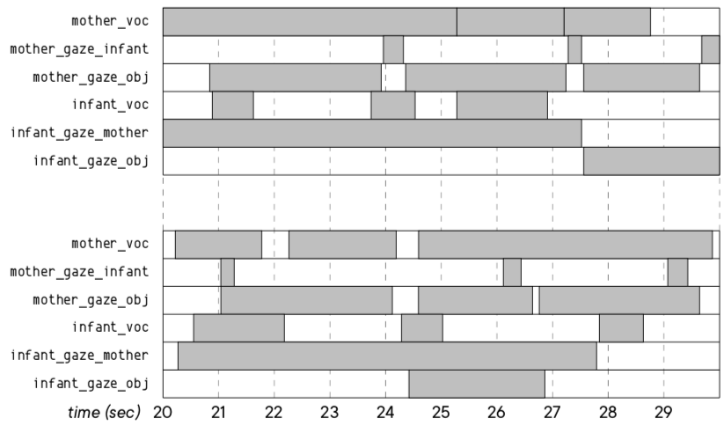
Significance – How?

Slide 10
Results
numerical vs applied significance
rules confirming existing research
new ”interesting” rules (whatever that means)
possible hypotheses generated from new rules

