Slide 1
Applying Frequent Pattern Mining to Multimodal Behaviour in Interaction

Slide 2
Basic Concepts
turn
turn-taking
Why do we care? Fundamental to human interaction also in other species
uni- vs multimodal
Why would turn-taking be multimodal?

Slide 3
Method
video ≤ 15 seconds
explain setup

Slide 4
Method
explain annotated categories
ELAN screenshot

Slide 5
Method
explain FPM-approach
only get as mathematical as you’re really comfortable with
give example rules (confirming established knowledge?)
if possible: video section where the example rule occurs

Slide 6
Significance
What’s the point?
choose “interesting” rules more objectively
numerical (=objective) support for subjectively deciding what’s “interesting”
explain how significance was established
3 metrics: “confidence”, # of occurrences, duration

Slide 7
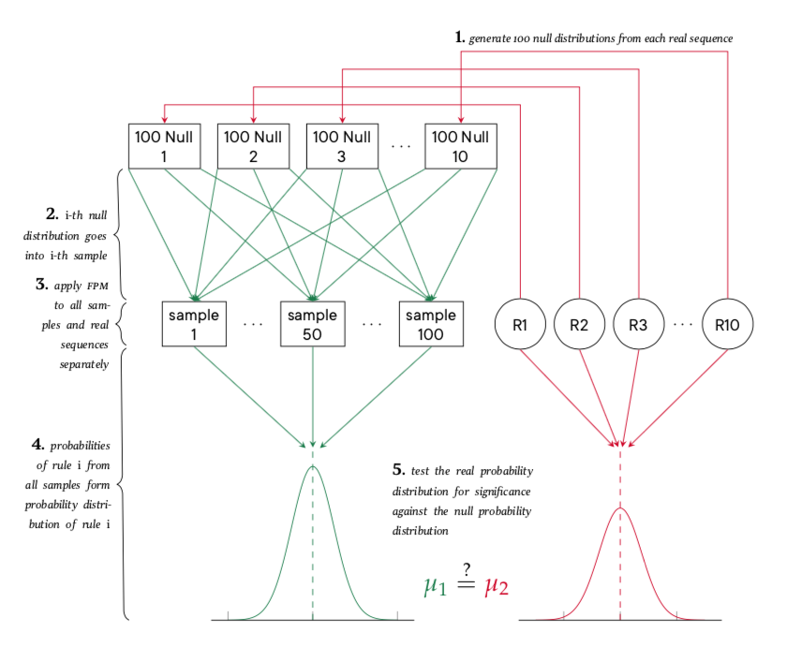
Significance

Slide 8
Method
explain model for null-distributions
What was randomised, what was not? Why?
recall 3 metrics: explain their weighting

Slide 9
Results (if we have them)
numerical vs applied significance
rules confirming existing research
new ”interesting” rules (whatever that means)
possible hypotheses generated from new rules

