Slide 1
SRL Lander Mech Project + Things Learned
Preston Rogers

Slide 2
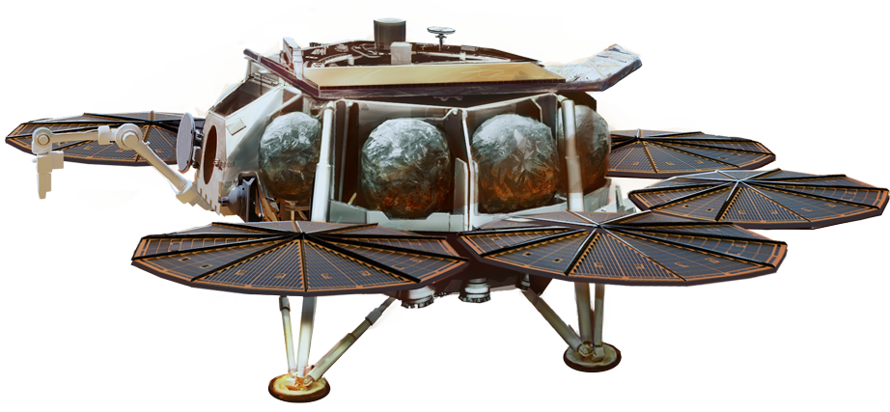
Project Goals
Test out numerous motors that will be on the Sample Retrieval Lander
Ensure sub-systems work properly
Verify sensors function and yield reliable information
Notes:
At a high level, the lander mechanical team or actuator team wanted to test out motors that will be used on the Sample Retrieval Lander.
---
There are a number of sub-systems on the Sample Retrieval Lander that require precise control of motors and require loose coordination between motors within the sub-system (such as deploying multiple legs simultaneously).
We want to make sure we can run each motor in the fashion necessary for the sub-system. This could include running the motor until a hard-stop occurs (or stall) or until a certain position is reached.
---
Lastly, various sub-systems incorporate sensors to inform about the outside world. For instance, temperature sensors are used to determine if motor windings are beyond standard operating conditions. We need to make sure these sensors are accurate before going on the Sample Retrieval Lander

Slide 3
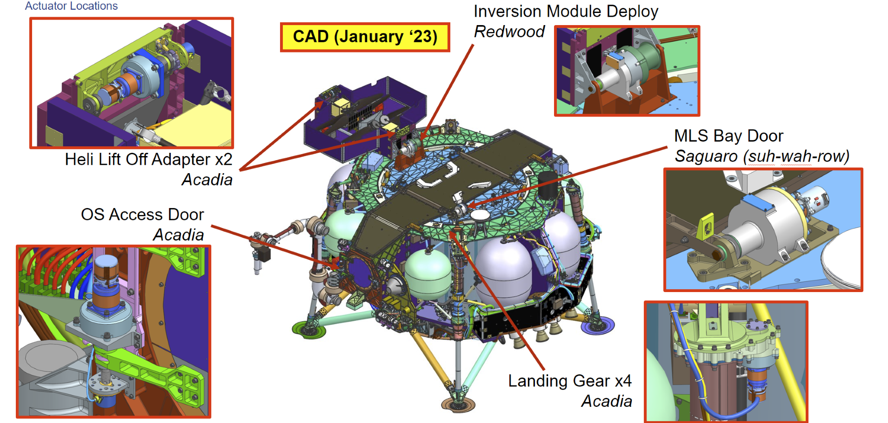
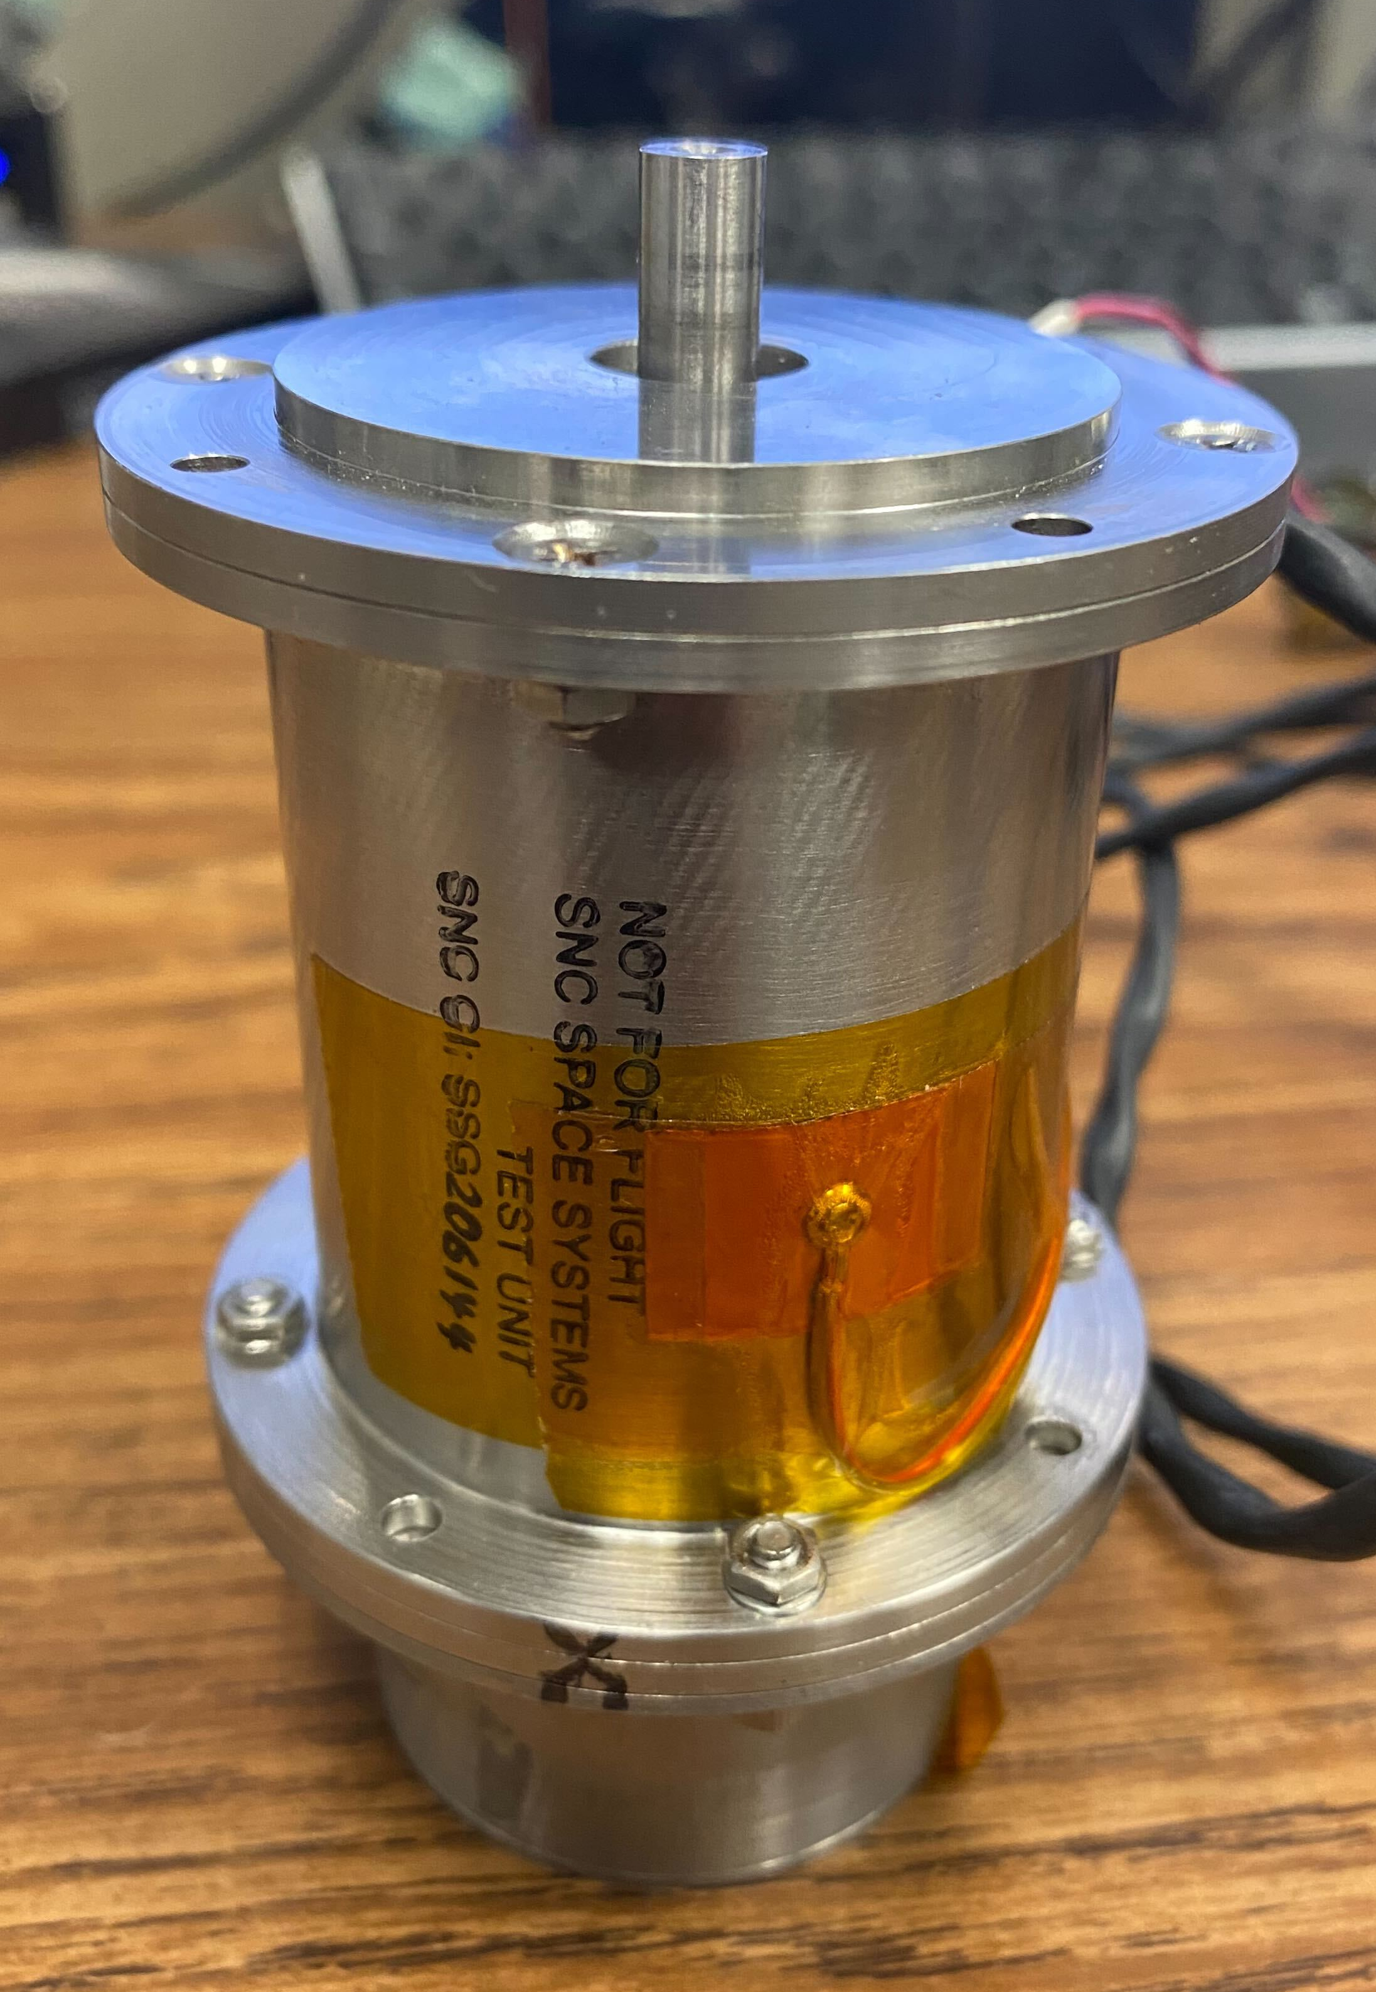
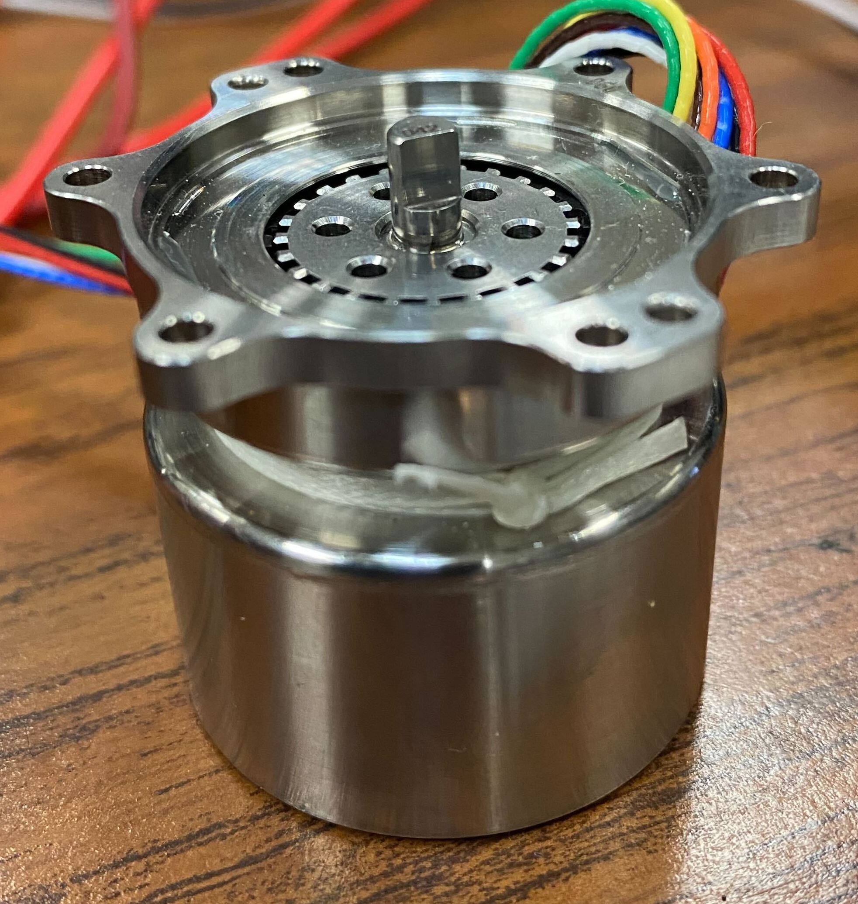
Project Goals Elaborated
Test out numerous motors that will be on the Sample Retrieval Lander
M32 and M45 used throughout the Sample Retrieval Lander
M32 (Acadia)
M45 (Saguaro)
Notes:
As was stated on the previous slide, the actuator team wanted to test out certain motors. Specifically, they wanted to test the M32 (AKA Acadia) and M45 (AKA Saguaro) as these two motors were deployed throughout the Lander for a number of sub-systems including hatches and landing legs.

Slide 4
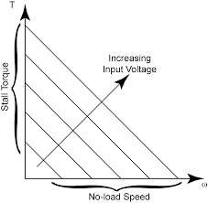
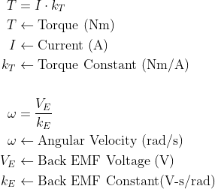
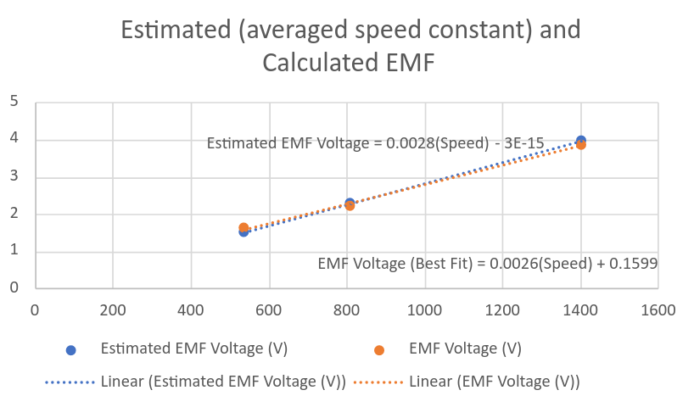
Project Goals Elaborated
Test out numerous motors that will be on the Sample Retrieval Lander
Need to characterize the M32 and M45
Find motor intrinsic constants
Determine startup and steady-state behavior when using set voltages
Speed-Torque Curve
Back EMF Constant Curve Fit
Notes:
These tests include characterizing each motor and testing the chosen control method--open-loop voltage control.
By characterizing, I mean finding the values of certain constants that are intrinsic to each motor. These constants include the torque constant which gives the relationship between current applied to the motor and the output torque and the back EMF constant which, in a similar fashion, gives the relationship between the back EMF voltage and the rotor speed.
To find this, one needs to run the motor at various loads and voltage values.
To obtain these voltage values, the actuator team was given the directive to use open-loop voltage control.

Slide 5
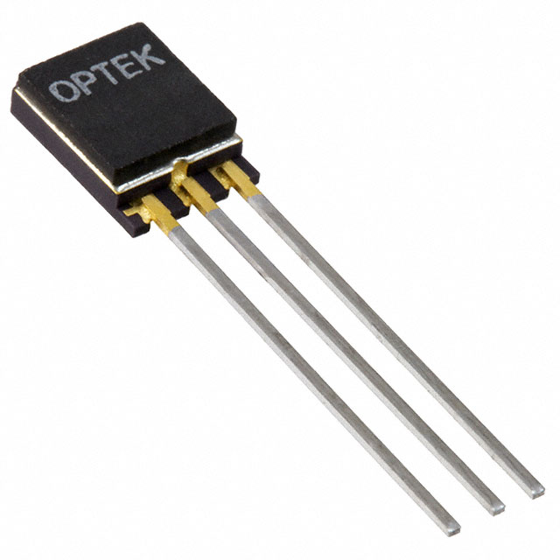
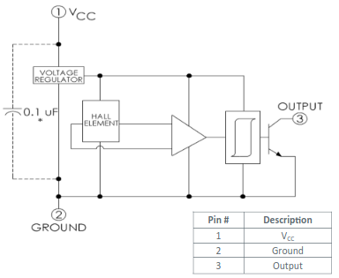
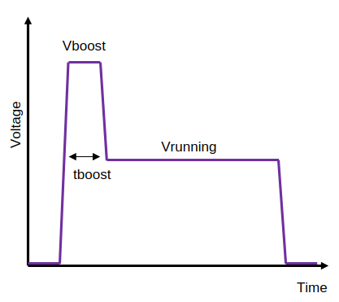
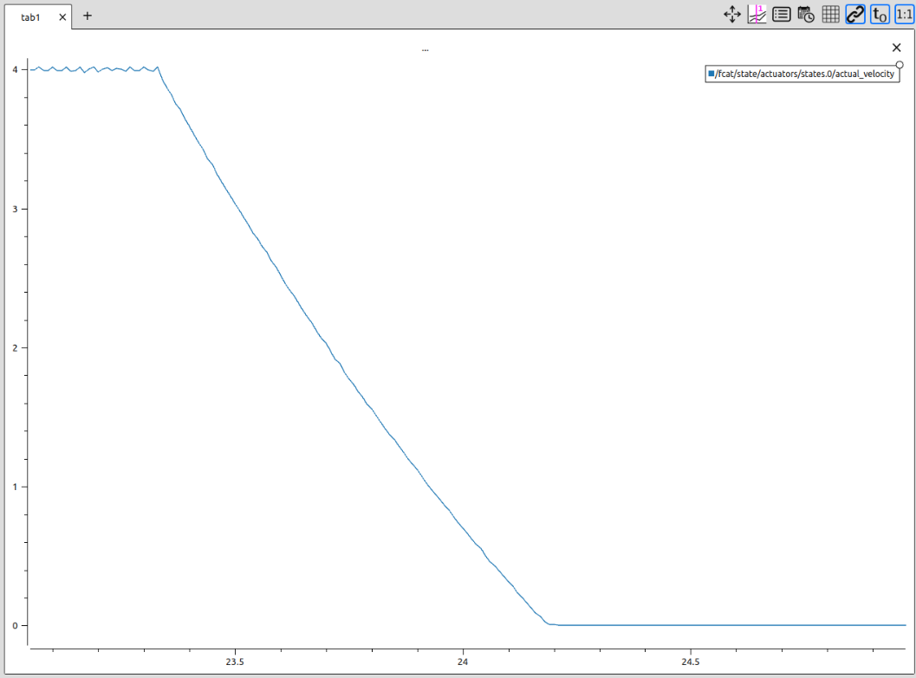
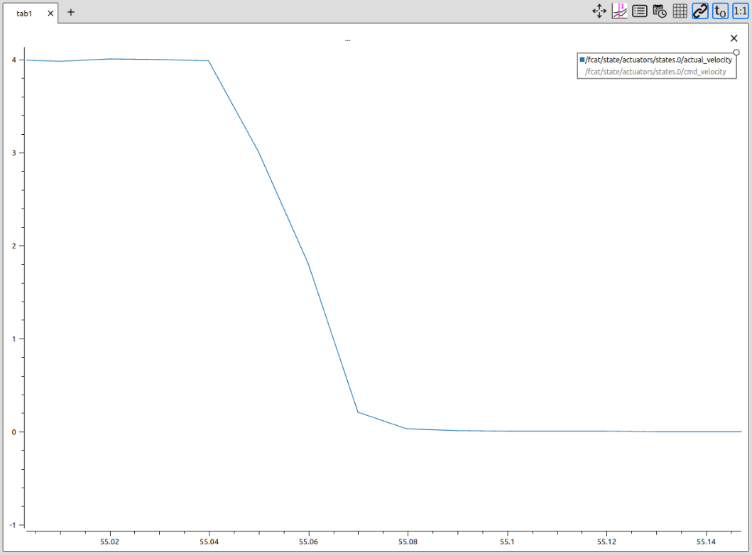
Project Goals Elaborated
Ensure sub-systems work properly
The equipment must have sub-system relevant capabilities
Able to apply desired voltages
Able to use the same stop criteria that will be on flight
Able to apply braking similarly to mimic wear and tear
Without dynamic braking (no physical brake)
Employ different braking methods
With dynamic braking (no physical brake)
Stop criterion satisfied such as triggering a contact switch
Notes:
When I said we need to ensure sub-systems work properly, I meant that while testing these motors, they have to be able to perform and stop in ways similar to what will be done on the Sample Retrieval Lander.
This means running these motors with torques and speeds they will likely experience (if not being tested on the true sub-system), having them stop for certain reasons (reaching a position, hard-stop, contact switch), stopping in a desired way (using dynamic braking or physical brake), etc.

Slide 6
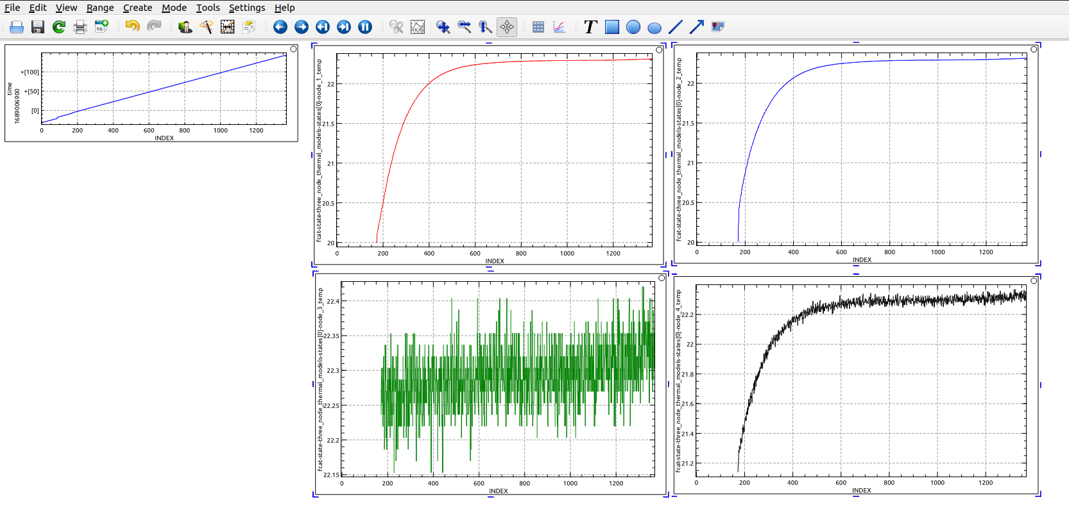
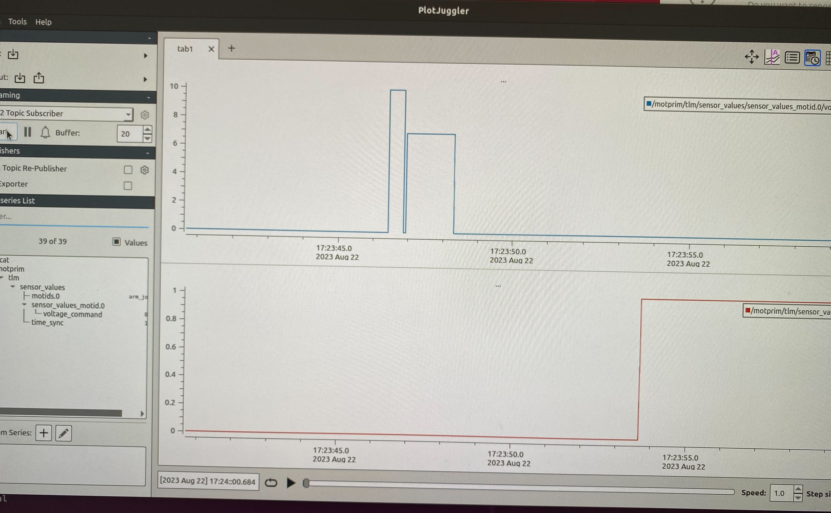
Project Goals Elaborated
Verify sensors function and yield reliable information
Telemetry galore!
Should know voltage/ current applied
Current velocity
Temperature external to the motor as well as internal
Value of the sync output (used to ensure timing is sync'd between telemetry devices)
Internal and External Temperature Telemetry
Voltage Command and Time Sync Telemetry
Notes:
We also need to make sure that we can understand the true state of the system as we are running the motors. This means knowing what voltage is being applied, how much current, the external temperature; things like that.
Some of these are taken care of by FCAT itself while others requiring modifications on higher and lower level software.

Slide 7
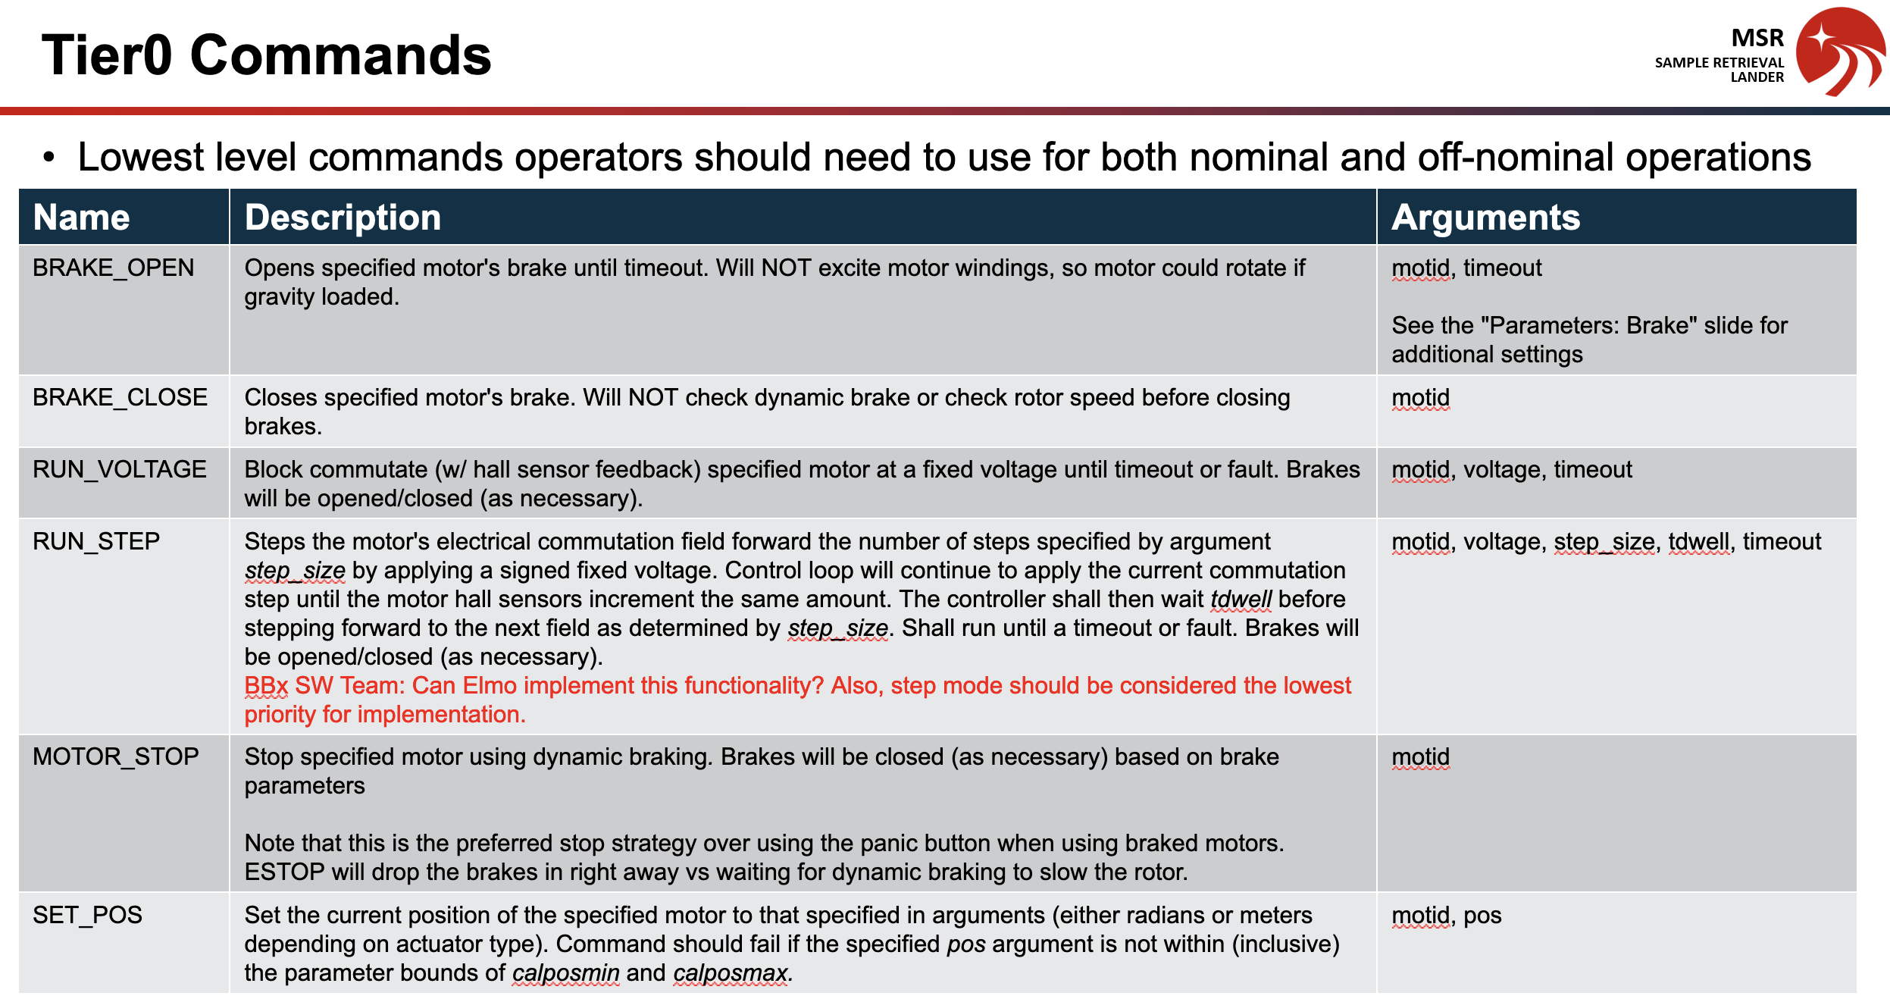
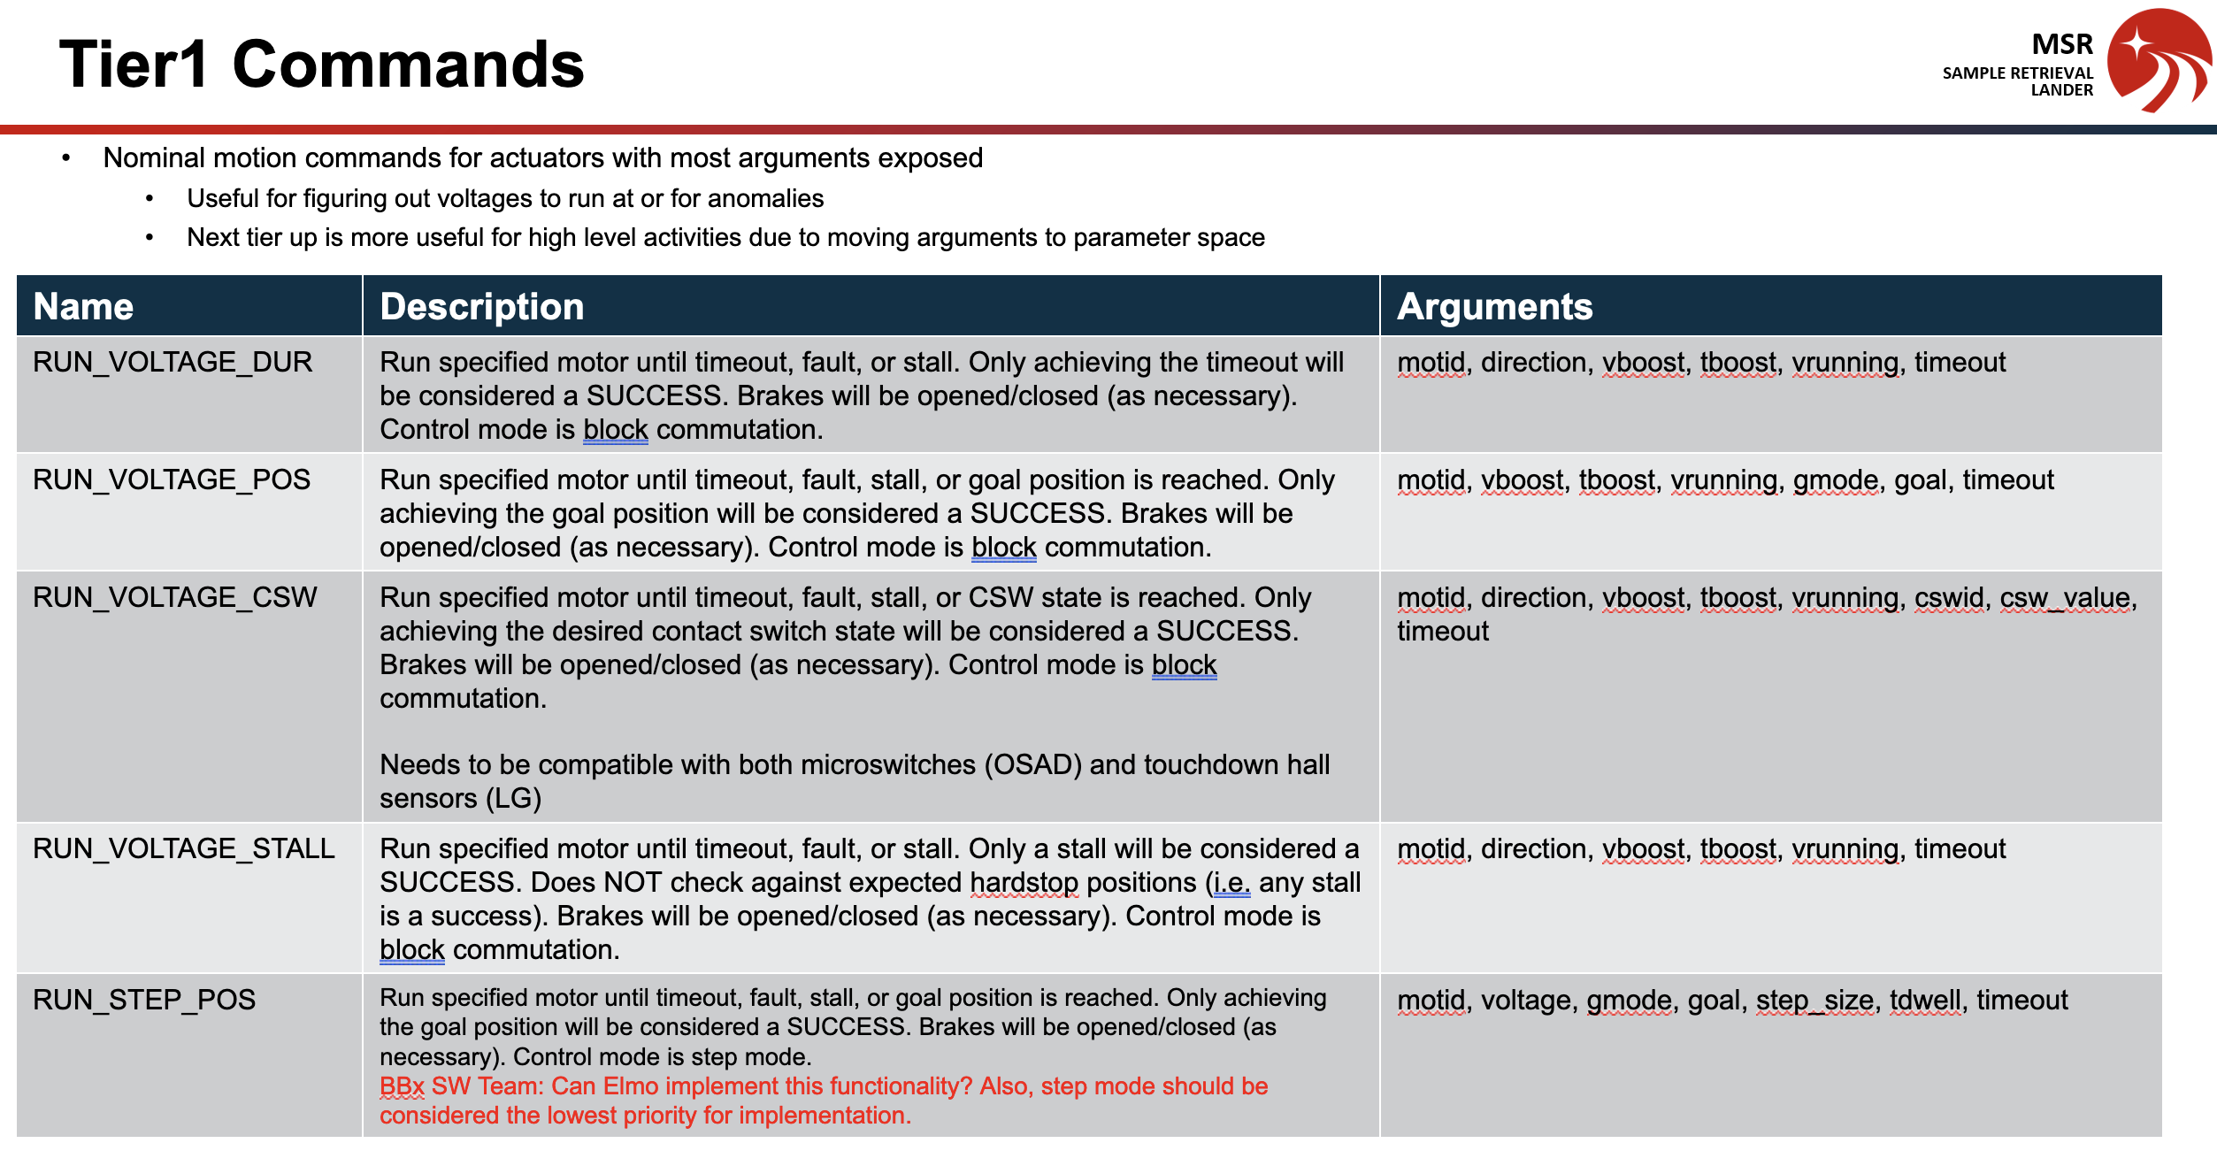
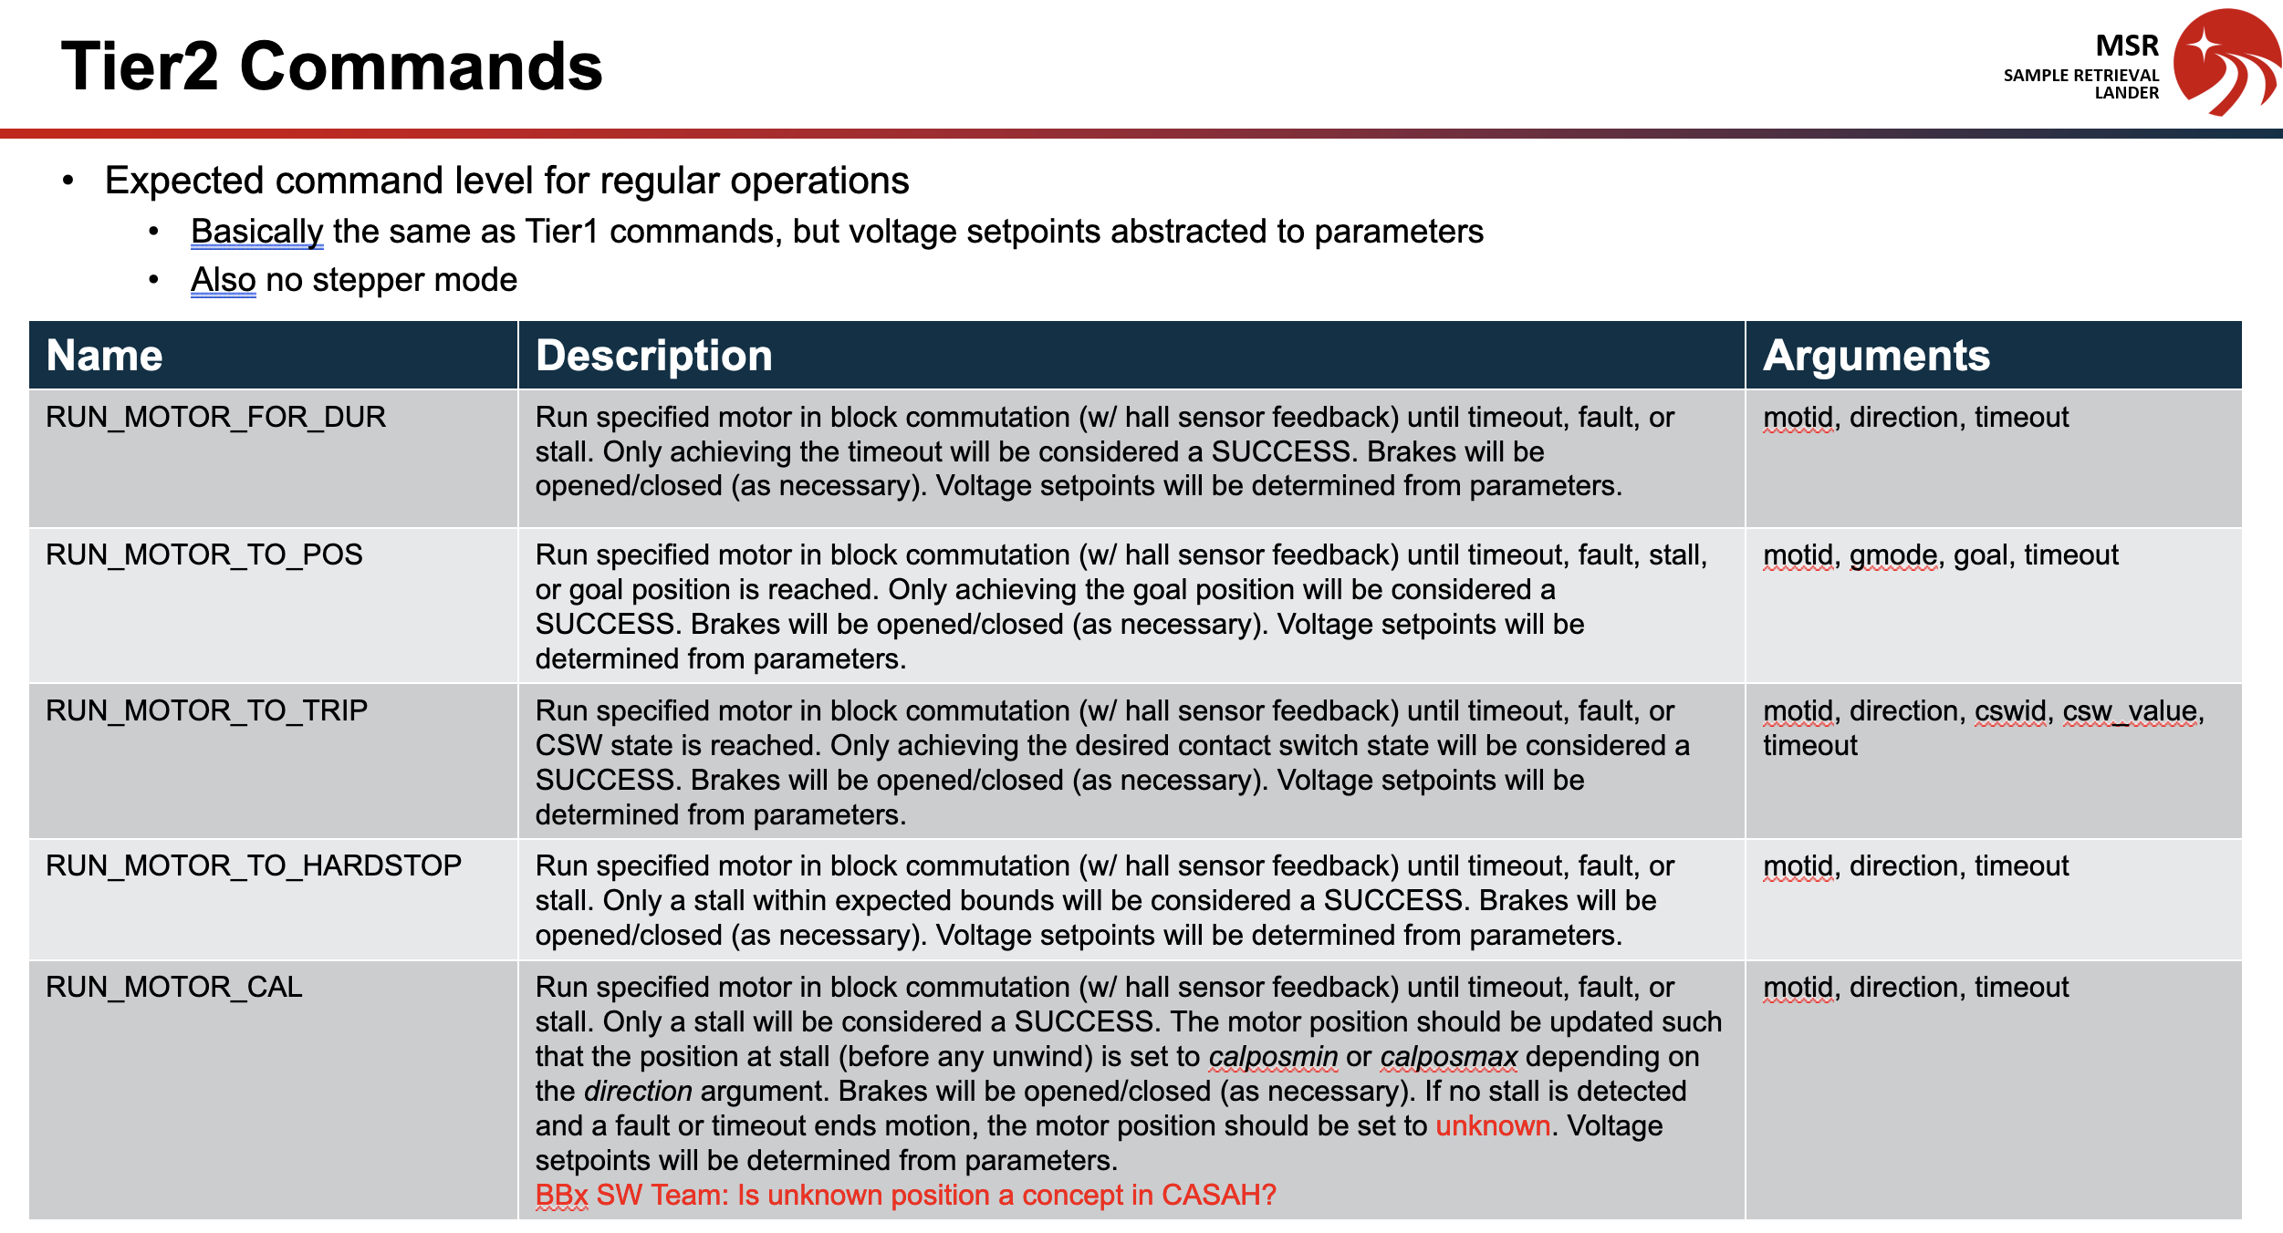
Project Requirements
Outlined command requirements
Worked based off a tier system
Lowest level requirements were closely tied to functionality of drive
Higher level requirements akin to sub-system specific requirements
Notes:
So we had a lot of functionality we wanted to get out of ground equipment – the equipment that would test out the motors.
To clear things up, a list of desired commands were given that more or less covered much of the goals.
The lowest level, tier0 commands, involved things like dynamic braking and open-loop voltage control that were closely tied to what the actual ELMO can achieve, functionality wise.
At the higher levels, tier0 and tier1, we have commands that are tied to sub-system needs, like stopping after a contact switch is triggered.

Slide 8

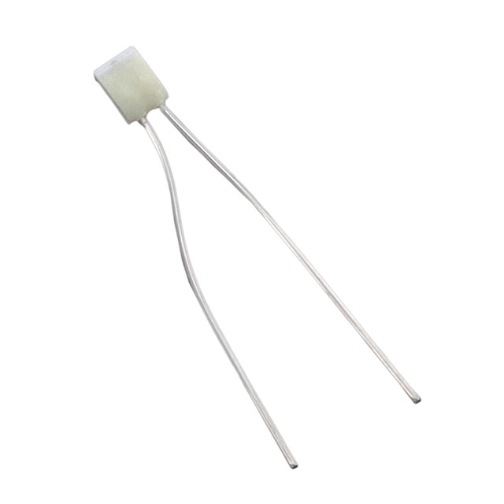
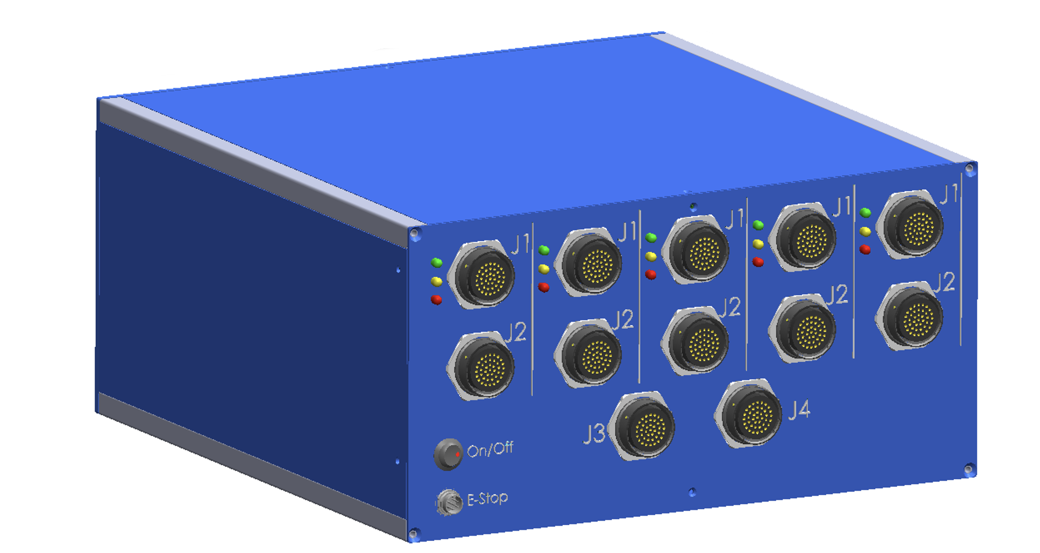
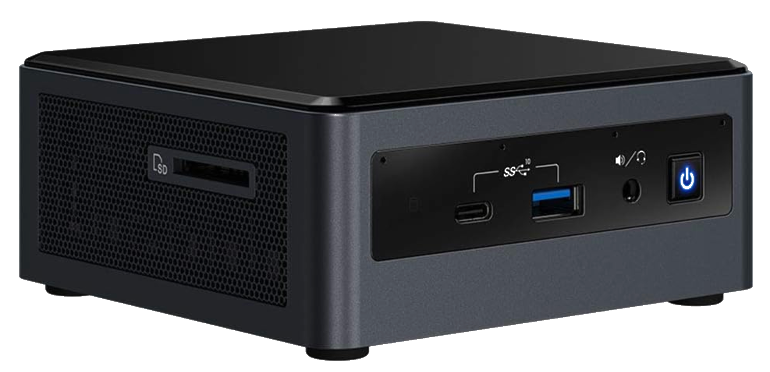
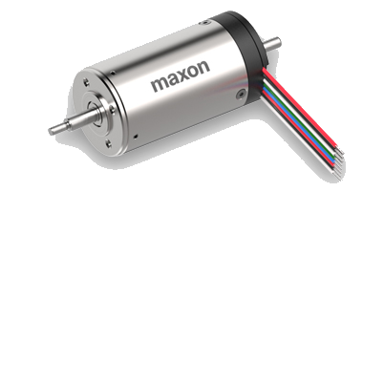
Computer/ Hardware Environment
Full Environment
Intel NUC 10 running Ubuntu 22.04
Flight BlueBox
Various motors (M32, M45, test motors)
Various sensors (PRT, Hall sensors (used for contact switches))
Platinum Resistance Thermometer (PRT)
Hall Sensor (for CSW)
Sensor feedback about world
Telemetry via Beckhoff modules and Elmos
Position feedback (via encoders or Halls)
Current commands given to Elmos and commands to Beckhoff modules
Phase voltage inputs
Notes:
At a high level, these are the primary components that would be used to command the motors.
We have the Intel NUC that would communicate to the flight bluebox over ethercat.
We have the motor that would be sent voltage inputs by the blue box.
And we have sensors that would provide information about the environment and would be eventually sent back to the NUC for telemetry.

Slide 9
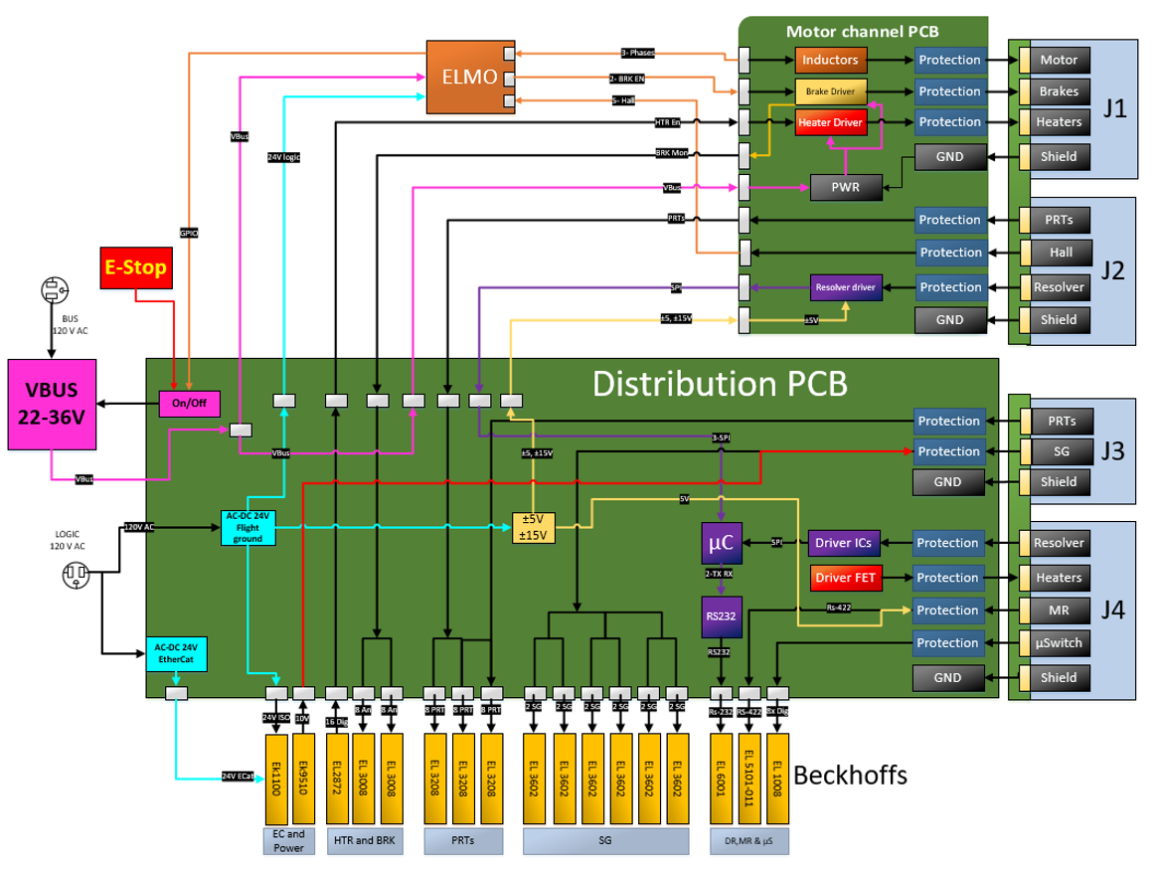
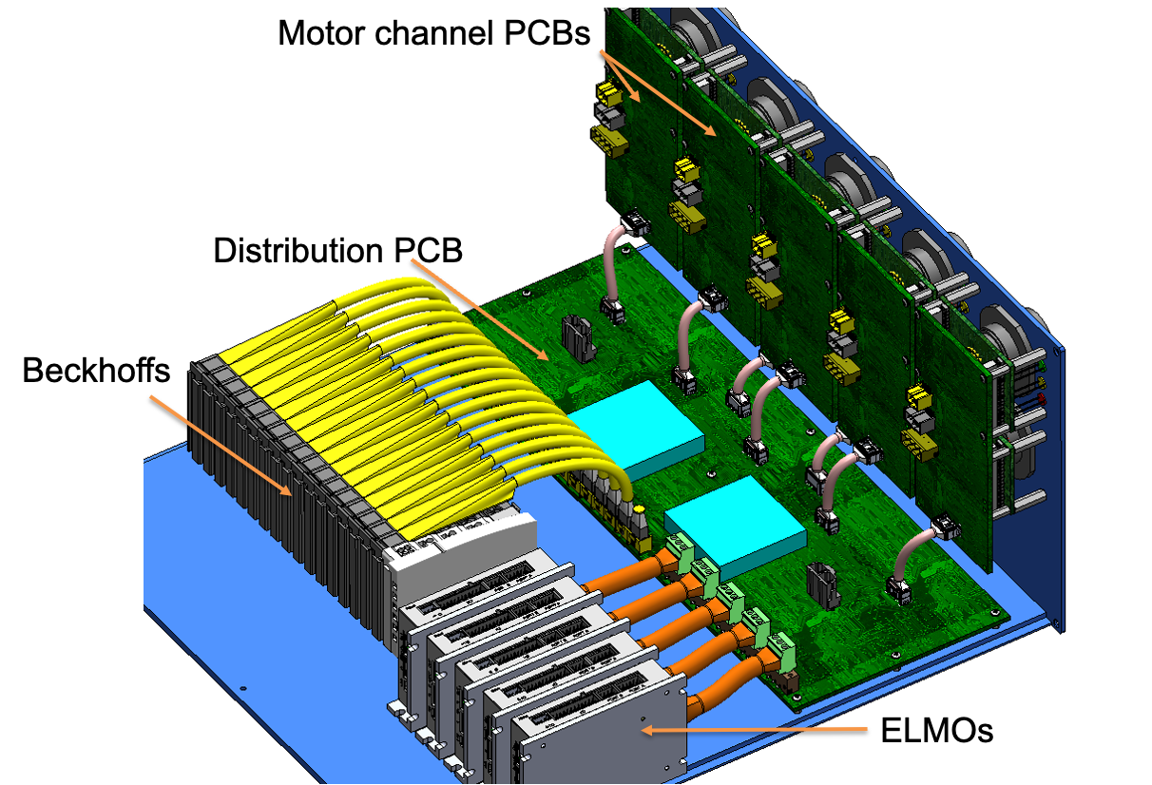
Computer/ Hardware Environment
Flight BlueBox Internals
Pre-existing beckhoff modules
Set internal circuitry (Motor Channel PCBs, Distribution PCBs, etc.)
Notes:
It is important to know the inner working of the Flight BlueBox for the possibility of needing to make internal modifications--as we did.
The Flight BlueBox is composed of up to five Elmos that send inputs to the motors and a number Beckhoff modules.
The signals from these Elmos and Beckhoff modules are sent over to the distribution board and distributed to channel-specific signals.
It is also worth noting that not all Flight BlueBox's were created equal with some functionality added/ removed based on the customer's needs.

Slide 10
Software Architecture
Existing Software
Existing Software would be used to minimize overhead
Additional software module(s) still required to get Flight BBox-specific functionality
Commander
Dispatcher
???
FCAT
Fastcat
JSD
Notes:
After being given the hardware, it was up to us to decide how to interface with it.
Primarily, we wanted to make sure that it worked with FCAT-Fastcat-JSD and that the new software we made would take satisfy requirements these alone did not satisfy.

Slide 11
Software Architecture
Initial Implementation
Most functionality was achieved by writing software for only one node
Took advantage of existing casah tools
Made modifications to existing software tools as need be (more on this later)
Commander
Communication made through services
Publishes some custom telemetry info.
Motor Primitive Node (custom high-level SW)
TLM (captures info. from pub/sub topics)
Performs service calls and publishes/subscribes
FCAT
Publishes actuator state and Beckhoff module states
Notes:
After figuring out a way to perform open-loop voltage control (as well as other work that involved playing around in EAS to learn about different ELMO objects), we (Bryson and I) were ready to create an initial rough draft of how this software would look like.
We thought of a number of ways of satisfying the requirements. We thought of a very high-level tier1/tier2 software that would make calls to a lower level tier0 software. We also thought of implementing our own console to minimize the functionality available to operators (such as FCAT services functionality).
We chose to not re-invent the wheel by a lot of existing CASAH tools; instead opting to use existing software like the commander. This is able to glean which services are available after starting dispatcher.

Slide 12
Software Architecture
Motor Primitive Node Files
motprim_msg repo
motor_primitive_node repo
msg directory (defines pub/sub interfaces)
main.cpp (runs the node)
msg directory (defines pub/sub interfaces)
motor_primitive.hpp
motor_primitive_tier0.cpp (defines tier0 methods like tier0_brake_open and tier0_run_voltage)
motor_primitive_tier1.cpp (defines tier0 methods like tier1_run_voltage_pos)
motor_primitive.cpp (defines the node and tier-agnostic methods)

Slide 13
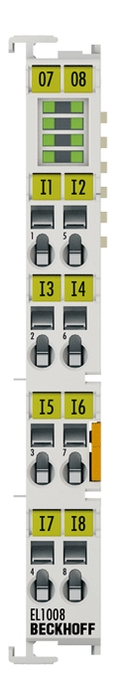
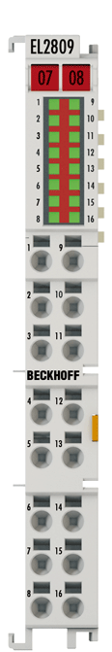
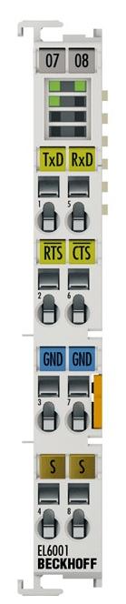
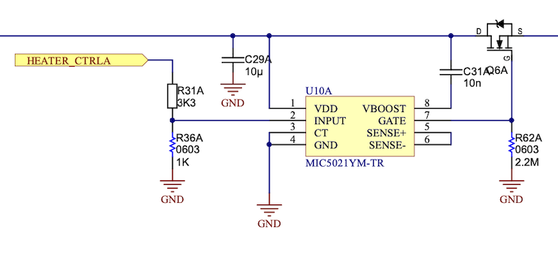
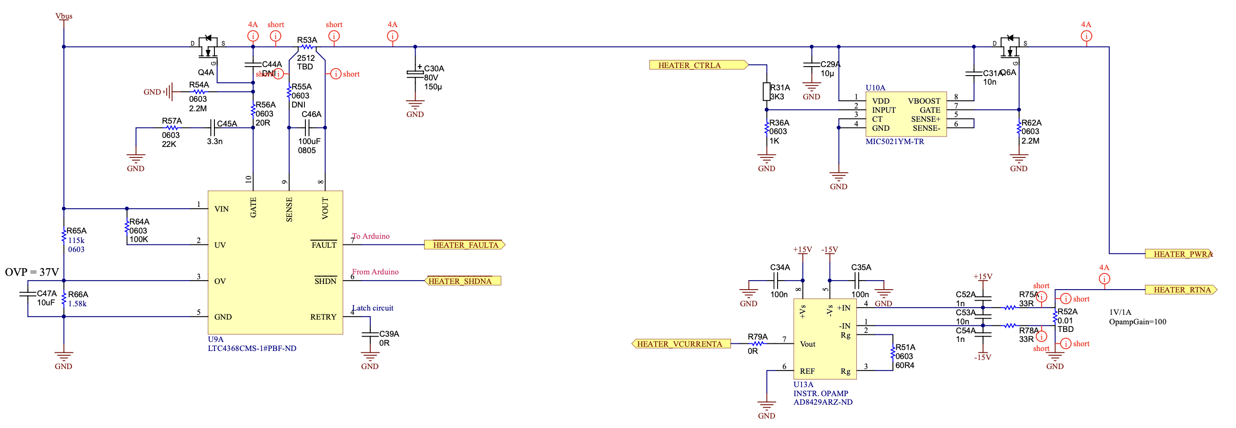
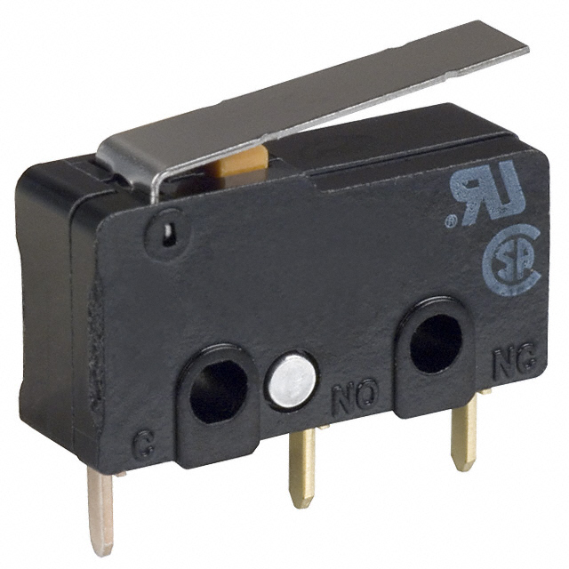
New Beckhoff Modules
Necessary modules listed
El1008
Used to test out hardware CSW functionality
El2809 (yet to be merged in)
Used for to set a MOSFET gate to connect heaters to power
El6001 (thanks David Kim!)
Potentially will be used to establish serial communication with safety circuitry
The initial CSW type used for testing (purely mechanical resulting in clear HIGH/LOW values
Picture of the heater circuitry showing where the EL2809 connects to (HEATER_CTRLA)
Notes:
As we were designing the additional node to get the Flight BlueBox – specific functionality, we soon realized that drivers did not exist for certain Beckhoff modules.
These Beckhoff modules were already in the box and replacements could not be easily found.
Drivers for the following devices were made:
El1008 – 8-channel digital input (used for contact switches to declare when a motor should cease motion)
El2809 – 16-channel digital output (used to notify the heater circuitry that power should be applied to the heaters)
El6001 – To enable communication to RS232 devices (used to get info. About safety but yet to be used)

Slide 14
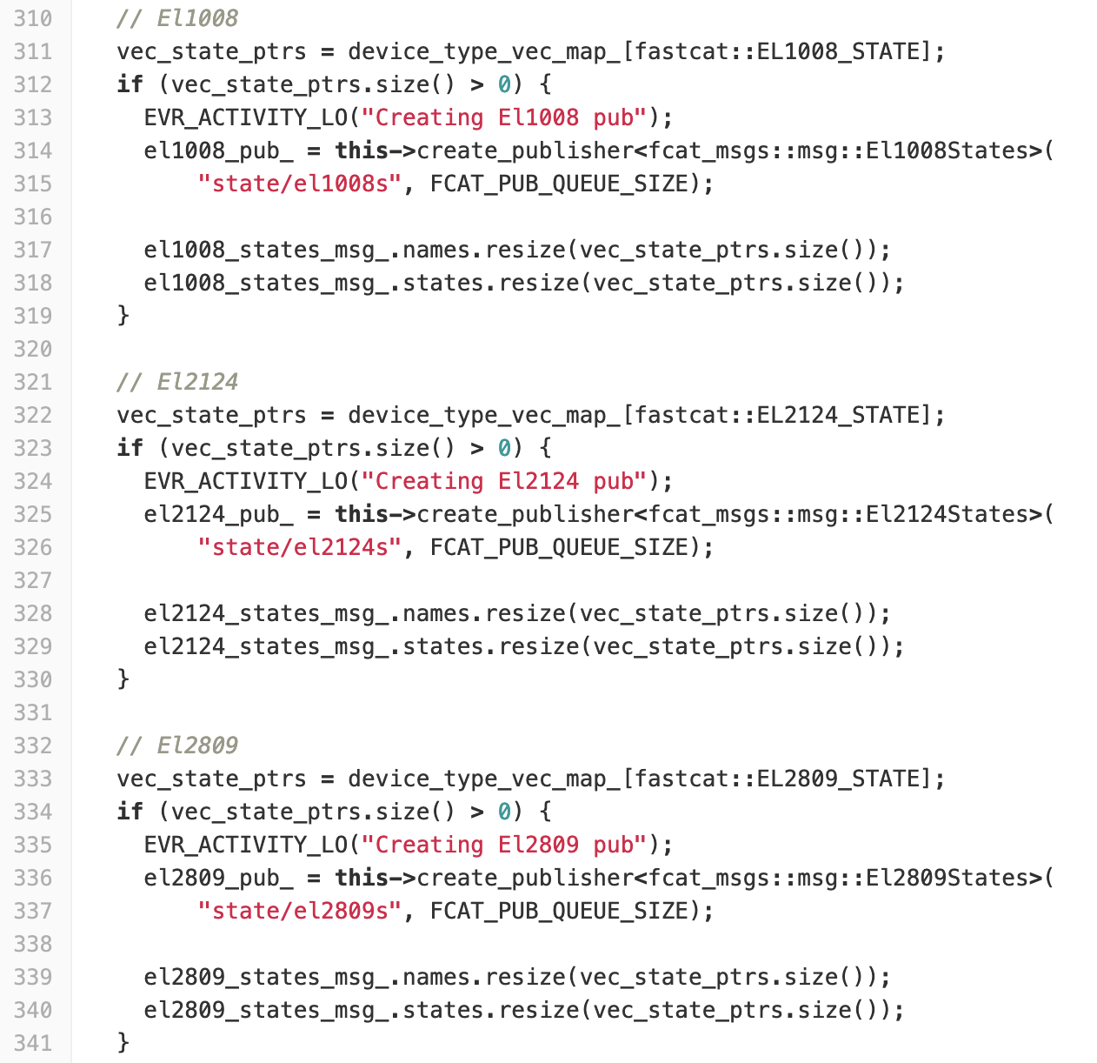
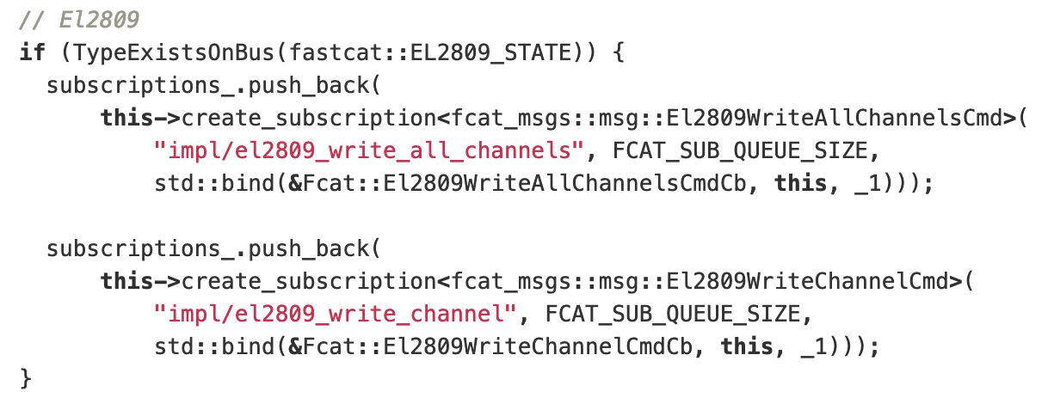
New Software for Beckhoff Modules
Software implementation details
El1008 and El2809 required updates to JSD, Fastcat, and FCAT
El1008 and El2809 both needed to publish state of module for telemetry
El2809 needed a service to get user's desired digital output polarity
El6001 required updates to JSD and Fastcat
Changes to these modules allows for transmitting/receiving messages
Consult David Kim for more information if interested
El2809 Subscriber creation for getting user's desired digital output polarity (fcat.cpp)
El2809 and El1009 Publisher creation for displaying module states (fcat.cpp)
Notes:
For one, the safety circuitry tries to constantly monitor the ELMO "heartbeat" (which was really just an output pin being toggled at a fixed frequency). Because of this heartbeat monitoring, we could not use the Flight BBox in the base configuration because the safety circuitry would lock us out of the box when these heartbeats failed to occur.

Slide 15
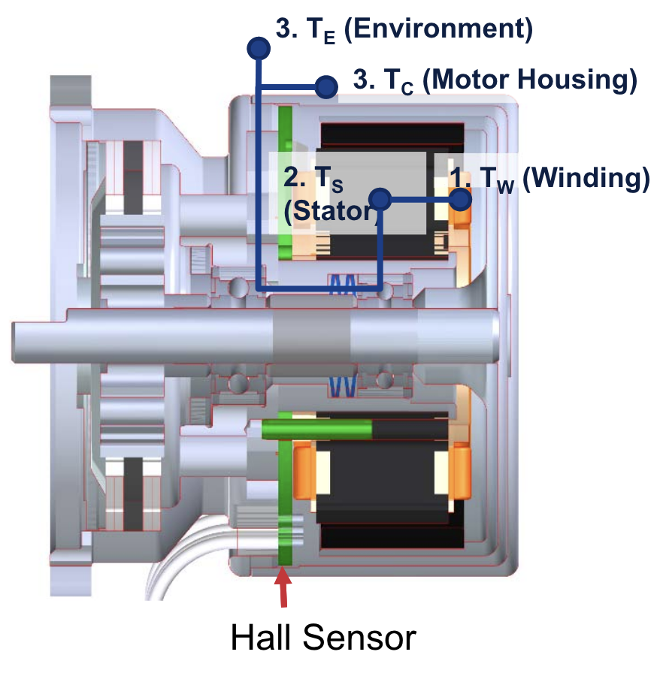
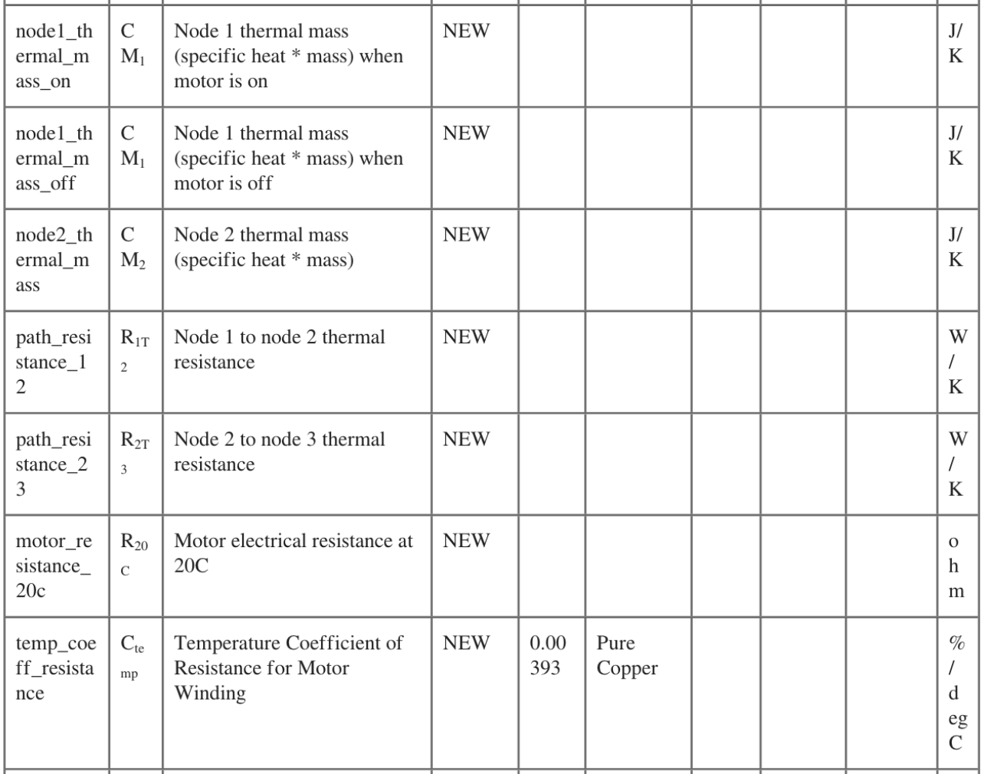
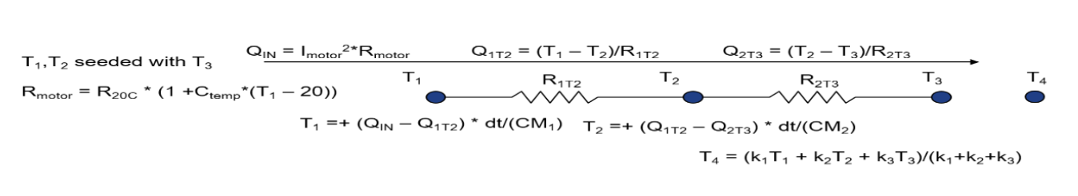
Three Node Thermal Model Fastcat Device
Mathematical Model
Requirement to model internal motor temperature
Mathematical model was given
Took in data about exterior temperature and total current
Spat out the temperature of internal components and environment
Illustration outlining the different components of motor being tracked
Notes:
We were given the requirement of modeling the internal winding temperatures of the brushless motor given only the temperature of the exterior via PRT.
The temperature of the PRT would come in as T_3 and the temperature of the other nodes, T_1, T_2, and T_4 would be found in the way described in the model, iteratively.

Slide 16
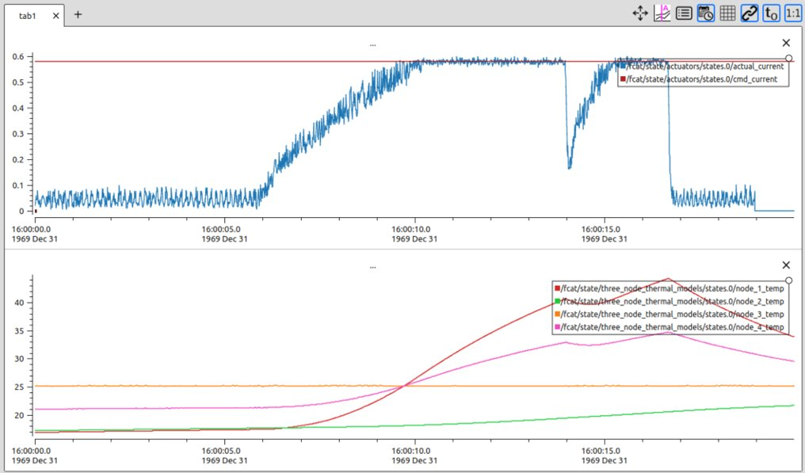
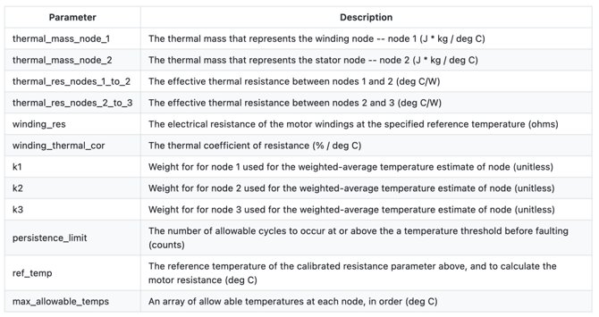
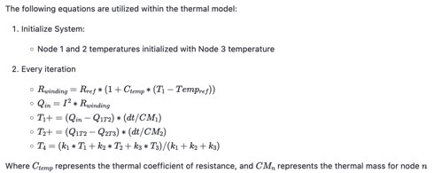
Three Node Thermal Model
Software Implementation
Required changes to Fastcat and FCAT
Choice between having a fixed starting temperature or initializing from node 3 (motor housing)
Faults all other devices if temperature exceeds given limits (max_allowable_temps)
Publishes temperature information for telemetry
Consult Bryson Jones for more information if interested
Notes:
The initial idea was to use a number of existing fastcat devices to accomplish this; stringing together summation devices, multiplication devices, etc. Instead, we chose to create a new fastcat device with the idea that the modeling motor winding temperature is a common one and others in the world out there would find this useful.
When any of the temperatures are exceeded in the max_allowable_temps array (specified in the fastcat yaml), all fastcat devices are faulted. This ensures the motor will cease movement.

Slide 17
Things Learned
There are a lot of pre-existing repos/nodes that can help you solve your problem more efficiently
FCAT, Fastcat, JSD, TLM, Dispatcher, the list goes on...
If something your considering creating sounds important, check with others to see if it exists already
Adding drivers/ devices often requires changes to multiple repos
Approval is needed for each repo
Seek approval for lower levels first (e.g. JSD before Fastcat)
Often, problems will arise that are not rooted in software
For instance, the brakes may be controlled by a circuit and not a Beckhoff module/ ELMO pin
The behavior of the testbed may not align with documentation (e.g. pin-outs incorrect)
There are JPL-specific things you should consider
Is the project information ITAR? (changes where the code can live)
Is the product going to be used outside of JPL? (they may not have VPN access)
Try to ask questions/ bounce ideas off senior team members
These members are more knowledgeable about existing software/ tools that will help
Sometimes what your client wants is not what they need and senior members are more aware of where this line is

Slide 18

Thanks guys

