Slide 1

Sales Forecasting
Ufuk Secilmis , Pavel Popov, Preston Powell

Slide 2

Overview
For this project, we built an algorithm using past sales data that can forecast the sales of any product for next day. Our data is derived from two main tables:

Slide 3
The Data
productDailyActions.csv:
It contains following information for the dates between '2018-11-01' and '2019-01-12’:
productid: unique id for each product
date: date of product action
soldquantity: sales of product
stock: beginning stock count of product
clickcount: the number of clicks of product
favoredcount: the number of favored click of product
AND
productAttributes.csv:
This file contains product-related information belonging to each product id. The file contains following information:
productid
gender
color
categoryid
brandid
subcategoryid

Slide 4
The Data
There are 19,359 unique products in our dataset, and each product has its own attributes
Of these attributes, there are:
101 unique product categories
103 unique product subcategories
868 unique brands
2,243 unique colors
We have 858,935 sales records taken over a 72-day time period.

Slide 5


Cleaning the Data
TO PREPARE OUR DATA, WE ANALYZED EACH PRODUCT AND SALE ATTRIBUTE TO DETERMINE IF IT WILL BENEFIT OUR PREDICTION MODEL.
AFTER REMOVING UNNECESSARY PRODUCT ATTRIBUTES, WE THEN HAD TO DECIDE HOW WE WERE GOING TO HANDLE OUTLIERS AND MISSING VALUES AMONG THE SALES DATA.

Slide 6
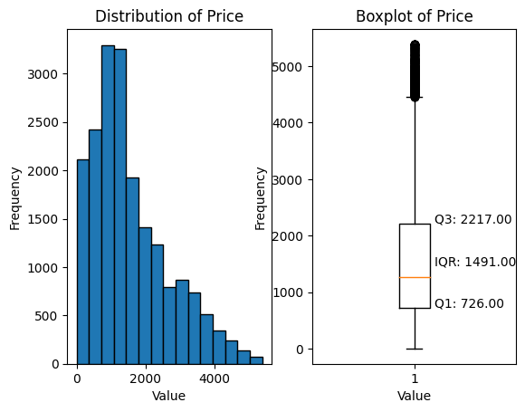
Outlier Analysis
We evaluated outliers in soldquantity as to remove rarely sold items from the dataset, and in price, as to remove extremely expensive items.
To the right is the distribution of prices among each unique item.

Slide 7
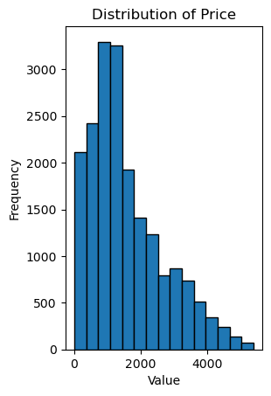
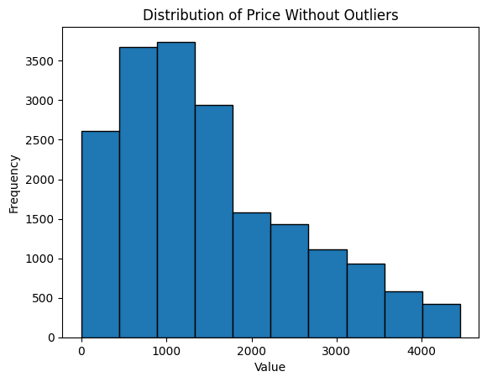
Outlier Analysis
Using the IQR, we identified a $4453.50 outlier threshold and found and removed 334 entries from the data whose price exceeded it.
To the right is our price distribution before and after removing the outliers.

Slide 8
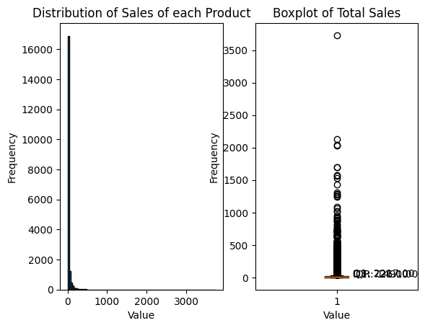
Outlier Analysis
Next, we evaluated the soldquantity of each unique item.
To the right is the distribution of sold item counts for each.
As shown, we have an extreme right-skew in the distribution, causing a very small IQR outlier of 37 sales. To remedy this, we removed 915 values that were never sold in any given time period.
After removing all outliers, we were left with 18444 unique products.
Interquartile Range is: 14.0

Slide 9
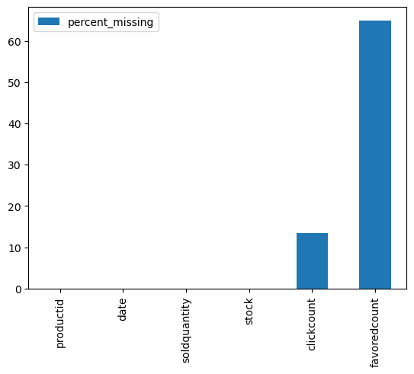
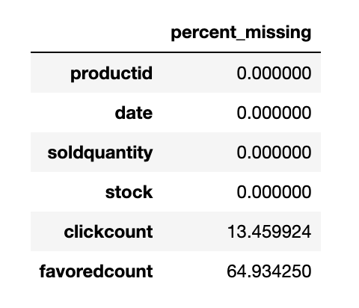
Missing Values
About 65% of data points for favorited item counts had NaN values, as well as over 13% of clicked item counts.
For entries with missing values for regular or favored clicks, we assumed it was safe to set those missing values to zero. Additionally, we assumed that the click count could be set equal to the quantity of the item that was sold (one purchase corresponds to one click).

Slide 10
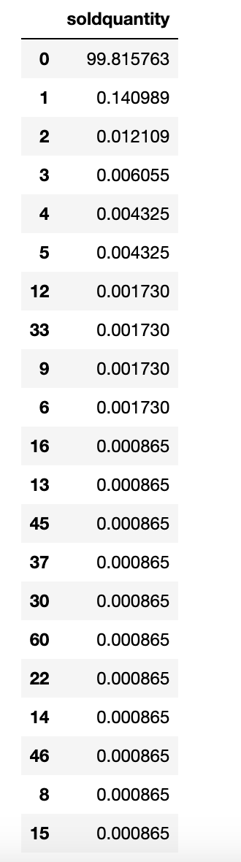
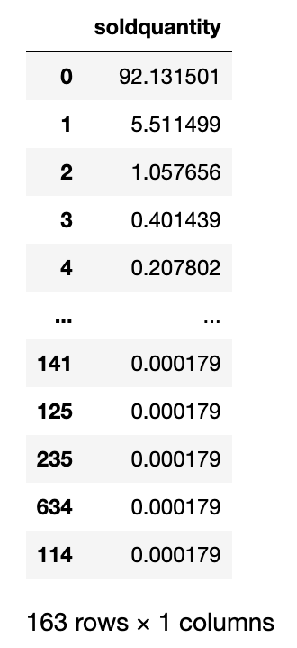
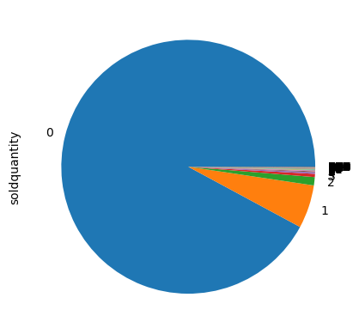
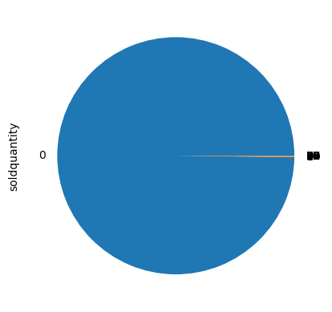
Missing Values
After comparing favored count to sold quantity, we found that about 92% of soldquantity values were 0 when favoredcount value was missing
Additionally, approximately 99.8% of soldquantity values were 0 when the clickcount value was missing.

Slide 11
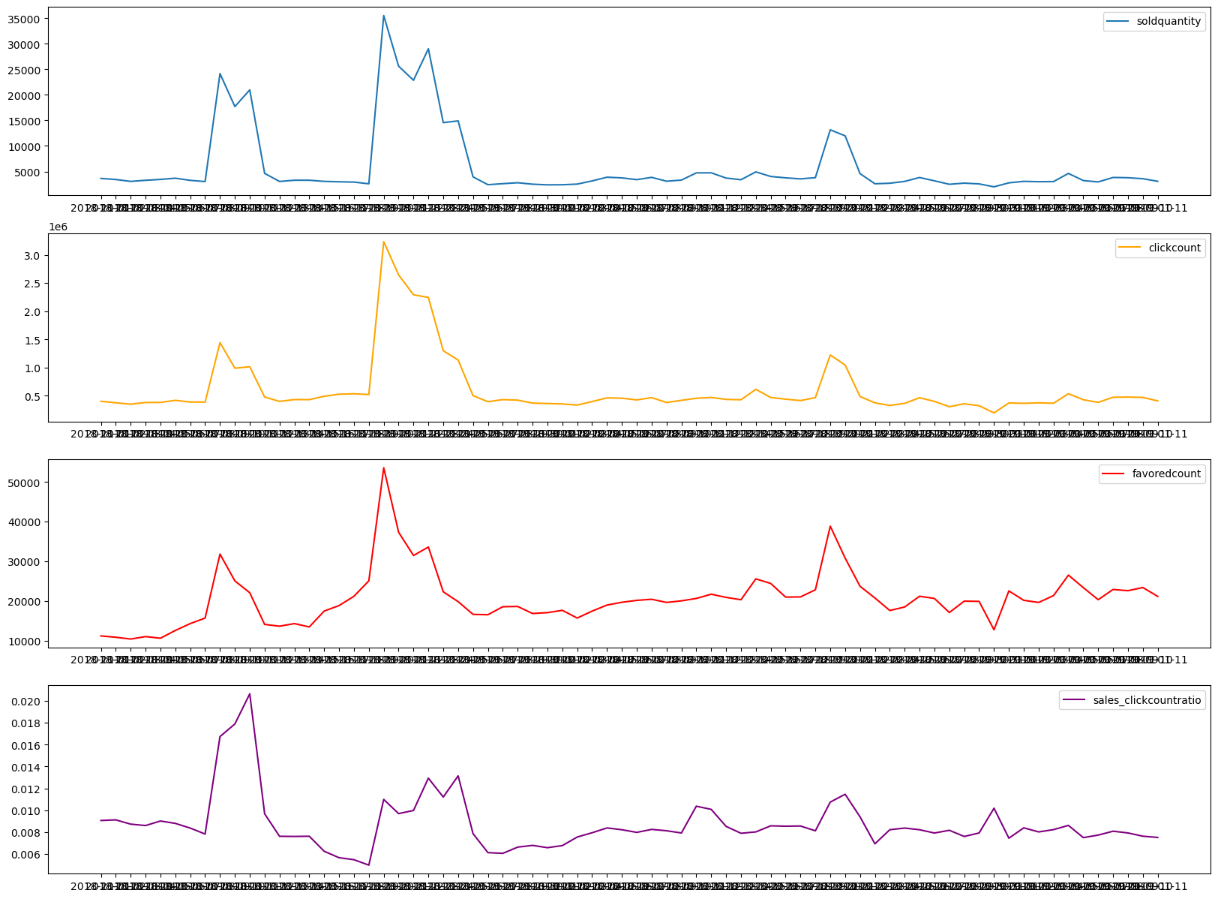
Dealing with Variation
While observing the data in totality, we realized the dates from which our data was observed falls over the majority of the holiday season.
When plotted against time, we noticed sharp increases in all of our major sales attributes at dates that lined up with Thanksgiving, Black Friday, and Christmas.
Figures show that soldqunatity, favoredcount, and clickcount reach their max on 20th November (Black Friday promotions)

Slide 12

Feature Engineering – Continuous Features
Stock - beginning stock count of product
Click Count - the number of clicks of product
Favored count - the number of favored click of product
Price
Revenue = the number items sold * price

Slide 13
Feature Engineering – Categorical Features
As there are sharp increases in some time periods, promotion_flag feature is created. For days below, promotion_flag =1, other days = 0
2018-11-09, 2018-11-10, 2018-11-11, 2018-11-20, 2018-11-21, 2018-11-22, 2018-11-23, 2018-11-24 2018-11-25, 2018-12-20, and 2018-12-21
Month and the day of sales are used as a features.
Gender – Label Encoded (Gender_2, Gender_3)
Category id – Label Encoded
There are 2,243 different colors in the dataset. When we use LabelEncoder, it creates 2,242 columns in the dataset. It does not fir the memory so color is not used in the model.

Slide 14
Features
Feature | Type
Stock | Continuous
Click Count | Continuous
Favored count | Continuous
Price | Continuous
Revenue | Continuous
Promotion flag | Categorical
Month | Categorical
Day | Categorical
Gender | Categorical
Category id | Categorical

Slide 15
Train and Test Splits
Split | Date | (The number of observation, # features)
Train | 11/01/2018 – 12/27/2018 | (647 K, 114)
Test | 12/28/2018 – 01/11/2019 | (165 K, 114)
We split the data into train and test based on the date.
We used the first 58 days in train set and the last 14 days in the test data.

Slide 16
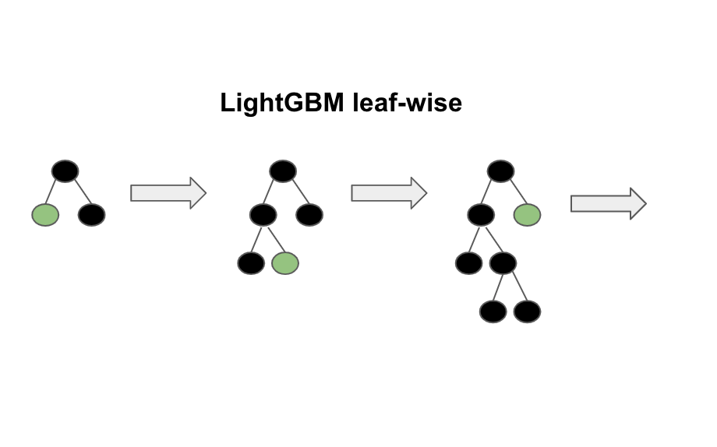
Model – LightGBM
Why LightGBM?
Higher accuracy and a faster training speed.
Low memory utilization
Comparatively better accuracy than other boosting algorithms and handles overfitting much better while working with smaller datasets.

Slide 17
Model – Details
Model
Metric | Root Mean Square Error
Learning Rate | 0.02
The number of boost | 6500

Slide 18
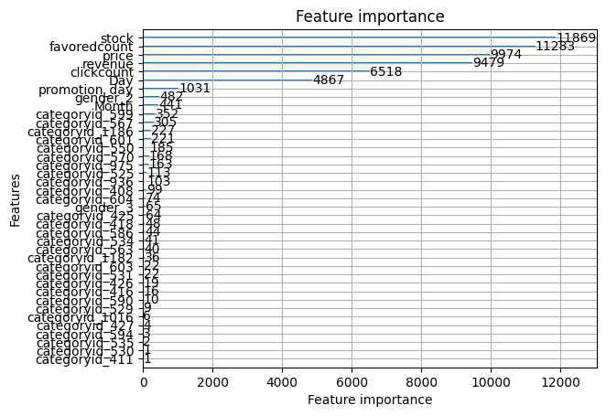
Feature Importance

Slide 19
Model - Performance
Split | RMSE
Training RMSE | 0.48
Test RMSE | 0.51

Slide 20
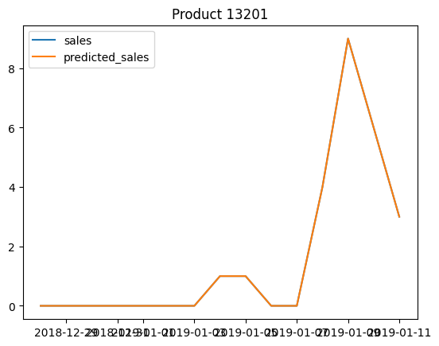
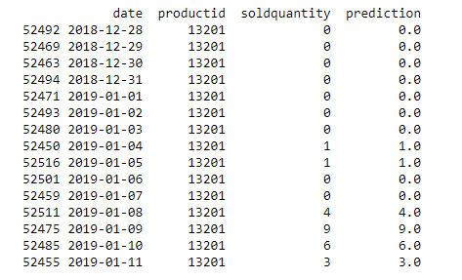
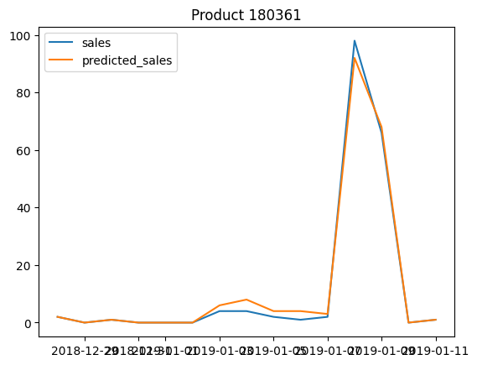
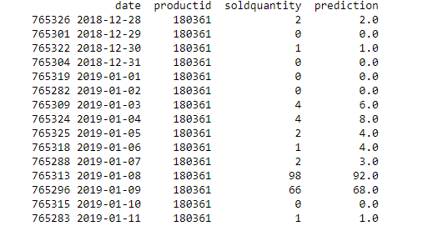
Predict the Sales of Some Products

Slide 21
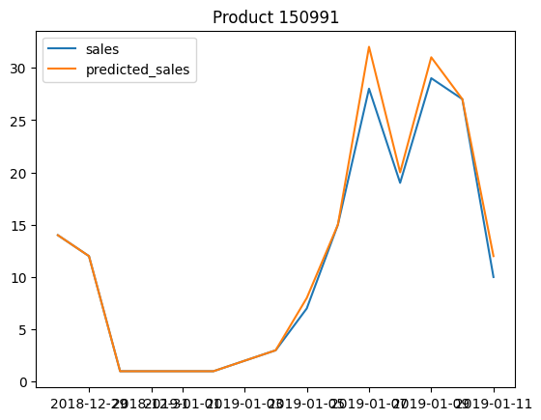
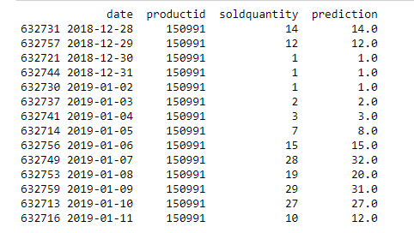
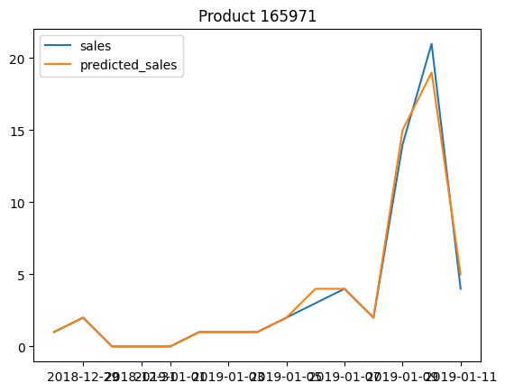
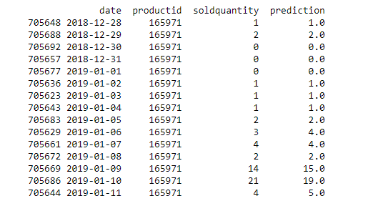
Predict Sales of Some Products

Slide 22
Discussion
1) Lag Features (Varying Time Window) can be used. They may be important features.
2) K –fold cross-validation will be used
3) One more model like XGBoostRegressor will be developed and compared to LightGBM performance.

Slide 23

Thanks for Listening

Slide 24
Models that did not make it: LSTM
Why LSTM?
Good baseline for any sequential data problem

