Slide 1


Reddit Analytics Engine
Dynamically Expandable Reddit Analysis Platform
Mattias Huber, Preston Peterson, Zoltan Batoczki,
Phillip Porter, Heather Bradfield, Jesus Bamford
Notes:
TODO: More Edgy background

Slide 2

Big Questions
What is Reddit?
Colloquially known as the ‘front page of the internet,’ reddit is a content aggregator that allows users to upload links to content and ‘upvote’ or ‘downvote’ based upon their interests, allowing good content to naturally bubble to the top. As of November 2016, there are 234 million unique users, and reddit places 26th by Alexa page rank.
What is a Reddit Bot?
A Reddit Bot is an software automaton living on a server that communicates with Reddit users. Their purpose can range from serious data collection to the simple amusement of the creator or users.
Examples: CompilerBot, IMDBBot, AutoModerator.

Slide 3
Terminology
Redditor - A reddit user (reddit.com/u/USER_NAME).
Subreddit - A community within reddit where users with similar interests post content (reddit.com/r/CSUCI).
Submission - Redditor submitted content, either a link to content outside of reddit or a text-based post (called a self-post).
Comment - Every submission has a comment section, in which users discuss the submission while upvoting and downvoting each other’s comments.
Examples of subreddits are:
/r/pics 13,808,514 redditors
/r/videos 13,116,402 redditors
/r/gaming 13,118,198 redditors
/r/wikipedia 151,200 redditors
/r/CScareerquestions 84,491 redditors
‘Default’ subreddits

Slide 4

Using CI_RAE
Basic Ideas / Initial Requirements
Comment anywhere on reddit with a mention to the bot starting with /u/ci_rae, followed by a command and a target. An example query for the reddit bot would be “/u/ci_rae word_cloud USER.” Go ahead and try it!
/u/CI_RAE word_cloud USER
http://imgur.com/#####

Slide 5
How it works
Step 3
Step 2
Step 1
Bot posts report on imgur, replies to the users comment with the URL.
Bot pulls data from reddit, performs analytics, generates report.
User sends the bot a command using
/u/ci_rae command target.

Slide 6
Commands
user_activity: Generates a bar graph that shows what time a user is most active.
user_interests: Generates a pie chart based on what categories a user has expressed interest in.
best_worst: Reports highest and lowest scoring comment for a user.
word_cloud: Generates a word cloud based on the user’s comment history.
word_count: Generates a bar graph that shows the words a user has said most frequently in their comment history.
karma_breakdown: Generates a graph that shows your total karma for the top 20 subreddits you have submitted in.
snarkiness: Generates a report on what profanity a user has posted in comments.
locations: Generates a list of locations a user has mentioned such as countries and states.
sentiment_search: Generates a report on user sentiment relating to a given search term.

Slide 7
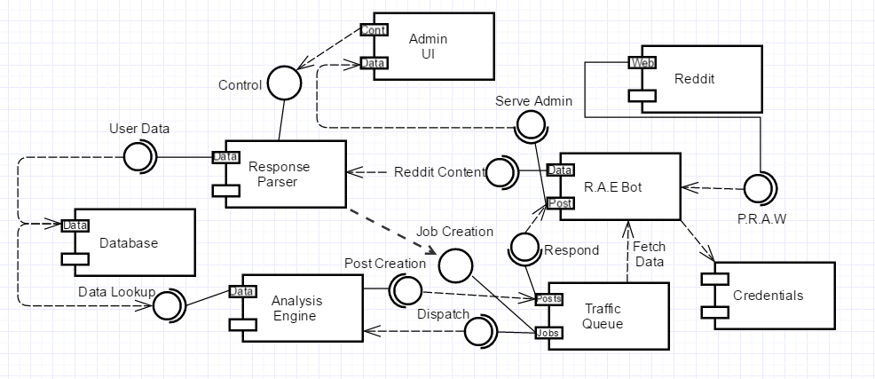
Design concept
Early Impressions

Slide 8
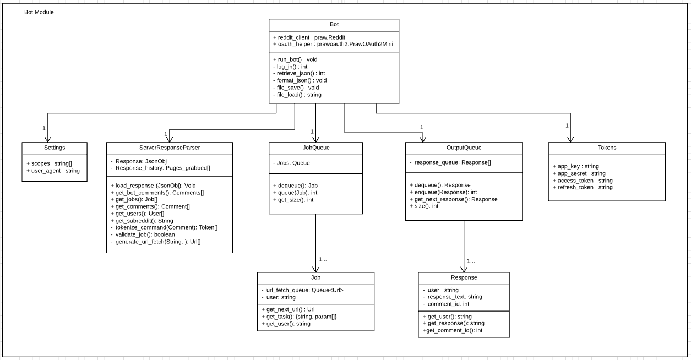

Slide 9
Why is the information valuable?
Social media is expanding:
Time spent online is increasing.
Information shared is increasing.
Prediction:
Information produced from analysis may hint how users are feeling about a product, and predict trends in user’s interest.
Marketers can use this information to compile a target audience.
Security:
Employee honesty is a good policy, but difficult to prove.
Big data analysis may paint a clearer picture than a resume.

Slide 10
Process
The evolution of CI_RAE
Notes:
TODO: More Edgy background

Slide 11
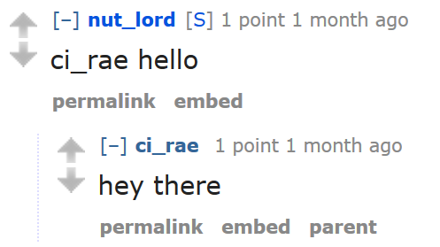
Phase 1 - Incremental/Agile
Basic Call and Response
Research and experiment with PRAW (Python Reddit API Wrapper).
Scan Reddit threads for ci_rae mentions and reply.

Slide 12
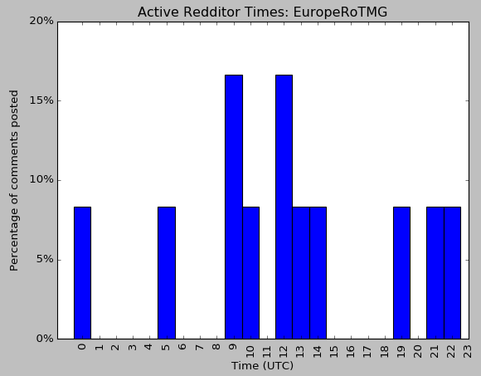
Phase 2 - Incremental/Agile
Basic Functionality / Analysis
Achieved basic analytics:
Karma breakdown.
User activity.
Word cloud.
And more…
Continued refining/refactoring the bot.

Slide 13
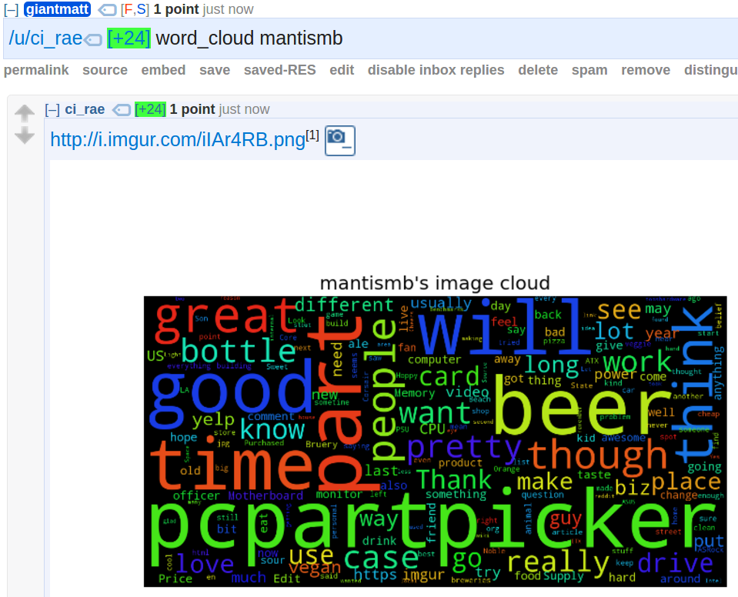
Phase 3 - Agile
Imgur Response
Added Imgur.com API framework to host our analytics graph.
Implemented replying with an imgur link.

Slide 14
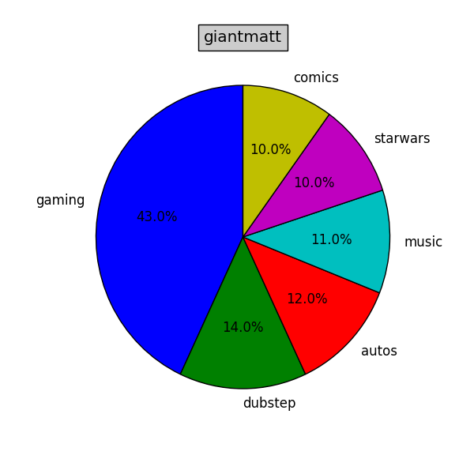
Phase 4 - Agile
Refactoring and More Analytics Modules
Bug fixes on existing analytics.
Added more marketable analytics.
Refactoring and documentation throughout all the modules.

Slide 15
Architecture
Architecture & Development Stack
Tools
Packages

Slide 16
Architecture
Pipe & filter pattern:
Sequential transformation.
Reddit user submits comment.
Listener ‘hears’ the comment.
Request Handler processes the comment, calls appropriate Analytics Module.
Analytics Module generates the report.
Imgur Uploader posts the generated report to Imgur, gets a URL from Imgur API.
Responder replies back to comment with the link or text of the generated report.
Listener
Request Handler
Analytics Module
Imgur Uploader
Responder

Slide 17
System Characteristics
Performance:
Use of ‘mentions’ which resulted in no database to scrape reddit required.
Multithreading: Listener, request handler, and analytics run in separate threads on separate cores.
Security:
Use of secret/access tokens for reddit bot account and Imgur account.
Bot is public, but not modifiable outside development group.
User input properly parsed.
Detect injections and prevent compromise.

Slide 18
System Characteristics
Safety:
Handles only public reddit data.
Availability:
Always running on a server.
Waits for user mentions, which places a job in the bot’s inbox.
Server stability error and timeout handling.
Accommodates for large number of users requesting the bot.
Incorrect user input results in the bot displaying a help message.

Slide 19
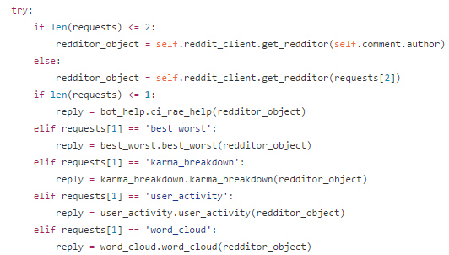
System Characteristics
Maintainability:
Standard input/output for analytics.
Input: Reddit object.
Output: A formatted comment.
Increases portability/extendability.
Have a new feature to add in? Add it in the handler!

Slide 20




Tools & Packages
Git/Github - keep source code up-to-date with progress.
Google Drive - collaborate on documents.
IDEs & text editors:
Intellij PyCharm (Python 3.5).
Sublime Text.
Command line interfaces:
Terminal.
Command Prompt.
Bash for Windows.
Online Resources:
Reddit.
Stack Overflow (you know you did too…)
PRAW, reddit API, Python documentation.
Operating Systems:
MacOS.
Ubuntu.
Windows.

Slide 21
Tools & Packages
Python Packages:
PRAW.
“An acronym for “Python Reddit API Wrapper”, is a python package that allows for simple access to reddit’s API”
Imgur API.
Upload to imgur image hosting service.
Matplotlib to generate graphs.
Threading.
Regex.
WordCloud.
Natural Language Toolkit
Doxygen.
Slack

Slide 22

Problems and Changes
Notes:
TODO: More Edgy background

Slide 23

Servers and databases
CI_RAE problems/changes
Dependent on reddit servers for data storage and Imgur servers for image hosting.
Problem: reddit and Imgur API limit number of requests per minute.
Result: Data retrieval is slower, but much less hardware overhead on our end.
Notes:
Might not have this

Slide 24
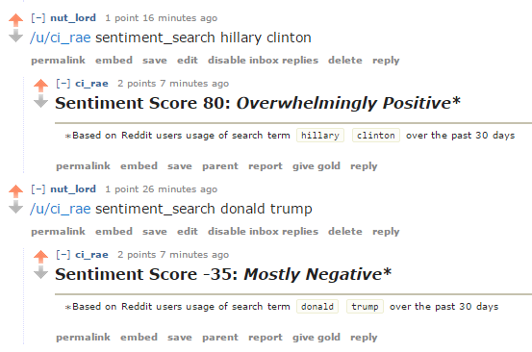
GUI
CI_RAE problems/changes
Initially we planned to design our own GUI for the engine.
Presently, we are using Reddit’s website as a GUI.
Result: Engine requests are public, but development and maintenance overhead is diminished.
Reddit.com
Notes:
Might not have this

Slide 25
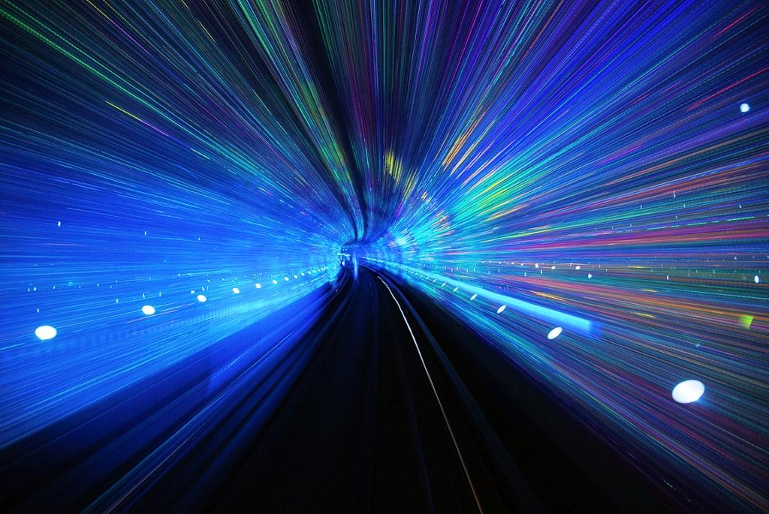
User input
CI_RAE problems/changes
Initially we scanned every comment in a subreddit and when found, added requests to a queue for processing. Essentially how web scraping is done.
Discovery: “Mentions,” a message is sent to your inbox whenever someone mentions your user name (/u/ci_rae).
Result: Much faster input detection and process time with multithreading.
Notes:
Might not have this

Slide 26

Testing
CI_RAE problems/changes
Testing done through Reddit and Imgur is slow, and unnecessarily intensive on their servers. But it is necessary for complete integration testing of the Engine.
Fortunately, since every module is completely decoupled from the rest, we were able to use unit testing throughout the system to bypass having to go through Reddit.

Slide 27
Results

Slide 28
Initial Design
Current Design
5 main components, 3 languages
Bot (Receiver): to find user requests receiver would scan every comment on a given set of subreddits.
Reddit user comments outputted to file.
Analytics: read file, split data, and perform data analysis.
Data would then be stored in database.
Client/UI: generate report (graph) and output png.
Bot (Sender): upload png and post Imgur link on reddit.
3 main components, 1 language
Bot (Listener): uses “mentions” to find user requests. Passes redditor object or client to requested analytics module.
Analytics module(s): takes redditor object, extracts comments, and performs analytics. Uploads image of data to Imgur and generates URL.
Bot (Responder): posts URL/results to reddit.

Slide 29
Initial Design vs. Current Design
Reddit
Sender
Receiver
Reddit
File
File
Responder
Listener
Client/UI
Analytics
Analytics
Database

Slide 30
What we’ve learned:
Documentation.
Improving efficiency (i.e., mentions, no need for database, PRAW).
Version Control.
Scrum.
Layering multiple APIs to work with each other. (Reddit, Imgur)
Following API guidelines.
Parsing data.
Analysis on large sets of data (i.e., Semantic analysis).

Slide 31
Conclusion

Slide 32


Marketplace of Ideas
Consumers in the Information Era typically look at reviews by other consumers before purchasing a product.
Buying something online? Amazon reviews.
Going out to a new restaurant? Yelp reviews.
Going out to the movies? Rotten Tomatoes.
Traditional advertising is becoming less effective as consumers are looking to what other people are saying about a product in their decision.
The “marketplace of ideas” holds that the truth will emerge from the competition of ideas in free, transparent public discourse. -wikipedia

Slide 33
Marketplace of Ideas
Reddit hosts a treasure trove of publicly accessible information about redditor’s demographics, interests, and site-wide trends.
Comments present insight into what people are actually thinking about anything from products to politics. Reddit’s upvote system makes the more interesting topics “bubble” to the top in a free market of competing ideas.
Our platform provides a framework to pull information from reddit and the tools needed to see what redditors are saying about your product or idea.
The platform is dynamically expandable to add future tools if needed.

Slide 34
Starting Over...
What would be done differently:
We had an initial goal to our design, but a ‘stream of consciousness’ type approach to achieve those goals.
Since limited research was committed on the tools available when we started, the initial design was bloated compared to the optimized final implementation.
Starting over we would commit to more research before starting the design process to have a final implementation match our initial design more closely.
In our experience, keeping the design simple and streamlined resulted
in better product than having as many features as possible.

Slide 35

Estimated Cost
Team size: 6
Project length: 6 weeks
Average person-hours per week: 5
~3 hours coding
~1 hour researching
~1 discussion
Estimated Total Cost:
6*6*5 = 180 total person-hours

Slide 36

Questions?

