Slide 1
SimSearch: A Similarity Search Tool for Research Paper Abstracts using NLP
20170717 한승우, 20180162 김지수

Slide 2
INTRODUCTION
CHALLENGE
GOAL
With the rise in research in various domains, locating relevant papers quickly and efficiently is difficult.
Develop a tool that uses NLP to assist researchers in finding similar papers based on their abstracts.

Slide 3
MOTIVATION
The field of research is expanding rapidly, making it difficult to stay up-to-date with the latest findings.
ML research is growing too fast to keep up, and many researchers struggle with information overload when searching for relevant papers.
With numerous papers published each year, identifying the most relevant and significant ones can be challenging.

Slide 4
GOAL
Develop a tool to assist researchers in finding similar papers based on abstracts, saving them time and effort

Slide 5
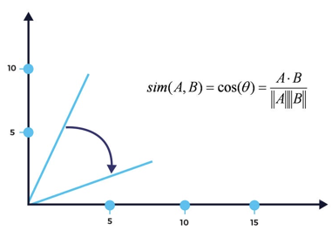
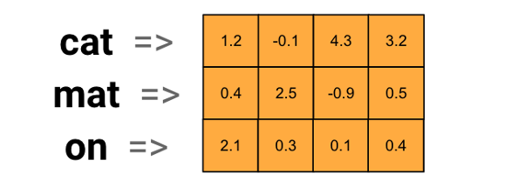
PROJECT OVERVIEW
Word embeddings and cosine similarity will be utilized to compare research paper abstracts and determine their level of similarity
Word Embeddings
Cosine Similarity

Slide 6
PROJECT OVERVIEW
TF-IDF
INPUT
PREPROCESSING
OUTPUT
Abstract of paper
Remove unnecessary words
Most similar paper
based on abstract
DOC2VEC

Slide 7
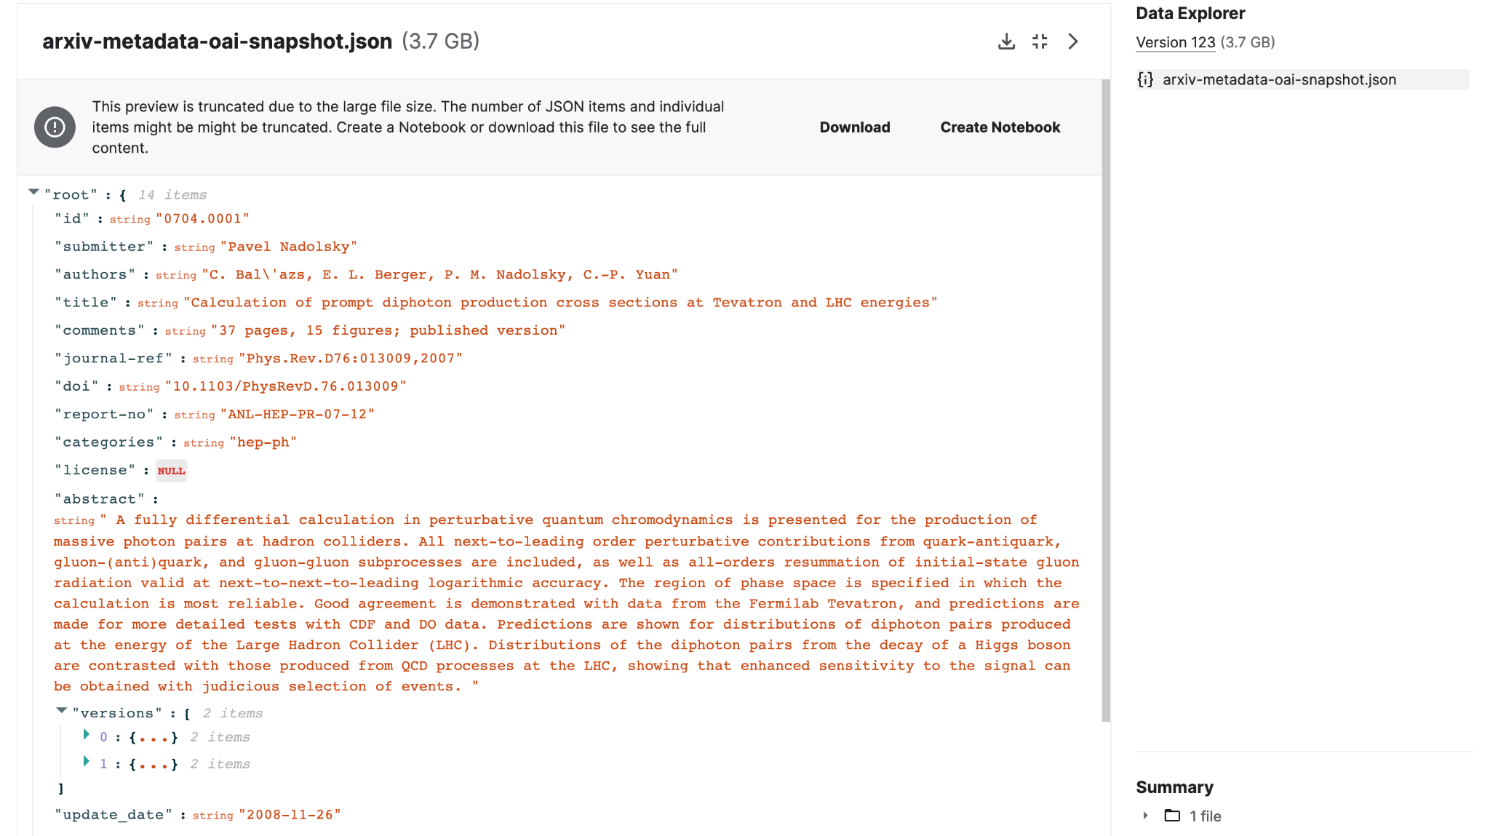
PREPROCESSING
Kaggle arXiv Dataset
arXiv dataset and metadata of 1.7M+ scholary papers across STEM

Slide 8
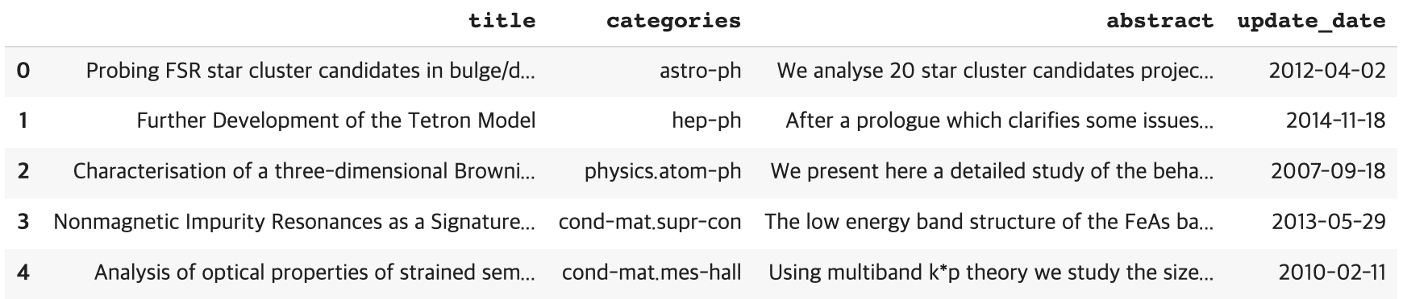
PREPROCESSING
Generate dataframe and filter out selected features:

Slide 9
PREPROCESSING
Remove unnecessary words using POS tags:
CC: coordinating conjunction (and, but, or)
DT: determiner (the, a, an)
IN: preposition or subordinating conjunction (in, on, with)
TO: to (to go, to see)
PRP: personal pronoun (I, you, he, she)
PRP$: possessive pronoun (my, you, his, her)
MD: modal verb (can, may, should)
WP: wh-pronoun (who, what, which)
WP$: possessive wh-pronoun (whose)
WRB: wh-adverb (when, where, why)

Slide 10
PREPROCESSING
Remove unnecessary words using POS tags:
We analyse 20 star cluster candidates projected mostly in the bulge direction ($|\ell|<60^\circ$). The sample contains all candidates in that sector classified by \citet{FSRcat} with quality flags denoting high probability of being star clusters. Bulge contamination in the colour-magnitude diagrams (CMDs) is in general important, while at lower Galactic latitudes disk stars contribute as well. Properties of the candidates are investigated with 2MASS CMDs and stellar radial density profiles (RDPs) built with field star decontaminated photometry. To uncover the nature of the structures we decontaminate the CMDs from field stars using tools that we previously developed to deal with objects in dense fields. We confirm in all cases excesses in the RDPs with respect to the background level, as expected from the method the candidates were originally selected. CMDs and RDPs taken together revealed 6 open clusters, 5 uncertain cases that require deeper observations, while 9 objects are possibly field density fluctuations.

Slide 11
PREPROCESSING
Remove unnecessary words using POS tags:
We analyse 20 star cluster candidates projected mostly in the bulge direction ($|\ell|<60^\circ$). The sample contains all candidates in that sector classified by \citet{FSRcat} with quality flags denoting high probability of being star clusters. Bulge contamination in the colour-magnitude diagrams (CMDs) is in general important, while at lower Galactic latitudes disk stars contribute as well. Properties of the candidates are investigated with 2MASS CMDs and stellar radial density profiles (RDPs) built with field star decontaminated photometry. To uncover the nature of the structures we decontaminate the CMDs from field stars using tools that we previously developed to deal with objects in dense fields. We confirm in all cases excesses in the RDPs with respect to the background level, as expected from the method the candidates were originally selected. CMDs and RDPs taken together revealed 6 open clusters, 5 uncertain cases that require deeper observations, while 9 objects are possibly field density fluctuations.

Slide 12
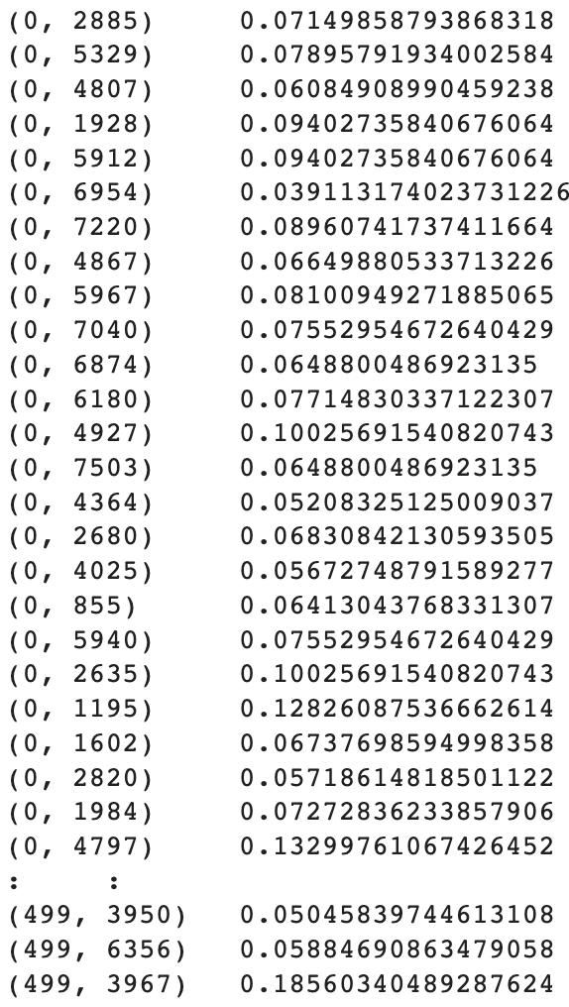
TF-IDF
TF-IDF Vectorization
Term Frequency: What is the frequency of a term?
Inverse Document Frequency: What is the frequency of a word throughout the corpus?
Notes:
TF-IDF is a way to represent text that offers typically better performance than a Bag-of-Words representation. TF-IDF refers to Term Frequency - Inverse Document Frequency, which refers to the way in which the importance/relevance of strings is determined. The goal is to get a sense of what words are relevant based on their frequency both within the document and across the corpus.
TF-IDF vectorization works based on two metrics, based on the name:
1) Term Frequecy - what is the frequency of a term? Term frequency can be defined multiple ways, including the number of appearances, of the frequency as a proportion of the words in the corpus.
2) Inverse Document Frequency - what is the frequency of a word throughout the corpus? This figure is calculated by looking at number of documents divided by the number of documents that the term appears in.
We then multiply the term frequency by the inverse document foodage to get the TF-IDF score. The higher the score, the more relevant the term is. As a term gets less relevant, its TF-IDF score approaches 0.
Sci-Kit Learn includes an implementation of TF-IDF vectorization that can be applied out of the box, we'll apply it here to the corpus (the first 10000 articles) to get the word representations for our initial approach.
Now that we've applied the TF-IDF vectorizer to the corpus, we have a matrix of values representing the data that we can then pass into a function to get the similarity of the text to other members of the corpus.

Slide 13
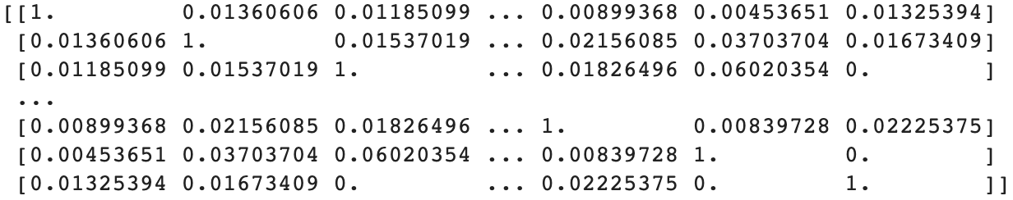
TF-IDF
Cosine Similarity
Notes:
Sci-Kit Learn includes an implementation of the Cosine Similarity, which is a useful way to represent text because it's similarity is calculated irrespective of vector size. The values of Cosine similarity that are close to 1 are determined to be "closer" or more similar to each other. We'll apply this metric first by getting the cosine similarity of the entire matrix.

Slide 14
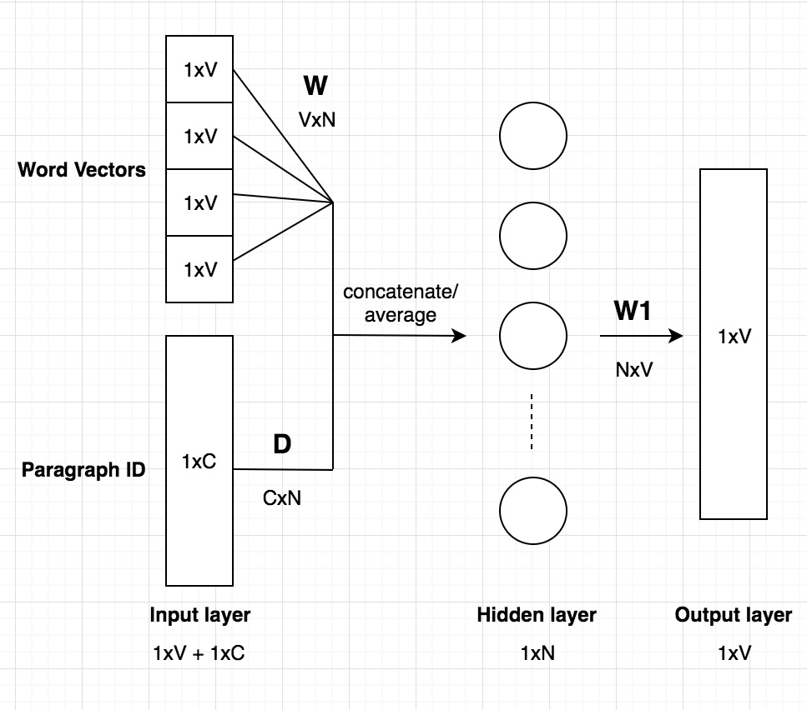
DOC2VEC
Doc2Vec Model
Extension of the Word2Vec model
Considers the semantic meaning and context of words within a document
PV-DM (Paragraph Vector-Distributed Memory) : preserves word order
PV-DBOW (Paragraph Vector-Distributed Bag of Words) : ignores word order
Notes:
Doc2Vec is an algorithm for generating vector representations of documents in an unsupervised manner. It is an extension of the popular Word2Vec model that learns continuous vector representations of words.
Unlike traditional bag-of-words models or TF-IDF, which treat documents as a collection of words, Doc2Vec considers the semantic meaning and context of words within a document. It learns fixed-length vector representations, often referred to as "document embeddings" or "doc vectors," that capture the overall meaning and semantic relationships of the entire document.
The basic idea behind Doc2Vec is to train a neural network to predict words within a document or predict the document given a set of words. This training process allows the model to learn distributed representations of documents that capture both the local word context and the global document context.
There are two main variants of Doc2Vec: PV-DM (Paragraph Vector-Distributed Memory) and PV-DBOW (Paragraph Vector-Distributed Bag of Words). PV-DM preserves the word order in the document and aims to predict the target word based on the context words and the document vector. PV-DBOW, on the other hand, ignores the word order and only predicts the target word based on the document vector.
We used PV-DM in our trained model.

Slide 15
DOC2VEC
Doc2Vec Model
Train Doc2Vec Model
Infer the vector from the given abstract
Get the most similar abstract
Notes:
In our Doc2Vec model, we first trained the Doc2Vec model using the Genesis library. We used Paragraph Vector-Distributed Memory as it is used as a default model for Doc2Vec. Then, we inferred the vector from the given abstract. Finally, we obtained the most similar abstract given an input abstract.

Slide 16


OUTPUT
https://ddiddu-simsearch.hf.space/
Notes:
You can see and try our result by clicking this link. We used gradio to deploy our model.

Slide 17
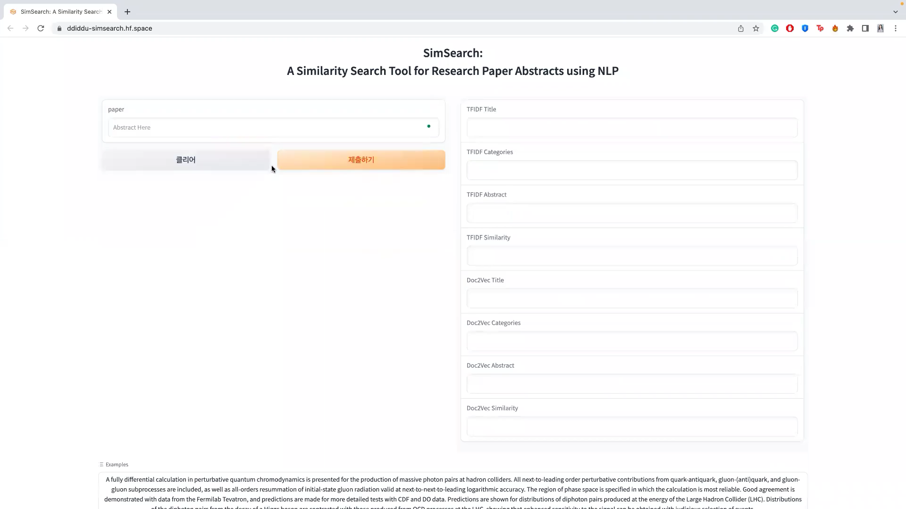

Slide 18
EXPECTED OUTCOME
Improved efficiency and effectiveness in locating relevant research papers
Increased accuracy in identifying similar papers based on abstracts
Reduction of time and effort required to conduct literature reviews
Potential for greater knowledge dissemination and collaboration in the research community

Slide 19
LIMITATIONS
Limited to papers in the dataset: Accuracy of recommendations may be lower for papers belonging to categories not covered by the dataset
Potential improvement with additional datasets: Incorporating additional dataset into the recommendation system could lead to improved accuracy and coverage across a wider range of categories

Slide 20
REFERENCES
[1] University, Cornell. “ArXiv Dataset.” Kaggle, 1 Apr. 2023, https://www.kaggle.com/datasets/Cornell-University/arxiv
[2] Silvan. “Using NLP to Find Similar Movies Based on Plot Summaries.” Medium, Towards Data Science, 28 Jan. 2021, https://towardsdatascience.com/using-nlp-to-find-similar-movies-based-on-plot-summaries-b1481a2ba49b
[3] Johntrygier. (2023, February 27). Scientific article recommendation. Kaggle. https://www.kaggle.com/code/johntrygier/scientific-article-recommendation

Slide 21
THANK YOU
https://ddiddu-simsearch.hf.space/

