Slide 1
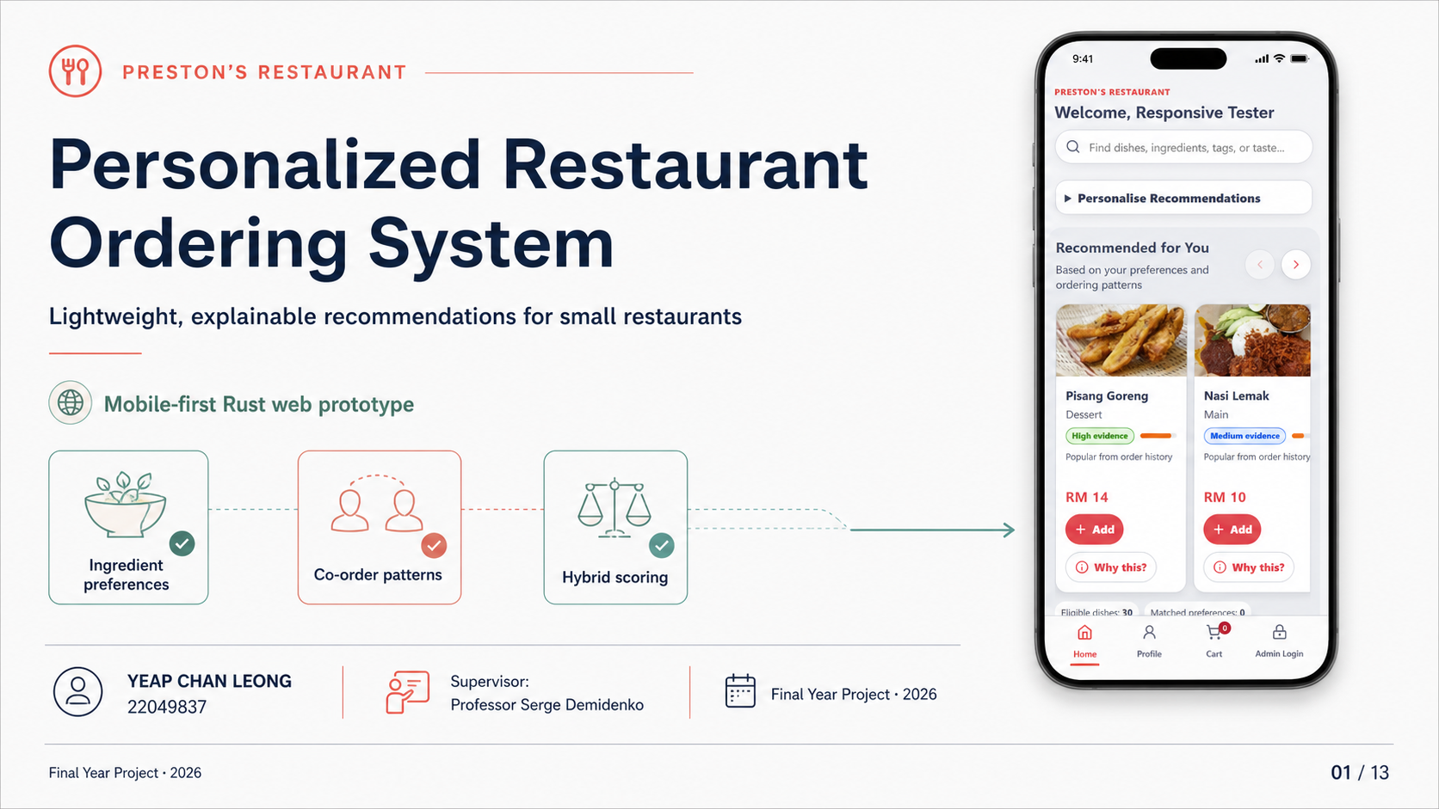
Notes:
Open by positioning the project as a mobile-first ordering and recommendation prototype for a small restaurant. Introduce the three recommendation signals and the QR-based access model.
[Sources]
- FR_22049837.pdf, title page and Abstract
- Repository mobile customer interface evidence
[/Sources]

Slide 2
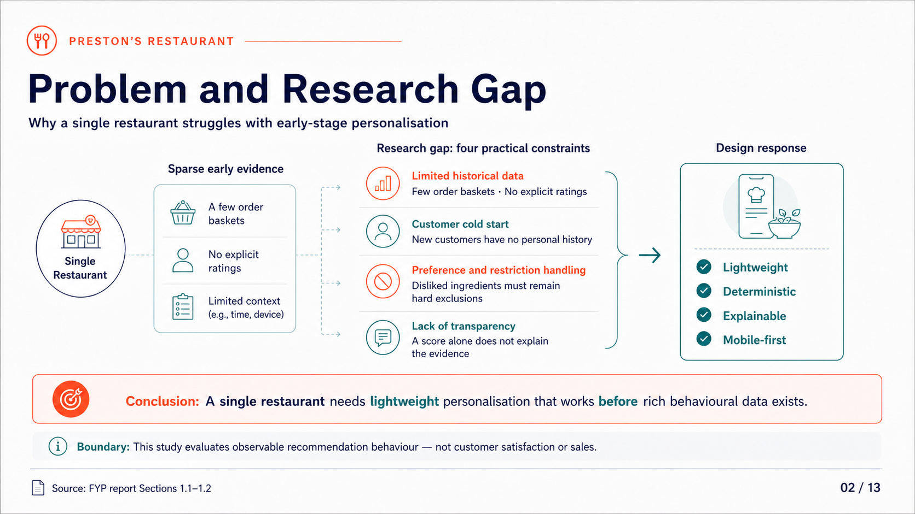
Notes:
Explain the four constraints: sparse history, cold start, hard restrictions, and weak transparency. Emphasise that the study evaluates observable recommendation behaviour, not sales or customer satisfaction.
[Sources]
- FR_22049837.pdf, Sections 1.1–1.2
- Bondevik et al. (2024), DOI 10.1016/j.eswa.2023.122166
- Zhang & Chen (2020), DOI 10.1561/1500000066
[/Sources]

Slide 3
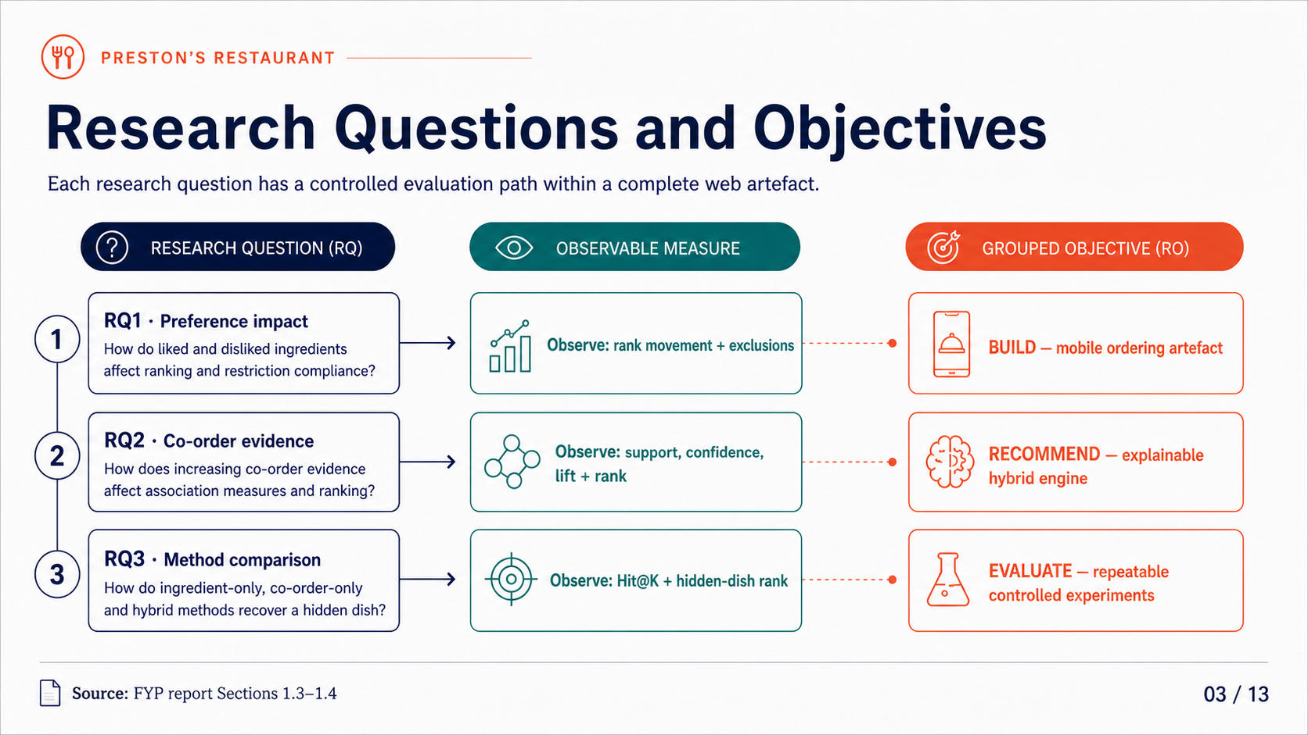
Notes:
Walk through RQ1, RQ2, and RQ3 as three controlled evaluation paths. Connect them to the grouped objectives: build the artefact, implement explainable recommendation, and evaluate observable behaviour.
[Sources]
- FR_22049837.pdf, Sections 1.3–1.4
[/Sources]

Slide 4
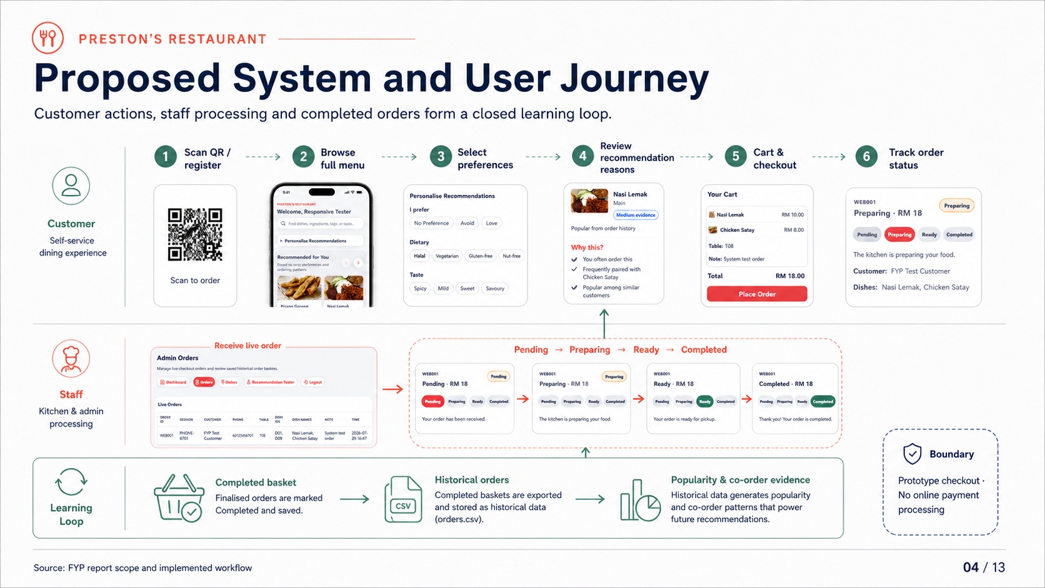
Notes:
Describe the customer journey from QR entry to checkout and the staff journey from Pending to Completed. Explain that only a completed basket becomes future historical recommendation evidence.
[Sources]
- FR_22049837.pdf, project scope and workflow sections
- docs/report-evidence/2026-07-29/figure-4-6a-customer-order-submitted.png
- docs/report-evidence/2026-07-29/figure-4-6b-admin-live-order.png
- docs/report-evidence/2026-07-29/figure-4-6c-customer-status-updated.png
[/Sources]

Slide 5
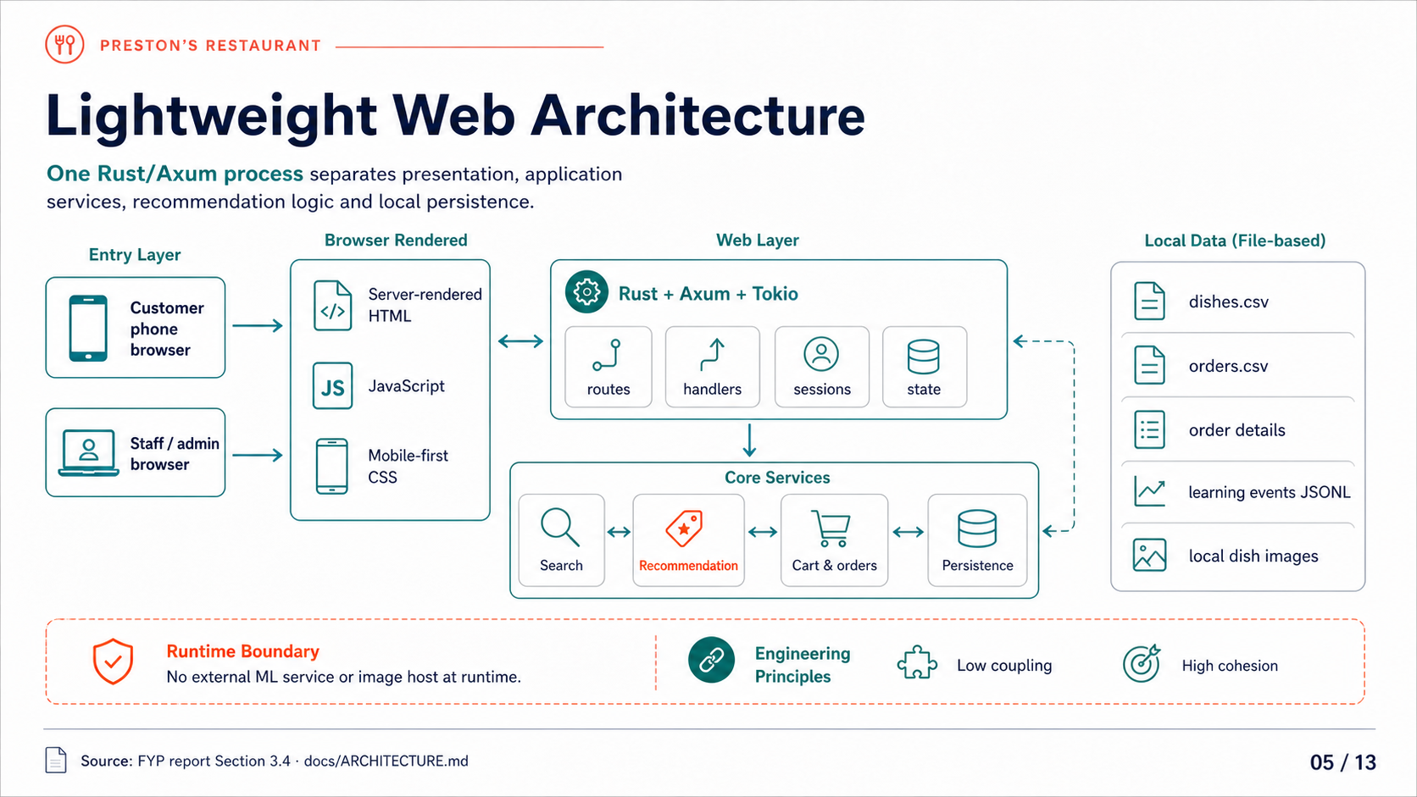
Notes:
Explain the single-process deployment and the internal responsibility boundaries. Stress that routes, scoring, persistence, and presentation are separated even though the prototype remains lightweight.
[Sources]
- FR_22049837.pdf, Section 3.4
- docs/ARCHITECTURE.md
[/Sources]

Slide 6
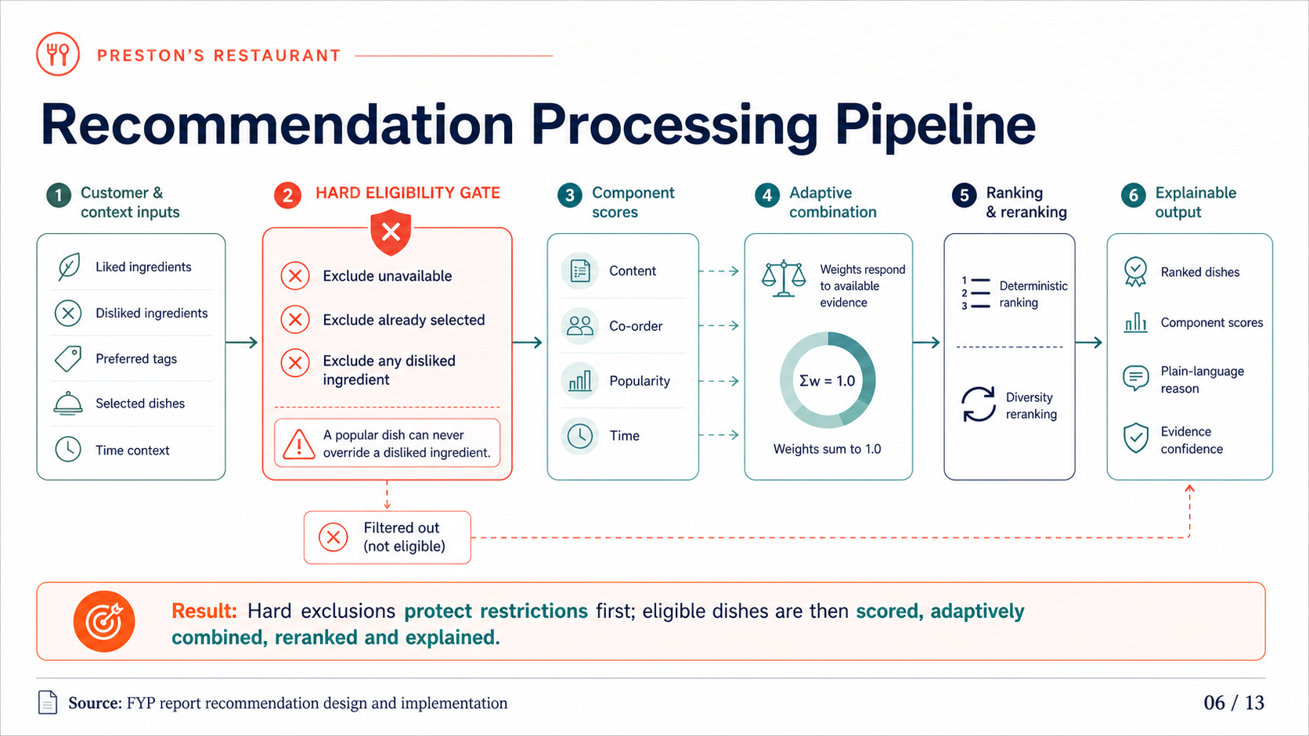
Notes:
Start with the hard eligibility gate: unavailable, selected, and disliked-ingredient dishes are removed before ranking. Then explain component scoring, adaptive weighting, deterministic ranking, diversity, and explanation generation.
[Sources]
- FR_22049837.pdf, recommendation design and implementation sections
- docs/ARCHITECTURE.md, Recommendation Flow
[/Sources]

Slide 7
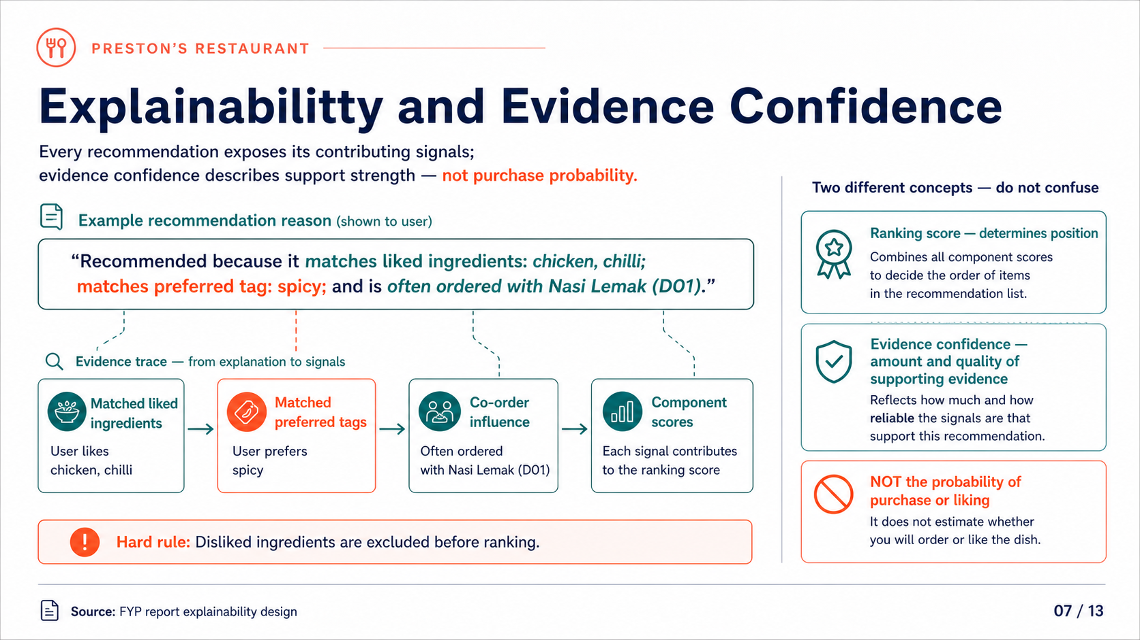
Notes:
Read the recommendation reason as an evidence trace. Distinguish ranking score from evidence confidence, and state clearly that confidence is not a probability that the customer will buy or like the dish.
[Sources]
- FR_22049837.pdf, Sections 1.6, 3.4, and 5.3
- Zhang & Chen (2020), DOI 10.1561/1500000066
[/Sources]

Slide 8
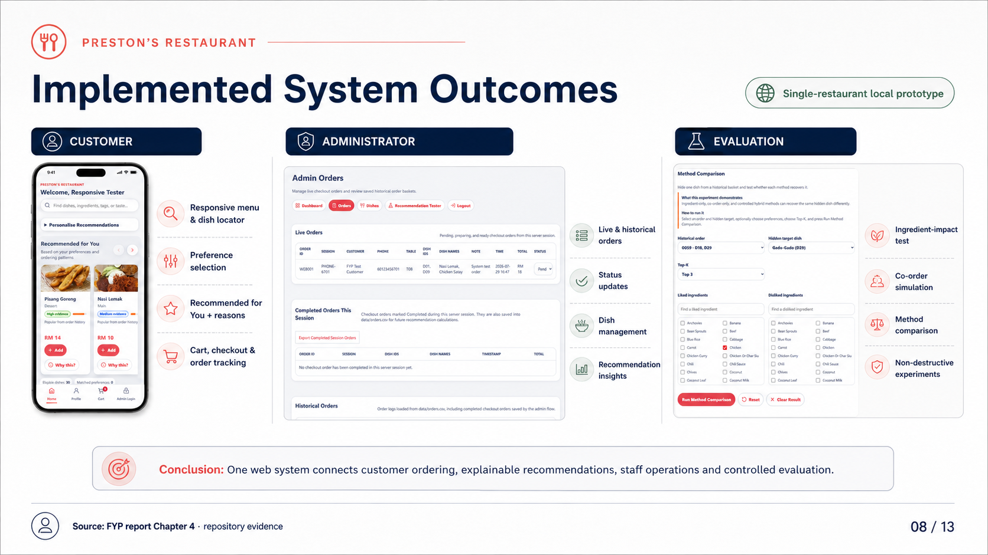
Notes:
Summarise the implemented customer, administrator, and evaluation capabilities. Keep the claim within the single-restaurant local prototype scope.
[Sources]
- FR_22049837.pdf, Chapter 4
- docs/report-evidence/2026-07-29/figure-4-7-mobile-390x844.png
- docs/report-evidence/2026-07-29/figure-4-6b-admin-live-order.png
- docs/report-evidence/2026-07-29/section-4-4/figure-4-12-method-comparison-interface.png
[/Sources]

Slide 9
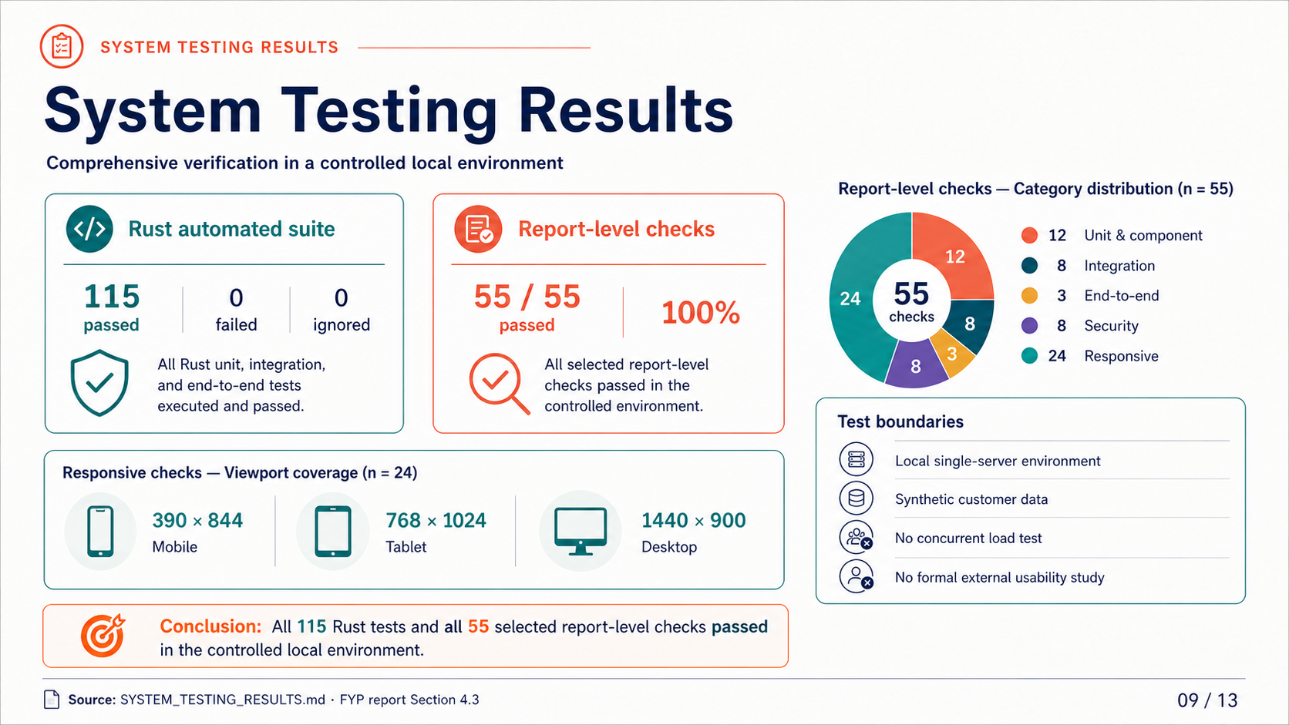
Notes:
Keep the two measurements separate: 115 Rust implementation tests and 55 selected report-level requirement checks. Explain the category breakdown and the controlled local test boundary.
[Sources]
- FR_22049837.pdf, Section 4.3
- docs/report-evidence/2026-07-29/SYSTEM_TESTING_RESULTS.md
[/Sources]

Slide 10
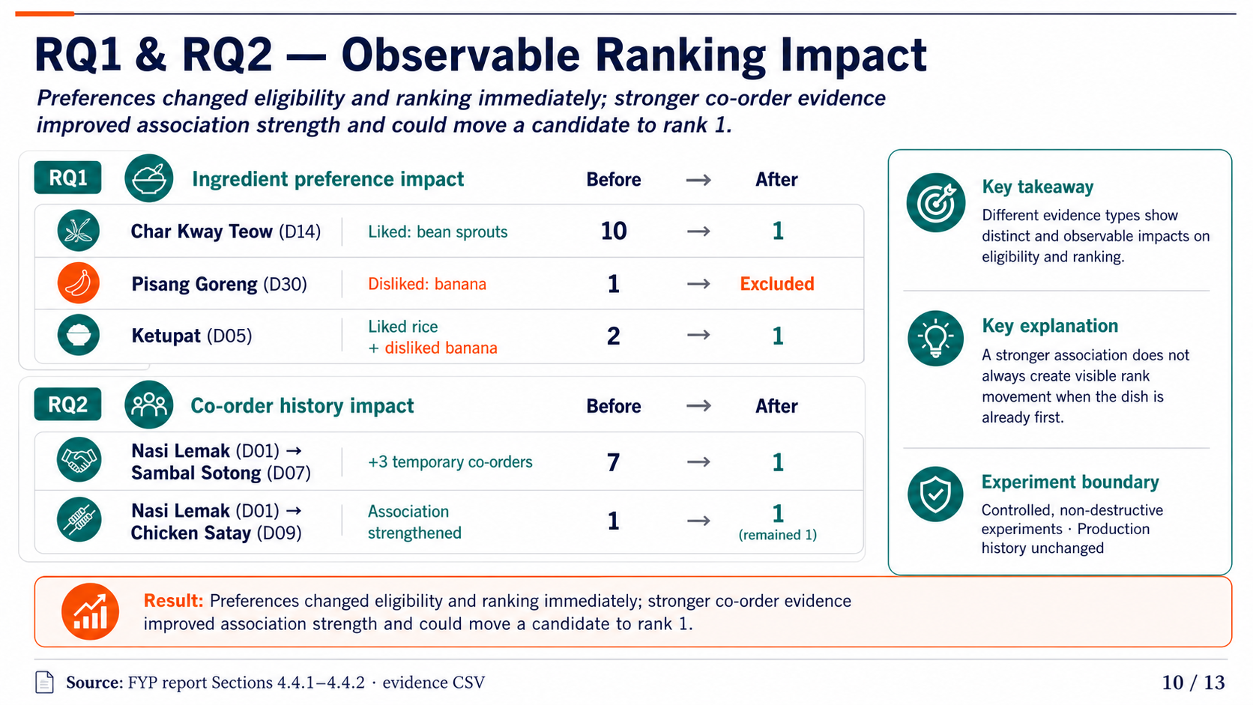
Notes:
Use the rank changes to answer RQ1 and RQ2. Liked ingredients raised compatible dishes, disliked ingredients caused hard exclusion, and stronger co-order evidence could improve rank. Note that D09 stayed first because it was already at the top.
[Sources]
- FR_22049837.pdf, Sections 4.4.1–4.4.2
- docs/report-evidence/2026-07-29/section-4-4/ingredient-impact-results.csv
- docs/report-evidence/2026-07-29/section-4-4/coorder-impact-results.csv
[/Sources]

Slide 11
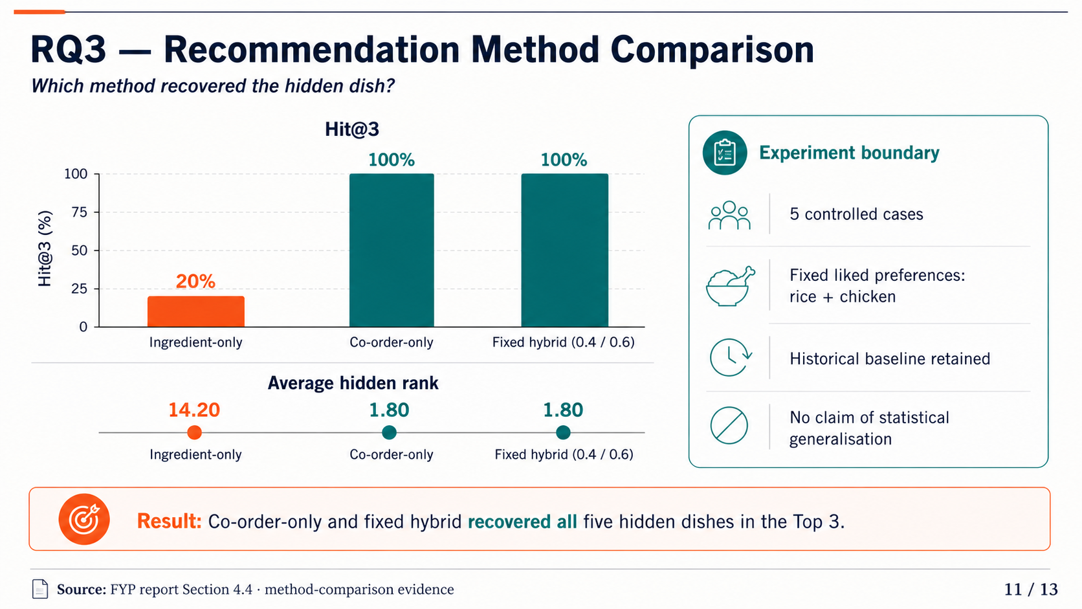
Notes:
Lead with Hit@3: 20 percent for ingredient-only and 100 percent for co-order-only and fixed hybrid. Then show average rank and immediately state the five-case, fixed-profile experimental boundary.
[Sources]
- FR_22049837.pdf, Section 4.4.3
- docs/report-evidence/2026-07-29/section-4-4/method-comparison-results.csv
- docs/report-evidence/2026-07-29/section-4-4/method-comparison-summary.csv
[/Sources]

Slide 12
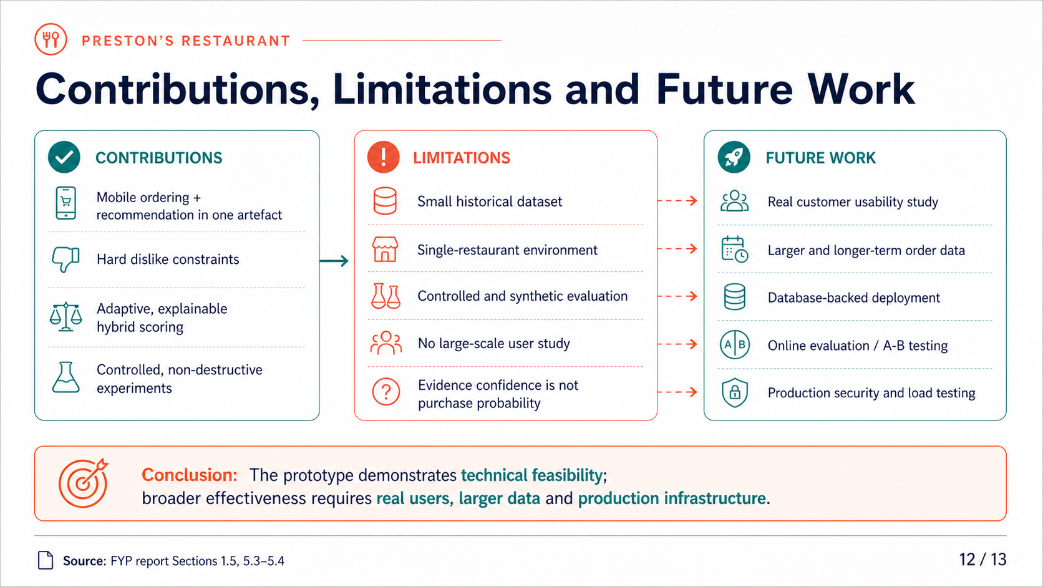
Notes:
Balance the achieved technical contribution with the explicit research limitations. Connect each limitation to a concrete validation or engineering next step.
[Sources]
- FR_22049837.pdf, Sections 1.5, 5.3, and 5.4
- Bondevik et al. (2024), DOI 10.1016/j.eswa.2023.122166
[/Sources]

Slide 13
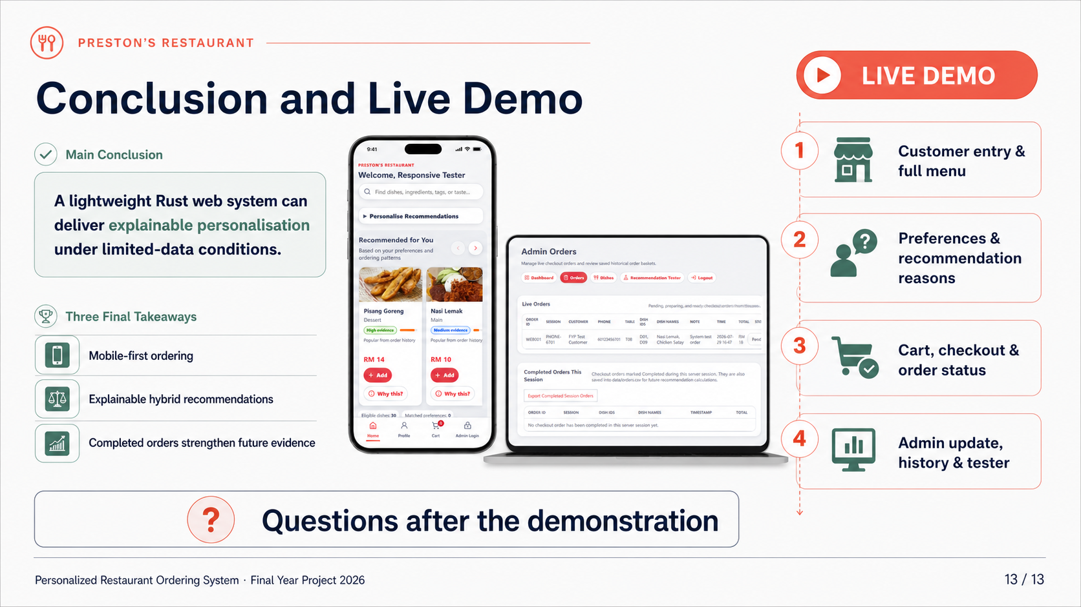
Notes:
Restate the central conclusion in one sentence and transition directly to the four-step live demonstration. Keep questions until after the demonstration.
[Sources]
- FR_22049837.pdf, Chapter 5
- Implemented customer and administrator interfaces in this repository
[/Sources]

