Slide 1
IDENTITY AND ECONOMIC ACTIVITY:
REPRESENTING CLASS
FROM
THE WEALTH OF NATIONS
TO
THE WEALTH OF NETWORKS
Mike Edwards

Slide 3
1. SCARCITY AS STRAITJACKET
2. CLASS AS PROCESS
3. CLASS IN THE NETWORK ECONOMY
4. SPACES OF ECONOMIC POSSIBILITY

Slide 5

1.
SCARCITY
AS
STRAITJACKET

Slide 7
Adam Smith
“The natural effort of every individual to better his own condition, when suffered to exert itself with freedom and security, is so powerful a principle, that it alone, and without any assistance, is not only capable of carrying the society to wealth and prosperity, but of surmounting a hundred impertinent obstructions with which the folly of human laws too often incumbers its operations.”
(The Wealth of Nations 581)

Slide 8
HOMO ECONOMICUS

Slide 9
ASSUMED
SCARCITY

Slide 11
CLASS
PRIOR TO
AND OUTSIDE
CLASSROOM

Slide 13
(COMMUNISM)

Slide 15
CAPITALISM
DETERMINES
PEDAGOGY

Slide 16
THE
ECONOMY
IS
CHANGING

Slide 18
EDUCATION
AS
MARKET
TRANSACTION

Slide 19
(LOVE)
(HUMANS)

Slide 21
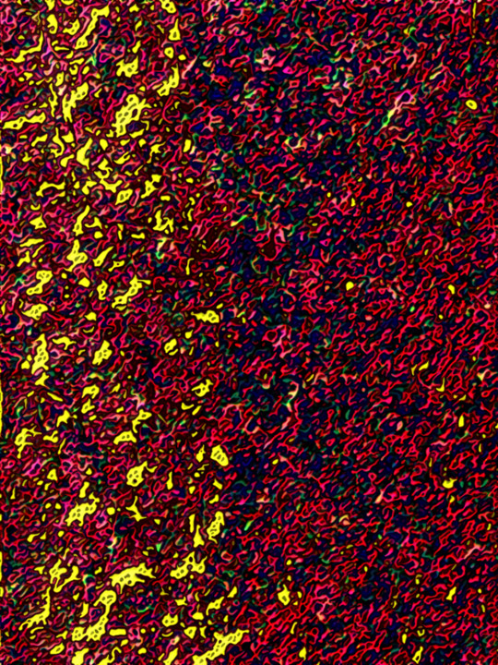
2.
CLASS
AS
PROCESS

Slide 23
CLASS =
ECONOMIC PROCESS OF
APPROPRIATING
VALUE

Slide 24
WHO
APPROPRIATES
VALUE
AND
HOW

Slide 26
DIVERSE
MOTIVATIONS

Slide 28
“Information is both input and output of its own production process.”
(The Wealth of Networks 37)

Slide 29
work
appropriation
use
ownership

Slide 30
“Symbols are now a class of material objects, conceptual objects, with market value, social force, and dimension.”
(Datacloud 37)

Slide 31

3.
CLASS
IN THE
NETWORK
ECONOMY

Slide 33
Market, wage, capitalist
TRANSACTIONS | LABOR | ENTERPRISE
Market | Wage | Capitalist
(A Postcapitalist Politics 71)

Slide 34
Alternative transactions
TRANSACTIONS | LABOR | ENTERPRISE
Market | Wage | Capitalist
alternative market fair-trade markets alternative currencies underground market cooperatives | alternative paid self-employed cooperative reciprocal labor in-kind | alternative capitalist state enterprise socially responsible firm nonprofit green capitalist
(A Postcapitalist Politics 71)

Slide 35
Noncapitalist transactions
TRANSACTIONS | LABOR | ENTERPRISE
Market | Wage | Capitalist
Nonmarket gift giving state allocations state appropriations hunting, gathering | Unpaid housework family care volunteer self-provisioning | Noncapitalist communal independent feudal slave
(A Postcapitalist Politics 71)

Slide 37
University transactions, labor, enterprise
TRANSACTIONS | LABOR | ENTERPRISE
Market tuition for instruction | Wage instructor salary | Capitalist for-profit higher ed
Alternative Market hired tutor paying for papers | Alternative Paid independent scholar work-study tutor | Alternative Capitalist state schools religious schools
Nonmarket in-class peer response parent tutoring open source docs government writing | Unpaid student writing writing to learn online communities caucus/SIG writing | Noncapitalist writing groups blog collectives community literacy student newspapers

Slide 39
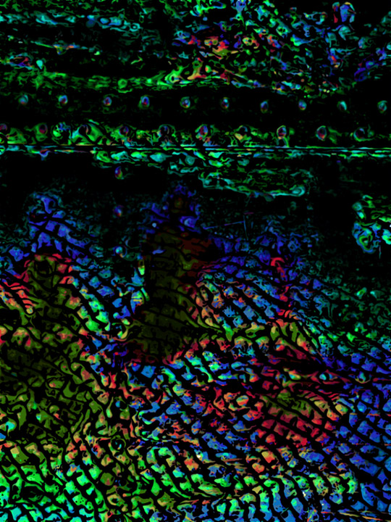
4.
SPACES
OF
ECONOMIC
POSSIBILITY

Slide 40
Immaterial labor: “the production and manipulation of affect.”
(Multitude 293)

Slide 42
Adam Smith
“How selfish soever man may be supposed, there are evidently some principles in his nature, which interest him in the fortune of others, and render their happiness necessary to him, though he derives nothing from it except the pleasure of seeing it.”
(The Theory of Moral Sentiments 9)

Slide 43
Adam Smith
“The natural effort of every individual to better his own condition, when suffered to exert itself with freedom and security, is so powerful a principle, that it alone, and without any assistance, is not only capable of carrying the society to wealth and prosperity, but of surmounting a hundred impertinent obstructions with which the folly of human laws too often incumbers its operations.”
(The Wealth of Nations 581)

Slide 45
michael.edwards@usma.edu
http://www.vitia.org/

