Slide 1
SDN by Examples
@fyang15

Slide 2
Agenda
Concepts
Vagrant
Network namespaces
iproute2
Hands on
Pods on the same host
Pods across hosts

Slide 3
Why
pods on a node can communicate with all pods on all nodes without NAT
agents on a node (e.g. system daemons, kubelet) can communicate with all pods on that node

Slide 4
Where we are
cgroups - limitation
namespaces - isolation

Slide 5
Vagrant
vagrant init
vagrant box
vagrant up
vagrant ssh
vagrant halt
vagrant destroy

Slide 6
Vagrantfile
config.vm.box
config.vm.network
config.vm.provision

Slide 7
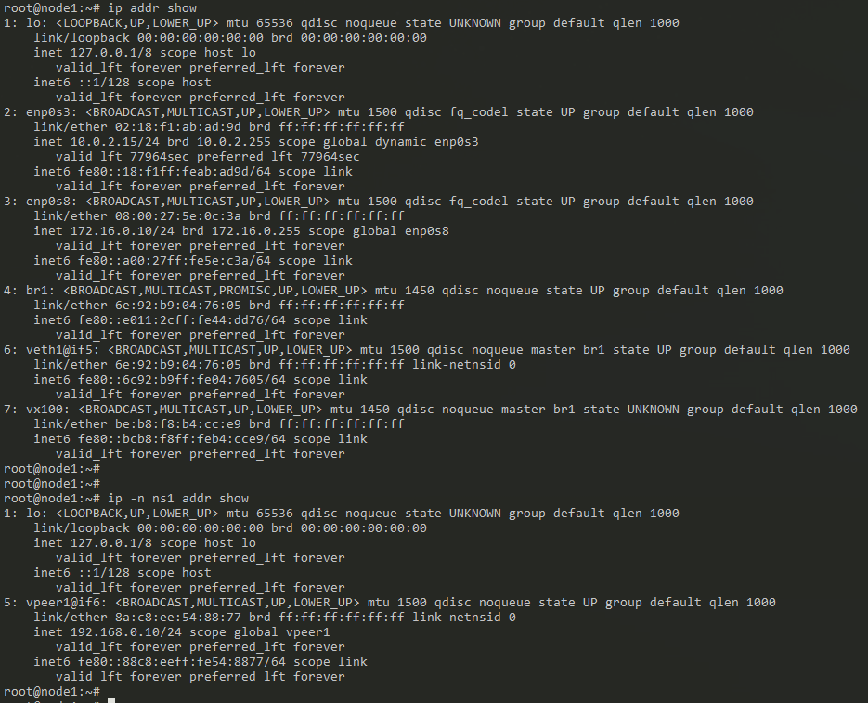
Network namespaces

Slide 8
iproute2
ip-link
ip-address
ip-route
ip-netns

Slide 9
Hands on - prerequisites

Slide 10
Hands on – pods on the same host

Slide 11
Hands on – pods across hosts

Slide 12
Pod to service

Slide 13
Service to pod

Slide 14
References
https://sookocheff.com/post/kubernetes/understanding-kubernetes-networking-model/

Slide 15
Q&A

Slide 16
The end

