Slide 1
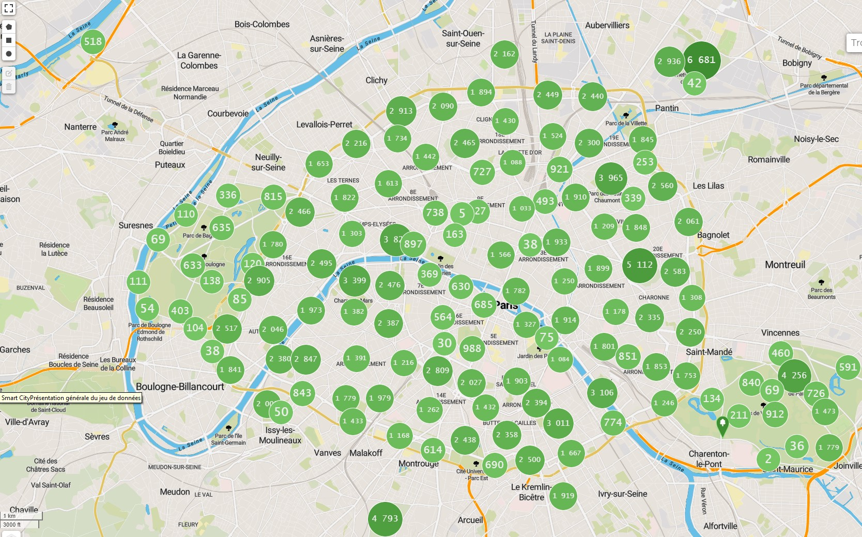
1.Analysis of Trees in Paris
patrice preudhomme - 04/2024 - V1.0

Slide 2
2. Introduction
In this presentation, we delve into an exploratory analysis of a dataset detailing the trees across the city of Paris. This analysis is a key component of the "Greening the City" program—a concerted effort to enrich the city's greenery and advance environmental sustainability.
What is expected:
Conducting an exploratory analysis with a dataset concerning the trees of the city of Paris, as part of the "Greening the City" program.
By leveraging data, we aim to influence real-world outcomes, ensuring that our work contributes positively to the ongoing efforts to cultivate a more sustainable and verdant Paris.

Slide 3
3.Resources
Anaconda scientific distribution containing:
  Python : a versatile programming language widely used in various fields, including data science, machine learning, web development, and more.
  Jupyter Notebook : an open-source web application that allows you to create and share documents containing live code, equations, visualizations, and narrative text. It's popular among data scientists for its interactive and exploratory nature.
  Dozens of scientific packages : refers to the numerous libraries and packages available in Python's scientific ecosystem, covering areas such as data manipulation, numerical computing, machine learning, statistics, and more
Libraries used:
  Pandas : data manipulation and analysis library, particularly useful for working with structured data.
  Matplotlib : comprehensive plotting library for creating static, interactive, and animated visualizations in Python.
  Seaborn : statistical data visualization library built on top of Matplotlib, providing a high-level interface for drawing attractive and informative statistical graphics.

Slide 4
4. Overview of the Data
Source of the Data :
  Download the dataset of the city of Paris trees.
  You can also view it in context at opendata.paris.fr. https://opendata.paris.fr/explore/dataset/les-arbres
Key Characteristics of the Dataset
It's a CSV file containing: 200,137 rows ,18 columns
Our analysis is supported by a dataset that meticulously catalogs the city's trees, with each entry rich in both qualitative and quantitative details:
Quantitative Variables:
CIRCONFERENCE (cm): The circumference of the tree, measured in centimeters, providing insights into the tree's size and possibly its age.
HAUTEUR (m): The height of the tree in meters, another critical measure of its growth and developmental stage.
geo_point_2d: Geographical coordinates (latitude and longitude), pinpointing the exact location of each tree within Paris.

Slide 5
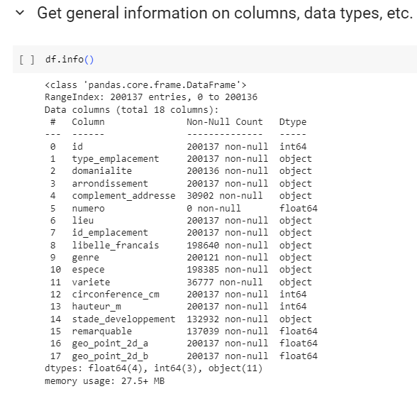
4. Overview of the Data

Slide 6
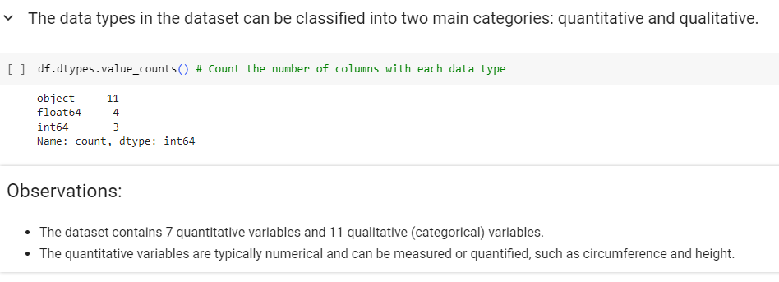
4. Overview of the Data

Slide 7
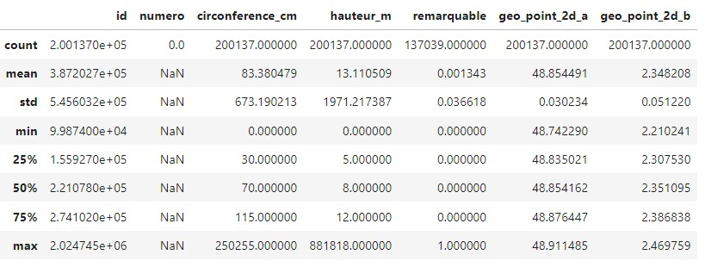
5. Methodology
Statistical Indicators for Quantitative Variables before cleaning the data

Slide 8
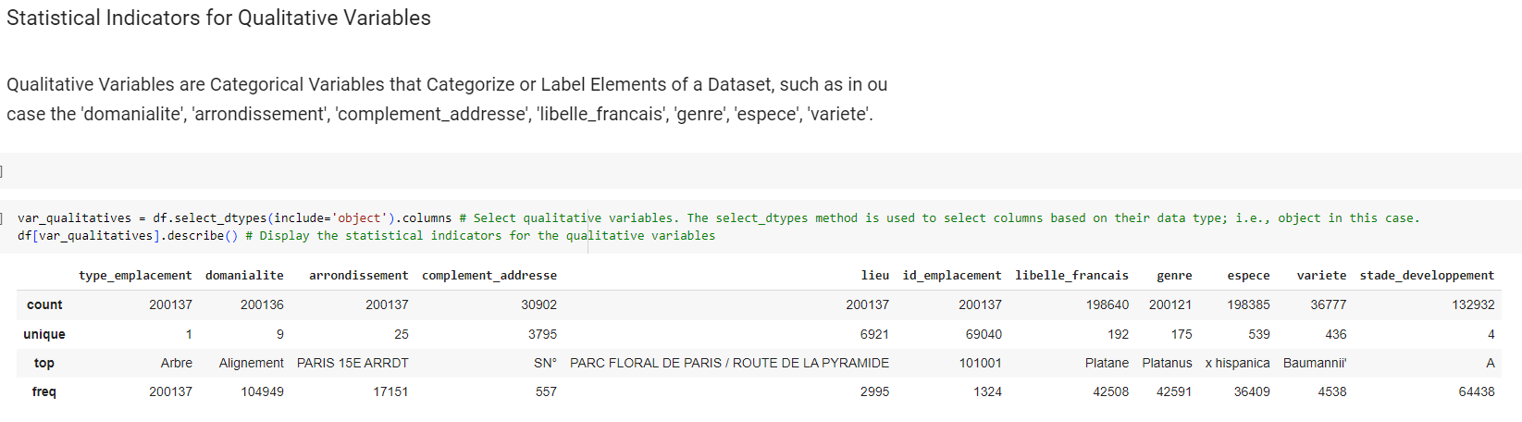
5. Methodology

Slide 9
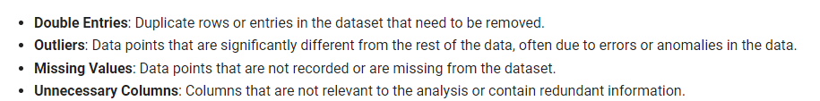
5. Methodology – Data Analysis and Data Cleaning (Double, Outliers, missing values, unnecessary columns)

Slide 10
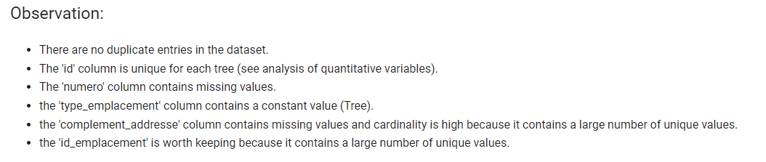
5. Methodology – Data Analysis and Data Cleaning (Double, Outliers, missing values, unnecessary columns)

Slide 11
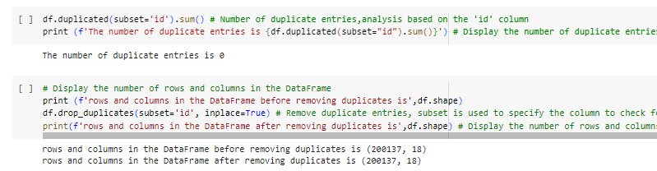
5. Methodology – Double entry of the same tree

Slide 12
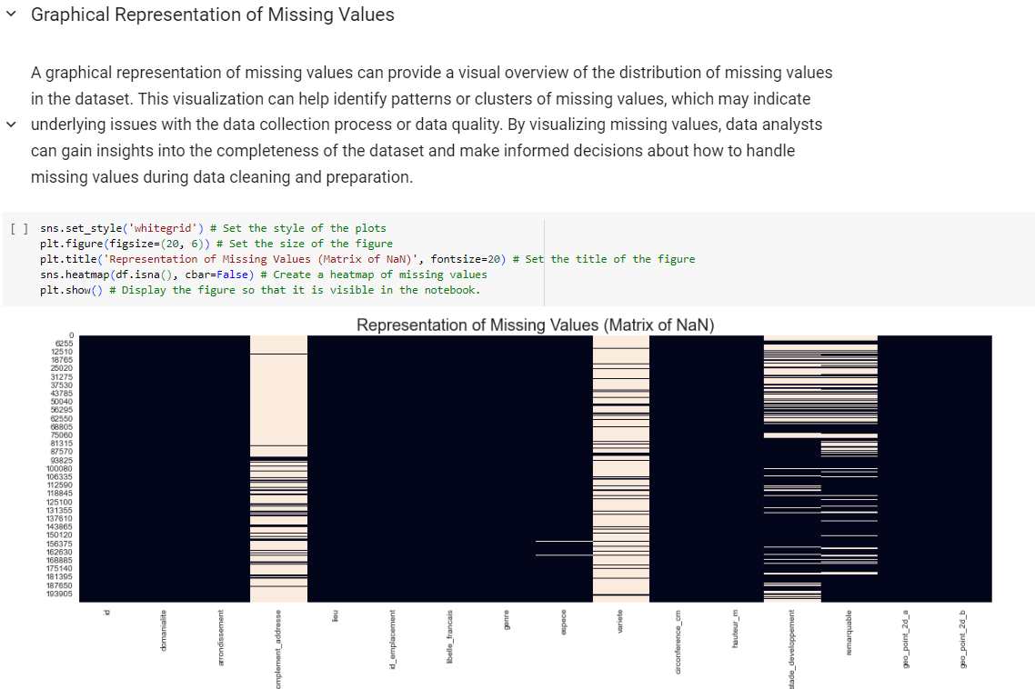
5. Methodology – Graphical Representation of Missing Values (after removing unique value and empty values from the 'numero' and 'type_emplacement' variables respectively

Slide 13
5. Methodology – Observation of Missing Values
Let's analyze the matrix of NaN :
complement_adresse: The matrix indicates a high number of missing values, noticeable from the prevalent light-colored lines throughout this column. It suggests that many entries do not have this additional address information.
varietes: This column also shows a considerable amount of missing data, which means that the variety of whatever entity is being recorded (possibly trees or plants, given the context of other columns) is frequently not specified.
remarquables: Although this column seems to have missing values, it doesn’t appear to be as dense as 'complement_adresse' and 'varietes'. However, due to its likely significance—'remarquable' often refers to something notable or protected—it would be important to investigate why these values are missing and whether they can be sourced from other means or need special attention in analysis.
dominalite, arrondissement, lieu, libelle_francais, genre, espece, circomference_cm, hauteur_m, and stade_developpement seem to have fewer missing values compared to 'complement_adresse' and 'varietes'.
geo_point_2d_a and geo_point_2d_b do not show missing values.
In data cleaning, columns with over 50% missing values are typically removed to ensure dataset integrity. However, for pivotal variables like 'remarquables', which may be essential for analysis, they are retained and considered for imputation to preserve critical information within the context of analysis

Slide 14
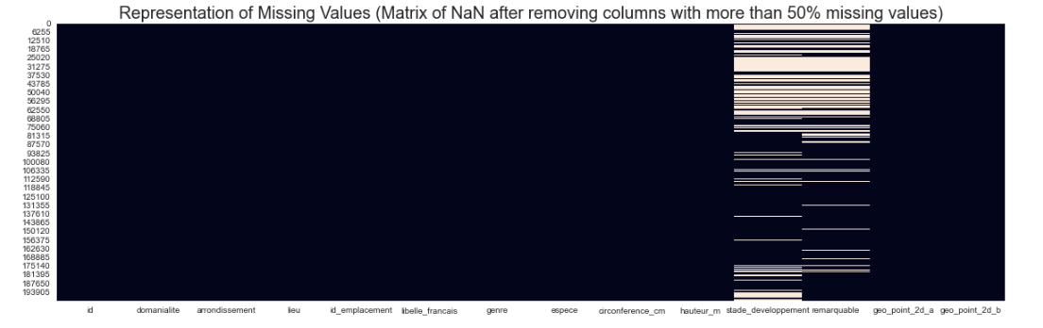
5. Methodology – Graphical Representation of Missing Values

Slide 15

5. Methodology – Missing Values

Slide 16
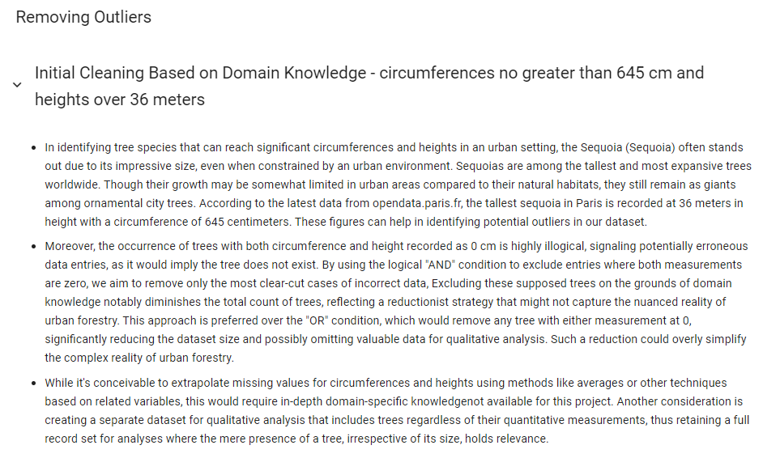
5. Methodology Outliers

Slide 17
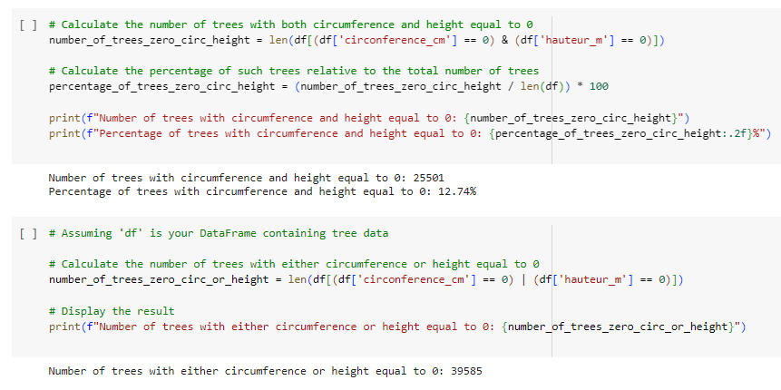
5. Methodology Outliers

Slide 18
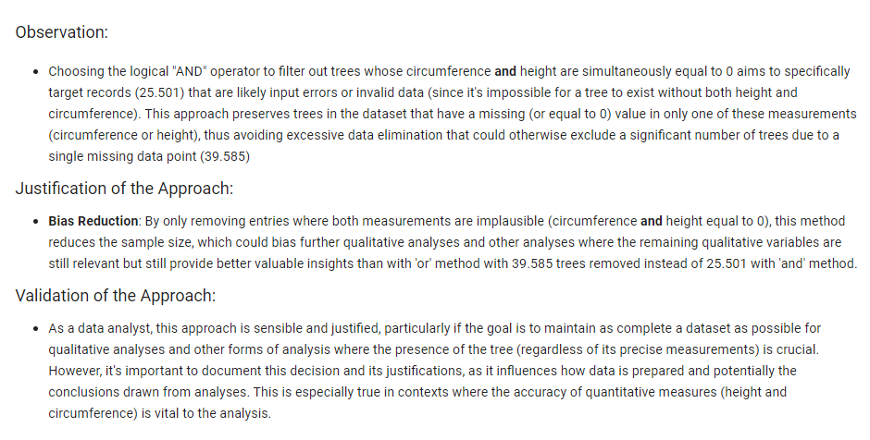
5. Methodology Outliers

Slide 19
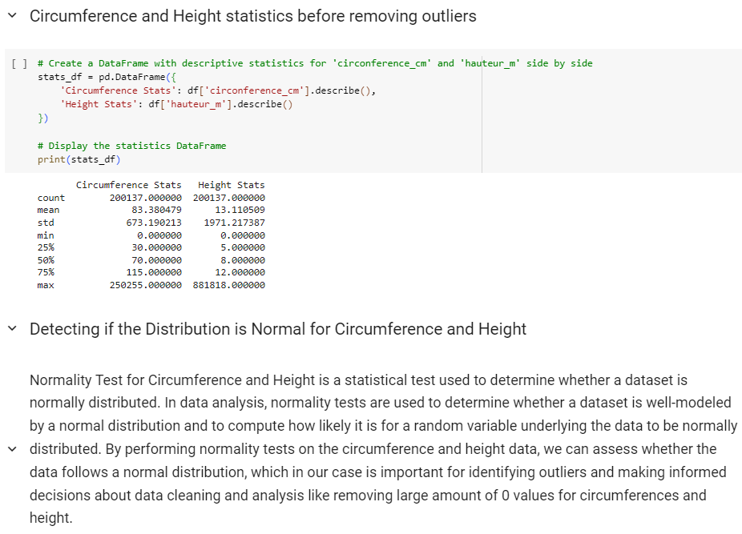
5. Methodology Outliers

Slide 20
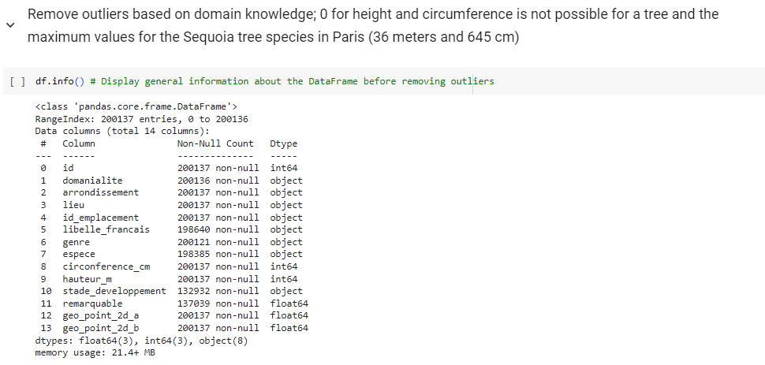
5. Methodology Outliers

Slide 21
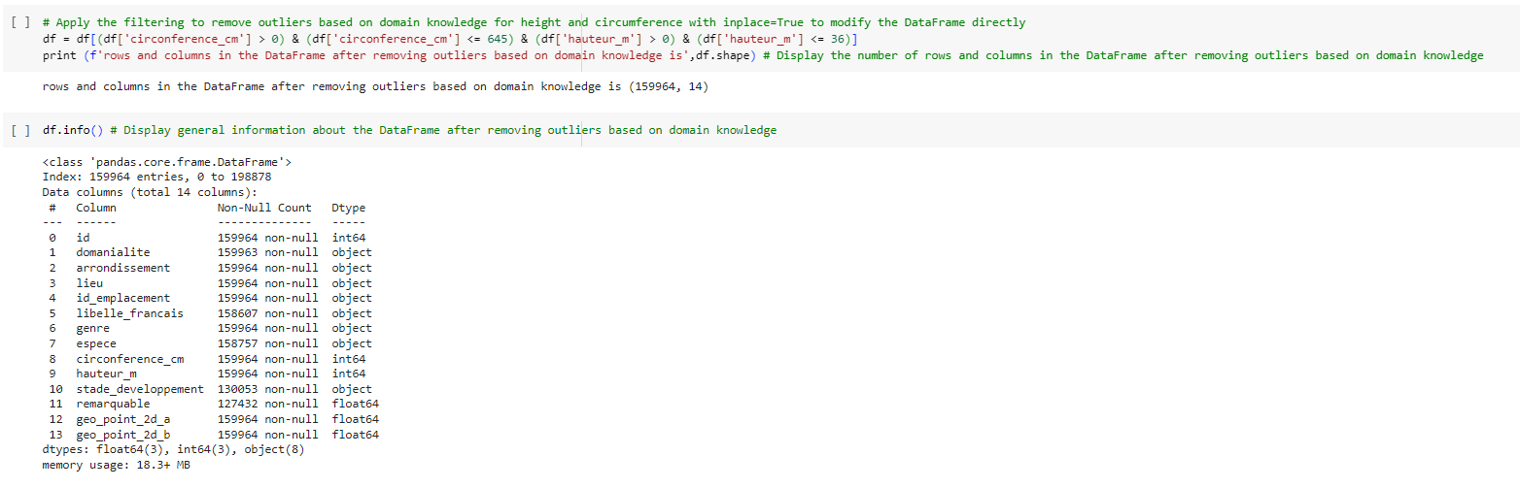
5. Methodology Outliers

Slide 22
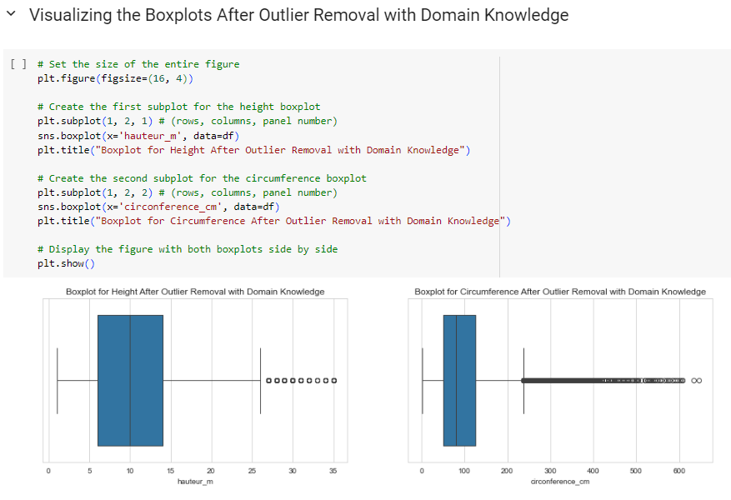
5. Methodology Outliers

Slide 23
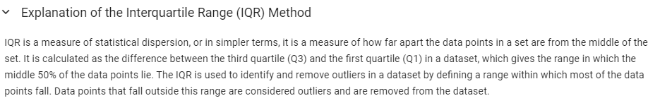
5. Methodology - tatistical Outlier Removal Based on IQR (after removing outliers based on domain knowledge)

Slide 24
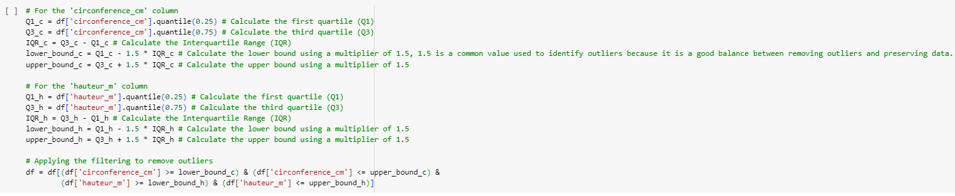
5. Methodology - tatistical Outlier Removal Based on IQR (after removing outliers based on domain knowledge)

Slide 25
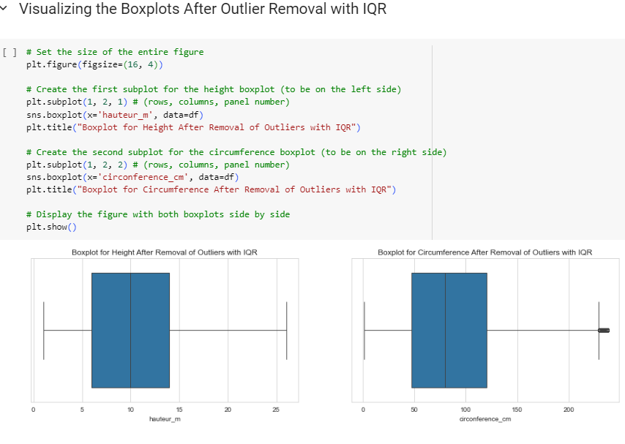
5. Methodology - tatistical Outlier Removal Based on IQR (after removing outliers based on domain knowledge)

Slide 26
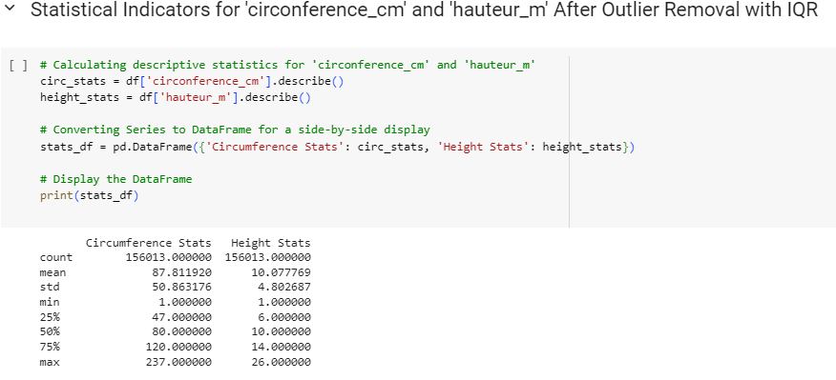
5. Methodology - tatistical Outlier Removal Based on IQR (after removing outliers based on domain knowledge)

Slide 27
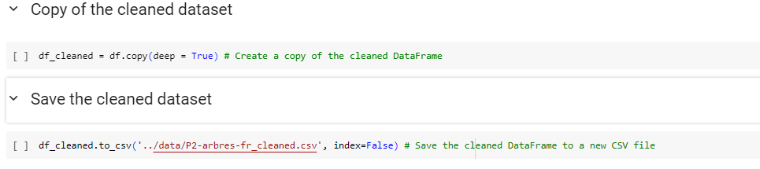
6. Copy and save of the cleaned dataset

Slide 28
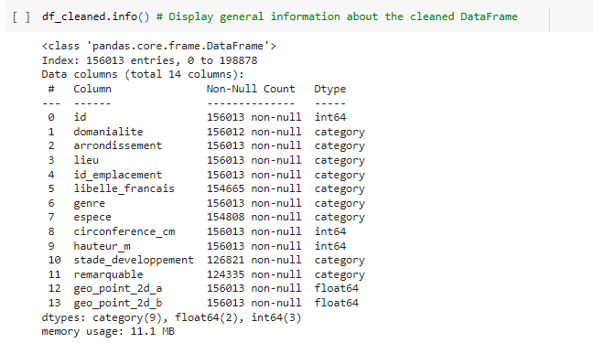
7. General about the cleaned DataFrame

Slide 29
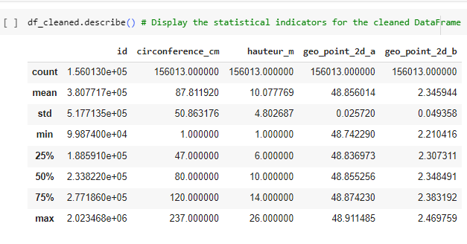
8. Statistical Indicators for the cleaned quantitative Variables

Slide 30
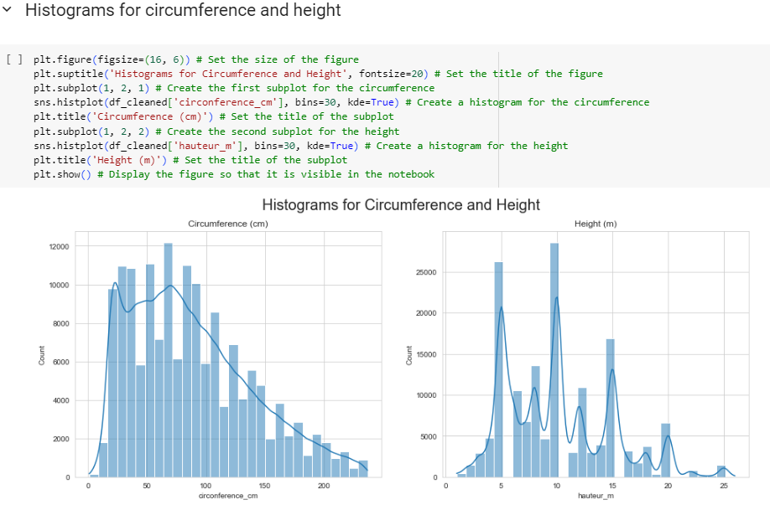
9. Visualizations of quantitative variables used for distribution analysis after data cleaning (domain knowledge, outliers, missing values, and unnecessary columns and IQR)

Slide 31
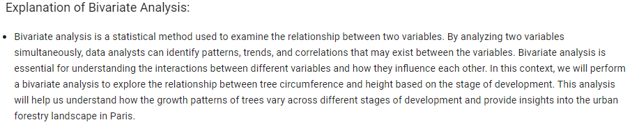
10. Analysis bi-variate : correlation beetween circumference / height and stage of development

Slide 32
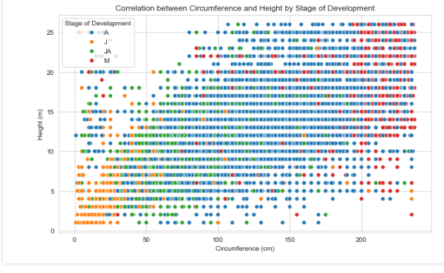
10. Analysis bi-variate : correlation beetween circumference / height and stage of development

Slide 33
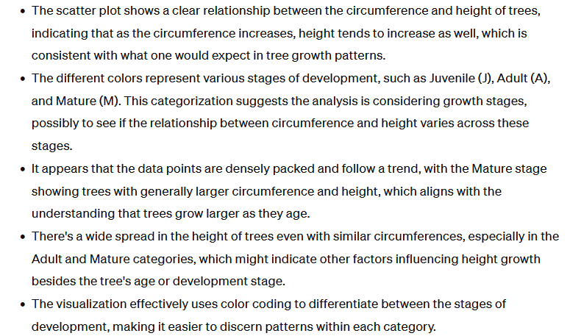
10. Analysis bi-variate : correlation beetween circumference / height and stage of development

Slide 34
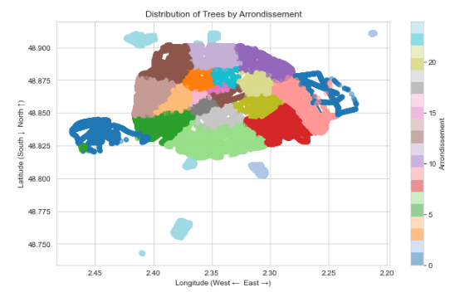
11. Distribution of Tree by arrondissement in scatter plot using geo_point_2d

Slide 35
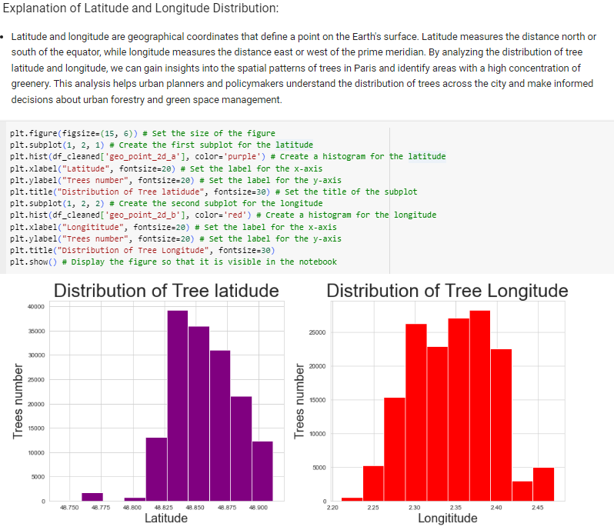
11. Distribution of Tree Latitude and Longitude

Slide 36
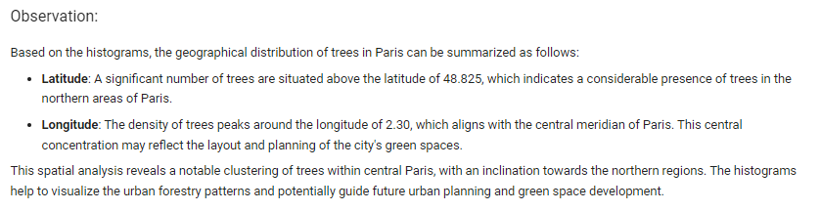
11. Distribution of Tree Latitude and Longitude

Slide 37
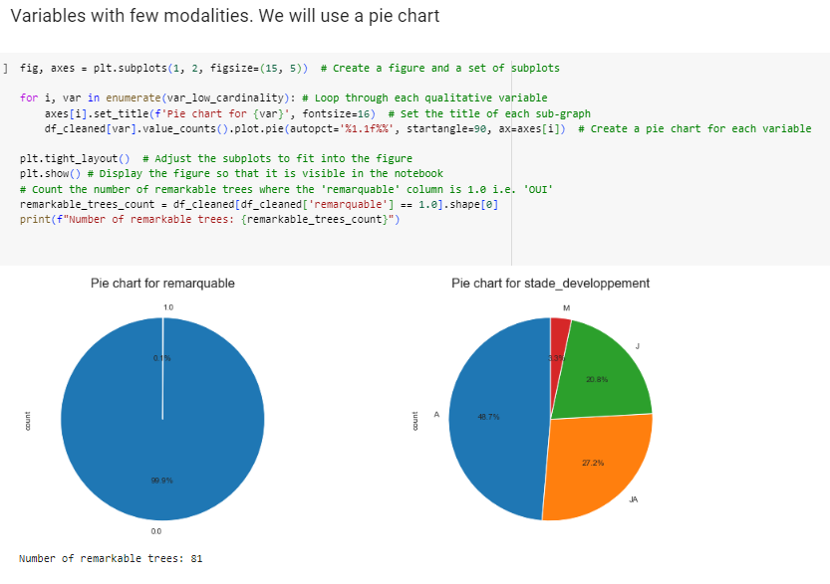
12. Pie Chart for remarquable and stade_developpement

Slide 38
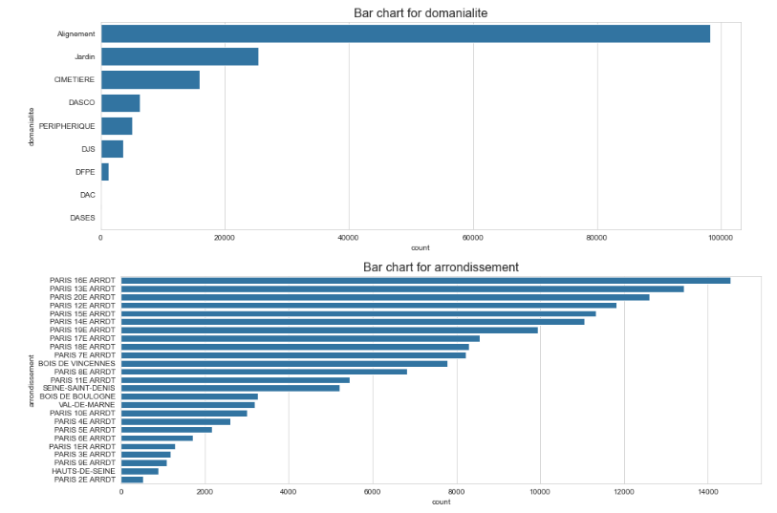
13. Variables with a medium number of modalities. We will use a bar chart

Slide 39
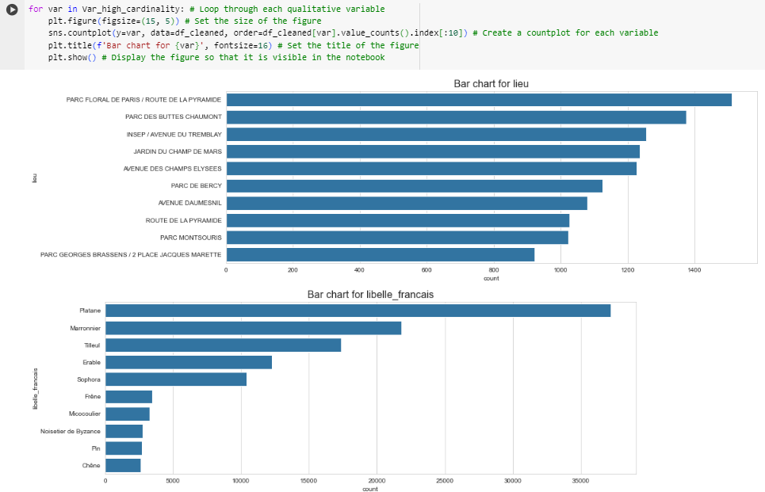
13. Variables with a high number of modalities. We will use a bar chart

Slide 40
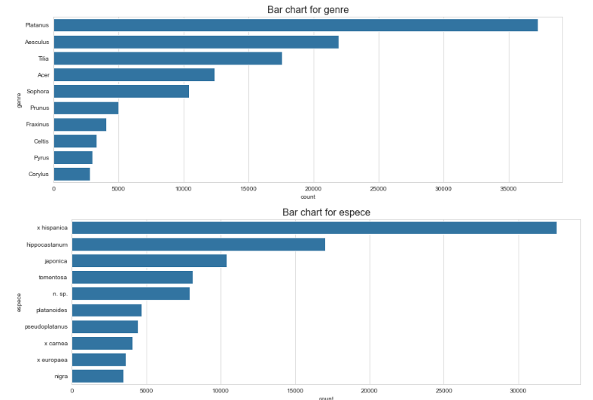
13. Variables with a high number of modalities. We will use a bar chart

Slide 41
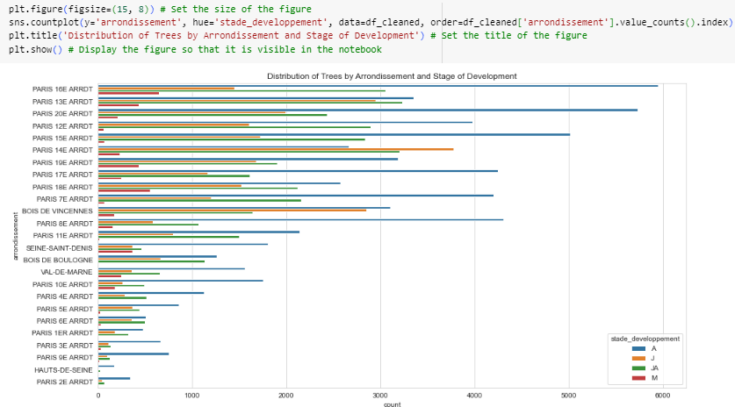
14.Distibution of trees by arrondissement according to the stage of development with A = adult, J = young, M = mature, JA = young adult

Slide 42
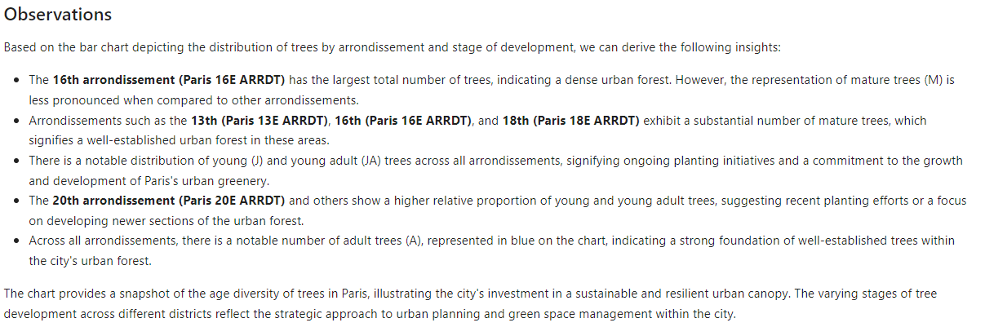
14.Distibution of trees by arrondissement according to the stage of development with A = adult, J = young, M = mature, JA = young adult

Slide 43
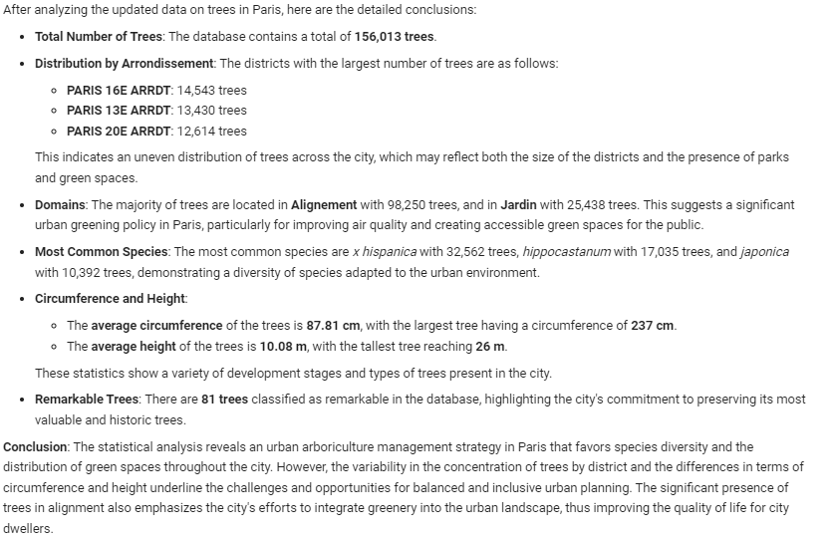
15.Comment on the results

Slide 44
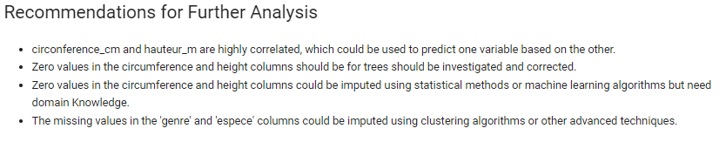
16. Recommendations

Slide 45
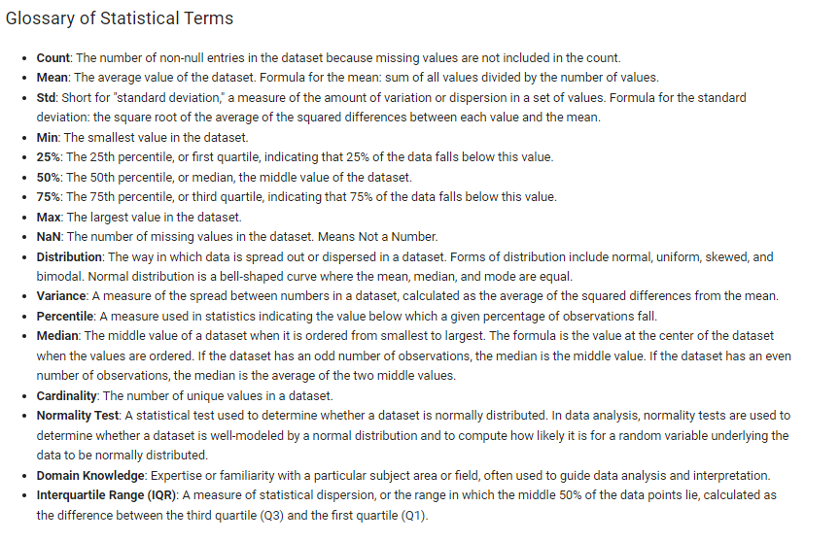
17. Glossary of statitiscal terms

