Slide 1
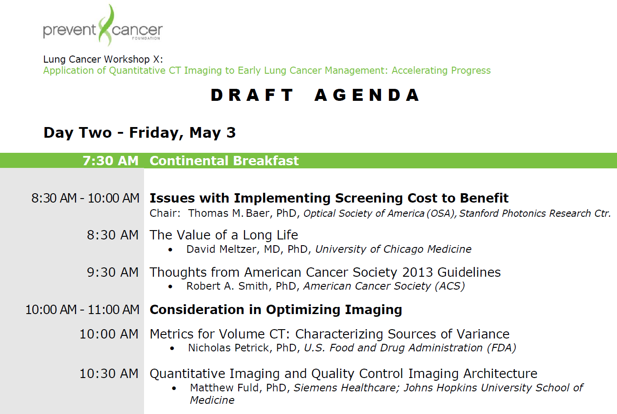

Slide 2

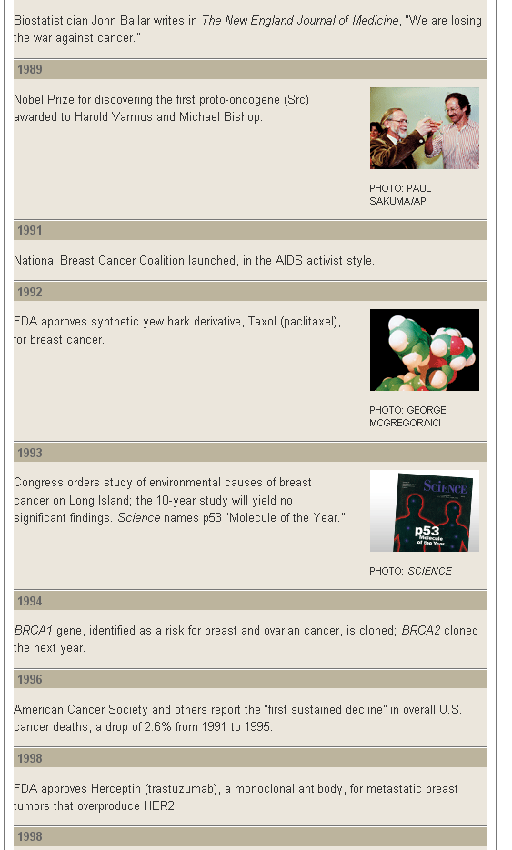
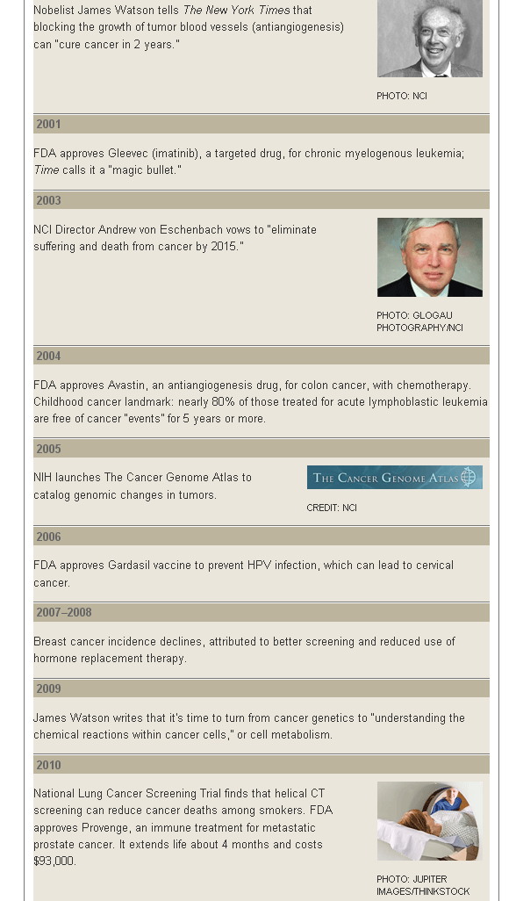
History of the War on Cancer
(Science, 2010)

Slide 3
Group B
Strategic Planning: Exploring Models for Implementing a National Infrastructure for Quantitative Imaging in Early Lung Cancer Management
Tom Baer
Laurie Fenton
Carolyn Aldige

Slide 4
Patients
FDA
Cost
Reimbursement
Convenience
Effectiveness
NIH
Efficacy
Cost
Alternatives
Clinical data
Cost effectiveness
Professional society support
Patient advocacy pressure
Private Insurers
CMS
NIH/FDA support
Financial model
Patient pressure
Advocacy groups
Clinical data
Cost effectiveness
Professional society support
Patient advocacy pressure
Congress
Department of Defense
Advocacy Groups
Clinical data
Cost effectiveness
Professional society support
Patient advocacy pressure
Clinical data
Cost effectiveness
Professional society support
Patient advocacy pressure
Instrument Manufacturers
Media
Hospital Administrators
Number of instruments
Proprietary advantage
Reimbursement
Regulatory hurdles
Clinical data
Cost effectiveness
Professional society support
Patient advocacy pressure
Radiologists
AHRQ
USPSTF
Surgeons
Efficacy of CT data
Reimbursement
Intervention options
Clinical data
Cost effectiveness
Professional society support
Patient advocacy pressure
Cardiologists
Pulmonologists
Efficacy of CT data
Reimbursement
Intervention options
Efficacy of CT data
Reimbursement
Intervention options
Big Pharma
Investors
Clinical data
Cost effectiveness
Professional society support
Patient advocacy pressure
Financial model
Radiologists who will read screening scans
Geographic locations
World-wide market
CT Clinics
Clinical data
Cost effectiveness
Professional society support
Patient advocacy pressure

Slide 5
USPSTF

