Slide 1
Urban Housing And Development
Team - 13:
Vivek Sharma
Riten Chhatrala
Preyang Shah

Slide 2
Affordable Rental housing
The following will be the features :
You can select the different dataset for different city.
You can see the database in tabular format or you can see houses on Google map for which we are using Google API.
You can see different chart like Line, Stack, Pie, Bar Chart by clicking on view chart option.
You can filter dataset by Rows, Columns, Query.
After applying filter you can export the dataset in CSV or Json.

Slide 3
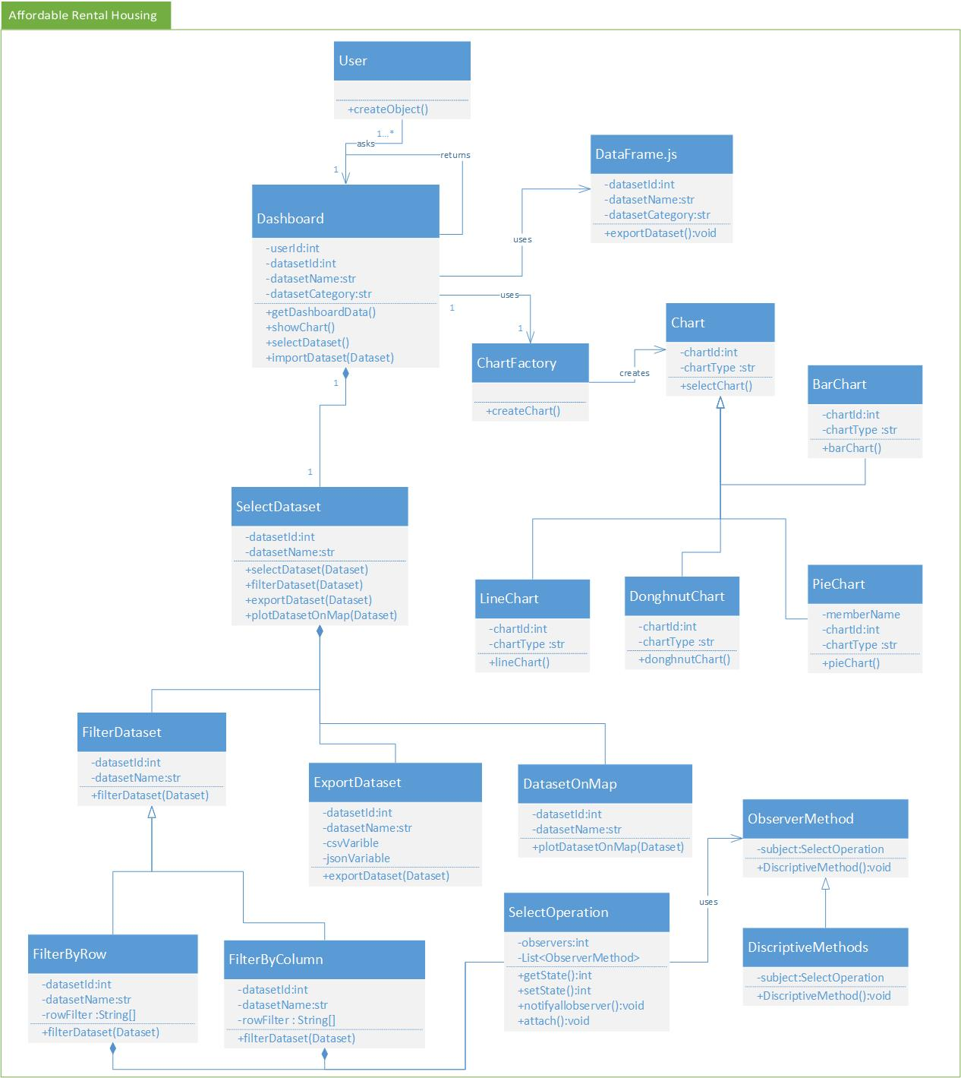
Design Model Class Diagram

Slide 4
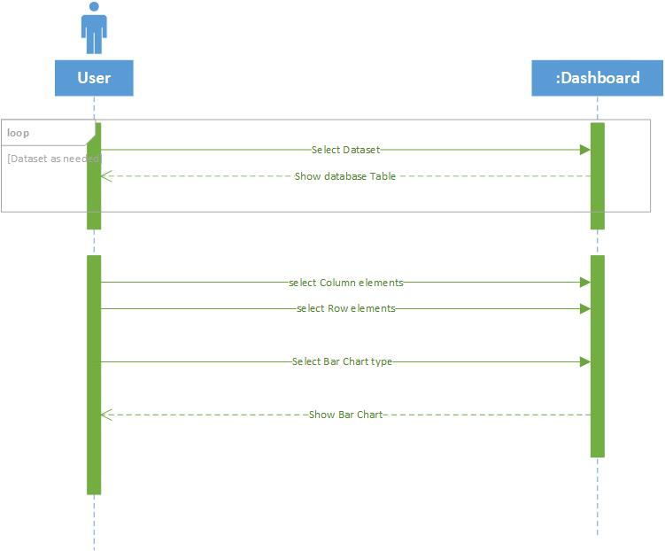
Sequence Diagram
Display Chart Sequence Diagram

Slide 5
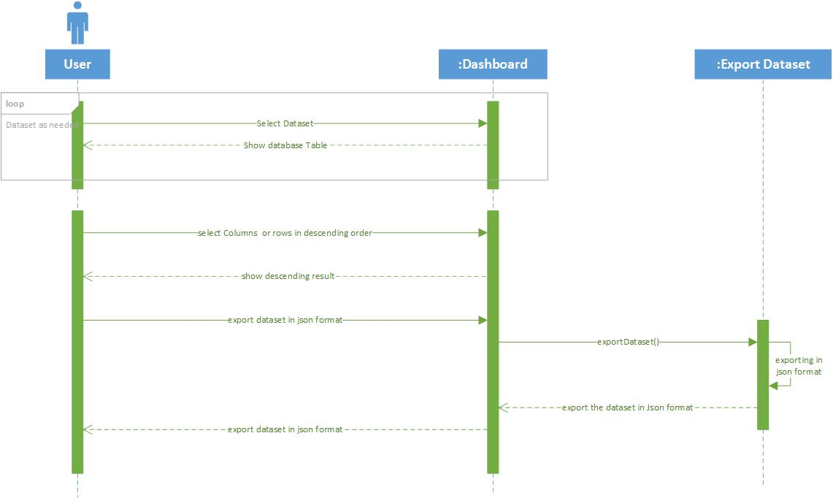
2. Export Dataset

Slide 6
Design Patterns
Factory Method Design Pattern
The Factory method design pattern is creational pattern which helps creating an object, but let subclasses decide which class to instantiate. Factory method lets a class defer instantiation to subclasses.
In, Factory pattern, we create object without exposing the creation logic to the client and refer to newly created object using a common interface.
In our System, chartFactory class has the factory method which calls Chart class and it is abstract class and the classes named PieChart, BarChart, LineChart, DoughnutChart is concrete classes which will implement the method of Chart class.

Slide 7
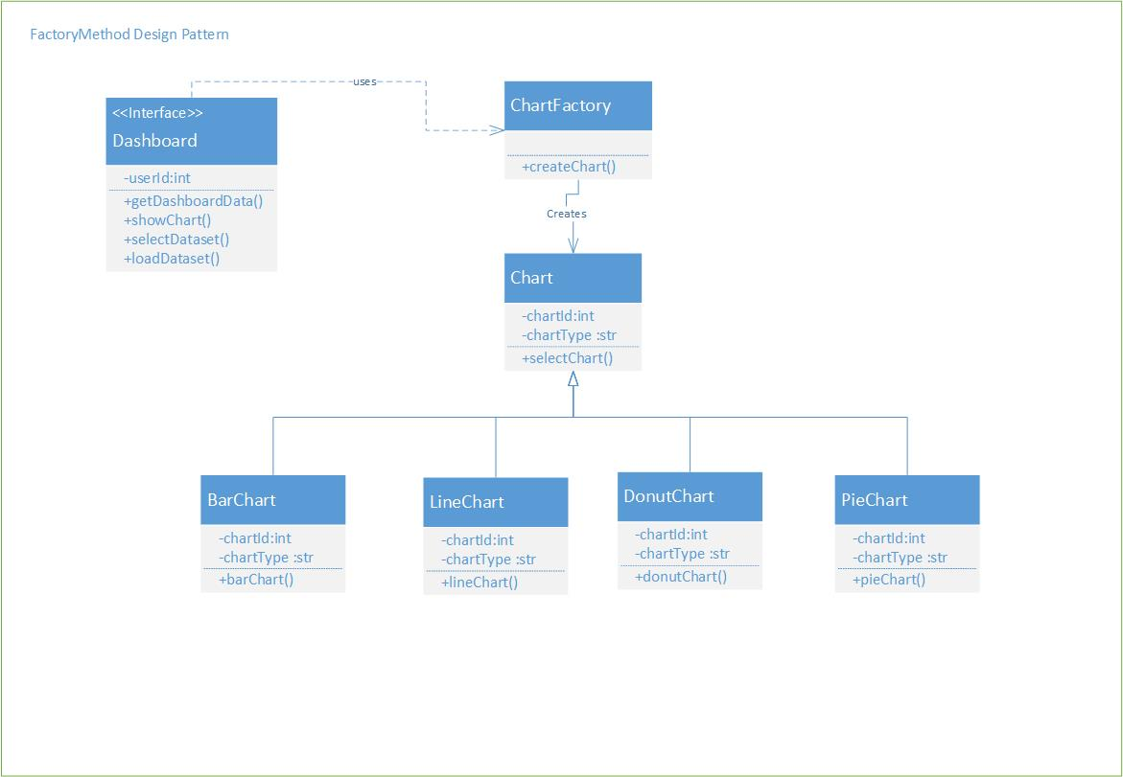
Factory Method Design Pattern

Slide 8
2. Singleton Design Pattern
This pattern involves a single class which is responsible to create an object while making sure that only single object gets created. This class provides a way to access its only object which can be accessed directly without need to instantiate the object of the class.
In our System, Singleton class is Dashboard whose object is created only once. Dashboard class provides a way to access its “only object” which can be accessed directly.

Slide 9
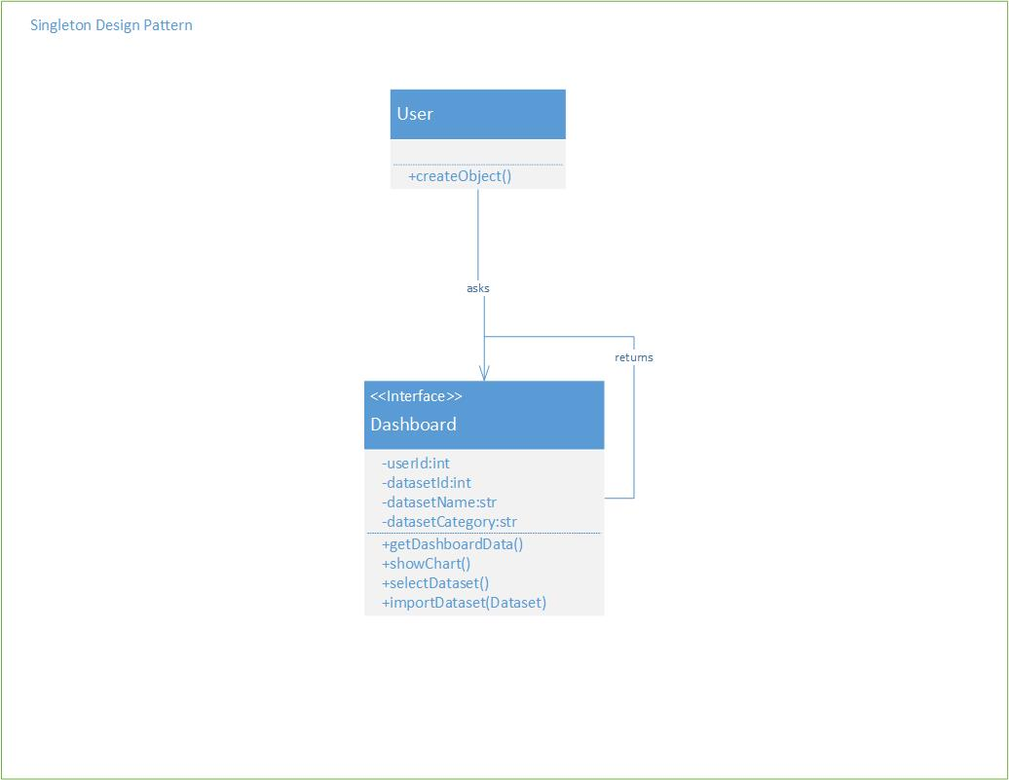
2. Singleton Design Pattern

Slide 10
3. Observer Design Pattern
Observer pattern is used when there is one-to-many relationship between objects such as if one object is modified, its dependent objects are to be notified automatically. Observer pattern falls under behavioral pattern category.
The observer pattern is also a key part in the familiar model-view-controller (MVC) architectural pattern.
In our System, ObserverMethod Class updates the SelectOperation class who Notify for the event when data is updated in DiscriptiveMethod class.
• Here, ObserverMethod is observer class which observer 1 classes named DiscriptiveMethod class. If data of any FilterByColumn or FilterByRow class changes then it notifies ObserverMethod class.

Slide 11
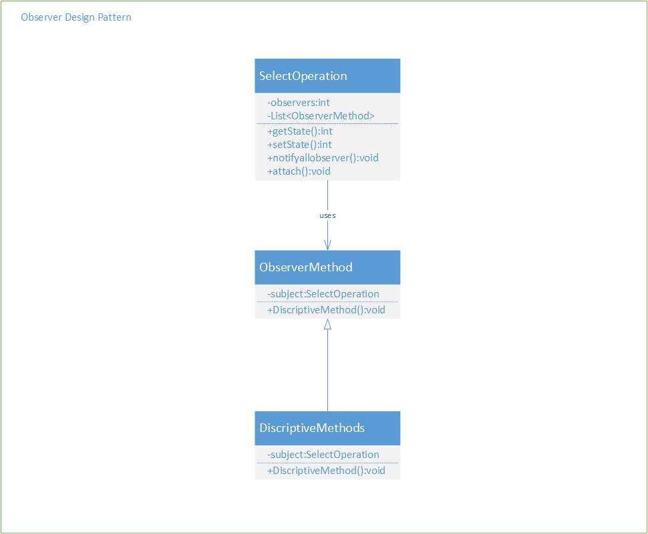
3. Observer Design Pattern

Slide 12
Dataset References
https://data.cityofchicago.org/Community-Economic-Development/Affordable-Rental-Housing-Developments/s6ha-ppgi
https://data.sfgov.org/Housing-and-Buildings/Map-of-MOHCD-s-Affordable-Rental-Portfolio/2hwb-ndvk/data
https://data.cityofnewyork.us/Housing-Development/Housing-New-York-Units-by-Building/hg8x-zxpr
https://egis-hud.opendata.arcgis.com/datasets/3d6ef39026b94eb59ddb7ce28eb0b692_0?uiTab=table
https://data.austintexas.gov/Building-and-Development/Affordable-Housing-Inventory-AHI-/x5p7-qyuv

Slide 13
Thank
You!

