Slide 1

AI Duplicate Image Checker
A lightweight desktop tool for spotting repeated images during amends
Presley Dobson • Easy Read Online • January 2026
Notes:
[Sources]
- User-provided Easy Read Online logo screenshot (local file)
[/Sources]

Slide 2
Why this exists
The amends problem: image reuse is hard to track manually
Pain points during amends
What we need
A single image can appear multiple times across a document
Re-use may be intentional (icons) or accidental (wrong context)
Manual scanning is slow in long PDFs
Hard to confirm every reuse location before sending updates
Duplicate groups (clustered by similarity)
Page numbers for each group
A preview image to verify quickly
Sorted by “most duplicated first”
Focus: reduce manual checking time and increase confidence during amends.
Notes:
[Sources]
- Problem framing based on internal workflow observation (no external sources)
[/Sources]

Slide 3
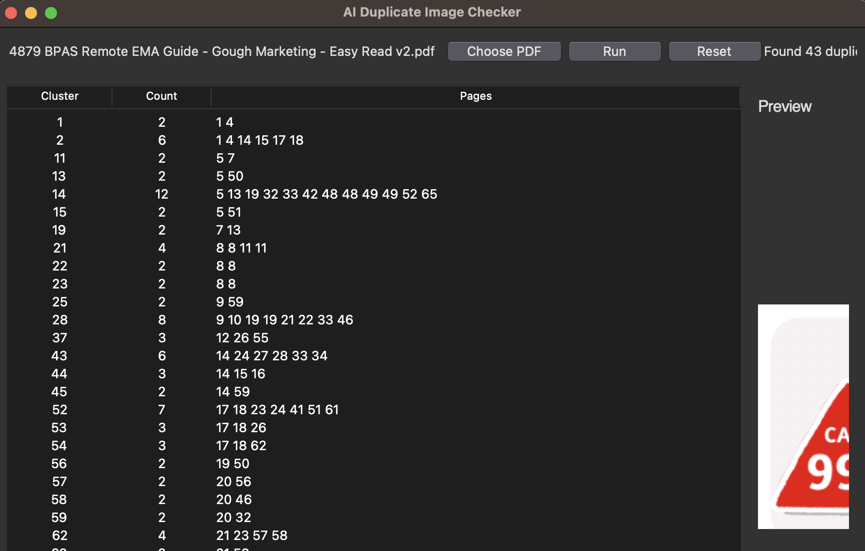
Current prototype
Desktop UI showing duplicate clusters with page numbers and a preview
Key features
Choose a PDF
Run the check
Clusters ordered by count
Click a row to preview
Reset between documents
Notes:
[Sources]
- User-provided prototype screenshot (local file)
[/Sources]

Slide 4
How it works
Pipeline from document → image regions → embeddings → clusters
Input
Extract
Embed
Cluster
Review
PDF (today)
Pages (next)
Find image blocks
Render regions
OpenCLIP
Image embeddings
Cosine similarity
Group duplicates
Sorted results
Pages + preview
The AI part: embeddings make “same image but resized/edited” match more reliably than byte-level hashing.
Notes:
[Sources]
- Method description based on implemented approach (PyMuPDF + OpenCLIP embeddings)
[/Sources]

Slide 5
Workflow for writers & editors
Designed to be usable without terminal commands
Typical use
1) Export Pages → PDF (or choose PDF directly)
2) Choose PDF in the app
3) Run the check
4) Start at the top (most duplicates)
5) Click each row to preview and verify
6) Reset before the next document
Notes:
[Sources]
- User-provided prototype screenshot (local file)
[/Sources]

Slide 6
What’s improved already
From a CLI script → a branded desktop tool
Usability
Presentation
No terminal needed (Automator launcher)
Simple controls: Choose PDF, Run, Reset
Preview pane for quick verification
White, high-contrast UI
FS Me font + brand accents
Team-friendly table layout
Signal quality
Maintainability
Embeddings reduce missed matches vs byte hashing
Basic filters reduce icon/template noise
Results ordered by highest duplicate count
Separated core + UI modules
Requirements file for setup
Devlog for evidence and iteration
Notes:
[Sources]
- Summary based on project implementation and repo artefacts (no external sources)
[/Sources]

Slide 7
Next steps
Planned improvements based on team feedback
Short-term (next iteration)
Progress bar + Cancel for long documents
Drag-and-drop PDF onto the app
Pages document support by exporting to PDF automatically (macOS)
Optional “Export CSV / Copy results” for sharing
Longer-term
Tuning controls (Strict / Balanced / Loose)
Ignore-list for known template icons/logos
Fallback mode for “flattened” PDFs
Packaging as a standalone .app when storage allows
Notes:
[Sources]
- Roadmap based on team feedback captured during development
[/Sources]

Slide 8
Feedback & rollout
How the team can start using it and what feedback helps most
What I need from the team
Try it on 1–2 documents you’re already amending
Tell me which clusters were useful vs noisy
Share examples where images are combined with icons/labels
Suggest small workflow tweaks (export, copy, filters)
Where this fits
An assistive tool: it speeds up review, but editorial judgement stays with the writer/editor.
Thanks!
Notes:
[Sources]
- Content based on internal rollout plan
[/Sources]

