Slide 1
An Approach for Static Analysis of Fluent APIs
26M30498 | Dennis Prüne
PRG Lab | 2026-07-24

Slide 2
Contents
Background
Related Work
My Proposal
Current Progress & Summary

Slide 3
What are Fluent APIs?
Background
List<Integer> ys = new ArrayList();
for (int x : xs) {
if (x >= 0) {
ys.add(2 * x);
}
}
List<Integer> ys = xs
.stream()
.filter(x -> x >= 0)
.map(x -> 2 * x)
.collect();
Imperative Style
Fluent Style
For-loops, if-clauses, …
Nested
Method chaining
Flat

Slide 4
Fluent APIs 🤝 Embedded DSLs
Background
SELECT name, birth_year
FROM Students
WHERE birth_year == 2005
naïve embedding
fluent embedding
Query query = SQL.query(
"SELECT name, birth_year "
+ "FROM Students "
+ "WHERE birth_year == 2005");
Query query = SQL
.select("name, birth_year")
.from("Students")
.where("birth_year == 2005");

Slide 5
The Tradeoff
Background
Advantages
Disadvantages
Less syntax to remember
Dynamic data support
NO static safety guarantees
NO syntax checking
NO type checking
NO semantic analysis
SQL.select(field).from("Students")
can be set
programmatically
SQL.select("name, birth_year")
.from("Students")
.from("Teachers")
illegal syntax
causes runtime error

Slide 6
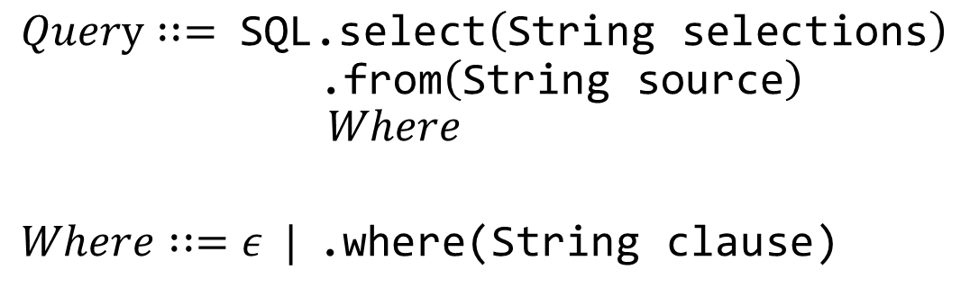
Safe Fluent APIs
Related Work
[EriLex, H. Xu, 2010][Fling, Gil & Roth, 2019][...]
Goal: Disallow bad method chains at compile time
Encode allowed chains as a CFG
Generate a fluent API where this syntax is encoded in the type system (Enums + Generics)
$$Query : := \text{SQL}\text{.}\text{select}\left(\text{String} \text{selections}\right) \\ \text{ .}\text{from}\left(\text{String} \text{source}\right) \\ Where$$ $$Where : :=ε | \text{.}\text{where}\text{(}\text{String} \text{clause}\text{)}$$

Slide 7
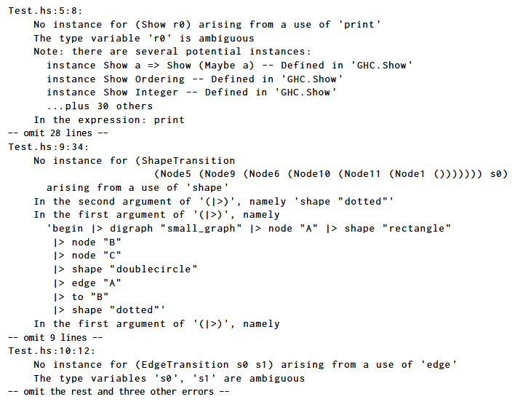
Limitations
Related Work
Only ensures partial syntactic correctness
Verbose error messages
realistic error message
SQL.select("1 + 6").from("Students")
syntax error which cannot
be detected by safe fluent API

Slide 8
Static Analysis via Backtranslation
Proposal
1. Find embedded language code
2. Translate to original DSL
3. Analyze w/ existing tools
4. Project results onto input

Slide 9
1. Find EDSL Code
Proposal
class Bar {
...
public void foo() {
...
Query query = SQL.select("name")
.from("Students")
.where("age == 18");
...
}
}
Query
select
from
where
"name"
"Students"
"age == 18"

Slide 10
2. Backtranslation
Proposal
Query
select
from
where
"name"
"Students"
"age == 18"

Slide 11
2. Backtranslation
Proposal
Query
select
from
where
"name"
"Students"
"age == 18"

Slide 12
2. Backtranslation
Proposal
Query
SELECT
select
from
where
"name"
"Students"
"age == 18"

Slide 13
2. Backtranslation
Proposal
Query
SELECT name
select
from
where
"name"
"Students"
"age == 18"

Slide 14
2. Backtranslation
Proposal
Query
SELECT name
select
from
where
"name"
"Students"
"age == 18"

Slide 15
2. Backtranslation
Proposal
Query
SELECT name
select
from
where
"name"
"Students"
"age == 18"

Slide 16
2. Backtranslation
Proposal
Query
SELECT name
FROM
select
from
where
"name"
"Students"
"age == 18"

Slide 17
2. Backtranslation
Proposal
Query
SELECT name
FROM Students
WHERE age == 18
select
from
where
"name"
"Students"
"age == 18"

Slide 18
3. Analysis
Proposal
SELECT name
FROM Students
WHERE age == 18
SELECT name
FROM Students
WHERE age == 18
age
Parse Successful✅
1 Semantic Error ❌

Slide 19
4. Projection
Proposal
class Bar {
...
public void foo() {
...
Query query = SQL.select("name")
.from("Students")
.where("age == 18");
...
}
}
SELECT name
FROM Students
WHERE age == 18
age
Parse Successful✅
1 Semantic Error ❌

Slide 20

4. Projection
Proposal
class Bar {
...
public void foo() {
...
Query query = SQL.select("name")
.from("Students")
.where("age == 18");
...
}
}
SELECT name
FROM Students
WHERE age == 18
age
Parse Successful✅
1 Semantic Error ❌
Unselected column 'age'
Select 'age' from 'Students'

Slide 21
Static Analysis via Backtranslation
Proposal
1. Find embedded language code
2. Translate to original DSL
3. Analyze w/ existing tools
4. Project results onto input

Slide 22
Challenges & Limitations
Proposal
Users will need to install an editor plug-in
Dynamic parameters are problematic…

Slide 23
Dynamic Parameters
Proposal
EDSL Code
SQL.select(field).from("Students")
DSL Template
SELECT {field} FROM Students
Next step:
Find value using dataflow analysis
Otherwise, insert some valid value

Slide 24
Current Progress
✅Come up with new method
🚧Create a Prototype
🚧Test it on existing Code

Slide 25
Summary
Fluent APIs for embedded DSLs are very useful!
…static analysis is very limited
My proposed method:
1. Find embedded language code
2. Translate to original DSL
3. Analyze w/ existing tools
4. Project results onto input

Slide 26
Style Sheet
class Example {
public void main(String[] args) {
if (args.length > 0) {
if (args[0].equals("help")) {
System.out.println("There's no help for the wicked...");
}
}
}
}
error
SELECT * FROM Students WHERE name == "John Doe"
error
Error annotation
Keyword
"Hello World!"
1_000_000
other
3.141529
Error annotation
Fix suggestion
true

