Slide 1
Backtranslating Fluent APIs
26M30498 | Dennis Prüne
PRG Lab

Slide 2
Contents
Background
Related Work
My Proposal
Current Progress & Summary

Slide 3
What are Fluent APIs?
Background
List<Integer> ys = new ArrayList();
for (int x : xs) {
if (x >= 0) {
ys.add(2 * x);
}
}
List<Integer> ys = xs
.stream()
.filter(x -> x >= 0)
.map(x -> 2 * x)
.collect();
Imperative Style
Fluent Style
For-loops, if-clauses, …
Nested
Method chaining
Flat

Slide 4
Fluent APIs 🤝 Embedded DSLs
Background
SELECT name, birth_year
FROM Students
WHERE birth_year == 2005
naïve embedding
fluent embedding
Query query = SQL.query(
"SELECT name, birth_year "
+ "FROM Students "
+ "WHERE birth_year == 2005");
Query query = SQL
.select("name, birth_year")
.from("Students")
.where("birth_year == 2005");

Slide 5
The Tradeoff
Background
Advantages
Disadvantages
Less syntax to remember
Dynamic data support
NO static safety guarantees
NO syntax checking
NO type checking
NO semantic analysis
SQL.select(field).from("Students")
can be set
programmatically
SQL.select("name, birth_year")
.from("Students")
.from("Teachers")
illegal syntax
causes runtime error

Slide 6
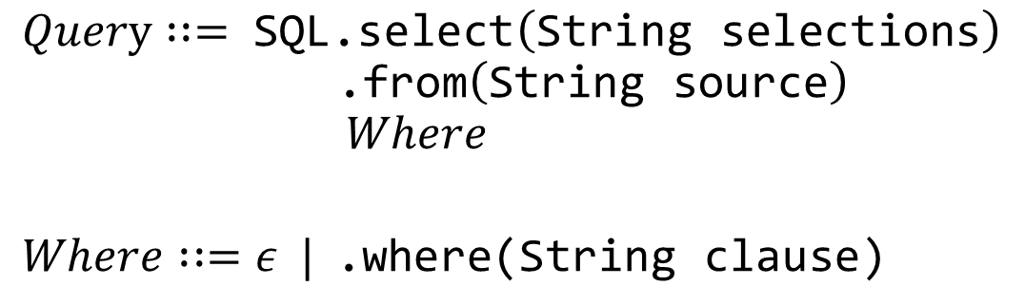
Safe Fluent APIs[EriLex, H. Xu, 2010][Fling, Gil & Roth, 2019][...]
Related Work
Goal: Disallow bad method chains at compile time
Encode allowed chains as a CFG
Generate a fluent API where this syntax is encoded in the type system
$$Query : := \text{SQL}\text{.}\text{select}\left(\text{String} \text{selections}\right) \\ \text{ .}\text{from}\left(\text{String} \text{source}\right) \\ Where$$ $$Where : :=ε | \text{.}\text{where}\text{(}\text{String} \text{clause}\text{)}$$

Slide 7
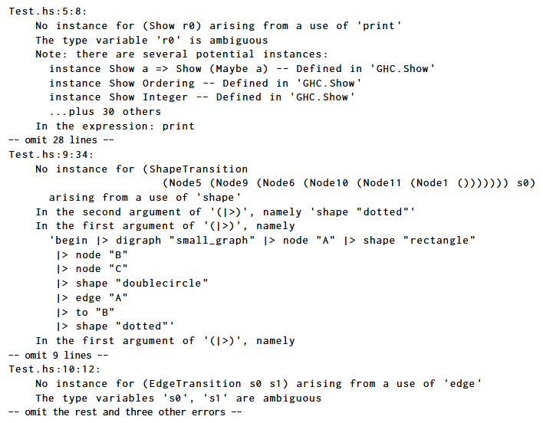
Limitations
Related Work
Only ensures partial syntactic correctness
Verbose error messages
realistic error message
SQL.select("1 + 6").from("Students")
syntax error which cannot
be detected by safe fluent API

Slide 8


Why not translate back?
Proposal
Fluent API
/
DSL
Host Language
Static
Backtranslation

Slide 9
Possible Use Cases
Proposal
Full syntax checking
Semantic Analysis
In-editor error messages
Custom syntax highlighting
this is how fluent API
code might look in the editor
SQL.select("name, birth_year")
.from("Students")
.where("age == 16 AND name == 'Joe'")
Unselected column 'age'
Select 'age' from 'Students'

Slide 10
How can backtranslation be done?
Proposal
SQL.select("*").from("Students")
transform
Chain
traverse & translate
select
from
SELECT * FROM Students
"*"
"Students"

Slide 11
Current Progress
Come up with new method
Create a Prototype
Test it on existing Code

Slide 12
Summary
Fluent APIs for embedded DSLs are very useful!
…static analysis is very limited
I proposed a simple and extendable way to translate method chains back to the original DSL

Slide 13

Style Sheet
class Example {
public void main(String[] args) {
if (args.length > 0) {
if (args[0].equals("help")) {
System.out.println("There's no help for the wicked...");
}
}
}
}
error
SELECT * FROM Students WHERE name == "John Doe"
error
Error annotation
Keyword
"Hello World!"
1_000_000
other
3.141529
Error annotation
Fix suggestion
true

