Slide 1

Perception for Robots
I.
BASICS
Thanks to Peter Corke for the use of some slides

Slide 2
What is a robot
For the purposes of this class a robot is a goal oriented machine that can sense, reason and act.
sensing
reasoning
acting

Slide 3
BASIC QUESTIONS
Where am I
Where are you
What are you
How do I get there
How to achieve a task

Slide 4
Where am I
Why not use GPS?
GPS is not perfect and has severe limitations is environments where robots are needed:
--- cities, mines, industrial sites, underwater,
deep forest.
It only tells where I am

Slide 5
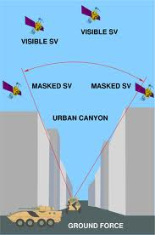

Urban Canyon Problem

Slide 6
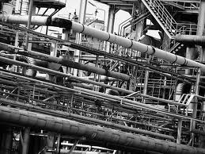
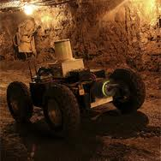
Industrial sites, mines

Slide 7

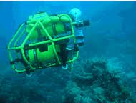
Underwater, deep forest

Slide 8
Humans and animals have a number of senses
Sight
Hearing
Touch
Smell
Taste
Balance
Echolocation: bats, electric fields: sharks, compass: birds

Slide 9
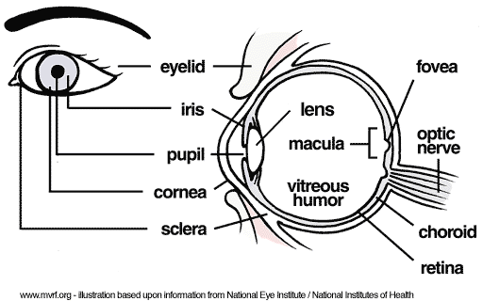
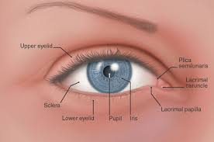
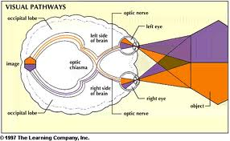
Vision

Slide 10
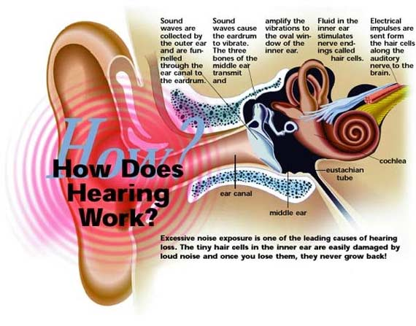
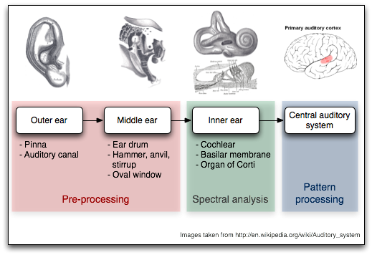
Hearing

Slide 11
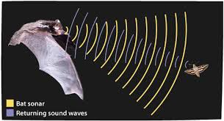
Echolocation of bats

Slide 12
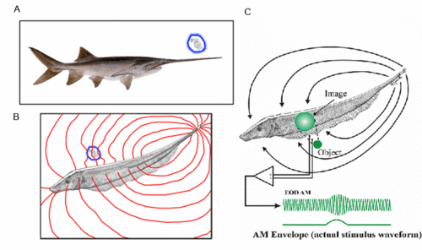
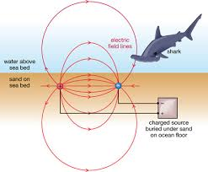
Electric field sensing

Slide 13
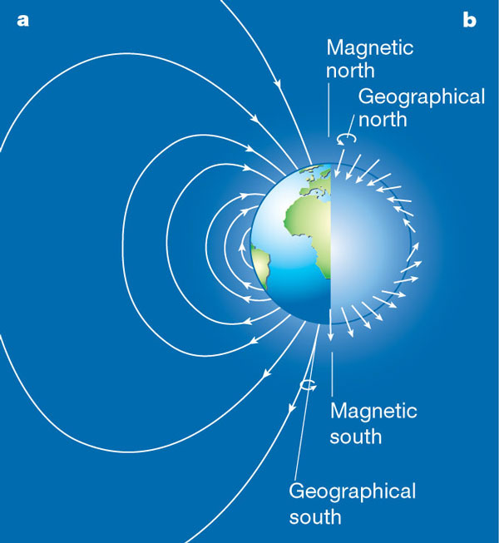
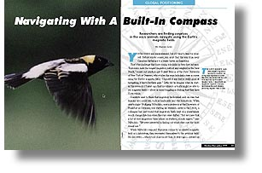
Magnetic field sensing

Slide 14
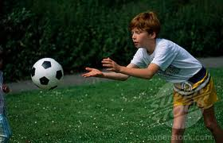

Vision: most powerful sense
Essential for survival: finding food, avoiding being food, finding mates
Long range sensing: beyond our fingertip (vision is our way to touch the world)

Slide 15
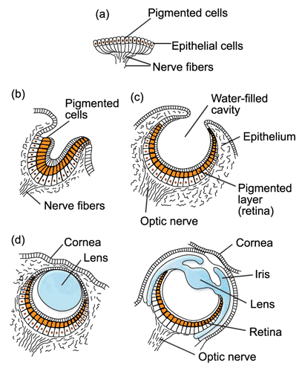
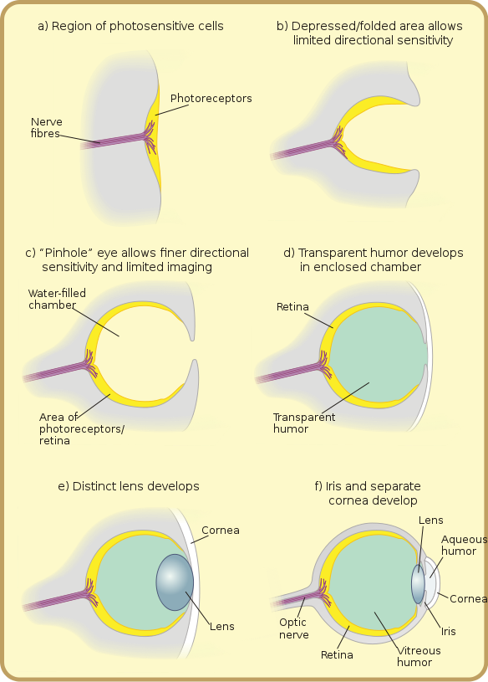
Evolution of the eye ½ billion years

Slide 16

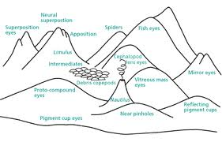
Climbing mount improbable 10 different designs

Slide 17

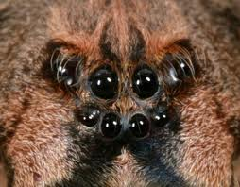
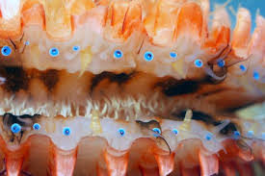

A plethora of eyes

Slide 18
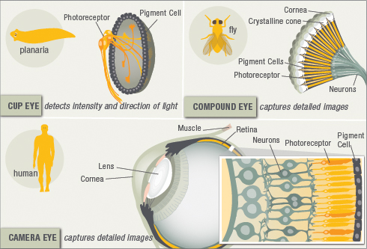
Complex Eyes

Slide 19
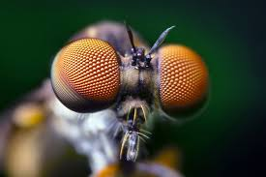
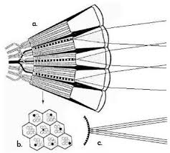
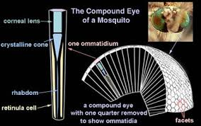
Compound eyes

Slide 20
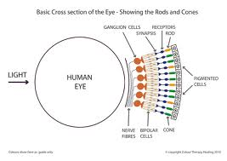
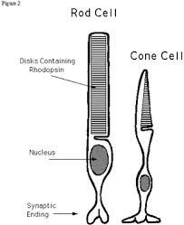
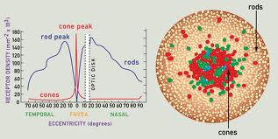
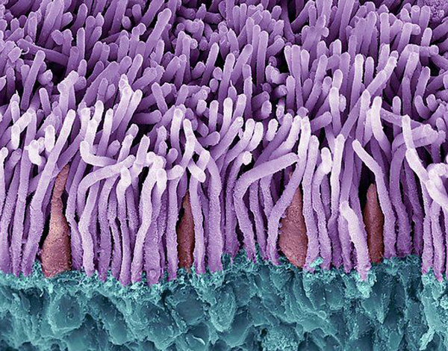
Human Eyes

Slide 21
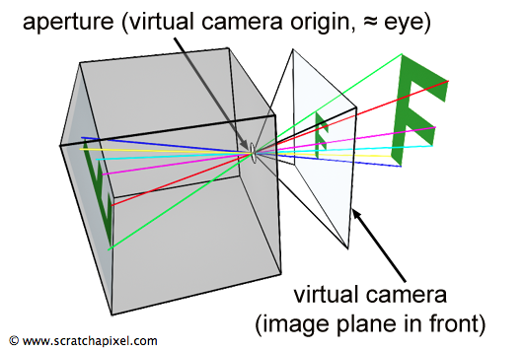
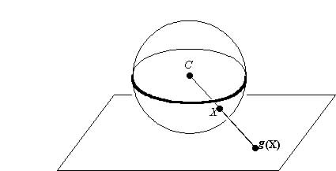
Two kinds of eyes at the top: Camera type or planar Spherical

Slide 22



Many cameras in the market

Slide 23
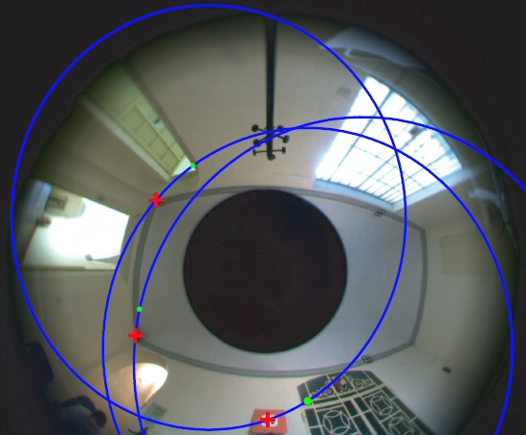
Catadioptric – panoramic images

Slide 24
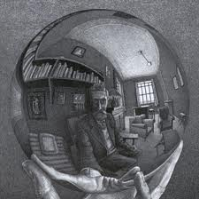

Slide 25
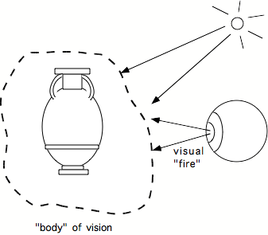

How does Vision work?
Ancient Greeks: Extramission Theory

Slide 26
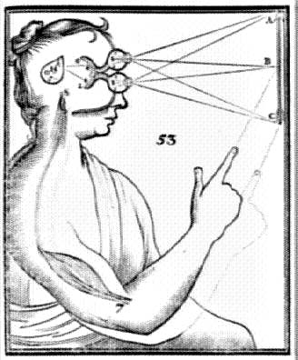
Descartes got it right

Slide 27
Many theories over the centuries
The Gestaltists
Von Helmholz: Unconscious inference
David Marr: A reconstruction process that tells us where is what.

Slide 28
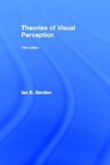
Theories influenced by the zeitgeist

Slide 29
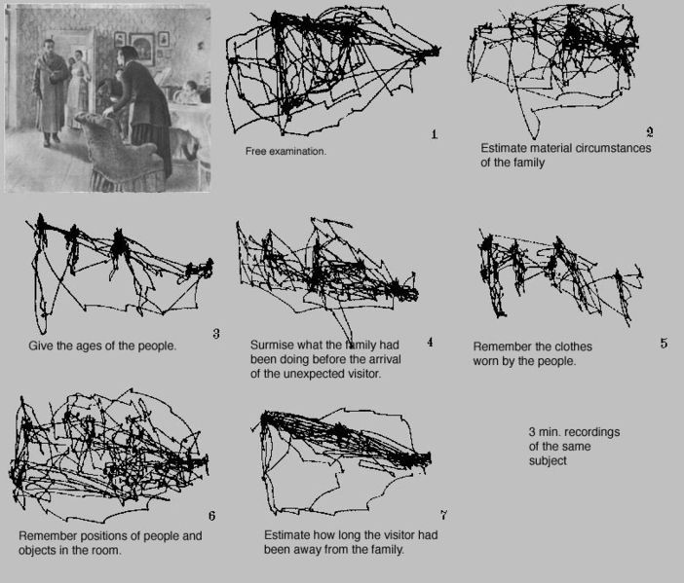
Animal perception is active

Slide 30
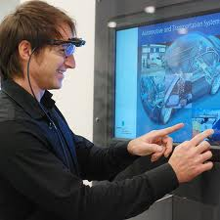
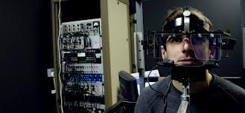
Measuring eye movements

Slide 31
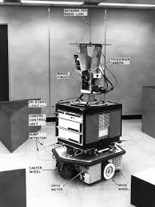
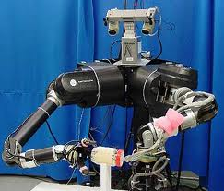
Robots with Vision

Slide 32
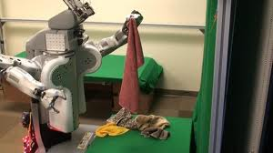
PR2 Humanoid

Slide 33
Perception for Robots 3 major problems
Reconstruction
Reorganization
Recognition

Slide 34
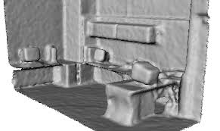
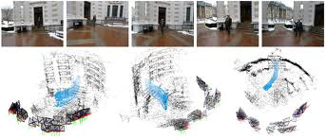
Reconstruction

Slide 35
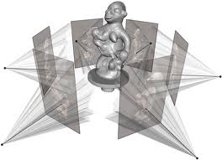

Slide 36
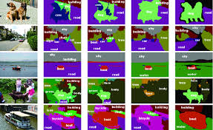
Reorganization: segmentation

Slide 37
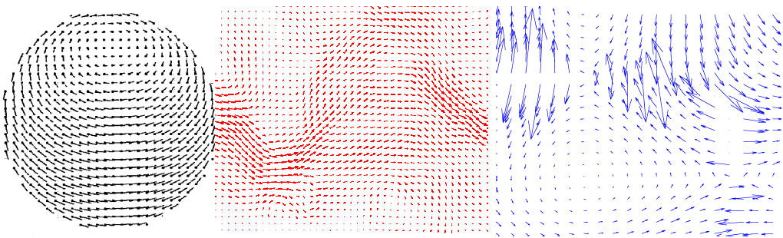
Reorganization: flow

Slide 38
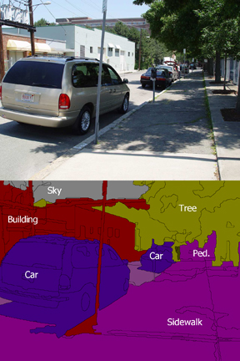
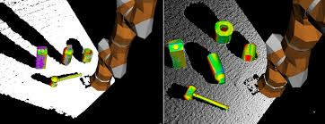
Recognition

Slide 39
Images and Videos Contain
Lines (contours, edges)
Intensity and Color
Texture
movement

Slide 40
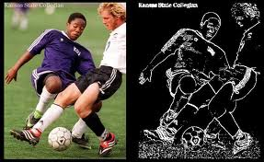
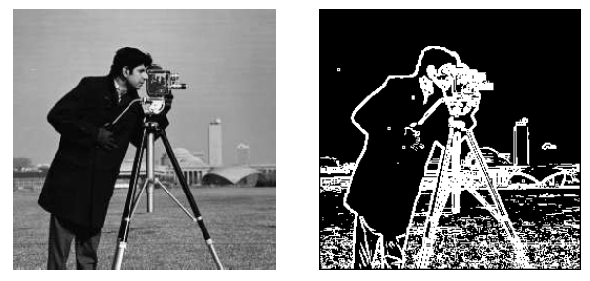
Lines

Slide 41


Color, Texture

Slide 42

Motion

Slide 43
A theoretical model of an eye
Pick a point in space and the light rays passing through
O

Slide 44
Then cut the rays with a plane
This gives an image
O

Slide 45

Pinhole cameras
Abstract camera model - box with a small hole in it
Pinhole cameras work in practice
(Forsyth & Ponce)

Slide 46

If we change the plane, we get an new image

Slide 47


How are these images related? (what remains invariant?)

Slide 48


Conics

Slide 49

Projection of circle

Slide 50
Vanishing points
image plane
vanishing point
camera
center
ground plane
Vanishing point
projection of a point at infinity

Slide 51
Vanishing points (2D)
image plane
vanishing point
camera
center
line on ground plane

Slide 52
Vanishing points
image plane
vanishing point V
camera
center
C
line on ground plane
line on ground plane
Properties
Any two parallel lines have the same vanishing point v
The ray from C through v is parallel to the lines
An image may have more than one vanishing point

Slide 53

Parallelism (angles) not invariant

Slide 54

Cross ratio = only invariant

Slide 55


Slide 56


Slide 57
Back to our question: how are the 2 images related to each other
Can we find a map, a function mapping x’ to x?

Slide 58

Fundamental Theorem: If we know how 4 points map to each other in the two planes, then we know how all points map. (if a→A, b→B, c→C,d→D, then we can map any point)

Slide 59
Proof
B
b
a
p
A
P
c
C
s
S
d
D

Slide 60
The projective plane
Why do we need homogeneous coordinates?
represent points at infinity, homographies, perspective projection, multi-view relationships
What is the geometric intuition?
a point in the image is a ray in projective space
y
(sx,sy,s)
(x,y,1)
(0,0,0)
z
x
image plane
Each point (x,y) on the plane is represented by a ray (sx,sy,s)
all points on the ray are equivalent: (x, y, 1) ≅ (sx, sy, s)

Slide 61
Projective lines
What does a line in the image correspond to in projective space?
A line is a plane of rays through origin
all rays (x,y,z) satisfying: ax + by + cz = 0
l
p
A line is also represented as a homogeneous 3-vector l

Slide 62
Point and line duality
A line l is a homogeneous 3-vector
It is ⊥ to every point (ray) p on the line: l p=0
p₁
p₂
l₁
p
l
l₂
What is the line l spanned by rays p₁ and p₂ ?
l is ⊥ to p₁ and p₂ ⇒ l = p₁ × p₂
l is the plane normal
What is the intersection of two lines l₁ and l₂ ?
p is ⊥ to l₁ and l₂ ⇒ p = l₁ × l₂
Points and lines are dual in projective space
given any formula, can switch the meanings of points and lines to get another formula

Slide 63
Ideal points and lines
(a,b,0)
y
(sx,sy,0)
y
z
image plane
z
image plane
x
x
Ideal point (“point at infinity”)
p ≅ (x, y, 0) – parallel to image plane
It has infinite image coordinates
Ideal line
l ≅ (a, b, 0) – parallel to image plane
Corresponds to a line in the image (finite coordinates)

Slide 64

Fundamental Theorem (homography or collineation)

Slide 65


Slide 66


Slide 67

Projective vs Affine

Slide 68

Rectification

