Slide 1
Testing Strategy for OLA
Motability Vehicle Application Workflow

Slide 2
Agenda
Purpose of the Testing Strategy
Overview of the Flow
Eligibility Checks: Why They Matter
Testing Strategy
Types of Tests
Tools & Frameworks
Risks & Mitigations
Q&A

Slide 3
Introduction
This test strategy outlines the structured approach to testing the customer eligibility submission flow on the OLA website focussing on the integration with DVLA services and the Motability-specific business rules for determining eligibility.

Slide 4
Purpose of the Document
To define the testing approach, levels, scope, and deliverables for validating the end-to-end customer eligibility workflow.

Slide 5
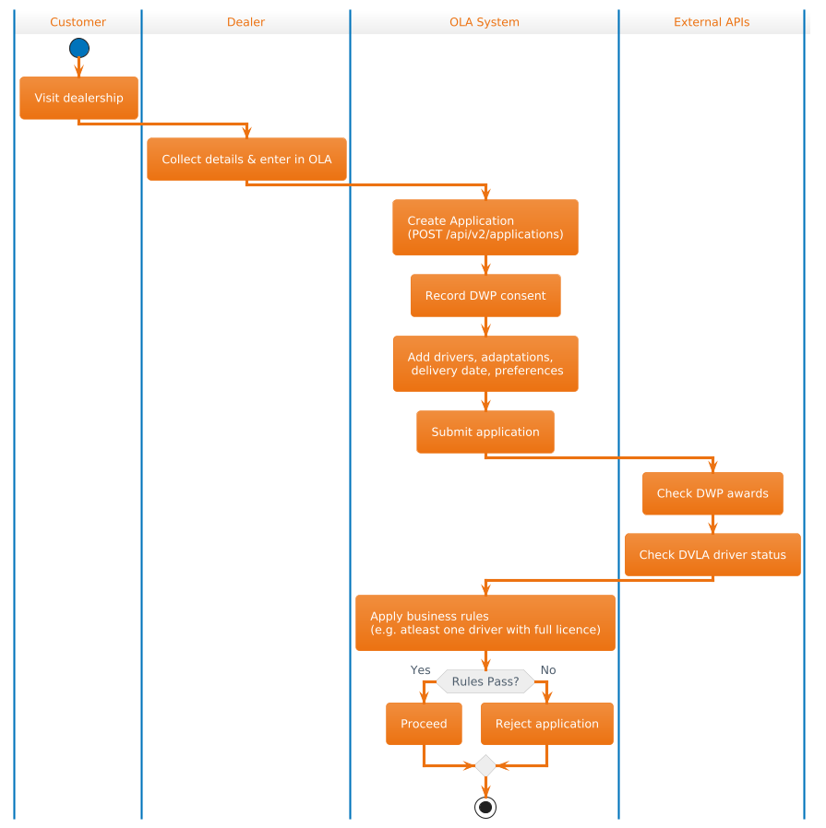
Workflow

Slide 6
Importance of Eligibility Checks
Regulatory Adherence
Protect Customer and Business from mistakes
Improve Customer Experience

Slide 7
Scope of testing
In Scope:
Website form for customer data submission
API interactions performed by the OLA application via /api/v2/applications
Integration with services to retrieve:
Benefits eligibility, e.g DWP
Driving licence endorsements, e.g DVLA
Application of business rules, e.g.:
DAG_V2_DRIVER_LICENCE_CATEGORY_GHI_ENDORSEMENT
Validation of errors, invalid inputs, and edge cases
Out of Scope:
Internal DVLA processing

Slide 8
Test Objective
Verify that customer data is accurately captured and transmitted.
Ensure third party services responses are correctly processed and interpreted.
Validate the accurate application of business rules based on the retrieved data.
Confirm system reliability under various data scenarios.

Slide 9
Test Levels
Unit Testing: Validate individual components like rule evaluation logic and DVLA response parsing.
Integration Testing: Test interactions between the website and DVLA service, and between modules.
System Testing: End-to-end workflow validation from customer submission to eligibility decision.
Acceptance Testing: Confirm system meets business requirements with representative test data.

Slide 10
Test Approach
Manual testing for exploratory testing, and complex test scenarios.
Automated testing for UI, API validation, rule logic, and regression suites.

Slide 11
Test Types
Accessibility
API Testing
Contract testing
Cross Browser
Integration Testing DWP, DVLA integration
End-To-End Full Customer journey
Data Driven Testing
Performance DVLA/DWP latency handling

Slide 12
Test Environment
Test Data- Test data will include valid and invalid driver licence numbers with endorsements, dates of endorsements, and driver categories
Test Doubles- Use of Stub, Mock, Fake Data

Slide 13
Stub and Mock
The stub simulates the behaviour of the DVLA service by providing controlled responses (i.e., simulate eligible/ineligible customers).
Mock verifies the interaction with the DVLA service (i.e., ensuring the eligibility check was called correctly)

Slide 14
Psuedocode for a Business rule
function checkEligibility(application):
results = []
// Rule 1: At least one driver must have a full licence
if no driver has full licence:
results.add("FAIL: No driver with full licence")
else:
results.add("PASS: At least one driver has full licence")
// Rule 2: No driver should be disqualified
for each driver in application:
if driver is disqualified:
results.add("FAIL: Driver " + driver.name + " is disqualified")
return results

Slide 15
Risk Assessment
Risk | Mitigation
DVLA Service Downtime or API Schema Changes | - Use mocks/stubs to simulate DVLA responses in test environments. - Implement schema validation tests to catch API schema changes early.
Regression from Business Rule Updates | - Maintain an automated regression test suite that tests all business rules. - Version control business rules and perform snapshot tests for rule consistency.

Slide 16
Test Deliverables
Test Plan & Strategy Document
Test Case Repository (manual and automated)
Test Execution Reports
Defect Logs and Metrics
Automation Scripts and Logs
Final Test Summary Report

Slide 17
Tools and Automation
Playwright for end to end flow
Postman/RestAssured for API Testing
WireMock Use of mocks/stubs for eligibility APIs
Continuous testing pipeline integration
Jira for defect management

Slide 18
Continuous Improvement
Retrospective after each sprint to assess test effectiveness.
Incorporate feedback to enhance test cases and automation.
Refactor tests for maintainability and better coverage.
Track escaped defects to identify gaps and improve early detection.

