Slide 1
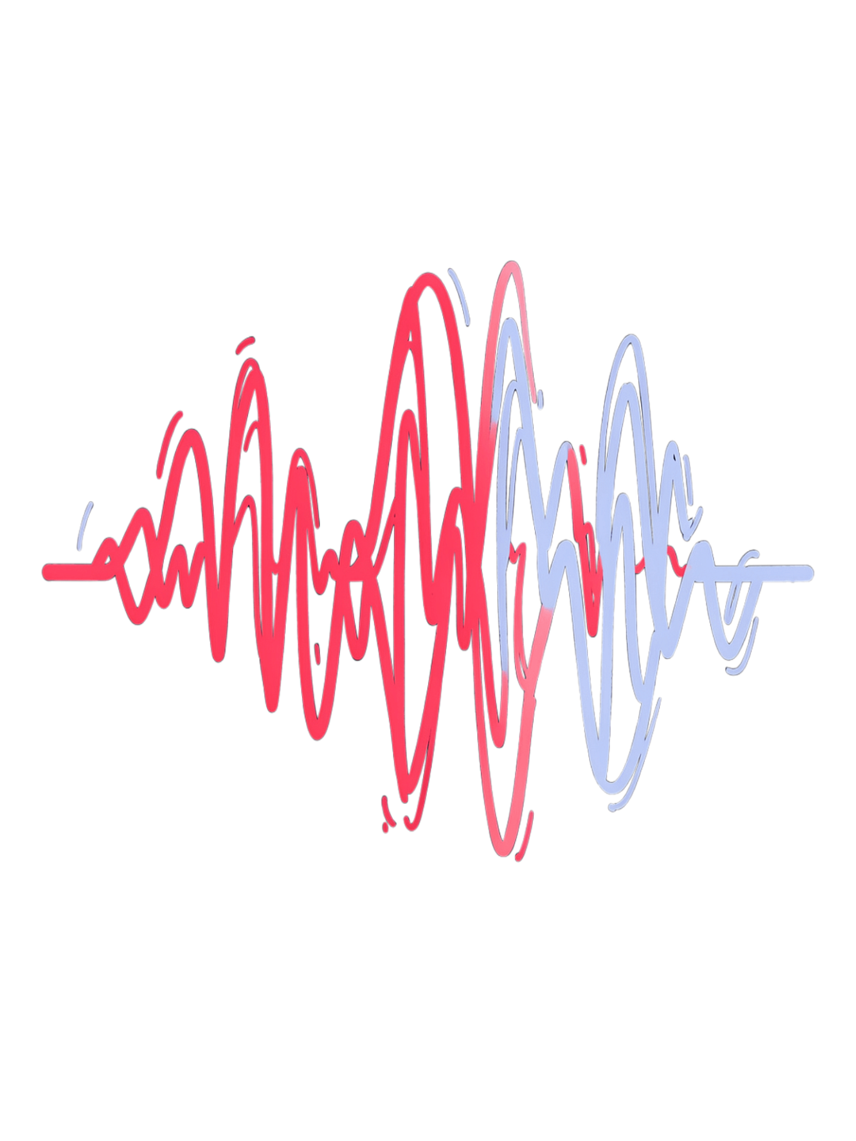

Hierarchical Classification of Gujarati Regional Dialects Using Acoustic Features
Phase 1: Research Topic Presentation
Research Area: Speech Processing and Machine Learning
Presented by —
Priyanka Bhatt (23000474)
Birva Dholakiya (23000749)

Slide 2
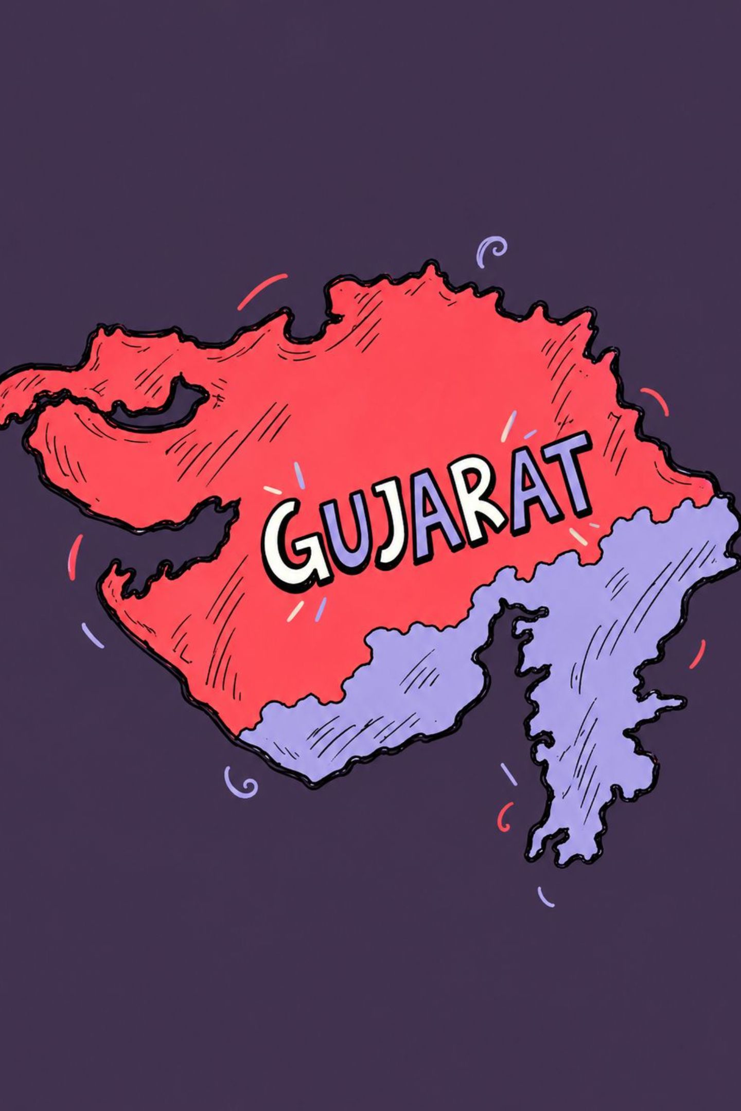
Introduction
Gujarati is spoken across different regions of Gujarat, and the way people speak can vary from one region to another.
These differences may be heard in pronunciation, pitch, speaking speed, and the way certain sounds are produced.
This project aims to build a machine learning model that can identify a speaker's regional Gujarati dialect from their speech recording.
Our approach: Instead of using an already-trained speech model, we will extract useful information directly from audio recordings and use traditional machine learning algorithms to classify the dialect.

Slide 3
Motivation
We chose Gujarati because it is our own language, and being familiar with the regional varieties spoken across Gujarat gives us an advantage while developing and evaluating the model.
If the model makes a wrong prediction, we can listen to the recording and use our understanding of Gujarati to investigate why the mistake occurred.
The project also explores how machine learning can recognize regional speech differences without using pre-trained models.
Beyond classification itself, this research could support future speech technology and help document Gujarat's linguistic diversity.
Why is this topic useful?
1
Our familiarity with Gujarati
Helps us interpret predictions and investigate classification errors.
2
Speech recognition
Could support future Gujarati speech-to-text systems in handling regional pronunciation differences.
3
Voice assistants and customer support
Could help voice-based services better account for regional Gujarati speech.
4
Language learning and education
Could demonstrate how pronunciation and speaking patterns vary across Gujarat.
5
Cultural preservation
Could support the documentation of regional dialects and local speech patterns.
6
Linguistic research
Could help researchers understand which dialects are similar and which speech features distinguish them.
7
Overall motivation
To use our knowledge of Gujarati and machine learning to build a useful regional dialect classifier and explore its potential applications in speech technology and language research.

Slide 4

Problem Statement
People from different regions may pronounce words differently, even when they are speaking the same language. However, these differences are not always obvious, and speakers from different regions may sound similar.
The challenge is to build a model that learns useful differences between Gujarati regional dialects rather than simply recognizing an individual speaker's voice.
The project will investigate how accurately traditional machine learning can classify regional dialects from audio recordings and whether classifying speech in stages can improve the results.

Slide 5
Research Gap
Gujarati dialect differences have been studied in linguistic research, but there is still scope to investigate how well traditional machine learning can classify selected regional varieties under a consistent testing setup.
Our research will focus on three questions:
1
Can features extracted directly from speech help distinguish selected Gujarati dialects?
2
Does classifying speech in two stages work better than predicting the dialect directly?
3
Which speech features help the model, and which dialects are most often confused?
The goal is not to claim that Gujarati dialects have never been studied. Instead, we aim to conduct a focused comparison and understand the strengths and limitations of these classification methods.

Slide 6
Research Objectives
The main objective is to develop and evaluate a Gujarati regional dialect classification system using audio features and traditional machine learning.
To achieve this, we plan to:
01
02
03
Identify or collect suitable Gujarati speech recordings with reliable regional labels.
Extract features such as pronunciation-related sound patterns, pitch, and speaking speed.
Train and compare machine learning models. Compare direct classification with a two-stage classification approach.
04
05
Test the models on speakers whose recordings were not used during training.
Analyze common mistakes and identify which features are most useful.

Slide 7





Proposed Approach
The project will begin with Gujarati speech recordings labelled by regional dialect. The audio will be prepared for analysis, and useful information will be extracted from each recording. This information will then be given to traditional machine learning models, which will learn patterns associated with the selected dialects. Finally, we will test the models on recordings from unseen speakers and compare their results.
Gujarati Speech Recordings
Audio Preparation
Feature Extraction
Audio with regional labels
Prepare recordings for analysis
Measure sound patterns, pitch and speaking speed
Machine Learning
Testing and Comparison
Train models to recognize dialect patterns
Measure performance and study mistakes

Slide 8
Classification Methods
We will compare two ways of identifying regional dialects.
1. Flat Classification — Direct Prediction
2. Hierarchical Classification — Prediction in Two Stages
The model receives a speech recording and predicts its dialect directly. For example, it may classify a recording as kathiyawadi, mehsani or surti.
The model first predicts a broader regional group and then identifies the dialect within that group. This may help when some dialects share similar speech patterns, although it may also introduce errors at the first stage.
We will compare both approaches using the same dataset and testing conditions to determine which performs better.

Slide 9
Speech Features and Machine Learning
To identify dialect differences, we will measure patterns in the audio rather than rely only on the words being spoken.
Some features we plan to explore are:
MFCC
Pitch
Represents important characteristics of speech sounds.
Measures how high or low a voice sounds and how it changes.
Speaking speed and pauses
Spectral features
Capture differences in speaking rhythm.
Describe how sound energy is distributed across frequencies.
We will use traditional machine learning methods such as Support Vector Machines (SVM), Random Forest, and Logistic Regression.
Tools such as Librosa and Praat may be used to process audio and extract features. No pretrained speech models will be used.

Slide 10

Evaluation
The models will be tested on recordings from speakers they have not encountered during training.
This is important because we want to identify regional speech patterns, not simply recognize familiar voices.
We will evaluate the models using:
Accuracy
Macro F1-score
How many predictions are correct overall?
How well does the model perform across different dialects?
Confusion matrix
Feature analysis
Which dialects does the model mix up?
Which audio features appear most useful?
We will also compare the flat and hierarchical approaches to see whether either provides a meaningful improvement.

Slide 11
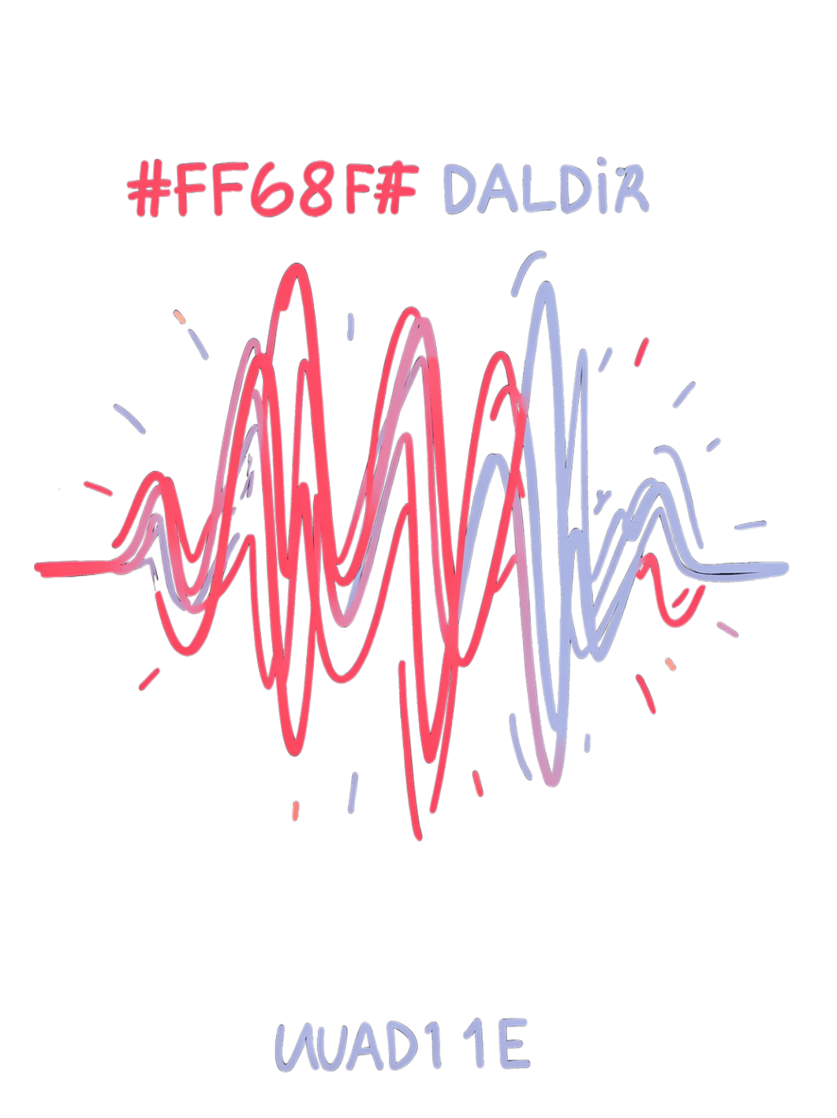


Expected Outcomes By the end of the project
By the end of the project we aim to develop a working prototype that can predict selected Gujarati regional dialects from speech recordings.
We also expect to understand which dialects are easier or harder to distinguish and which audio features contribute most to the predictions.
The comparison between direct and two-stage classification will help us decide whether a hierarchical approach is useful for this task.
The findings may also help identify limitations in the available speech data and suggest improvements for future research.

Slide 12
Applications
1.Dialect-Aware Speech Recognition
2.Regional Voice Assistants and Customer Support
3.Gujarati Language Learning and Education
Speech recognition systems convert spoken language into text. A dialect classifier could help a future system account for regional pronunciation differences, potentially improving its performance for Gujarati speakers.
Voice-based services may encounter callers who speak different regional varieties of Gujarati. Dialect identification could help such systems adapt their speech processing or choose more suitable language responses.
The project could help document how pronunciation and speaking patterns vary across regions. It may support language-learning resources that explain regional differences without treating one dialect as better than another.
4.Linguistic Research and Cultural Preservation
5.Speech Analysis and Research
Regional dialects are an important part of Gujarat's linguistic heritage. Analysing recorded speech can support the documentation and study of these varieties, especially when combined with reliable speaker and region information.
Researchers could use the system to explore which dialects sound similar to a machine learning model and which features help separate them. These findings may guide further studies of Gujarati speech.
These are potential applications. The initial project will focus on dialect classification rather than building a complete speech-recognition or voice-assistant system.

Slide 13
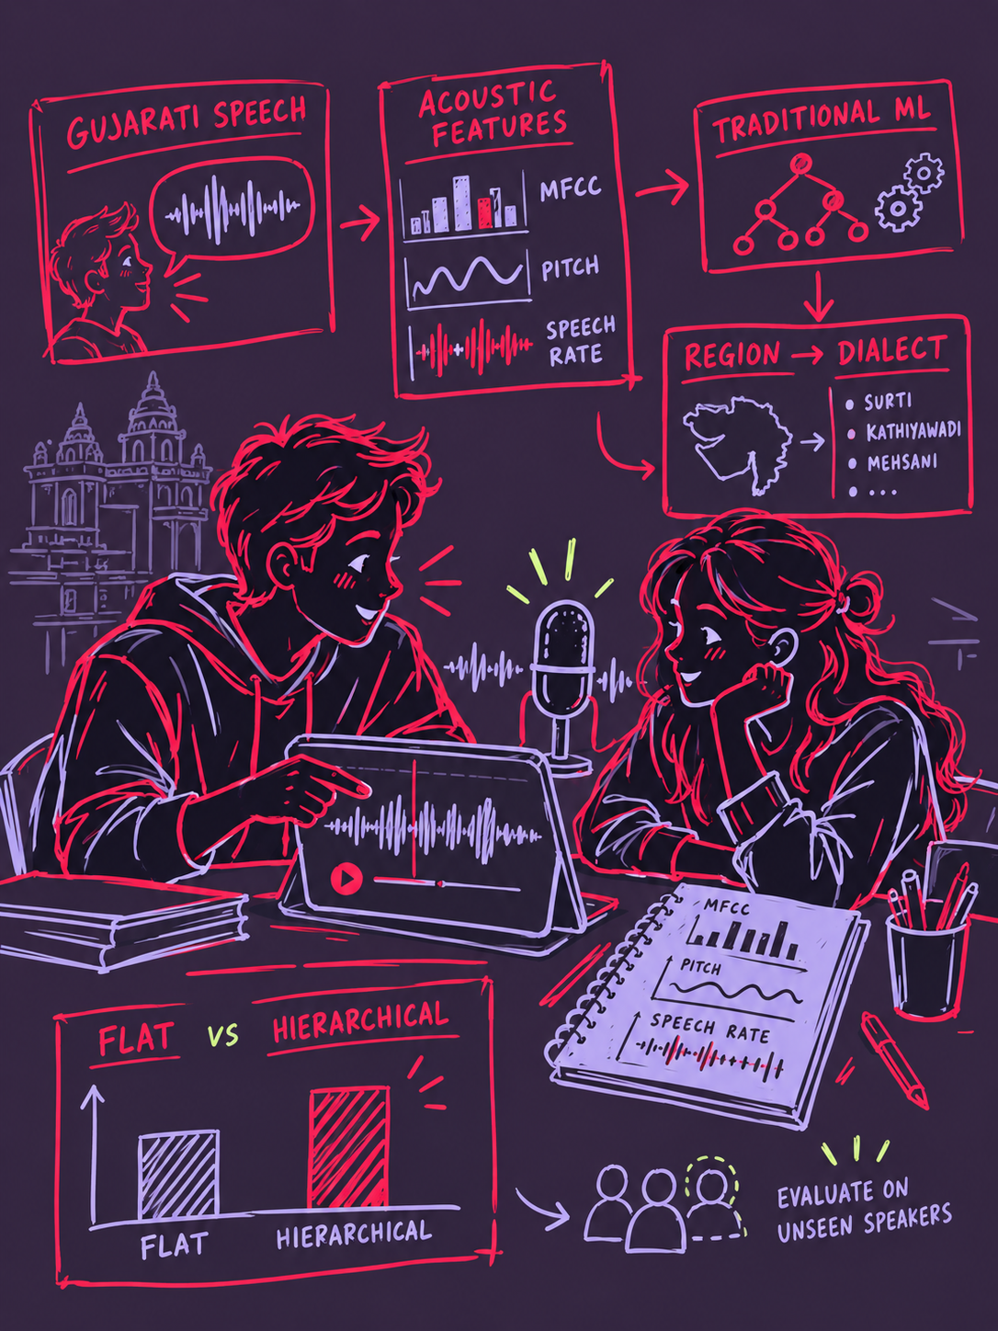
Conclusion
This project explores whether traditional machine learning can identify selected Gujarati regional dialects using features extracted directly from speech. By comparing direct classification with a two-stage approach, we aim to measure performance, understand common mistakes, and investigate which speech features help distinguish regional varieties. Our familiarity with Gujarati will also help us interpret the results and assess whether the model's predictions make sense in real speech situations.
Research Question: Can a two-stage classification approach identify Gujarati regional dialects more effectively than direct classification when tested on speakers not seen during training?

