Slide 1
The Basics of Supply
and Demand

Slide 2
Ordinal utility analysis
The concept of Cardinal Utility to define Consumer's Equilibrium.
Cardinal Utility means consumer could measure the satisfaction derived by the consumption of any goods or services in terms of number and unit of that measurement is Utils or the Money.
Diminishing Marginal Utility!

Slide 3
Indifference analysis is an alternative way of explaining consumer choice that does not require an explicit discussion of utility.
Indifferent: the consumer has no preference among the choices.
Indifference curve: a curve showing all the combinations of two goods (or classes of goods) that the consumer is indifferent among.

Slide 4
Assumptions
More is Preferred to Less: Diminishing Marginal Rate of Substitution.
Consistency: If a consumer prefer A to B in one period then he will not prefer B to A in another period.
Transitivity: If a consumer prefer A to B and B to C, then he must prefer A to C.

Slide 5
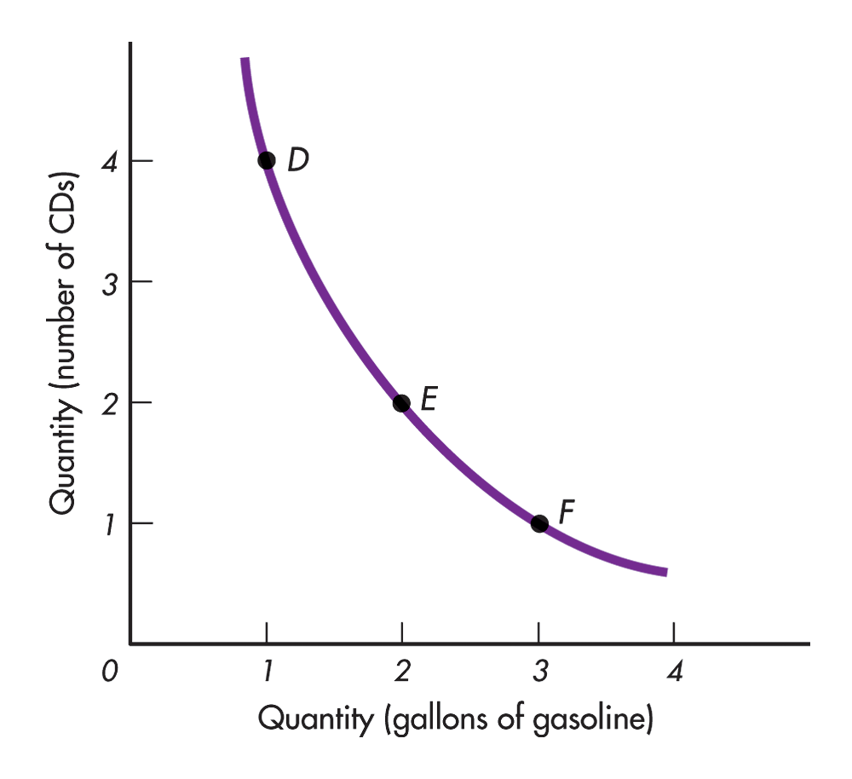
Indifference Curve

Slide 6
Marginal Rate of Substitution
Marginal rate of substitution – the rate at which one good must be added when the other is taken away in order to keep the individual indifferent between the two combinations.

Slide 7
Budget Constraint
The indifference map only reveals the ordering of consumer preferences among bundles of goods. It tells us what the consumer is willing to buy.
It does not tell us what the consumer is able to buy. It does not tell us anything about the consumer’s buying power.
The budget line shows all the combinations of goods that can be purchased with a given level of income

Slide 8
The mathematical expression for budget constraint is:
M= P_{x} X + P_{y} Y
Y= M/Py – Px.X/Py
Example: Y = Rs 200
Px= Rs 2
Py= Re1

Slide 9
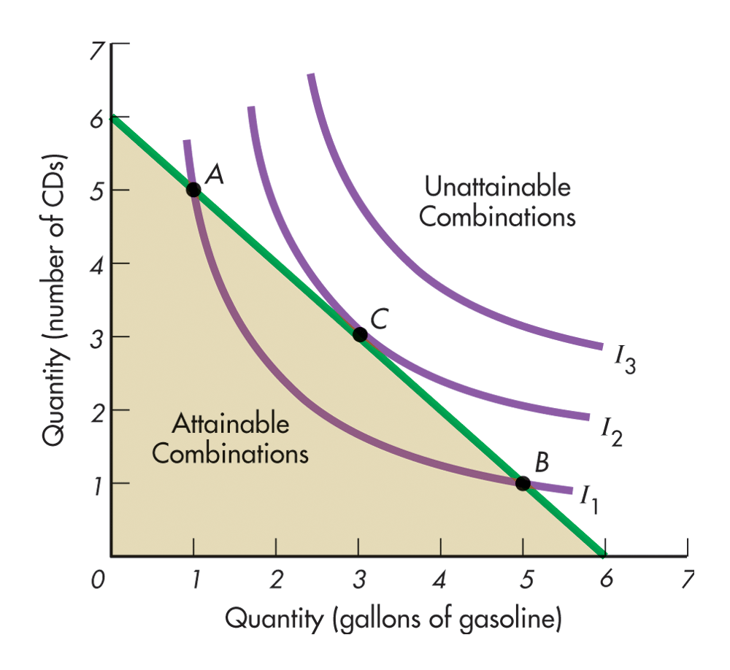
Consumer Equilibrium

Slide 10
Consumer Equilibrium
The indifference map in combination with the budget line allows us to determine the one combination of goods and services that the consumer most wants and is able to purchase. This is the consumer equilibrium.
The demand curve for a good can be derived from indifference curves and budget lines by changing the price of one of the goods (leaving everything else the same) and finding the equilibrium points.

Slide 11
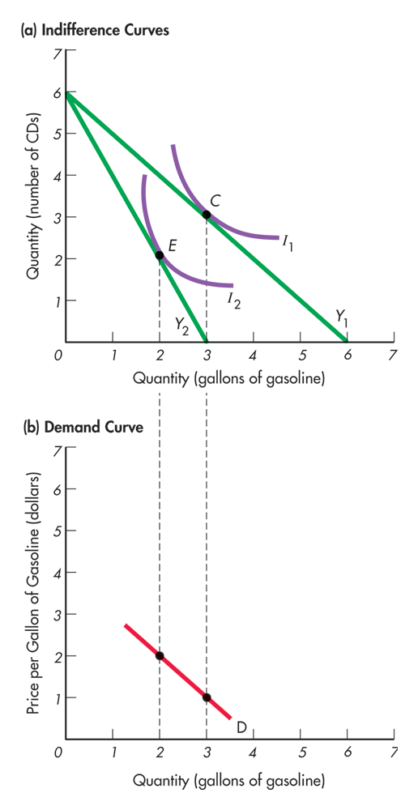
Deriving the Demand Curve

Slide 12
Supply and Demand
Supply and demand analysis can:
  Help to understand and predict how real world economic conditions affect market price and production
  Analyze the impact of government price controls, minimum wages, price supports, and production incentives on the economy
  Determine how taxes, subsidies, tariffs and import quotas affect consumers and producers
Notes:
4

Slide 13
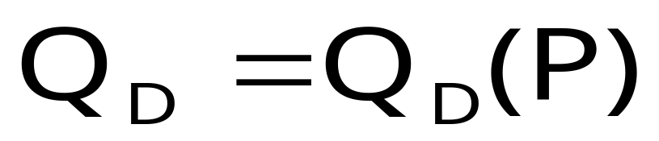
Demand
The Demand Curve
  The relationship between the quantity of a good that consumers are willing to buy and the price of the good
  Measures quantity on the x-axis and price on the y-axis
Notes:
8

Slide 14
The DEPENDENT variable is the amount demanded.
The INDEPENDENT variables are:
  the good’s own price
  the consumer’s money income
  the prices of other goods
  preferences (tastes)

Slide 15
Substitutes?
Compliments?

Slide 16
THE LAW OF DEMAND
The Law of Demand says that a decrease in a good’s own price will result in an increase in the amount demanded, holding constant all the other determinants of demand.
The Law of Demand says that demand curves are negatively sloped.

Slide 17
The Demand Curve
Price
($ per unit)
The demand curve slopes
downward, demonstrating
that consumers are willing
to buy more at a lower price
as the product becomes
relatively cheaper.
P₂
P₁
D
Q₁
Q₂
Quantity
Notes:
10

Slide 18
The Demand Curve
Other Variables Affecting Demand
  Income
    Increases in income allow consumers to purchase more at all prices
  Consumer Tastes
  Price of Related Goods
    Substitutes
    Complements
Notes:
36

Slide 19

x₂
Fixed p₂ and m.
p₁x₁ + p₂x₂ = m
p₁ = p₁’
p₁= p₁’’
x₁

Slide 20
x₂
Fixed p₂ and m.
p₁x₁ + p₂x₂ = m
p₁ = p₁’
p₁=
p₁’’’
p₁= p₁’’
x₁

Slide 21
The Demand Curve
Changes in quantity demanded
  Movements along the demand curve caused by a change in price
Changes in demand
  A shift of the entire demand curve caused by something other than price
    Income
    Preferences
Notes:
45

Slide 22
Change in Demand
D
Income Increases
  Purchased Q₀, at P₂ and Q₁ at P₁
  Now purchased Q₁ at P₂ and Q₂ at P₁
  Same for all prices
  Demand curve shifts right
P
D’
P₂
P₁
Q₀
Q₁
Q₂
Q
Notes:
41

Slide 23
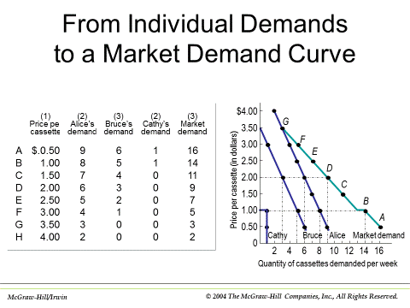

Slide 24
Normal and inferior goods defined
Normal good: When an increase in income causes an increase in demand.
Inferior good: When an increase in income causes a decrease in demand.

Slide 25

Downward-sloping
demand curve
Fixed p₂ and m.
x₂
p₁
p₁ price
offer
curve
⇔
Good 1 is
ordinary
x₁*
x₁

Slide 26

If the quantity demanded of a good decreases as its own-price decreases and vice versa (i.e. positively related) holding all other factors constant, then the good is called a Giffen Good.
Note: we need to hold other factors constant. Thus, if the price change is also associated with change in income or preference, then even if there’s a positive relation between price and quantity, it is not characterized as Giffen good.

Slide 27

x₂
p₁
p₁ price offer
curve
⇔
Good 1 is
Giffen
x₁*
Demand curve has
a positively
sloped part
x₁
Fixed p₂ and y.

