Slide 1


Department of Artificial Intelligence and Data Science
Predictive Energy Analytics: Leveraging Machine Learning And Weather Data Integration for Smart Consumption Forecasting And Optimization
Mrs. SORNA SHANTHI D M.Tech.,
Associate Professor
PRIADHARSHNI P
221801039
PRIYADARSHINI S
221801040

Slide 2
Problem Statement and Motivation
Develop a forecasting model that accurately predicts energy consumption for residential and commercial buildings using historical data and weather forecast information.
MOTIVATION:
Accurate energy consumption forecasting allows users to manage their energy usage more efficiently, reducing unexpected high bills and promoting smarter energy consumption practices.
Effective forecasting helps in optimizing resource allocation, reducing energy waste, and supporting cost savings, while also contributing to environmental sustainability by encouraging responsible energy use and reducing carbon footprints.
2

Slide 3
Abstract
An advanced energy management solution helps residential users manage energy consumption effectively. Leveraging XGBoost, it predicts daily energy usage with accuracy, allowing users to anticipate consumption patterns and optimize energy use. The model integrates sophisticated feature engineering, including lagged variables, rolling statistics, and weather-energy interactions, to enhance predictive performance. Users receive actionable insights, personalized recommendations, and alerts for high consumption events. Rigorous testing through metrics like MAE and RMSE highlights its accuracy and reliability. By fostering smarter energy practices, the system enables cost savings and supports environmental sustainability, empowering users to adopt sustainable habits.

Slide 4
Introduction and Overview of the Project.
The development of a predictive energy analytics model using the XGBoost algorithm aims to forecast daily energy consumption. By integrating historical data and weather conditions, the model accurately predicts usage and provides actionable insights. The model construction starts with the collection and preprocessing of data to ensure high-quality inputs. Feature engineering, including lagged variables and weather interactions, further enhances prediction accuracy. The system provides personalized recommendations and alerts for high consumption. Evaluated using metrics like MAE and RMSE, this solution empowers users to optimize energy use, save costs, and support sustainability efforts.

Slide 5
Literature Survey
S.No | Author Name | Paper Title | Description | Journal | Volume/ Year
1 | S. Tabasi, A. Aslani, and H. Forotan | Prediction of Energy Consumption by Using Regression Model | Developed a regression model to predict energy consumption. Provided Insights into energy usage trends | IEEE | 2020
2 | Karan Kumar. K | Quantum support vector machine for forecasting house energy consumption | Compare quantum SVM with deep learning models for house energy forecasting, showcasing quantum model benefits | Cloud Computing: Systems | 2024
3 | M. Qureshi, M. A. Arbab | Deep learning based forecasting of electricity consumption | Presented a deep learning approach for electricity consumption with improved accuracy. | Scientific Reports | 2024

Slide 6
Literature Survey
S.No | Author Name | Paper Title | Description | Jornal | Volume/ Year
4 | L. Semmelmann, S. Henni, and C. Weinhardt | LSTM-XGBoost hybrid model based on smart meter data | Introduced an automated parameter optimization process for house pricing using hybrid model achieving greater accuracy. | IEEE | 2022
5 | Y. Zhang, C. Shao, and C. Zou | Prediction of customers’ behaviors based on XGBoost model | Identified key fraud indicators : injury claim, auto claim, capital gain and customer tenure to predict customer fraud . | IEEE | 2023

Slide 7
Existing System
The current approach to predicting energy consumption employs a range of machine learning techniques, including Linear Regression, Decision Trees, Support Vector Machines (SVM), and Deep Learning models. These algorithms analyze historical data along with various factors such as temperature, humidity, time of day, and day of the week. Linear Regression identifies simple linear relationships between input variables and energy consumption. Decision Trees capture more complex, non-linear patterns, while Random Forest, an ensemble technique, enhances prediction accuracy by combining multiple decision trees. SVMs are used to find the optimal hyperplane that separates different data points, aiding in accurate predictions. Deep Learning models, with their ability to learn complex hierarchical features, are particularly useful in modeling intricate relationships within the data, thus improving the overall prediction accuracy and robustness for energy consumption forecasting.

Slide 8
Drawback of Existing System
Models like SVM and Deep Learning often lack transparency, making it difficult to interpret their predictions.
Algorithms such as Deep Learning require large amounts of data for training, which may not always be available.
Complex models like Decision Trees and Deep Learning are prone to overfitting, especially with insufficient or noisy data.
Some algorithms, particularly Deep Learning and SVM, can be computationally expensive and may not scale well with large datasets.
Techniques like Random Forest and SVM may struggle with fine-tuning, requiring significant computational resources and hyperparameter adjustments.

Slide 9
Proposed System
The proposed system leverages the XGBoost algorithm to predict daily energy consumption by integrating historical energy data, weather conditions, and occupancy patterns. It incorporates advanced feature engineering, including lagged variables and weather interactions, to enhance prediction accuracy. The system offers energy insights, and smart alerts for high consumption events. By analyzing patterns and optimizing energy usage, the system helps users reduce waste and lower costs. It uses metrics like MAE and RMSE for model evaluation to ensure reliable performance. The solution supports sustainability efforts by promoting energy-efficient practices. Ultimately, the system empowers users to make data-driven decisions for smarter energy management.

Slide 10
Proposed System Advantages
Accurate Predictions: Utilizes XGBoost, a powerful machine learning algorithm, to generate accurate energy consumption forecasts.
Advanced Feature Engineering: Enhances prediction accuracy with lagged variables and interactions between weather and energy data.
Smart Alerts: Provides real-time notifications for high energy consumption, helping users manage their usage effectively.
Cost and Energy Savings: Optimizes energy usage by identifying patterns, reducing waste, and lowering energy costs.
Sustainability Focus: Encourages energy-efficient practices, supporting sustainability goals by minimizing energy wastage.

Slide 11
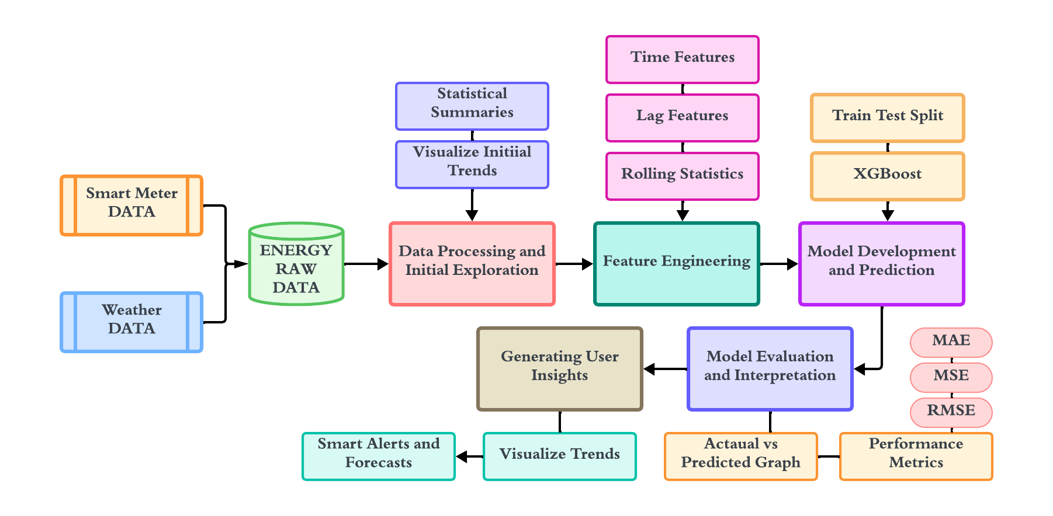
System Architecture

Slide 12
List of Modules
Data Collection
Data Preprocessing and Initial Exploration
Feature Engineering
Model Training
Model Validation
Generating User Insights

Slide 13
Module 1: Data Preprocessing
Step 1: Load and inspect the dataset by reading the CSV file and displaying the first few rows, dataset info, and summary statistics.
Step 2: Identify and handle missing values by checking for null values and printing the count of missing values per column.
Step 3: Convert the 'date' column to datetime format and extract time-related features like hour, day, and month.
Step 4: Visualize key features like active power over time, temperature distribution, and the correlation heatmap of numerical data.
Step 5: Plot average energy consumption patterns by hour, day of the week, and month to identify trends and seasonal variations.
Step 6: Create additional features such as is_weekend based on the day of the week and update the dataset for further analysis.

Slide 14
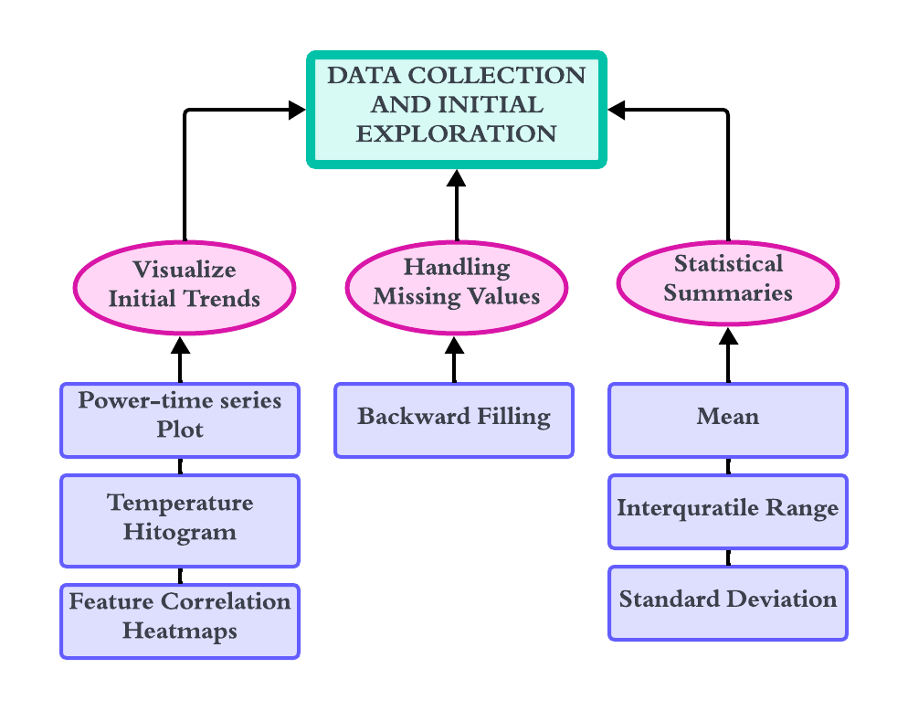
Data Flow Diagram

Slide 15
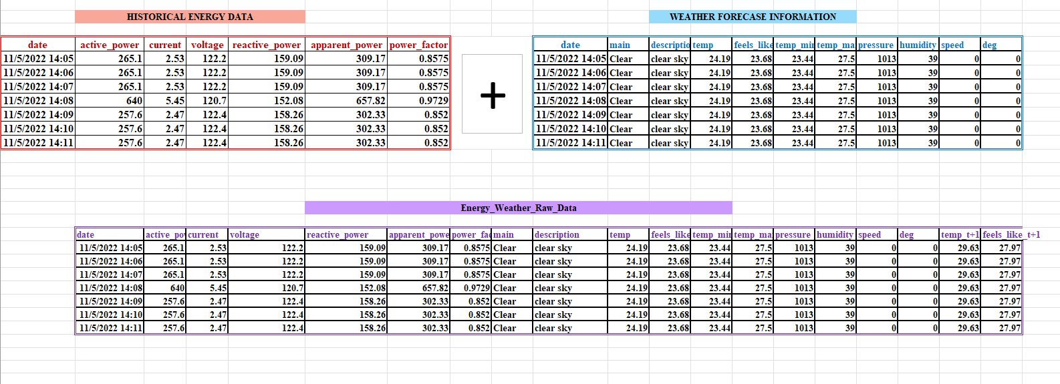
Historical Energy and Weather Data merging

Slide 16



Preprocessing
Correlation Heatmap: Calculates the correlation between numerical features:
Average Power by Grouping: Groups active_power by time intervals (e.g., hour, day, month) and calculates the mean:
Normalize(MinMaxScaler):- It is used convert the data in different scale to a defined range typically between the 0 and 1

Slide 17
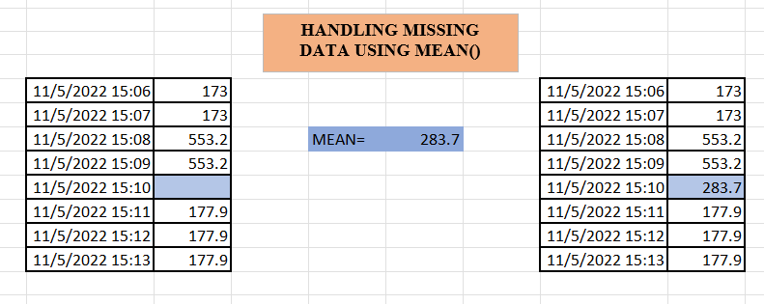
Handling Missing values

Slide 18
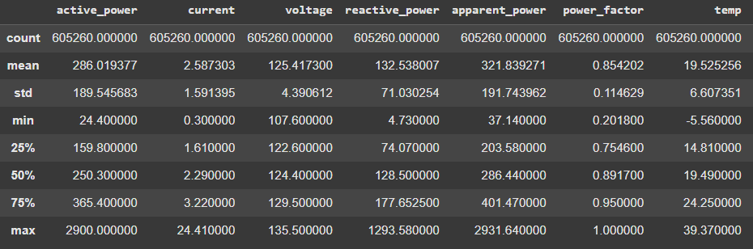
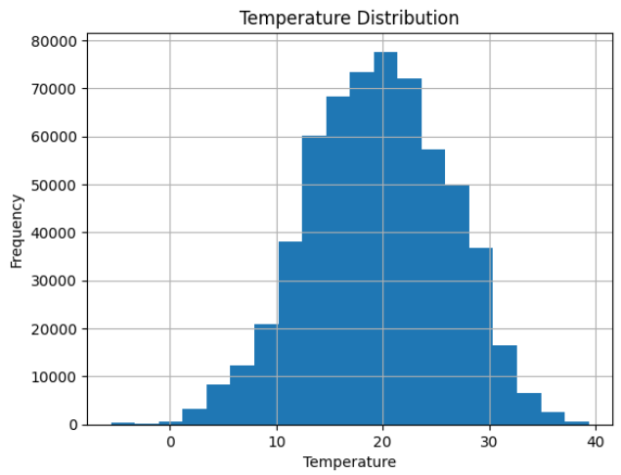
Outputs
Figure 1- Statistical Summaries of Data
Figure 2- Temperature Distribution – Histogram
The statistical summary of the dataset reveals key insights, such as the completeness of data entries and the range of values for each variable as shown in Figure 1
The histogram as shown in Figure 2, defines the underlying distribution of temperature values before incorporating them into our forecasting model.

Slide 19
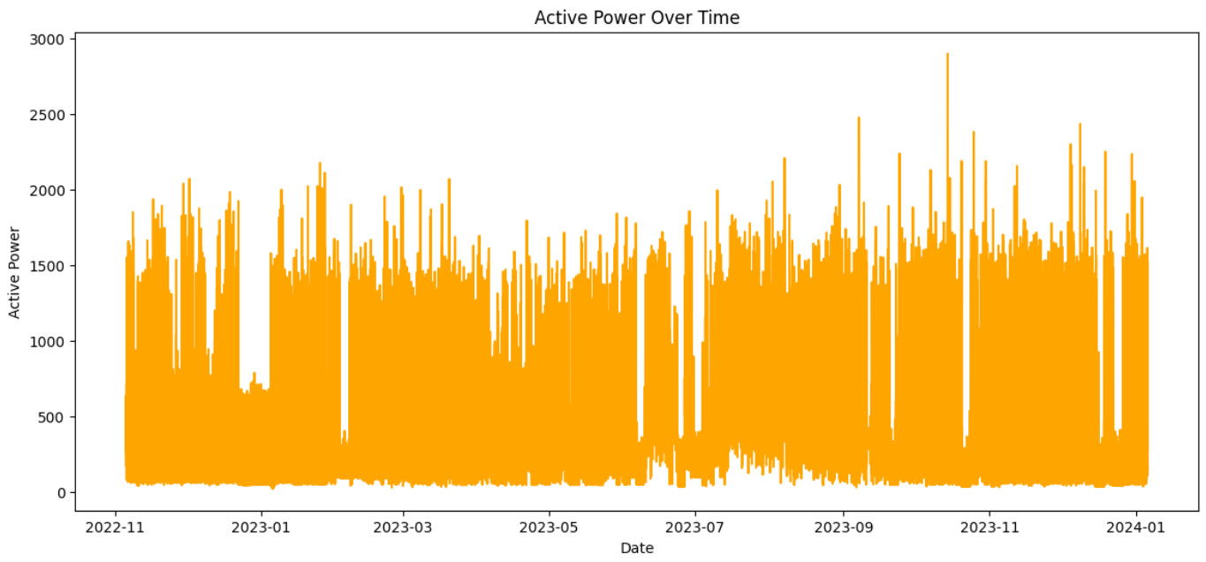
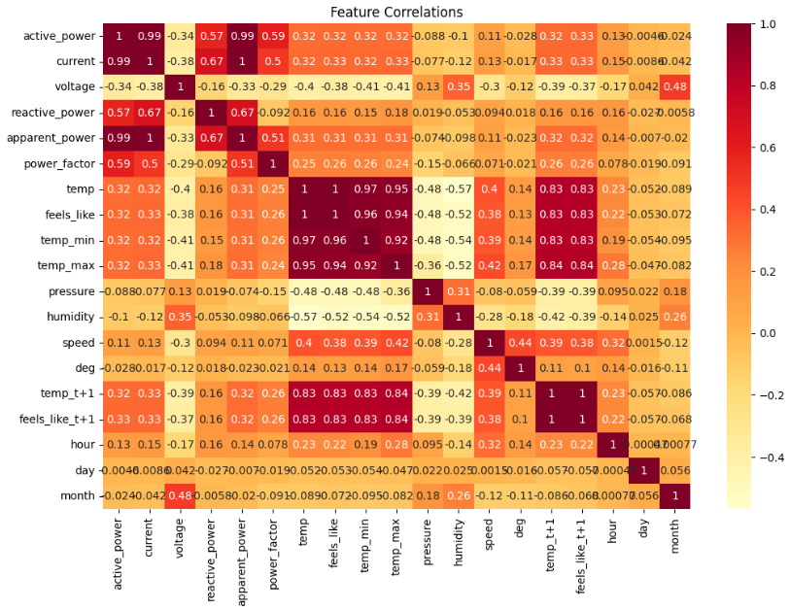
Outputs
Figure 3. Active Power over Time Series Plot
Figure 4. Feature Correlation Heatmap
The line plot as shown in Figure 3, serves as an important step in understanding how active power consumption varies over time
As mentioned in Figure 4, Exploring correlations identifies relationships between different factors helping select key features

Slide 20
Module 2: Feature Engineering
Step 1: Identify time based features to capture patterns in energy consumption.
Step 2:Apply rolling window on time based feature to compute rolling mean,rolling standard deviation which captures trends over time.
Step 3:Create lagged version of the data to predict future values based on past observations.
Step 4:Combining rolling statistics, time based features and lagged features transforms raw data into meaningful inputs which enhances prediction accuracy.
Step 5: Ensure all features are normalized and free from missing values, ready for model training.

Slide 21
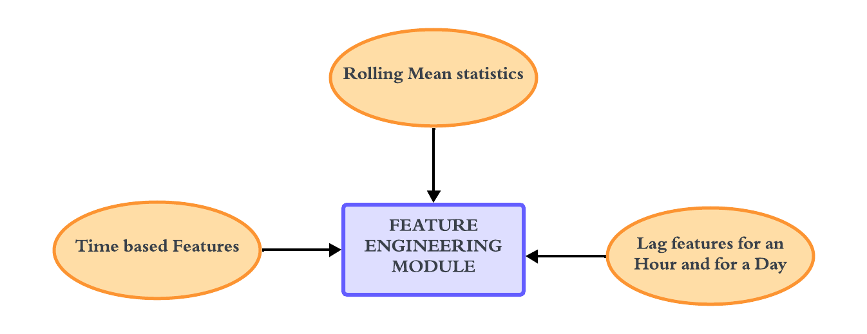
Data Flow Diagram

Slide 22
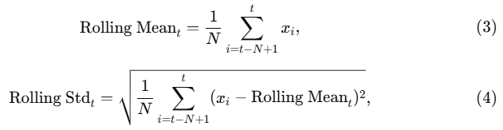
Feature Engineering
Lag Features
Lag features look at past values to help the model understand recent trends, making it easier to predict future values based on short- and long-term usage patterns.
Rolling Statistics
Rolling statistics smooth out short-term fluctuations and highlight longer-term trends.
Rolling Mean (24 Hours): Calculates the average usage over a full day.
Rolling Standard Deviation (24 Hours): Shows variability in usage over the past 24 hours.

Slide 23
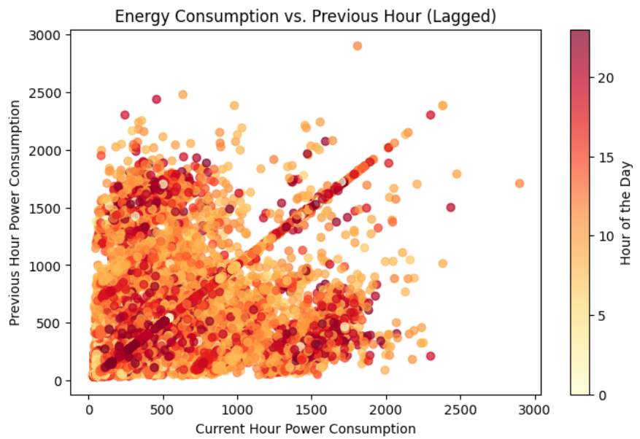
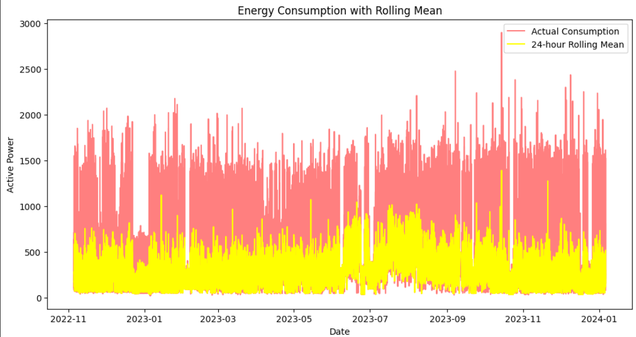
Outputs
Figure 6. Energy Consumption over the previous hour Scatter Plot
Figure 5. Energy Consumption with Rolling Mean Time Series Plot
The Line Plot as shown in the Figure 5, shows variability in energy usage over the past 24 hours, which can help detect unusual spikes or drops.
The Line Plot as shown in the Figure 6, shows the energy usage from the same hour the previous day. This is helpful for capturing daily usage patterns.

Slide 24
Module 3: Model Training and Prediction
Prepare Data: Split the dataset into input features (X) and target variable (y), and remove unnecessary columns.
Split Dataset: Divide the data into training and testing sets using an 80-20 split.
Clean Data: Drop unnecessary columns from the dataset (e.g., date, main, description).
Initialize Model: Configure the XGBRegressor with appropriate hyperparameters.
Train Model: Fit the model on the training data (X_train, y_train).
Predict Outcomes: Use the trained model to predict values on the testing set (X_test).

Slide 25
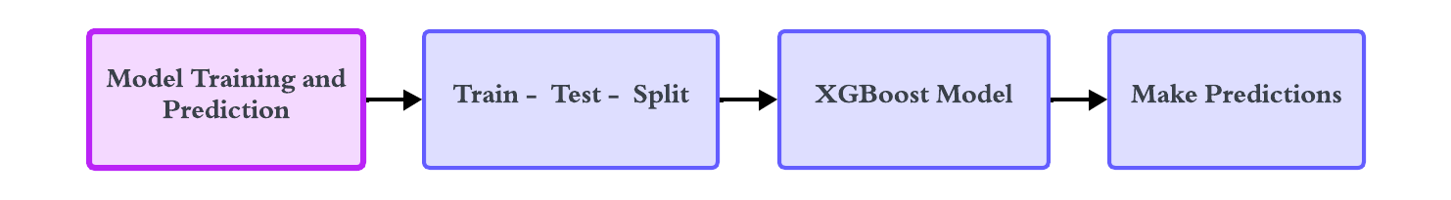
Data Flow Diagram

Slide 26
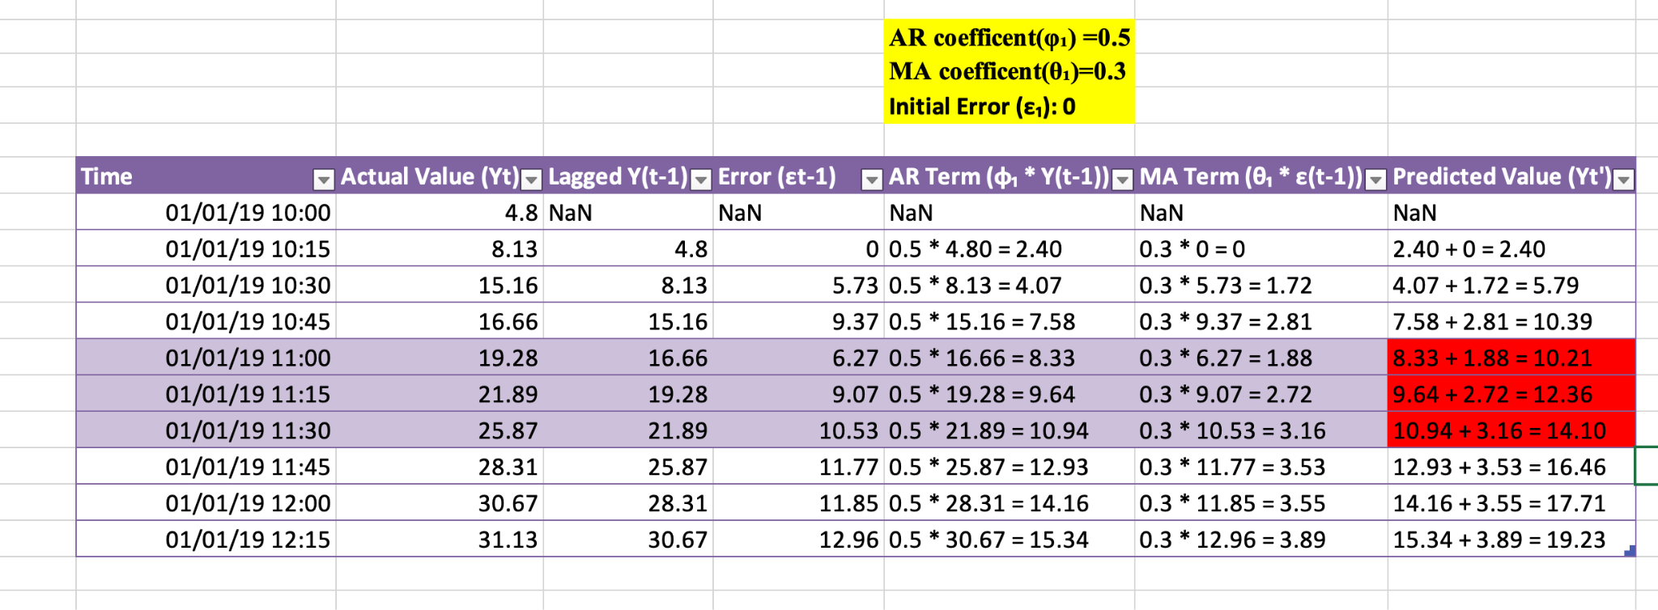
Calculation using Excel

Slide 27
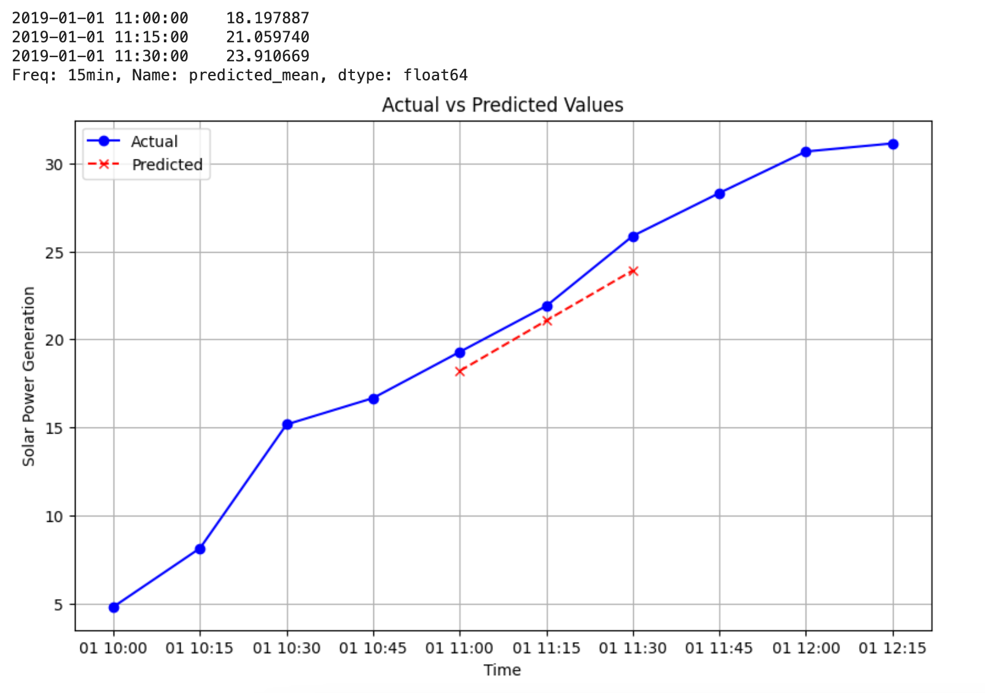
Calculation by the model

Slide 28
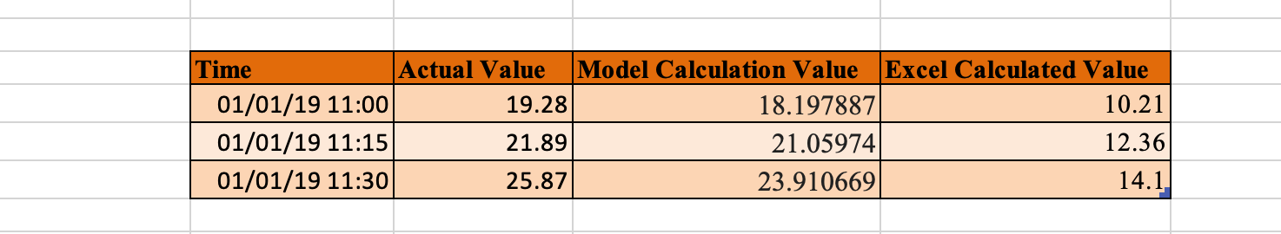
Actual VS Excel VS Model

Slide 29
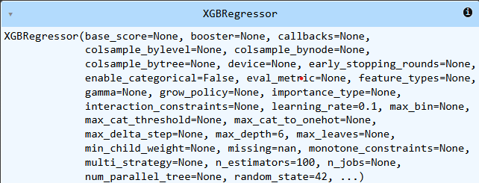
Outputs
Figure 7. XGBRegressor Model Overview
The Figure 7 shows the initialization parameters of the XGBRegressor class in the XGBoost library, used for training gradient-boosted regression models with customizable hyperparameters

Slide 30
Module 4 :Model Evaluation and Interpretation
Evaluate Model Predictions: Compute evaluation metrics: Mean Absolute Error (MAE), Mean Squared Error (MSE), and (RMSE) to quantify the model's prediction accuracy.
Visualize Predictions: Create a scatter plot comparing actual (y_test) vs. predicted values to assess how well the model aligns with observed data.
Analyze Residuals: Calculate and visualize residuals (errors between actual and predicted values) to check their distribution for randomness and normality.
Analyze Feature Importance: Extract and visualize the importance of features used in the model to understand which factors significantly influence predictions.
Refine and Retrain: Address any mismatches or residual trends, and retrain the model if necessary to improve its accuracy and reliability.

Slide 31
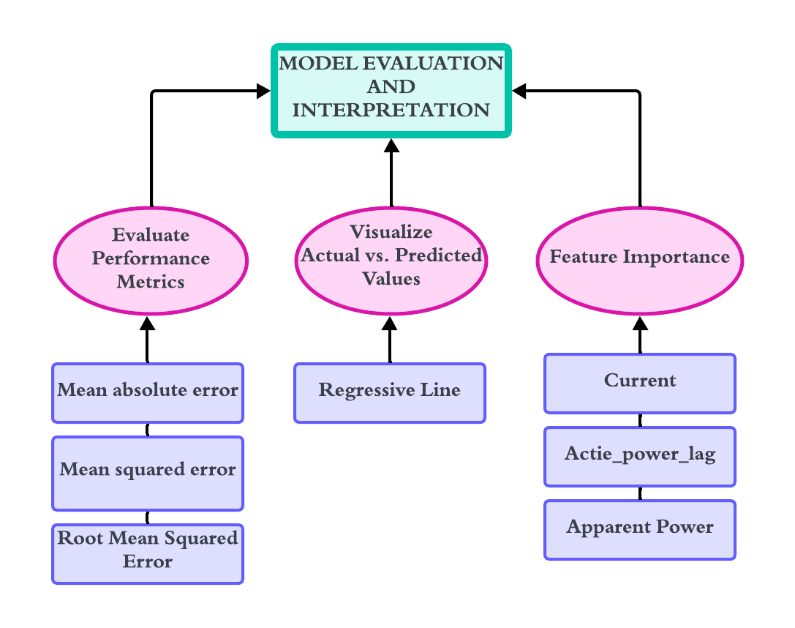
Data Flow Diagram

Slide 32

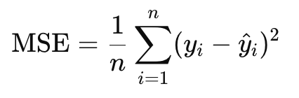
Evaluation
MAE(Mean Absolute Error):- It is a absolute difference between the predicted and actual values. If mae is 100 then the model deviate by 100 units from the actual value
MSE(Mean Squared Error):- It is the average of the squared error between the predicted and actual values. It gives more weight to large errors. If the mse is 100 the deviate by 10 units from the actual value.

Slide 33
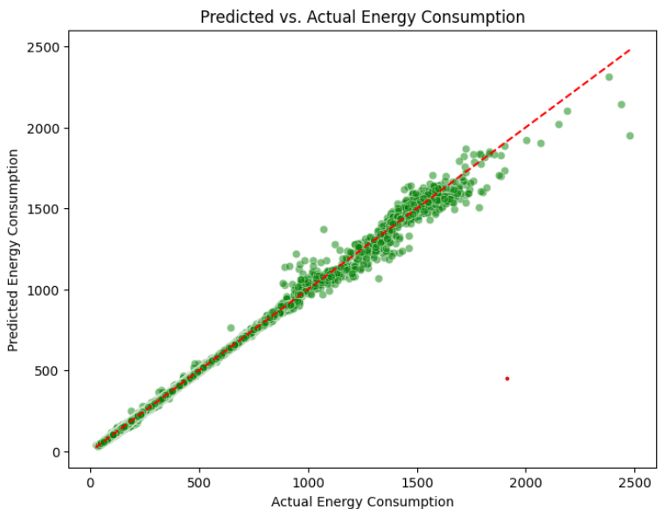
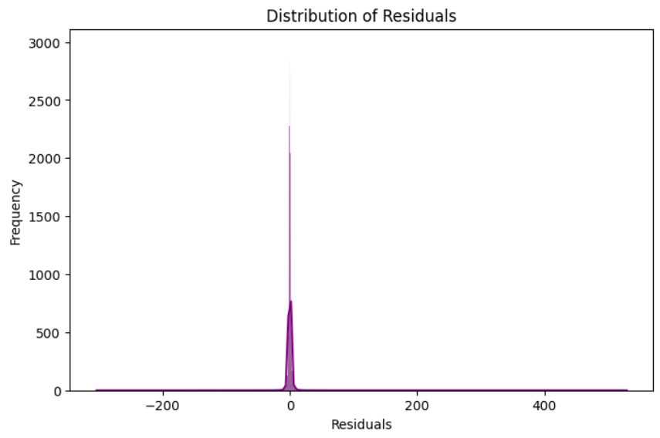
Outputs
Figure 8. Predicted vs. Actual Energy Consumption Regression Line
Figure 9. Distribution of Residual – Histplot
As shown in Figure 8 helps visualize how well the model captures the data's trends. The closer the points are to the line y = x, the better the model.
A histogram of residuals as shown in Figure 9, can indicate whether there’s any systematic error in the model’s predictions.

Slide 34
Results
Mean Absolute Error (MAE): The model achieved an MAE of 1.66 kWh, indicating that, on average, predictions deviate from actual energy consumption by 1.66 kWh.
Mean Squared Error (MSE): The MSE value of 28.89 reflects the squared average of errors, showing the presence of some larger discrepancies.
Root Mean Squared Error (RMSE): The RMSE of 5.38 highlights the overall magnitude of prediction errors, representing significant deviations in some cases.
Effectiveness: These metrics demonstrate the model's strong predictive performance with relatively low errors given the complexity of energy consumption patterns.

Slide 35
Comparison and Analysis
Accuracy: The low MAE and RMSE suggest the XGBoost model effectively captured intricate relationships in energy data influenced by factors like temperature and time of day.
Key Drivers: Feature importance analysis identified temperature, humidity, and hour of the day as the most influential predictors, aligning with real-world expectations.
Utility: The model’s ability to provide reliable forecasts and detect high usage patterns makes it valuable for energy optimization in smart homes and commercial spaces.
Future Scope: Despite some residual errors, the model’s accuracy can be enhanced with granular data, advanced time series methods, and real-time integration.

Slide 36
Conclusion
The XGBoost Regressor (XGBR) model demonstrated strong performance in predicting energy consumption using historical, weather, and time-based data, achieving low errors as measured by MAE, MSE, and RMSE. Feature importance analysis highlighted key factors like temperature and humidity, aligning with expected energy usage patterns. The model provides actionable insights, such as high energy consumption alerts, enhancing its practical utility for energy optimization in residential and commercial settings. Future improvements could include incorporating granular data (e.g., occupancy patterns, device usage), advanced models like RNNs or LSTMs for time series forecasting, real-time data integration, and deployment in smart home or building management systems.

Slide 37
References
[1] S. Tabasi, A. Aslani, and H. Forotan, "Prediction of Energy Consumption by Using Regression Model," Computational Research Progress in Applied Science & Engineering, vol. 2, no. 3, pp. 110-115, Jul. 2016.
[2] D. Ramos, P. Faria, A. Morais, and Z. Vale, "Using decision tree to select forecasting algorithms in distinct electricity consumption context of an office building," in Proc. 8th Int. Conf. Energy and Environment Research (ICEER 2021), Porto, Portugal, Sep. 13–17, 2021, pp.
[3] Karan Kumar. et al., "Quantum support vector machine for forecasting house energy consumption: a comparative study with deep learning models," Journal of Cloud Computing: Advances, Systems and Applications, vol. 13, no. 105, 2024.
[4] M. Qureshi, M. A. Arbab, and S. ur Rehman, "Deep learning-based forecasting of electricity consumption," Scientific Reports, vol. 14, no. 6489, 2024. doi: 10.1038/s41598-024-56602-4.
[5] L. Semmelmann, S. Henni, and C. Weinhardt, “Load forecasting for energy communities: a novel LSTM-XGBoost hybrid model based on smart meter data” Energy Informatics, pp. 1–21, Sep. 2022
[6] C. Sheng and H. Yu, “An optimized prediction algorithm based on XGBoost”in Proc. 2022 Int. Conf. Networking and Network Applications (NaNA), Xinjiang, China, Nov. 2022, pp. 442–447

Slide 38
Thank You

