Slide 1
Front End Engineering-II
Title of the project
Resume Maker
Team Name/No:
Rajat Sharma 2210990707(Leader)
Rajat Saini 2210990706
Priyanshu Bindal 2210990686
Prianshu Kumar 2210990681

Slide 2
Index
Objective
Introduction
Technologies Used
Key Features
Algorithm
Flow Chart
Project Highlights
Conclusion
Reference

Slide 3
Objective:
The primary objective of our project is to revolutionize the way individuals create resumes by offering a user-friendly, dynamic, and customizable platform. By harnessing the power of ReactJS, we aim to provide a seamless experience that not only simplifies the resume-building process but also enables users to tailor their resumes to specific job roles with ease.

Slide 4
Introduction
In today's competitive job market, crafting a compelling resume is crucial for standing out among countless applicants. To streamline this process and empower users with a tool to create professional resumes effortlessly, we embarked on the development journey of a cutting-edge Resume-Making App using ReactJS.

Slide 5
Technologies Used:
React: React.js, commonly referred to as React, is an open-source JavaScript library developed by Facebook. It is used for building user interfaces (UIs) for web applications. React allows developers to create reusable UI components and manage their state efficiently, making it easier to build complex and interactive user interfaces.
Components: React.js utilizes a component-based architecture, where UIs are broken down into small, reusable components. Each component encapsulates its own logic and UI, making it easier to manage and maintain code. 1

Slide 6
Technologies Used:
JSX(JavaScript XML): JSX, or JavaScript XML, is an extension syntax for JavaScript that allows developers to write HTML-like code within JavaScript. It is commonly associated with React.js, although it can be used with other libraries or frameworks as well. JSX allows embedding JavaScript expressions within curly braces {}. This enables dynamic content and logic to be incorporated directly into JSX elements. For example, {} can be used to interpolate variables, call functions, or perform calculations.
CSS Modules: We utilize CSS Modules to encapsulate styles and ensure component-based styling, enhancing maintainability and reducing the risk of styling conflicts.

Slide 7
Key Features:
Intuitive User Interface: A sleek and intuitive interface ensures that users can navigate the app effortlessly, regardless of their technical expertise.
Dynamic Template Selection: Users can choose from a variety of professionally designed templates, each tailored to different industries and career levels, ensuring their resumes make a lasting impression.
Customizable Sections: From personal information and professional experience to skills and achievements, users have the flexibility to customize each section of their resume to highlight their unique strengths and qualifications.

Slide 8
Key Features:
Real-Time Preview: A real-time preview feature allows users to see how their resume will appear to potential employers as they make changes, ensuring accuracy and consistency throughout the editing process.
Data Validation and Error Handling :Validate user inputs (e.g., email format, phone number) to ensure accurate data. Display error messages if required fields are missing or invalid.

Slide 9
Algorithm:
To develop a resume-making app in ReactJS, begin by initializing the project and setting up the necessary dependencies. Design the component hierarchy, including features like user authentication if required, template selection, resume builder, real-time preview, export functionality, and styling. Manage application state either locally or with Redux, ensuring seamless data flow between components. Enable users to select from a variety of resume templates and input their personal and professional information through an intuitive interface, validating input data for accuracy

Slide 10
Flow Chart:
The flow chart of the application outlines the steps involved in creating a resume, from entering personal information to generating the final resume document. It includes decision points for user inputs and actions.

Slide 11
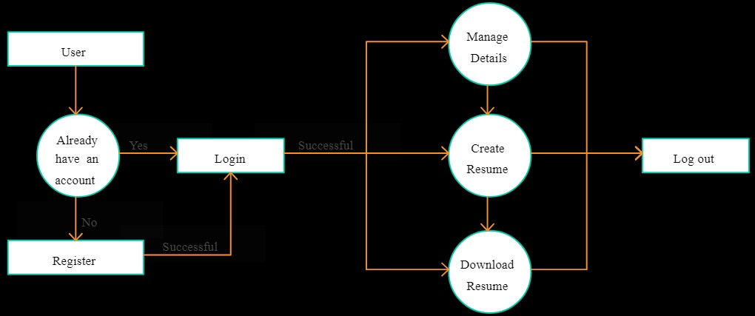
Flow Chart:

Slide 12
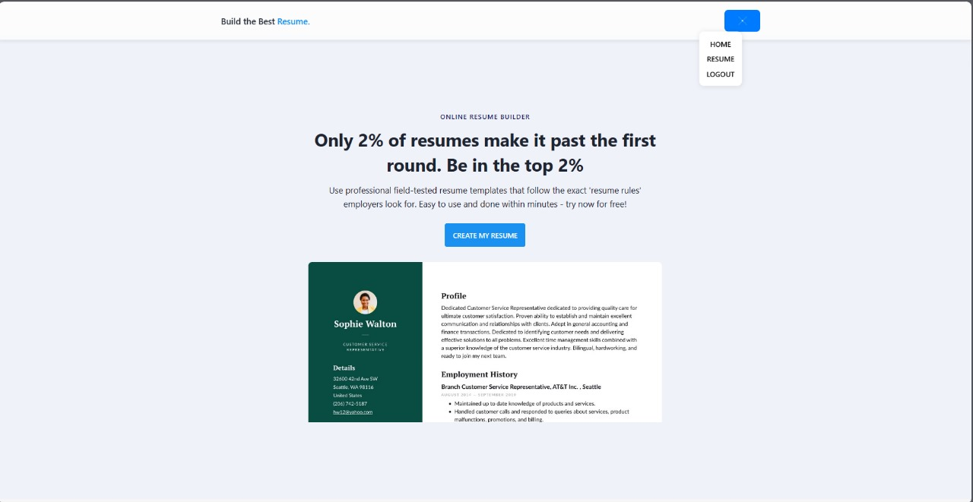
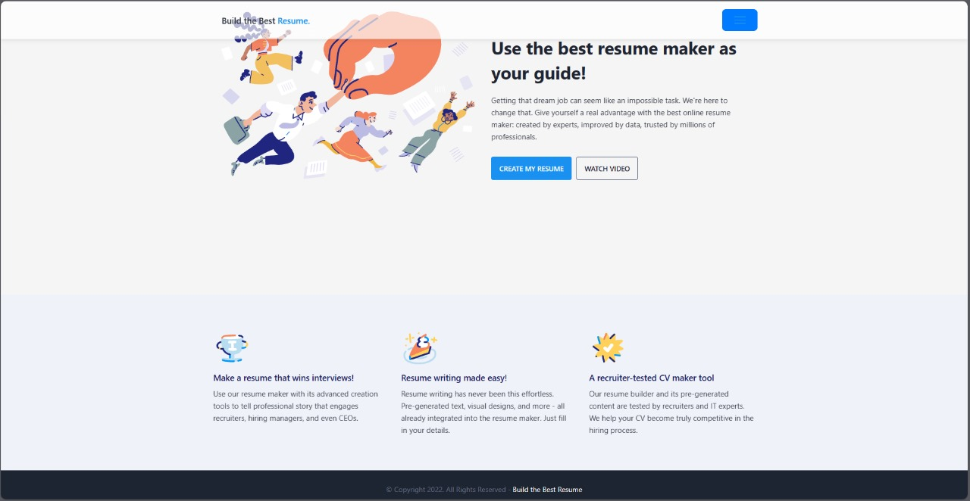
Project Highlights:
Home page

Slide 13
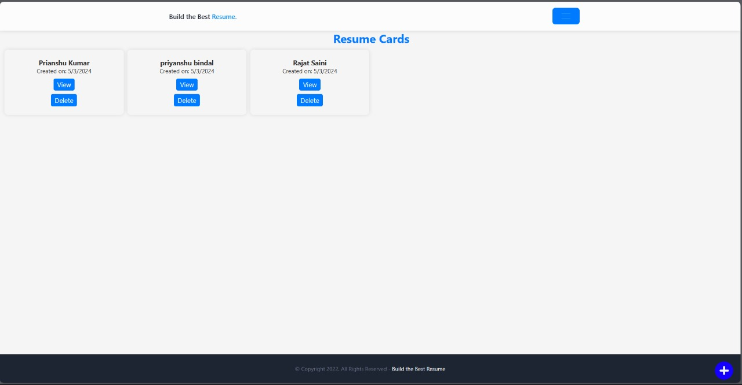
Project Highlights:
Resume Cards

Slide 14
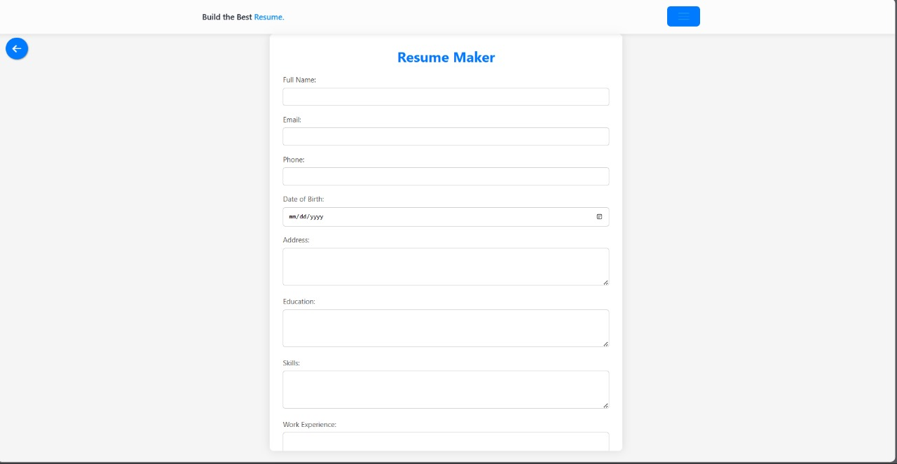
Project Highlights:
Resume Page

Slide 15
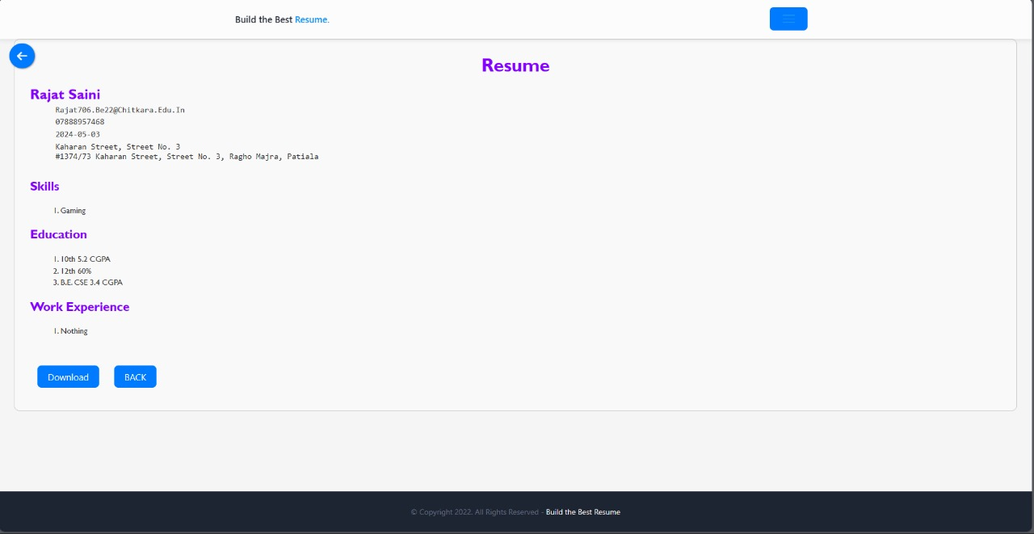
Project Highlights:
Preview

Slide 16
Conclusion:
In summary, our Resume-Making App represents a paradigm shift in the way individuals approach resume creation. By harnessing the power of ReactJS and modern web development practices, we've created a tool that empowers users to craft professional resumes tailored to their unique skills and experiences, ultimately helping them stand out in today's competitive job market.

Slide 17
Reference:
https://resume.io/
https://zety.com/in/resume-builder

Slide 18
End:
The End

