Slide 1
WireShark

Slide 2
What is Wireshark?
Network packet analyzer
Capture network packets and tries to display that packet data as detailed as possible
Open Source

Slide 3
Purpose
Network administrators use it to troubleshoot network problems
Network security engineers use it to examine security problems
Developers use it to debug protocol implementations
People use it to learn network protocol internals

Slide 4
What it doesn’t do
Isn’t an intrusion detection system. It will not warn you when someone does strange things on your network
Will not manipulate things on the network, it will only "measure" things from it

Slide 5
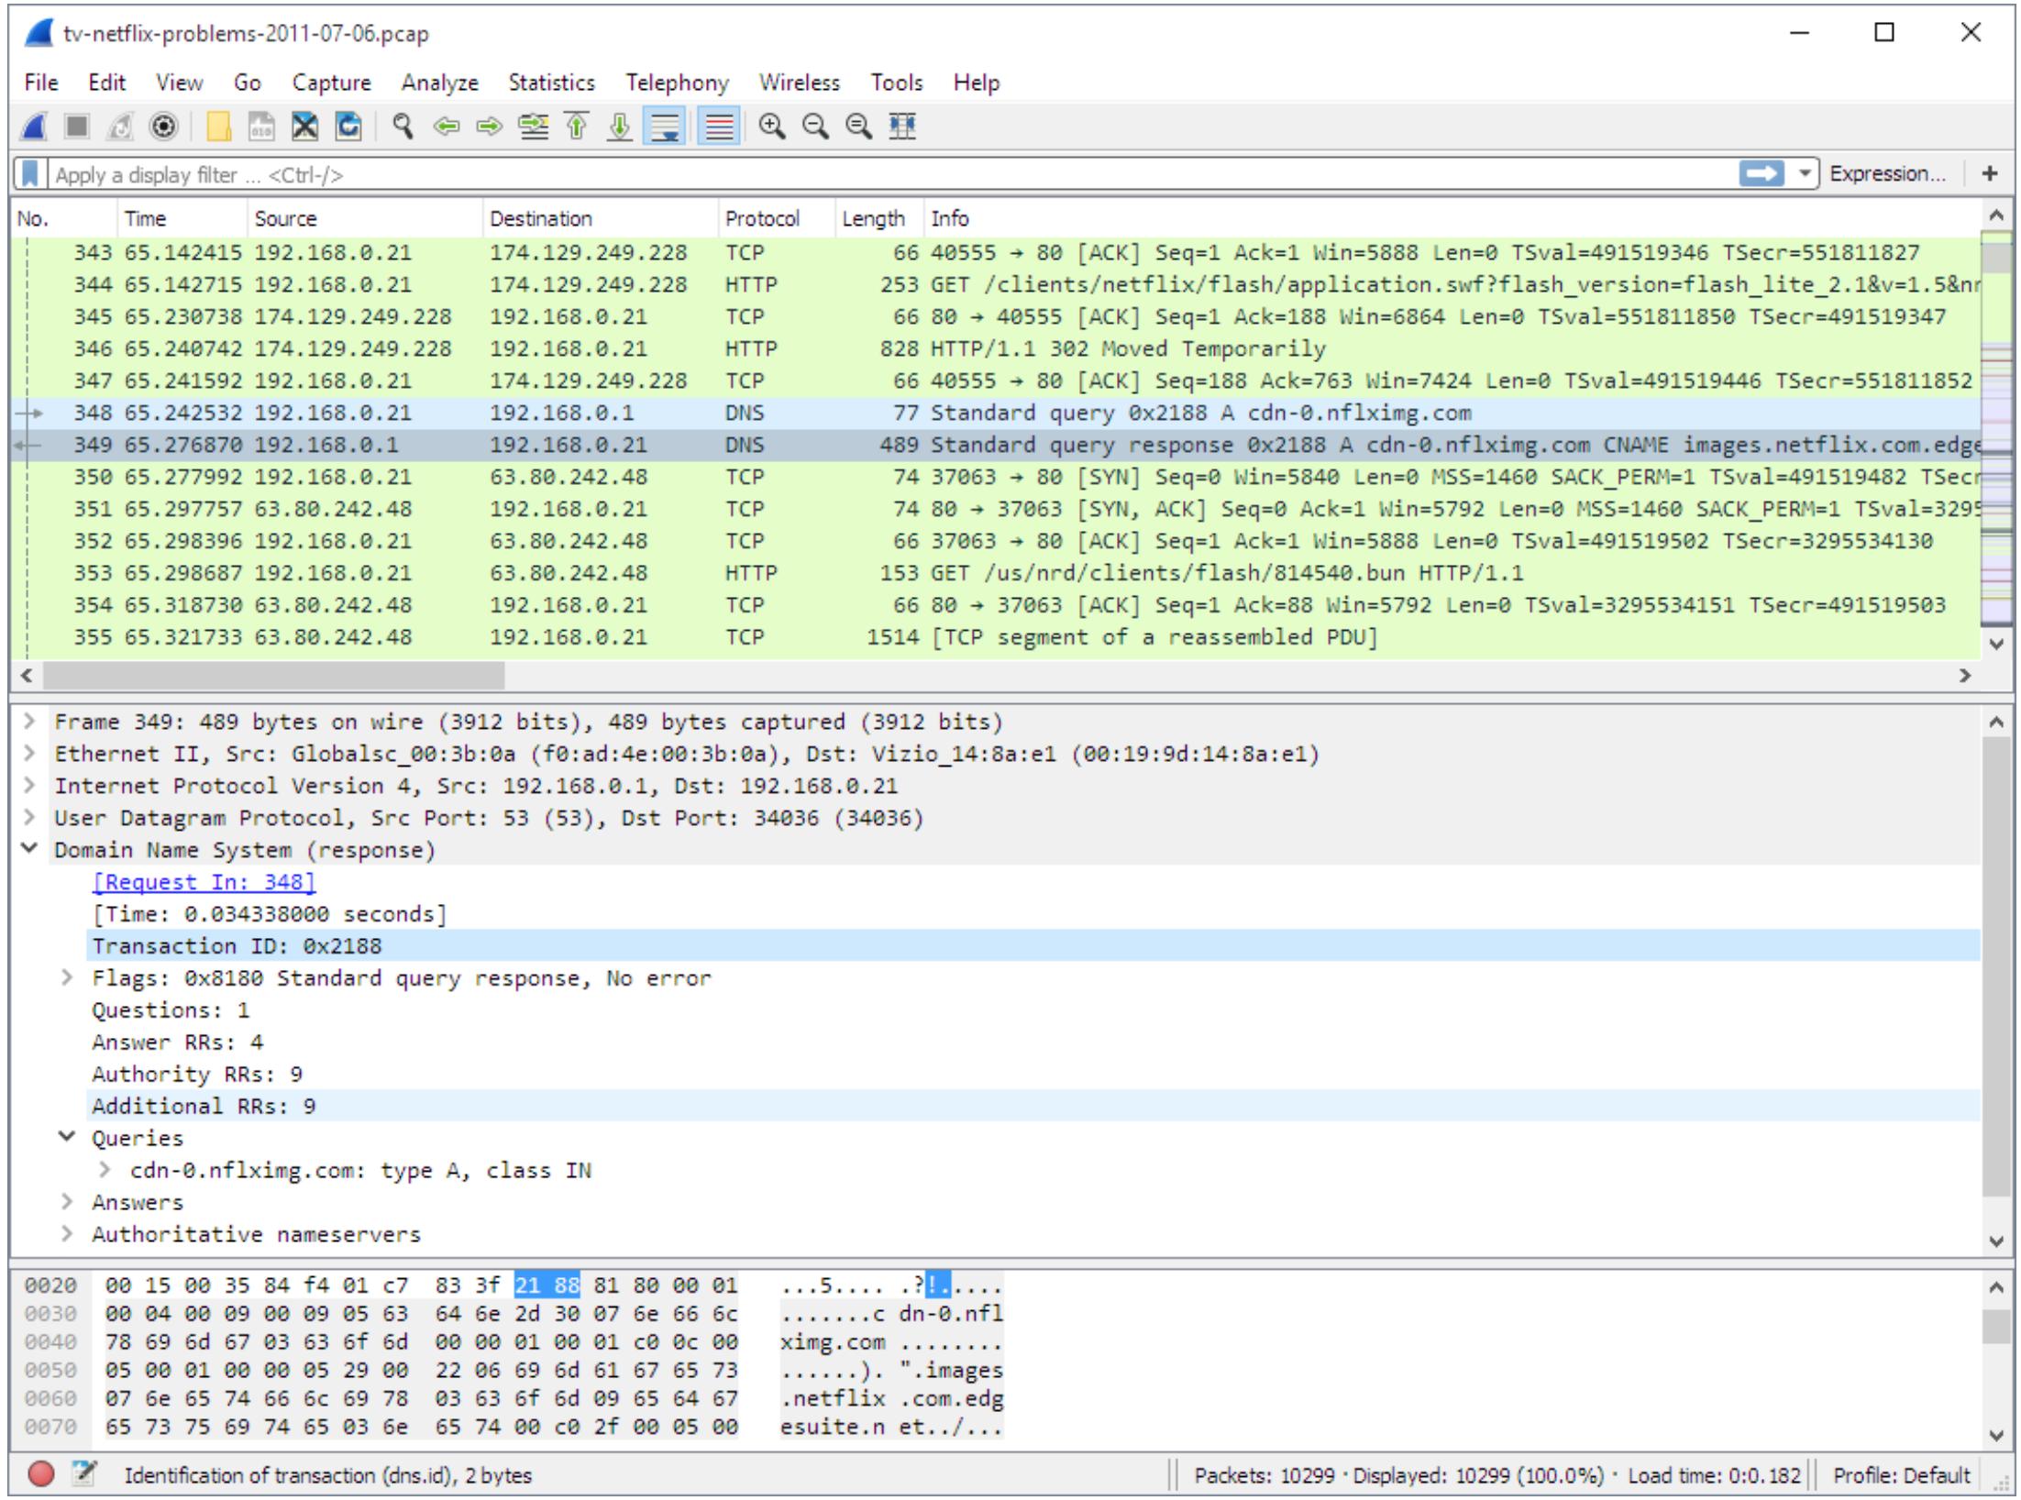

Packet Capture
Packet Detail
Packet Hexidecimal

Slide 6
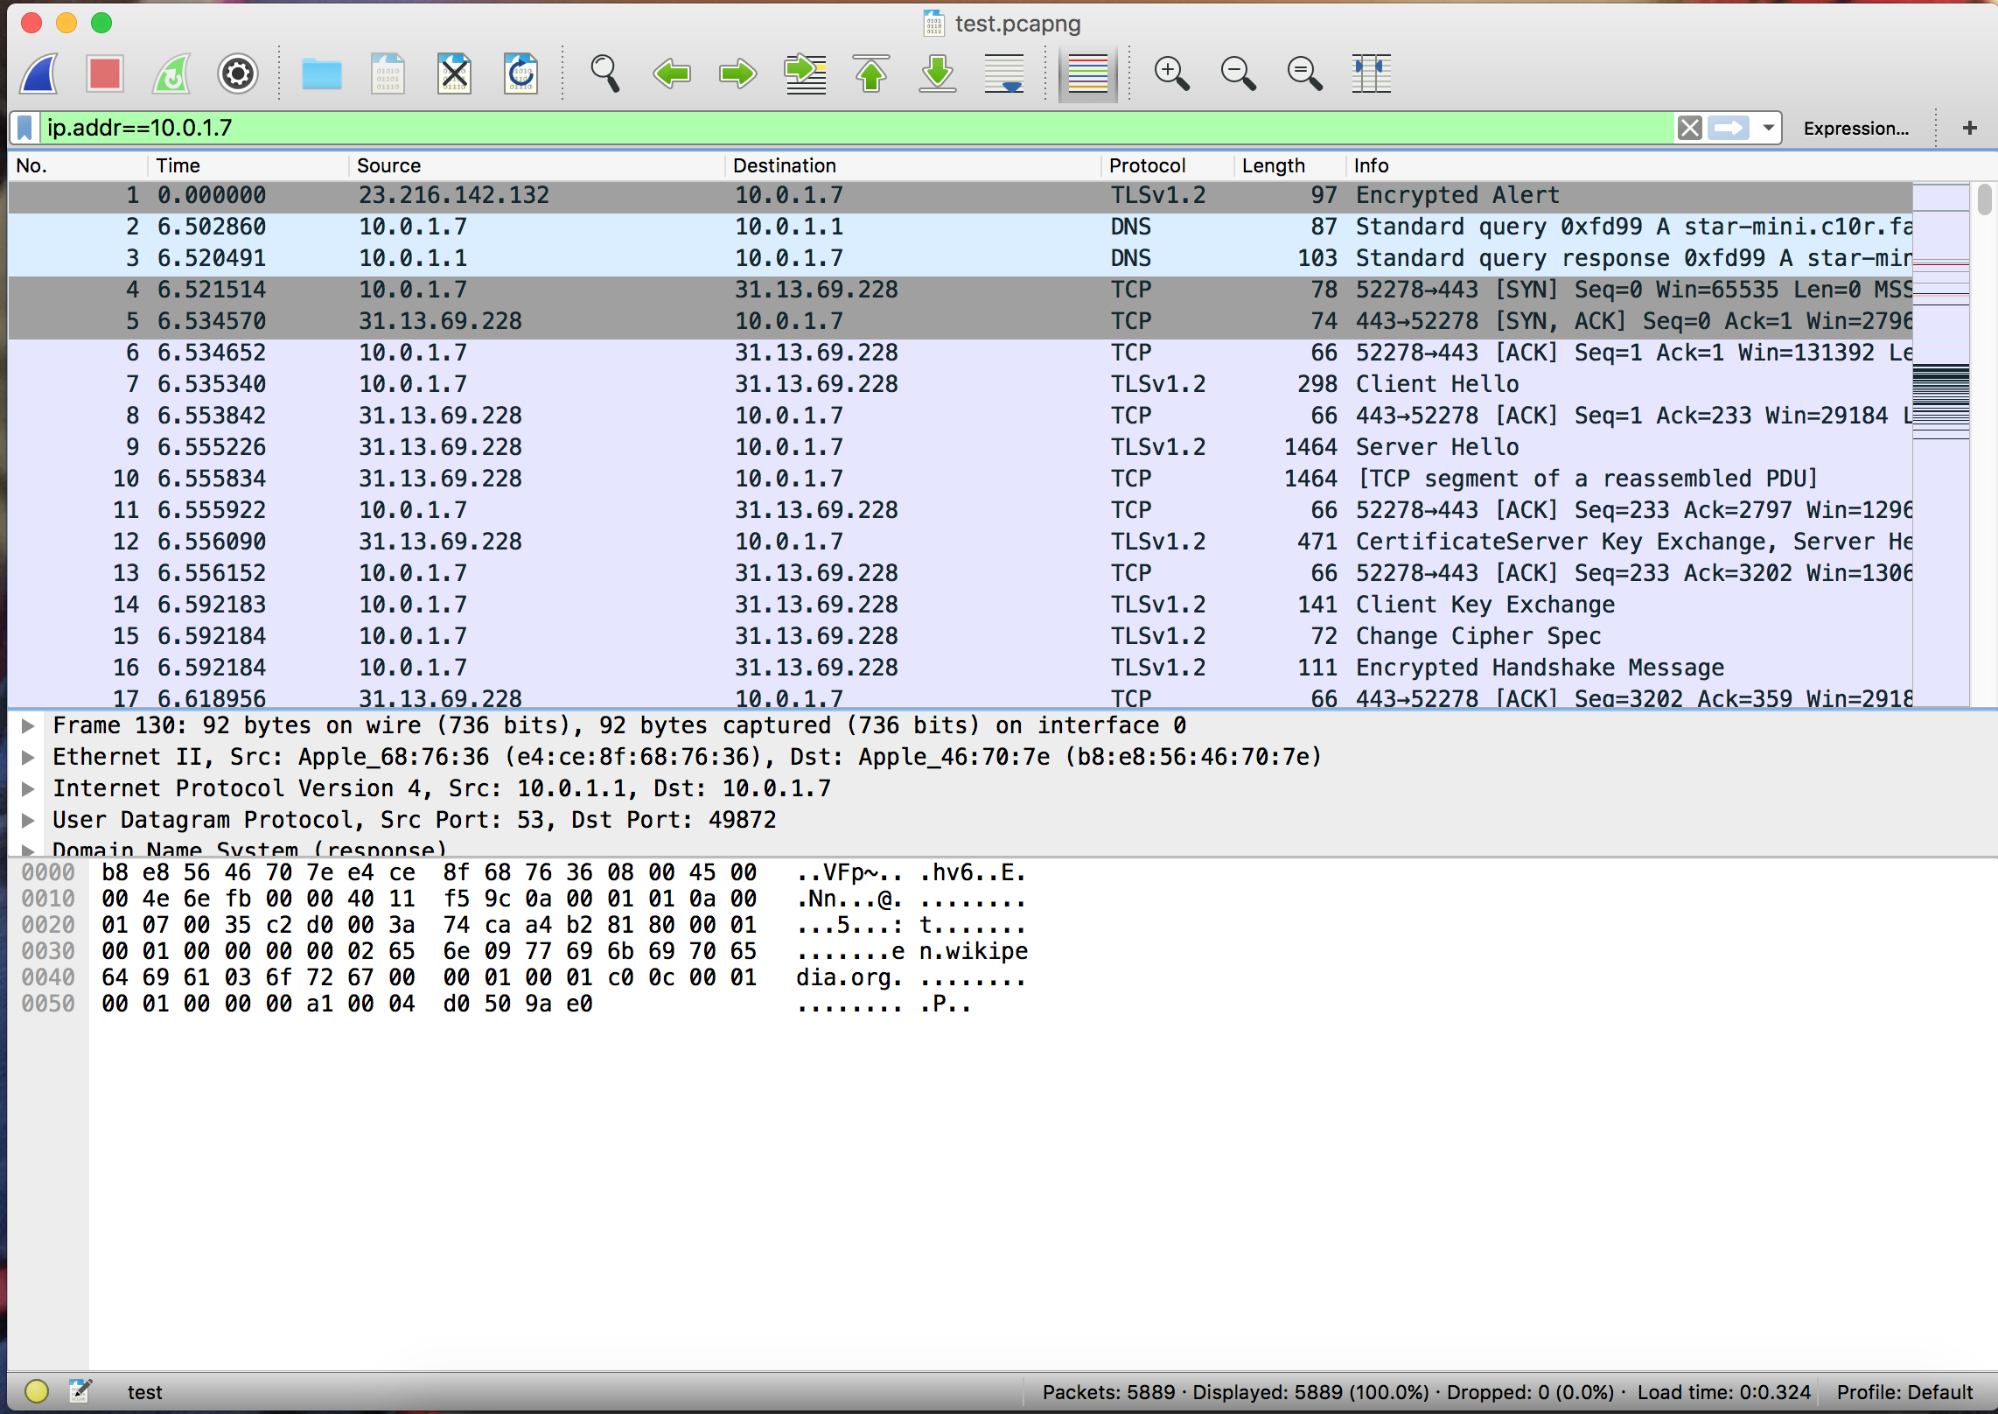

Slide 7
HACKATHON
Mingle and create teams
4 people per team
Tell team name and an email address to CNSP staff
Download questions and pcap at: https://github.com/pricept/hackathon
Use tools to answer questions
Answers due by 1500

