Slide 1
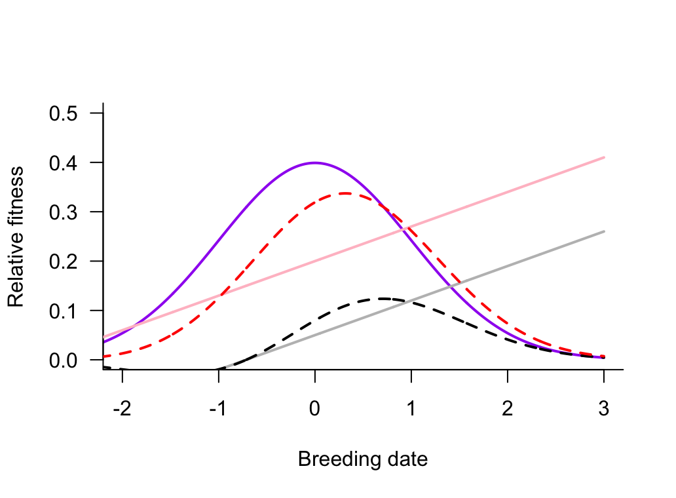
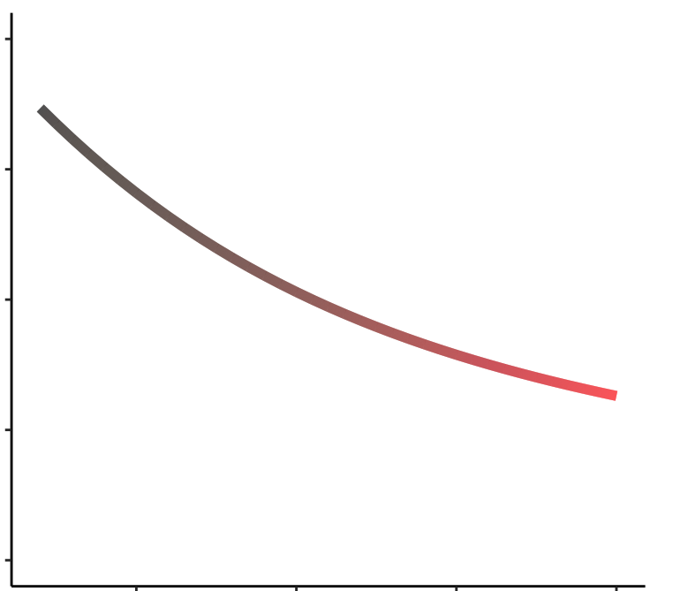
Fitness functions
Displacement from
θ
1.0
θ
Survival
Fecundity
Relative fitness
Displacement
0.5
0
-2 -1 0 1 2 3
0.05
0.1
0.15
0.2
Later breeding ->
Nutritional state, n
Notes:
Optimum in stab seln function
yl<--0.1+0.07*x. this was when x axis was 0-5. rescaled so theta=0. gives 0.04+0.07X and 0.34+0.07X
yhh<-0.2+0.07*x
Ojo: total fitness is rescaled

Slide 2
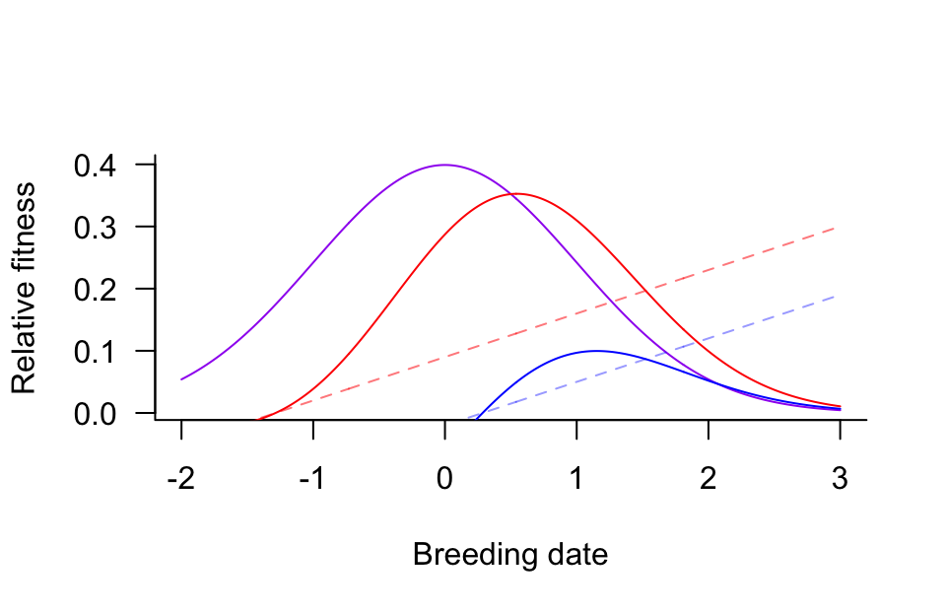
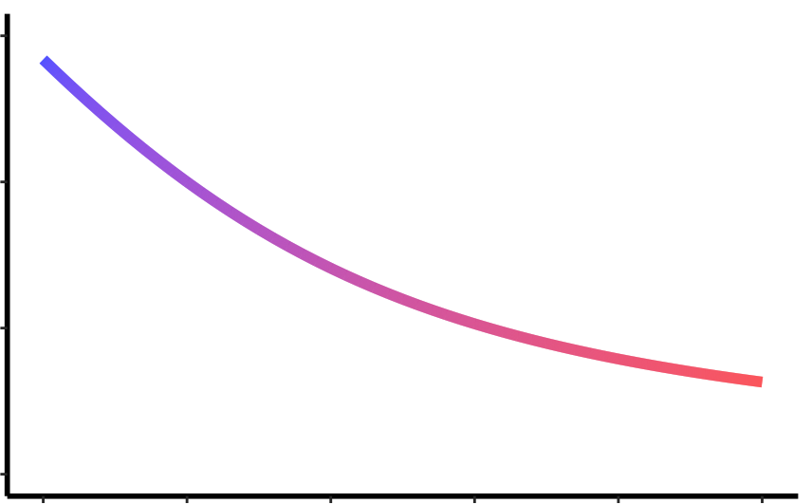
Fitness functions
Displacement from
θ
θ
1.5
Relative fitness
1.0
Displacement (days)
0.5
-2 -1 0 1 2 3
-0.05
0.05
0.15
Breeding date, days
Nutritional state, n
Notes:
Optimum in stab seln function
yl<--0.02+0.07*x.
yhh<-0.09+0.07*x
Ojo: total fitness is rescaled by 8

Slide 3
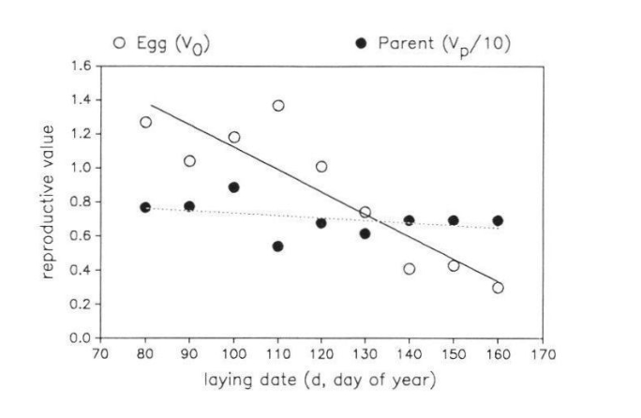
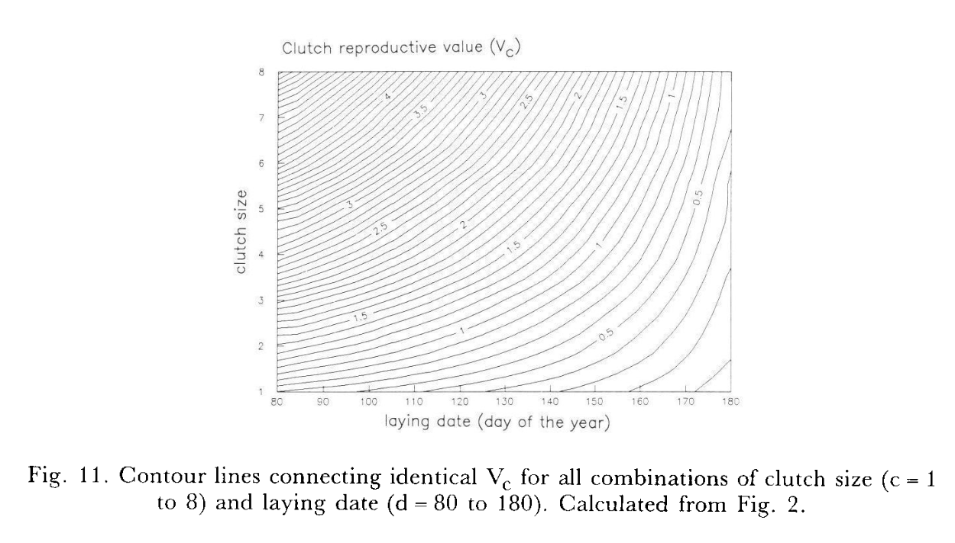
Vc=c*Vo*0.5
Assuming no investment into chick survival

Slide 4
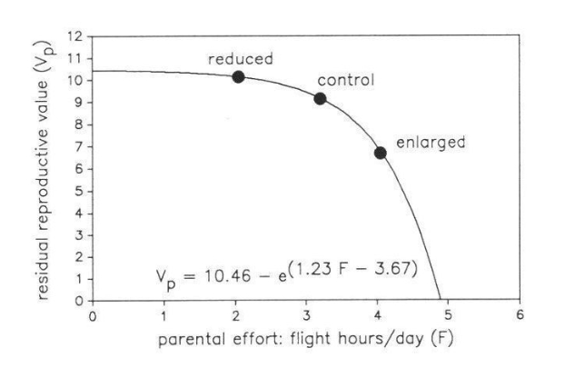

Slide 5
Notes:
yl<--0.1+0.07*x
yhh<-0.2+0.07*x

Slide 6
Notes:
yl<--0.1+0.07*x
yhh<-0.2+0.07*x

Slide 7


A
B
Fitness
Phenotype
$$θ$$
$$θ$$
Breeding date, b
Breeding date, b
Notes:
yl<--0.1+0.07*x
yhh<-0.2+0.07*x

Slide 8
+
-
-
Date
Voles
Flight time
Parental survival

Slide 9
Notes:
yl<--0.1+0.07*x
yhh<-0.2+0.07*x

Slide 10
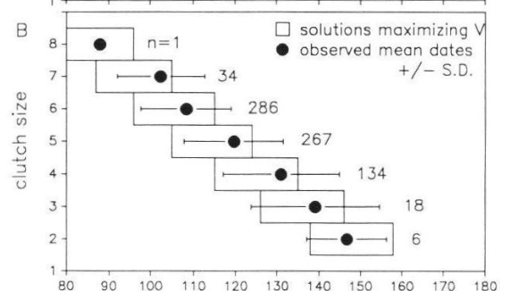
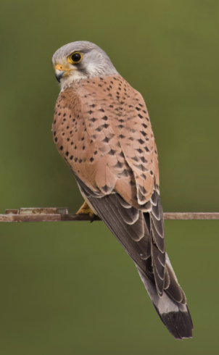
Day in season
Dijkstra et al.

Slide 11
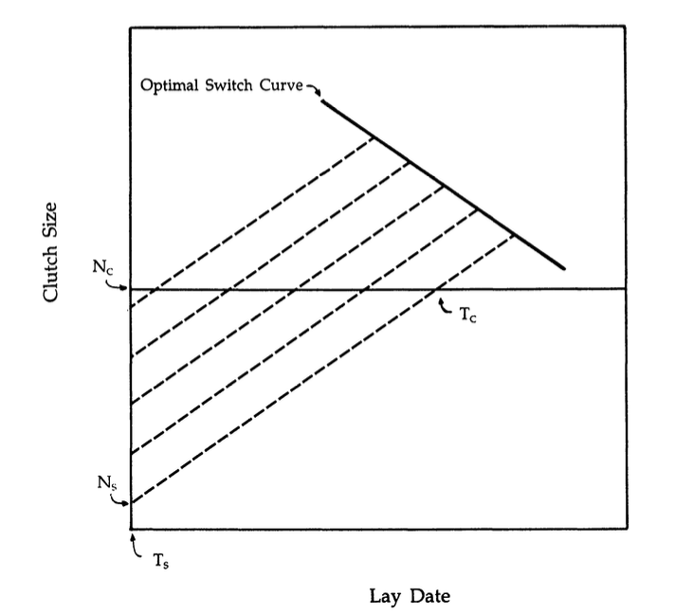
Rowe et al. 1994.
sigmaY = sigmasqn + K

Slide 12
Individual optimization model
θ
Relative fitness
0 1 2 3 4 5
Later breeding ->
2. Result is possibility of negative fitness which can’t happen, can’t find function that gives the pattern and doesn’t go negative
Notes:
yl<--0.1+0.07*x
yhh<-0.2+0.07*x

Slide 13
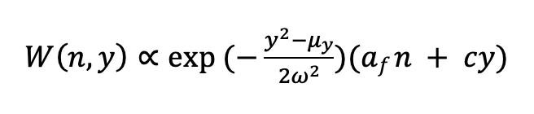
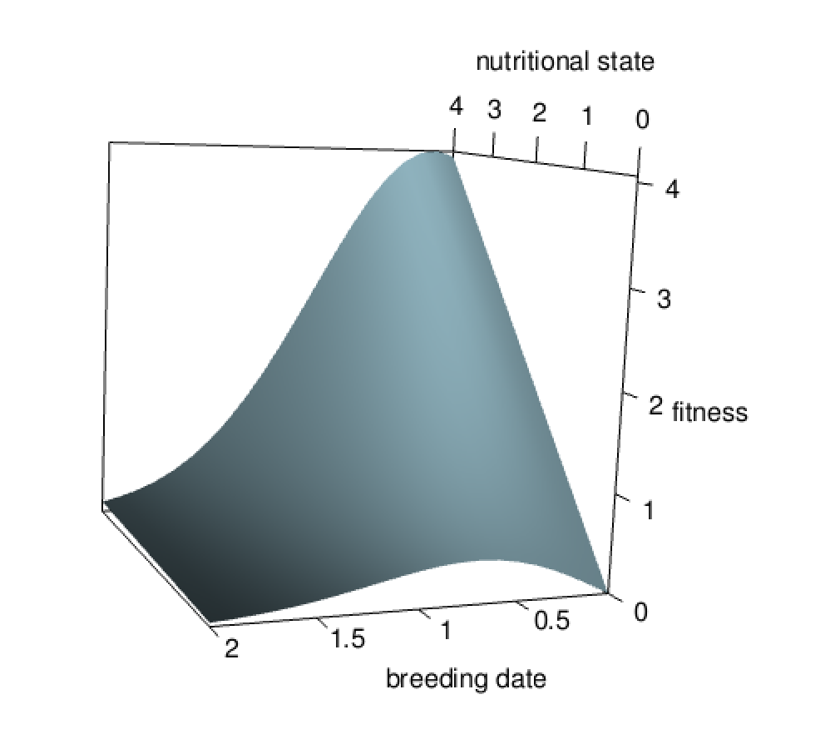

Slide 14
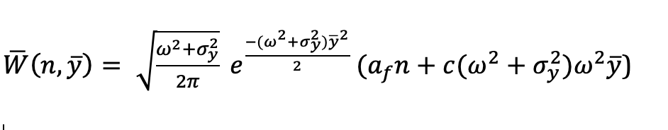
Wish to compute
the equilibrium variance and mean in y. Differentiate set equal to 0, then integrate over n.
The correlation between y and w.

Slide 15
Individual optimization model
θ
Relative fitness
Rowe et al
0 1 2 3 4 5
Later breeding ->
Notes:
yl<--0.1+0.07*x
yhh<-0.2+0.07*x

Slide 16
The functions result in later breeding birds having lower fitness, i.e., a correlation of fitness with lay date that comes through n

