Slide 1
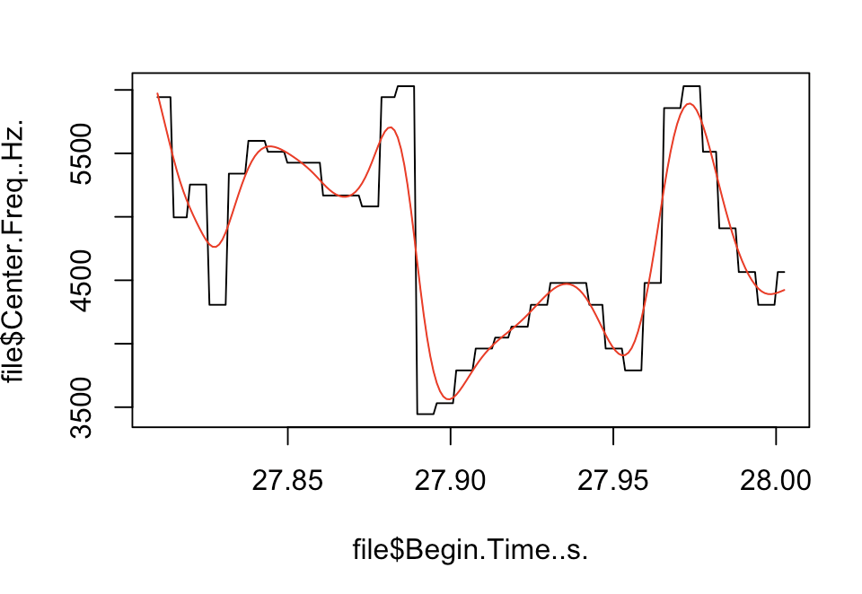
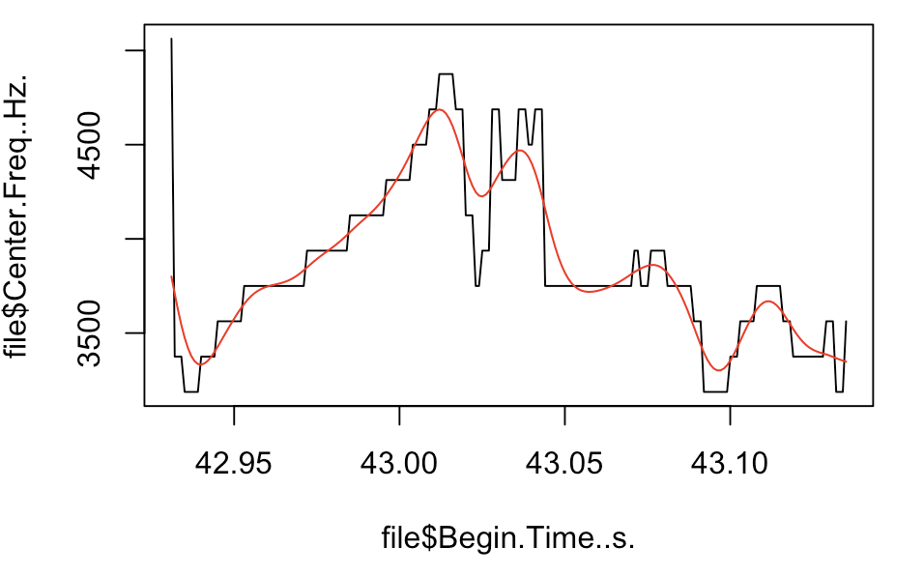
g
a
end
Center frequency, Hz
Time, seconds
Time, seconds

