Slide 1
From Crisis to Opportunity: A Google Trends Analysis of Global Interest in Distance Education Tools During and Post the COVID-19 Pandemic
Priyanga Dilini Talagala
Senior Lecturer
Department of Computational Mathematics
University of Moratuwa
June 28, 2024

Slide 2
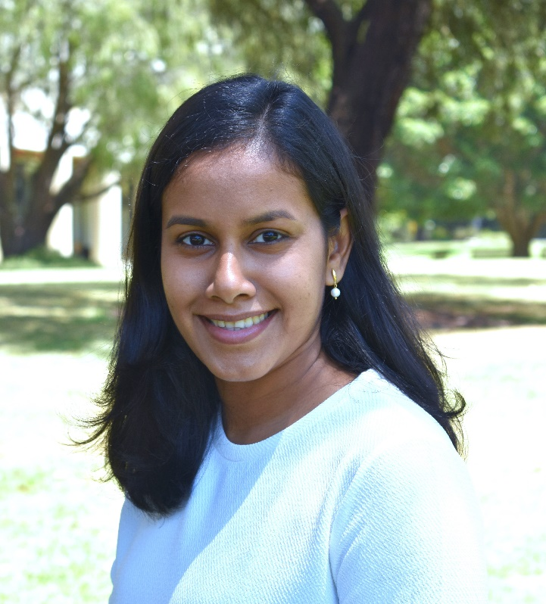
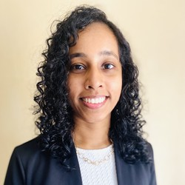



Data and codes available at: https://github.com/pridiltal/CARMA2024_Analysis
Priyanga Dilini Talagala
PhD (Monash)
prital.netlify.app
pridiltal
Thiyanga S. Talagala
PhD (Monash)
thiyanga.netlify.app
thiyangt

