Slide 2
Outliers
Missing Values
Class Imbalance

Slide 3
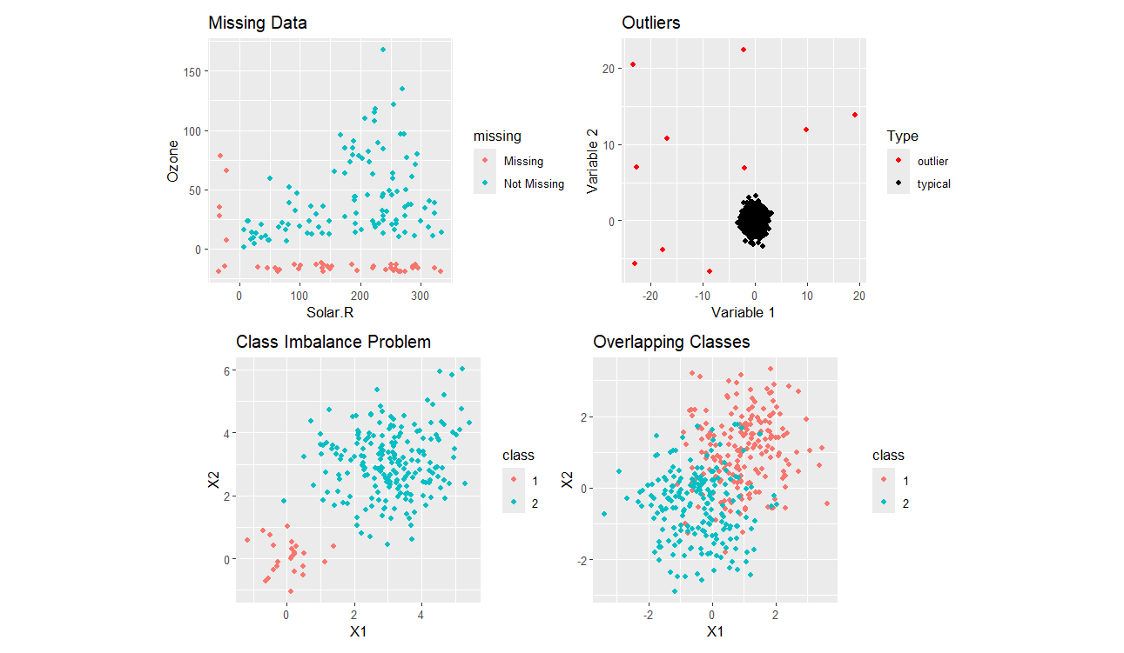




?
ROSE
smotefamily

