Slide 1
Vertical Interaction in Open Software Engineering Communities
  Patrick Wagstrom
  Ph.D. Thesis Defense
  March 9, 2009
  Committee:
  James Herbsleb
  Kathleen Carley
  M. Granger Morgan
  Audris Mockus

Slide 2


Slide 3
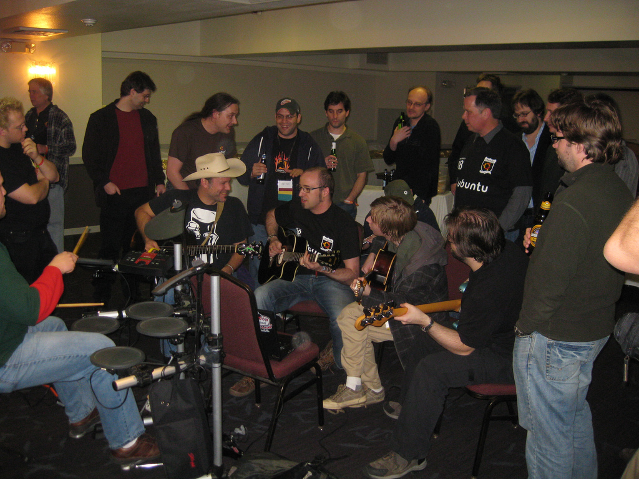
http://www.flickr.com/photos/nixternal/3131672372/

Slide 4
Open Source is BIG Business

Slide 5
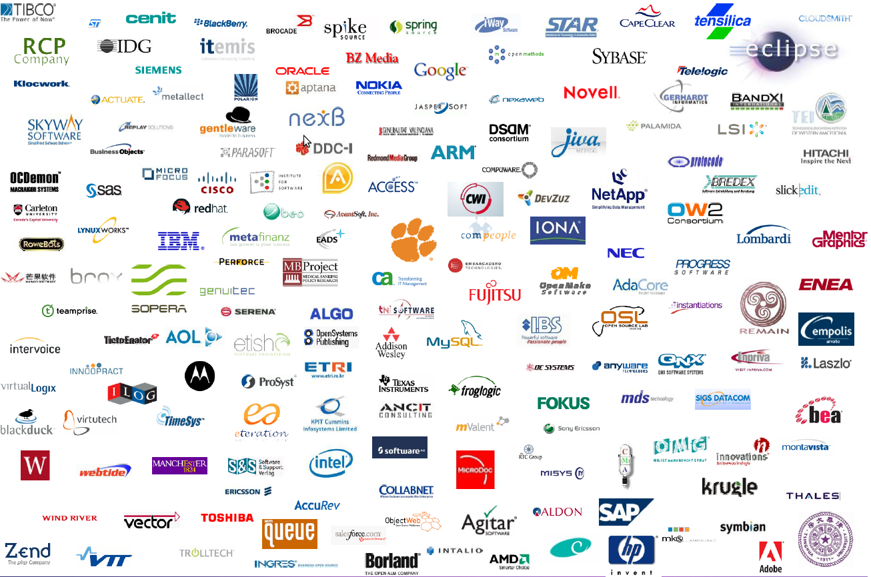
Open Communities are Bigger
From March 2008 Eclipse Executive Director's Report:
http://www.eclipse.org/org/foundation/membersminutes/20080317MembersMeeting/DirectorsReport.pdf

Slide 6
Central Players In Open Source
Foundations
Commercial Firms
Developers

Slide 7
4 Empirical Studies
Firms and Foundations
Firms and Firms
Firms and Individuals
Individuals and Individuals

Slide 8
Firms and Foundations:
Guiding an Ecosystem to Promote Value

Slide 9
The Problem
Some research has been done about why individual focused OSS projects utilize foundations
Little research has addressed why commercial firms would participate in foundations
  Large monetary cost
  Giving up some control
  Possibly increased work
What does the foundation do to drive value?

Slide 10
Data
Semi-structured interviews with Eclipse Foundation staff and employees of member companies
  38 interviews with 40 individuals
Face-to-face meetings at EclipseCon 2007 and 2008
Participation in Eclipse members meetings

Slide 11
Driving Value Creation
Non-market player
Introduction of process
Value of the Eclipse brand and marketing
Organizational structure driving value
Platform for innovation

Slide 12
Non-Market Player
Eclipse grew out of IBM's old VisualAge ecosystem
Small firms had to worry about being stepped on
Allows innovation without worry about “Gorillas”
Opens the door for distribution based business models

Slide 13
Platform for Innovation
Foundation actively recruits new members
Encourages components to be as modular as possible
  Modularity == Independence from other components
Create projects outside of Eclipse and bring inside later
Push usage outside traditional realms

Slide 14
Takeaways
Eclipse Foundation has taken concrete steps to build ecosystem
Governance structure ensures all can provide input
Non-market nature is very beneficial
Services provided for members are worth the cost

Slide 15
Firms and Firms:
Business Collaboration Through Open Source

Slide 16
The Problem
Much data about how individuals interact in OSS
Little data about how firms collaborate
Is there an overdependence on single firms?
How collaborative are OSS ecosystems?

Slide 17
Data
Projects from Eclipse Foundation
Two level project hierarchy
  Top Level Projects (11)
  Sub Projects (89)
Collected data from version control system and IP repository
Ties individuals to code changes and firms
Compared with data from GNOME

Slide 18
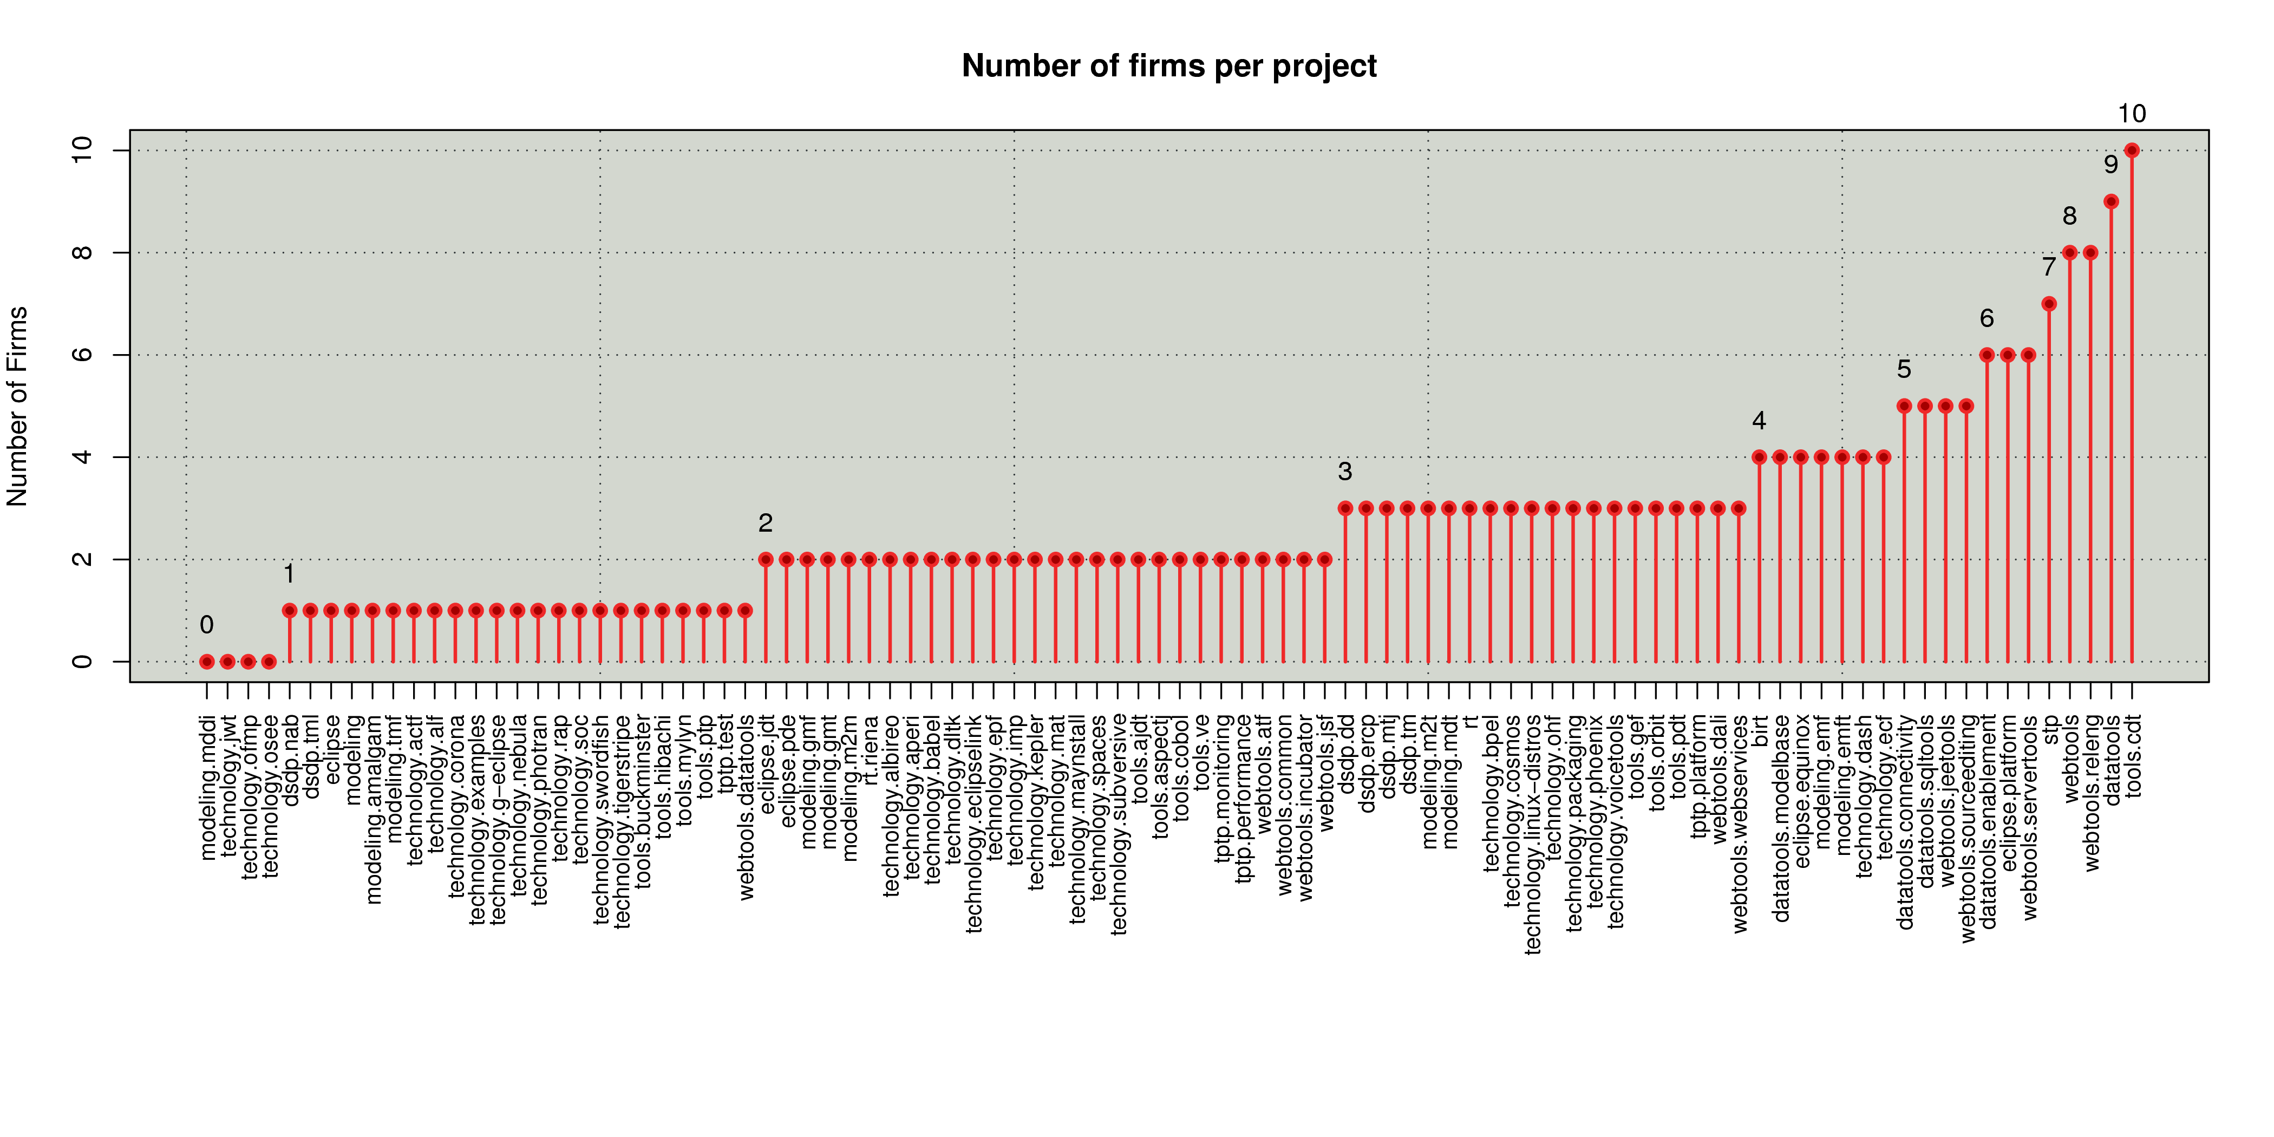
How Much Collaboration Really Exists?
eclipse.platform
tools.cdt

Slide 19
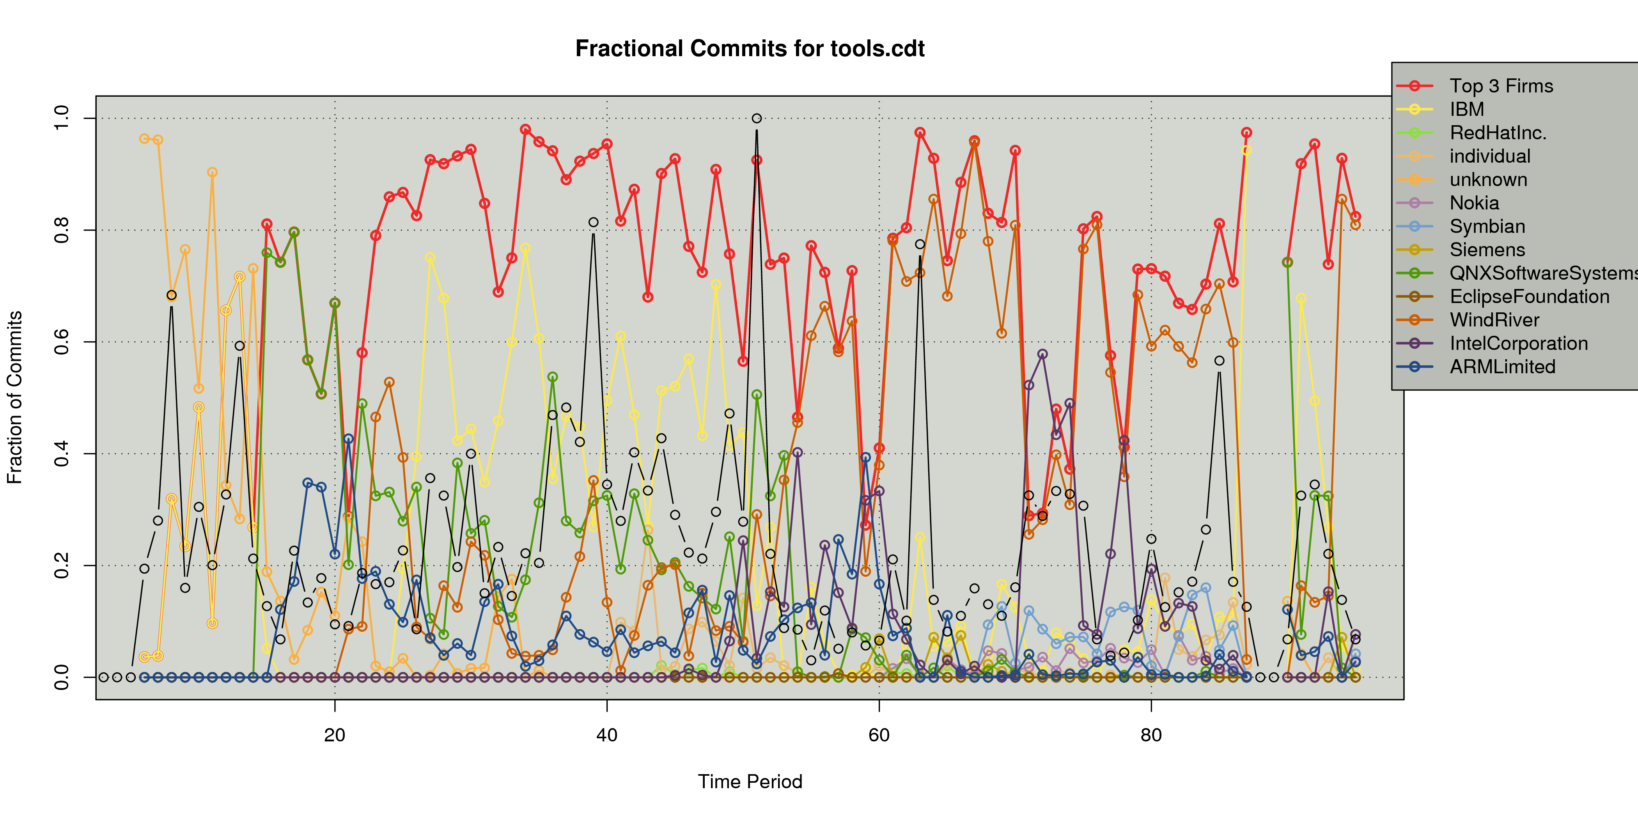
Collaboration in CDT
IBM Leaves/QNX Lead
WindRiver Joins/IBM Lead
WindRiver Leads

Slide 20
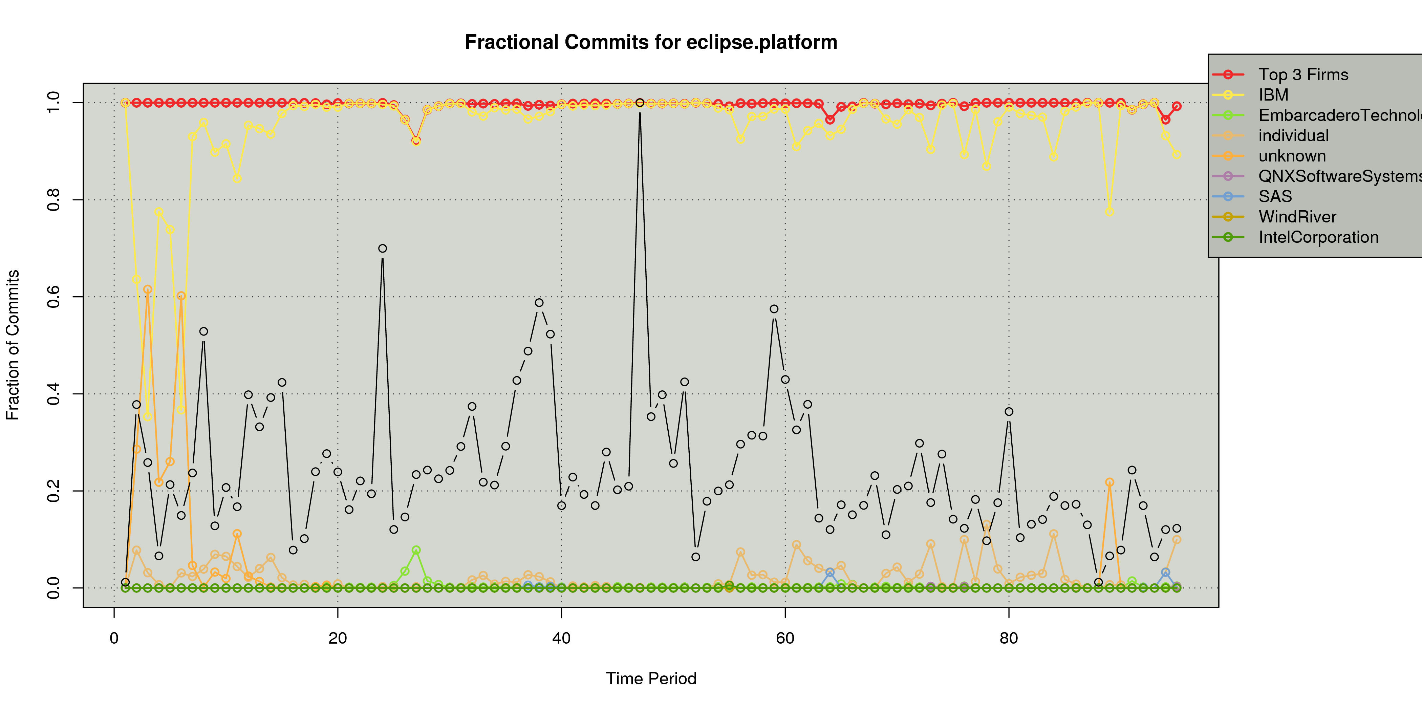
Who Builds the Platform?

Slide 21
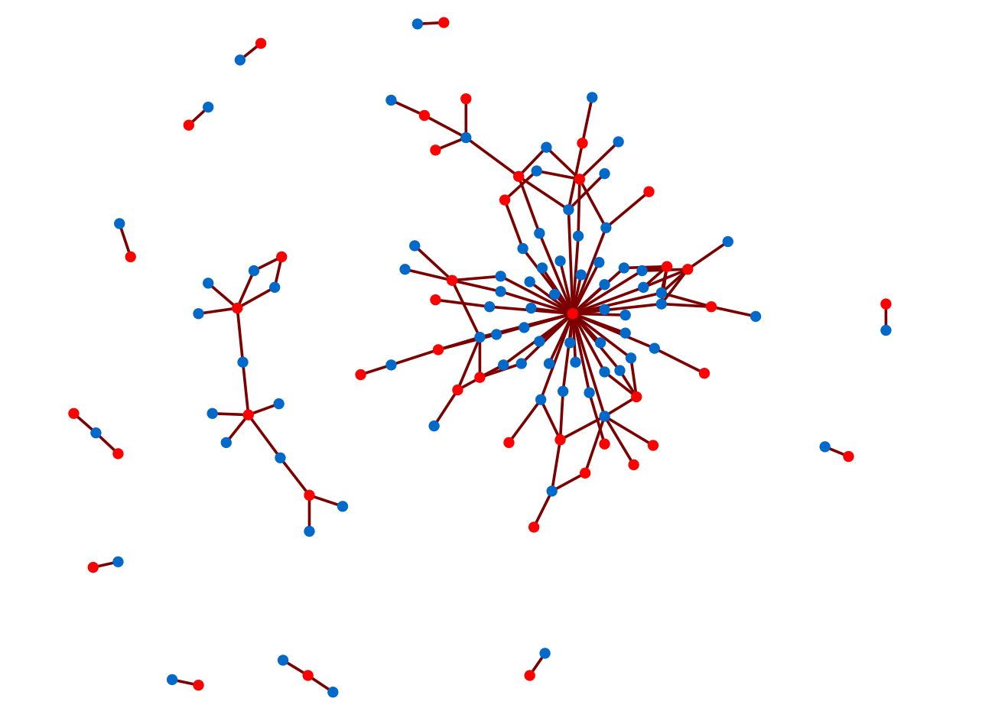
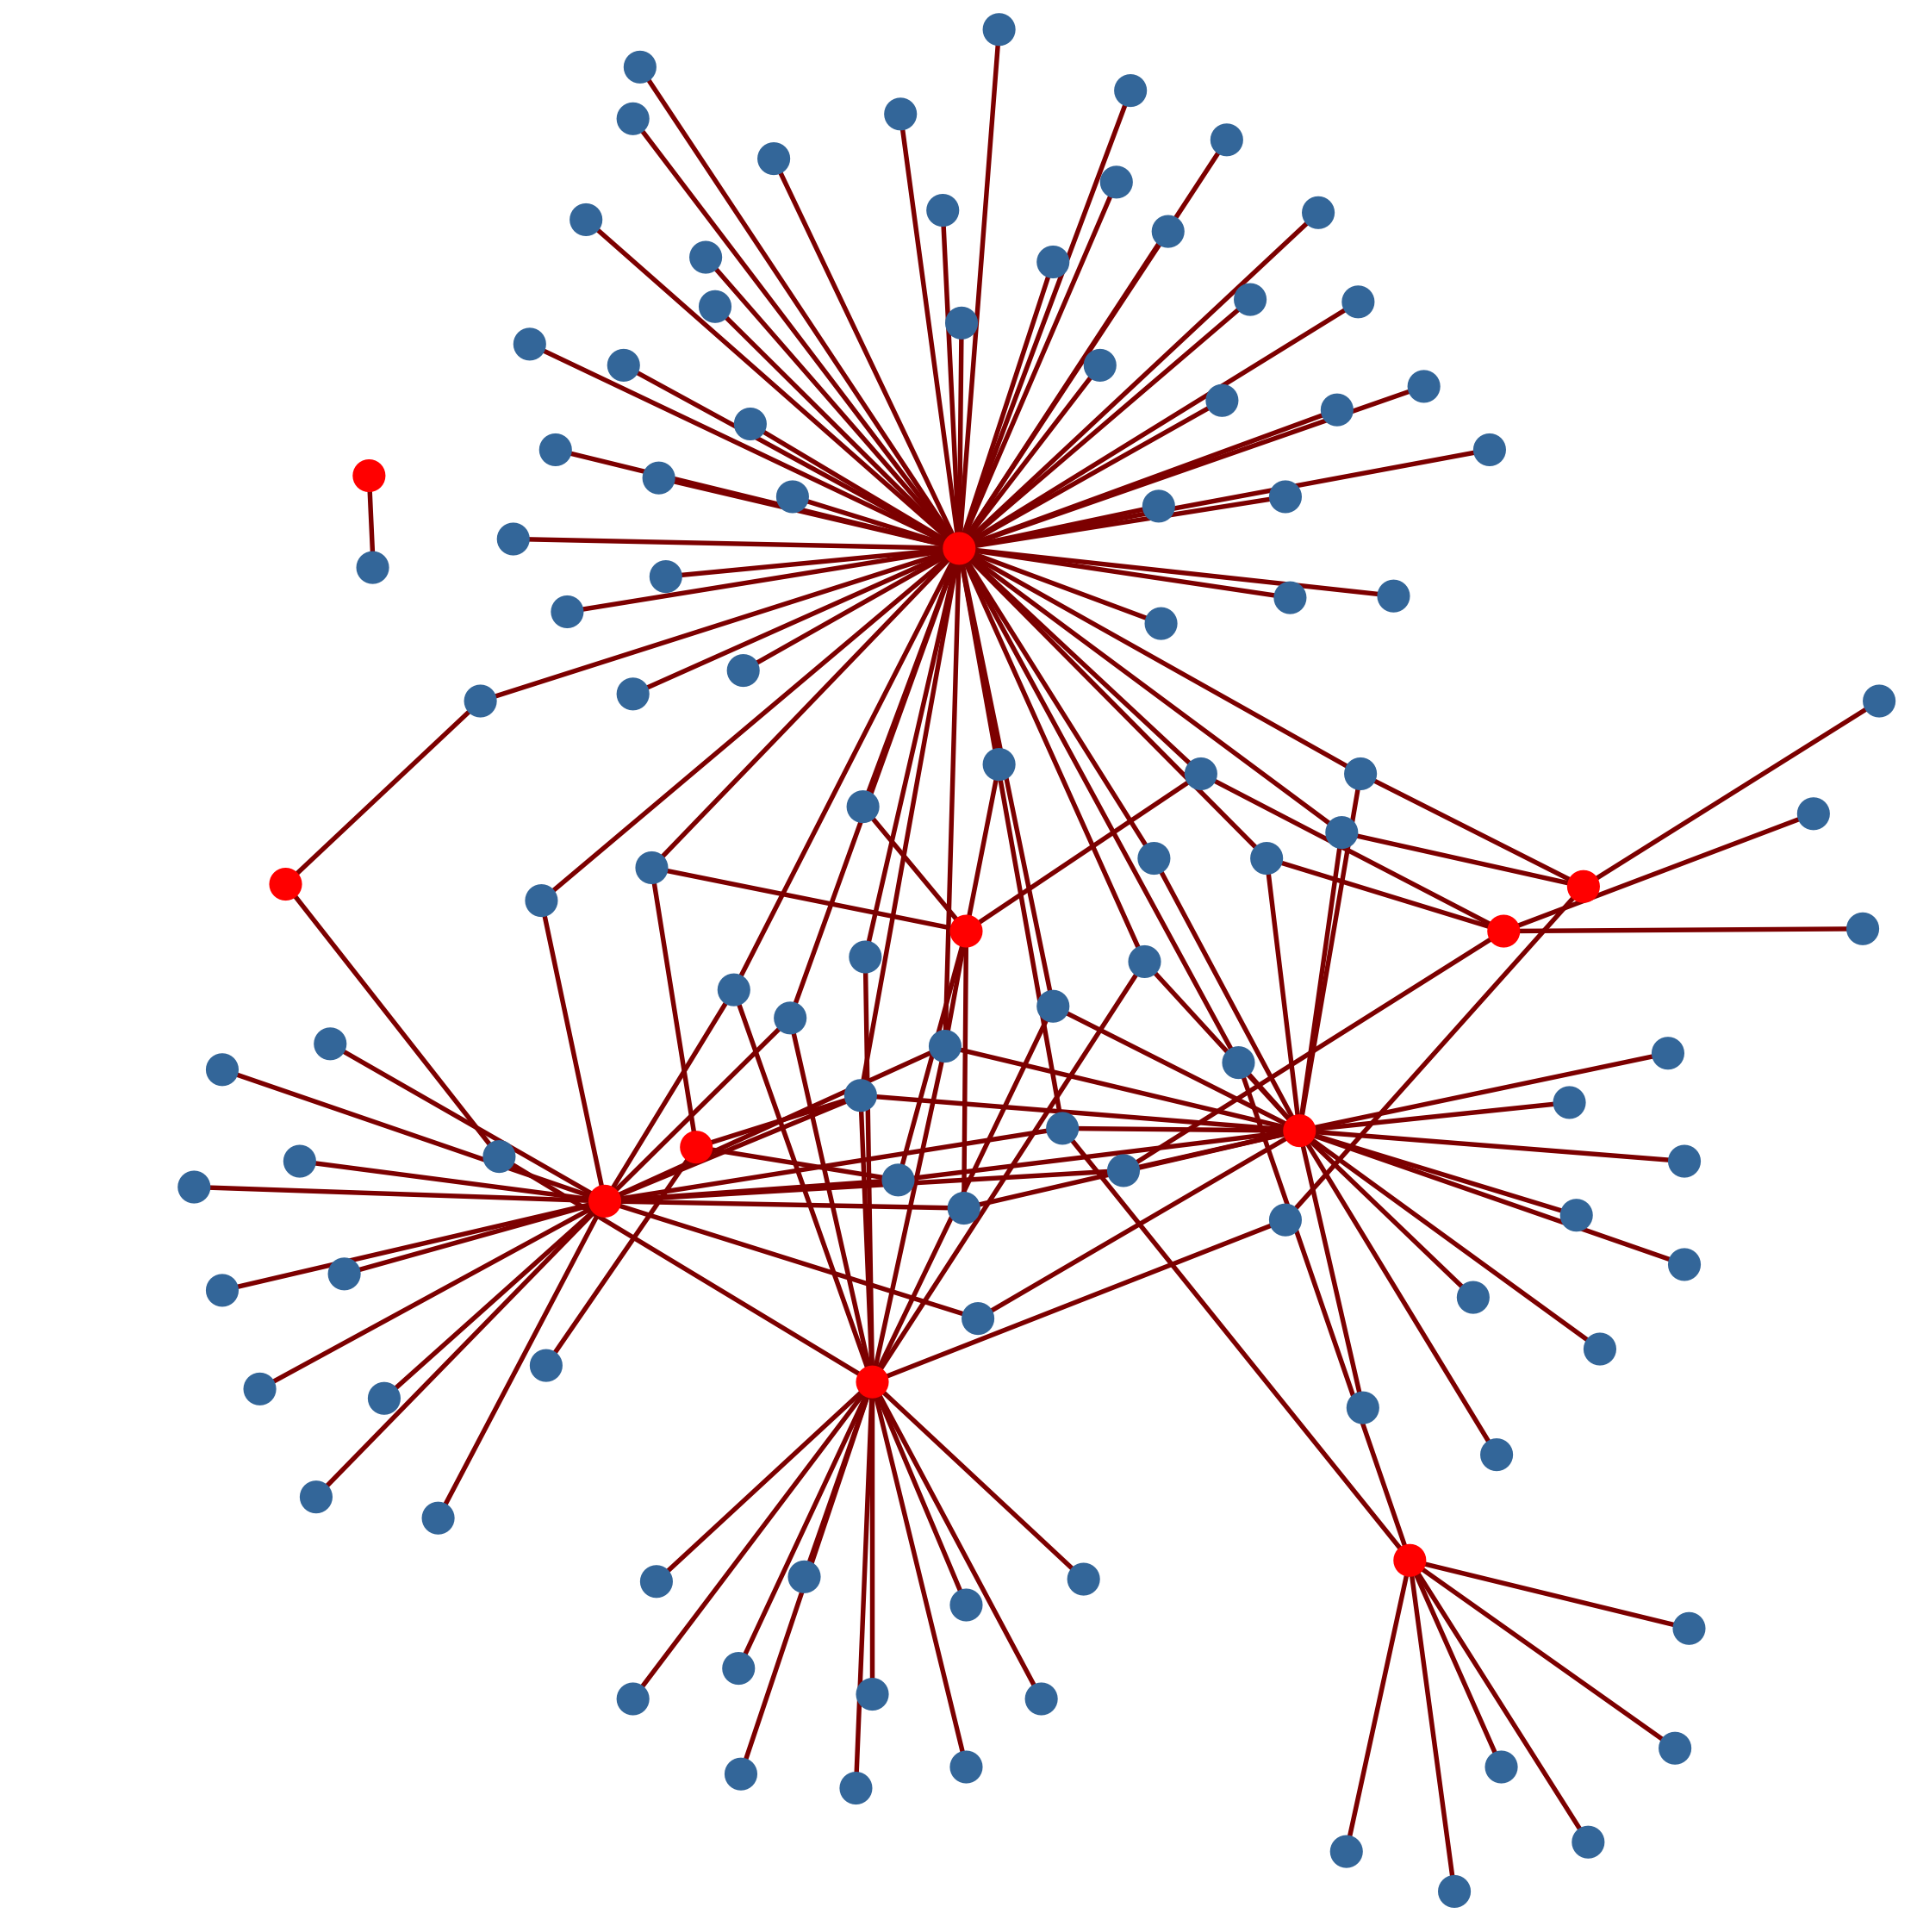
Community Network Structure
GNOME
May 2005
IBM
Eclipse.platform
tools.cdt
gtk
Eclipse
May 2008

Slide 22
Takeaways
Participation in an OSS ecosystem may require little collaboration with other firms
Many key portions of Eclipse are centered on IBM
Allows IBM to exert great influence, even though no longer at the center
The organic community around GNOME shows much more collaboration

Slide 23
Firms and Individuals:
The Impact of Commercial Participation on Volunteer Participation

Slide 24
The Problem
Commercial firms have different interests than volunteer OSS developers
Firms bring many resources to projects that benefit projects
What impact do these firms have on volunteer participation?

Slide 25
Data
Source code version control, bug tracker, and email lists from GNOME project
Individuals are disambiguated and identities linked
Commercial affiliation for developers identified
Face to face interviews with 18 developers

Slide 26
Firm Classifications
9 major firms in community
Divided into two categories -
  Product focused
  Community focused
Validated through interviews
Developers from community focused firms generally more active within the community

Slide 27
Do commercial developers drive away volunteers?
Designed a multilevel model to predict current volunteers based on previous participation
No! They actually have a slight positive impact on the number of volunteers!

Slide 28
Do commercial developers drive away volunteers (by firm)?
Developers at community focused firms have a significant attractive power while developers at product focused firms have no relation.

Slide 29
Takeaways
Commercial firms do increase volunteer participation in Open Source
Community focused firms have a much greater attractive power than product focused firms

Slide 30
Individuals and Individuals:
Evolution of the Socio-Technical Congruence Metric

Slide 31
The Problem
STC hasn't been replicated in OSS
Difficult to distill to individual level
  Typically done at network level
  Ratio muddles effects of coordination requirements and actual coordination
Original analysis looked only at short term
  Most software projects are long term

Slide 32
Data
GNOME project
Filtered for projects that had CVS, bug tracker, and mailing list archives
Do not have as much developer information as Cataldo et. al.
Examine time to resolve bugs
  Only include those bugs marked as defects

Slide 33
Individualized STC
Proportion of coordination requirements that are mirrored
in the actual communication network.

Slide 34
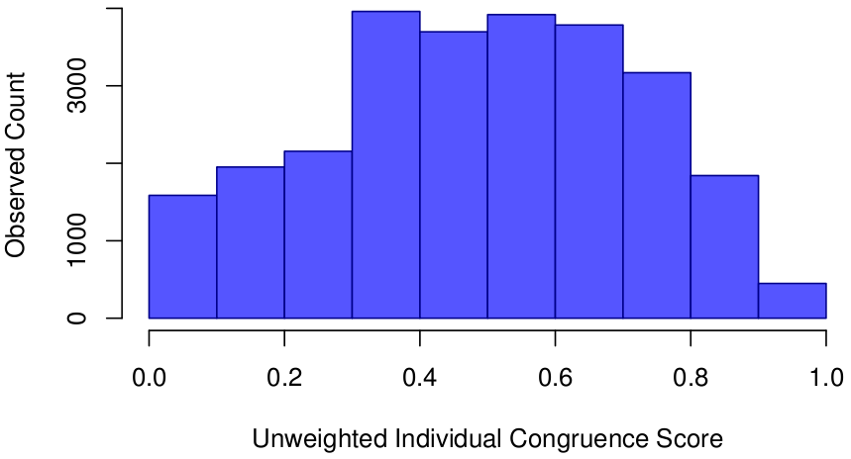
Individualized STC

Slide 35
Testing Individualized STC
Predict log2 of time to resolve defect
Independent variables
  Number of developers active on defect
  Number of people changing defect status
  Number of comments made
  Individualized STC for developers

Slide 36
Disambiguating Results
Extra Communication
Coordination Requirements
Matched Communication

Slide 37
Takeaways
Demonstrated a method to individualize STC
Should break apart STC metric into it's constituent portions
Extra communication, not related to coordination requirements, improves task performance

Slide 38
Conclusions

Slide 39
Building OSS Communities
Not a matter of just throwing code out there
Designating non-market player for head is helpful
Need to find way to drive additional value to members, beyond just software
Enable members to work independently
Watch the centralization of components
Invite firms to participate with volunteers
Encourage discussion in the community

Slide 40
Thank You!
This work was supported in part by a National Science Foundation graduate research fellowship, the National Science Foundation (IIS-0414698), the IGERT Training Program
in CASOS(NSF,DGE-9972762), the Office of Naval Research under Dynamic Network Analysis program (N00014-02-1-0973), the Air Force Office of Sponsored Research (MURI: Cultural Modeling of the Adversary, 600322), the Army Research Lab (CTA: 20002504), and the Army Research Institute (W91WAW07C0063) for research in the area of dynamic network analysis. Additional support was provided by CASOS - the center for Computational Analysis of Social and Organizational Systems at Carnegie Mellon University. The views and conclusions contained in this document are those of the authors and should not be interpreted as representing the official policies, either expressed or implied, of the the National Science Foundation, the Office of Naval Research, the Air Force Office of Sponsored Research, the Army Research Lab, or the Army Research Institute.
And more folks than I can fit on a single slide.
Thanks!

