Slide 1
Vertical Interaction In Open Software Engineering Communities
Ph.D. Thesis Proposal
Engineering and Public Policy
Computation, Organizations, and Society
Carnegie Mellon University
Patrick Wagstrom
March 5th, 2008

Slide 2
Committee
James Herbsleb (ISR, co-chair)
Kathleen Carley (COS/EPP, co-chair)
Granger Morgan (EPP)
Audris Mockus (Avaya Labs Research)

Slide 3
Framing The Problem
Software Engineering has a plethora of development processes
  XP, Agile, Pair, Scrum, Waterfall, Spiral, RAD, RUP, ...
Processes differ between companies and within companies
Participation in Open Source communities further complicates issues
  New needs to collaborate and share information
  Suddenly everything is public

Slide 4
Open Source – Changing the Market?
Open Source Software (OSS) was originally seen as a competitor to commercial software
Commercial firms readily participate in Open Source projects
  Alongside both competitors and collaborators
Most successful Open Source projects have significant commercial involvement
Many commercial projects include Open Source
Firms need adapt their processes and learn to communicate and cooperate in these communities

Slide 5
Early Open Source
Collaboration by independent developers
Infrastructure provided by project leads
Little monetary gain
Licenses were ignorant of commercial use or designed to hinder commercial exploitation

Slide 6
Nascent Commercial Participation
Into the mid 1990's there was little commercial participation
IBM really kicked off commercial Open Source
  Shipped Apache web server
  Utilized Open Source purely as a commodity
  Cheaper than developing their own web server
  Almost purely financial decision

Slide 7
Incorporating Open Source
Firms next started to include Open Source components into their projects
  Apple (Mac OS X)
  Microsoft (NT's TCP/IP)
  embedded Linux
Firms were independently leveraging Open Source

Slide 8
Building Communities
Now firms build and manage entire ecosystems
  Eclipse, OpenSolaris, Xen
Primary unit is the firm, not the individual
Volunteers are scarce – usually university students
Ecosystems attract previous competitors to rally together
Launching points for new commercial products

Slide 9
The Structure of Open Source
Open Source Foundations
Commercial Firms
Individual Developers

Slide 10
The Big Problem
There is academic research on Open Source
  Most qualitative work addresses only a single firm
  Most quantitative work doesn't address commercial participation
Press frequently assumes that OSS is still volunteers working independently
Huge companies are adopting OSS like strategies in other contexts
  Boeing is building rockets with an OSS process

Slide 11
The Big Solution
A vertical examination using two large OSS communities
Address the realities of commercial participation
Focus on communication because it's more generalizable across industries
  Firms and Foundations
  Firms to Firms
  Individuals and Firms
  Individuals to Individuals

Slide 12
§1 – Firms and Foundations in Open Source
Eclipse has consolidated the IDE market down to two products
Swarms of former competitors are collaborating on the base technology
The large market provides great opportunities for new firms to make a name
Structure of Eclipse allows small firms to have a big impact

Slide 13
The Structure of Eclipse
Problem: The structure is so new, no one knows what is going on
Goal: Develop a comprehensive picture of how firms interact, collaborate, and generate value under the umbrella of a foundation
Method: Qualitative interviews of developers, managers, foundation members, and other affiliated people. Attend annual conference and interview lots more people.

Slide 14
Preliminary Results
Interviewed ~ 30 individuals from ~ 20 firms
  Wide breadth of corporate sizes
  Original Eclipse developers (pre-IBM)
Assembled a robust history of the project
Analyzed relationships to Eclipse for 75 firms
I'm fully buzzword compliant
  Ask me about my OSGi RCP AJAX client...
Starting to understand the methods of participation

Slide 15
Preliminary Results
Identified several business models and incentives for participation
  Market Consolidation
  Commodity Utilization
  Plugin Sales
  Complimentary Goods
  Nested Platform Building
  Customization and Consulting
  End Users

Slide 16
Potential Problems
Haven't sufficiently differentiated the business cases
Not sure how the roles affect decision making in the community
As outsiders, we could really be missing things
Luckily, I'm going to EclipseCon in two weeks and presenting to the board of directors

Slide 17
Distinguishing My Contribution
All technical analysis
Broad community analysis
Working with Eclipse foundation to refine story
Recently, I've been the main person working on this research

Slide 18
§2 – Firm to Firm Interactions
The foundation performs some key roles, but most of the work still must be done by individual firms
In the course of our interviews, we gained insight into how firms claim to interact with each other
Little has been done to create a robust picture of these interactions

Slide 19
Interactions: Translation
Eclipse ships in a variety of languages
Most firms benefit from translation as the components are reusable
But translation is not key element of sales for most firms
Forces the “Translation Bluffing Game”
IBM usually caves and does the translations
  Highly centralized

Slide 20
Interactions: SWT
Eclipse uses a widget set called SWT
Originally was IBM specific
Later generalized into a new Java toolkit
Firms that want a new widget must write it themselves
Widgets are generally independent
  Highly distributed

Slide 21
Interactions: Editor
Text editor is the primary interaction tool in Eclipse
Key example of a commodity technology
Utilized in many commercial IDEs based on Eclipse
Each firm has small customizations
Usually contributes code back to the common component
  Highly collaborative

Slide 22
Understanding Collaboration
Problem: Firms collaborate on components in Eclipse, but no one is certain of the “big picture”
Goal: A quantitative overview of contributions to Eclipse components by firm
Method: Identify contributors to Eclipse source code by firm and then examine the contributions of each firm to components in Eclipse

Slide 23
Modeling Interactions of Firms
Problem: Firms collaborate over channels other than source code. These channels have multiple possible representations.
Goal: Understand the implications of assumptions in generating networks from archival data
Method: Generate many different networks using different techniques and compare what the results mean for position

Slide 24
“True” Interaction Models In Eclipse
Problem: We have no idea how truly collaborative Eclipse is
Goal: Generate a network structure that is backed with explanations of possible variance
Method: Utilize earlier network formulations to create a overall picture of the participation in Eclipse. Compare this network to data about collaboration from interviews and analysis in §1

Slide 25
Possible Issues
Data collection
  I have bug data, but no information on developers, need to spider the data
  Identification of firms requires use of work email addresses. IP licensing agreement strongly recommends but does not require use of work email. May be possible to get access to some info from Eclipse Foundation.
  The web accessible Eclipse mailing lists have email addresses sanitized
Determination of “best” network model

Slide 26
§3 – Individual and Firm Interactions
Problem: Not all OSS communities are commercial. Commercial firms entering these communities have the potential to disrupt the community.
Goal: Understand how commercial participation affects subsequent volunteer participation.
Method: Longitudinal multi-level analysis of the GNOME project identifying the impact of commercial developers on volunteer participation.

Slide 27
There Goes the Neighborhood
Two part study
18 developer interviews to understand developer motivations, viewpoints, and opinions of commercial firms
Quantitatively test:
  Cognitive complexity Issues
  Volunteer developer signaling and project momentum
  Heterogeneity in developer populations
  Clash of norms and values

Slide 28
Results
Cognitive complexity not an issue
Signaling and momentum are supported
Heterogeneity is not supported
Differences of norms and values is supported
  Community focused firms attract volunteer developers
  Product focused firms have no statistically significant relation

Slide 29
Proposed Work – Signaling
Problem: Unable to differentiate between signaling and momentum as cause for increased volunteer participation
Goal: Test if volunteers preferentially communicate with commercial firms that may hire them
Method: Generate networks of email messages in the community and test if volunteers preferentially communicate with commercial developers

Slide 30
Proposed Work – Feature Preferences
Problem: Interviews indicate some preference for corporations that work on features useful to volunteers
Goal: Empirically test if new volunteers preferentially work on features they find useful
Method: For a selection of projects, identify features and cluster networks from CVS and Bugzilla to identify “hot spots” of new volunteers

Slide 31
§4 – Individual to Individual Interactions
Firms can exert a lot of control over employees, but in the end, people make their own decisions
Developers need to choose who to interact with
Must ensure that technical dependencies are accounted for in communication

Slide 32
Socio-Technical Congruence
A
1
2
B
3
4
C
5
D
6
7
E
Developers
Artifacts (Files)
0.67 Overall Congruence
1.00 Overall Congruence

Slide 33
Individualized Congruence
Problem: Tools are being developed for STC, but isn't clear how individuals affect STC
Goal: Develop a metric for STC that addresses the actions of individuals
Method: Subdivide communication and dependencies into ego networks. Create a weighted coordination requirements network to evaluate if information was properly directed

Slide 34
Preliminary Work
Created two metrics: Unweighted (UIC) and Weighted Individual Congruence (WIC)
Analyzed approximately 8,000 bugs from 10 projects in GNOME
More communication decreases performance
More coordination requirements increases performance
Key Question: Are individualized STC and overall STC just new proxies for centrality related metrics?

Slide 35
Uncertainty Analysis
Problem: Network methods often have non-linear responses. We also have uncertainty about the underlying network structure.
Goal: understand what effect errors of omission and commission have on STC
Method: Monte Carlo to create response surface for a variety of networks of different densities. Farm computing out to Amazon EC2.

Slide 36
Uncertainty Analysis
Problem: Most communication in STC metrics is from archives and it is not known if the communication was actually relevant
Goal: Create a set of probabilistic metrics for observed communication in STC
Method: Create distribution of probabilities for edges in . Probabilistically instantiate actual communication network. Provides a set of confidence bounds for STC.

Slide 37
Thesis Impact – Foundations
Provide guidance in recruiting firms
Better develop standards for cooperation and collaboration
  Particularly regarding how firms work together
Understand collaboration and direct new projects accordingly

Slide 38
Thesis Impact – Firms
Method for analyzing an ecosystem
  Understand roles of competitors, collaborators
Understand the required resource contribution
Participate in a manner that doesn't disrupt the community

Slide 39
Thesis Impact – Individuals
Understanding of commercial firms in Open Source
  They're not the enemy
Improved metrics for collaborative tools
  Know who to communicate with

Slide 40
Timeline
March
May
Submit Corporate Involvement paper to ISR (§3)
Spider Eclipse Bugzilla Profiles (§2)
Retool and update R scripts for Congruence (§4)
Present at EclipseCon (§1)
Schedule and begin followup interviews (§1,2)
Sloan Industry Studies Conference (§1,2)
Analyze Probabilistic Model (§4)
STC 2008 (§4)
Code methods to generate Eclipse networks (§2)
Incorporate feedback from STC and Sloan (§1,4)
Affinity networks (§3)
Load and Clean up Data from Eclipse (§2)
Explore theoretical concepts around individual congruence (§4)
Submit congruence paper to CSCW 2008 (§4)
Implement probabilistic model for congruence (§4)
Continue followup interviews (§1,2)
April

Slide 41
Timeline
June
August
Build and analyze networks from Eclipse (§2)
Write up congruence sensitivity results (§4)
Hopefully, get feedback from ISR paper (§3)
Schedule final interviews for Eclipse (§1,2)
Write up most of network generation (§2)
Final touches on writing
Bribe wife to proofread
Prepare slides
Buffer space
Defend
Continue followup interviews (§1,2)
Write up data from Eclipse interviews (§1)
Explore theoretical concepts around individual congruence (§4)
Submit congruence paper to CSCW 2008 (§4)
Implement probabilistic model for congruence (§4)
July

Slide 42
End of Presentation

Slide 43
There Goes the Neighborhood
Momentum and Signaling – Project Level

Slide 44
There Goes the Neighborhood
Norms and Values – Project Level

Slide 45
There Goes the Neighborhood
Mediating Differences

Slide 46
There Goes the Neighborhood
Cognitive Load – Module Level

Slide 47
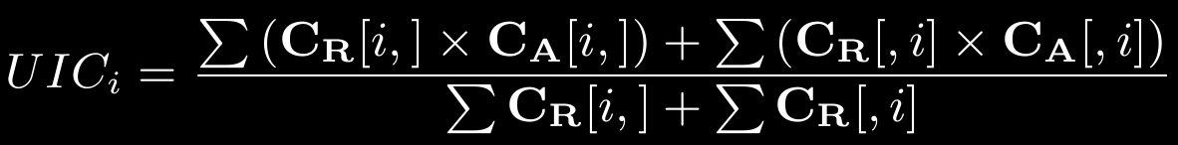
Individualized Congruence Formulas

Slide 48
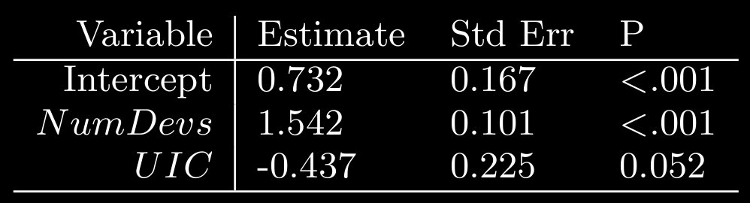
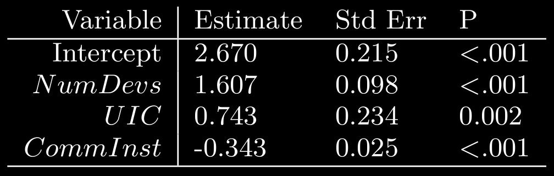
UIC: Preliminary Results

Slide 49
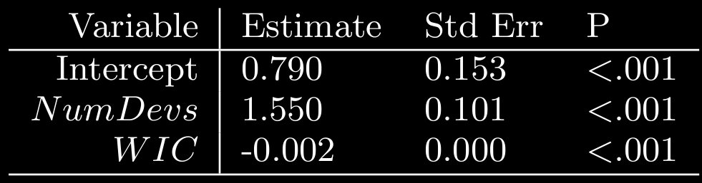
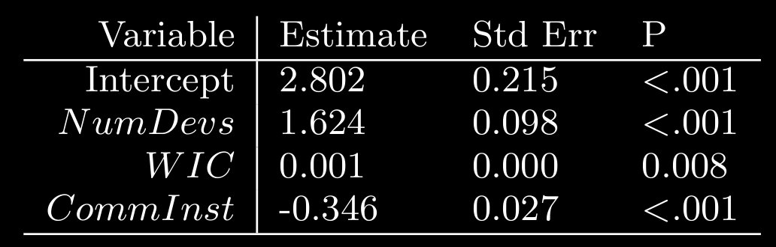
WIC Preliminary Results

