Slide 1

IMPACTs of the IMF Backed TAX reforms
An Environmental Perspective

Slide 2
Background to the Reforms
The tax reforms introduced through the Finance Supplement Bill (2021) (or “mini budget”) which was bulldozed through the Assembly.
Under the new reforms, GOP has now withdrawn exemptions on renewable technologies, instituting a 20% tax on solar panels and wind turbines, as well as a 12% increase in sales tax for imported electric vehicles.
Additionally, plants, machineries, installation products and other technologies related to renewables such as inverters, and batteries have also been taxed, and taxes have also been increased on hybrid vehicles.
The present tax reforms have been undertaken in order to meet the IMF’s “prior action” conditions to enable the release of the next $1 billion tranche under the EFF program following the sixth review under the program.
The 39-month, $6 billion Extended Fund Facility (EFF) arrangement, began in 2019, and was suspended in January 2020 because Pakistan resisted IMF recommendations to increase electricity prices and impose additional taxes

Slide 3

Social and Environmental effects of the new tax on renewables
Market impacts

Slide 4
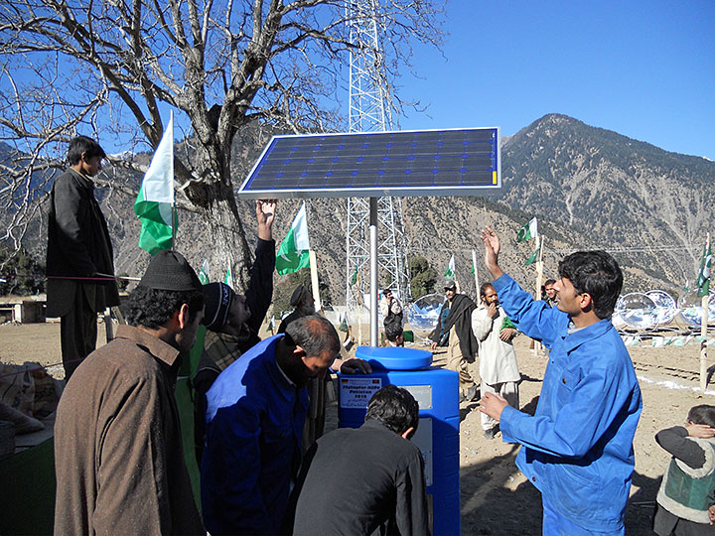
Hinders access to cheap energy for vulnerable communities
- Between 2015 and 2019, there has been a boom in solar PV installations in off-grid and weak grid regions.
Solar is most suitable for powering tube wells, water purification systems, and pumps for irrigation in remote areas.
The beneficiaries are therefore poor farming communities in underdeveloped areas.
Solar technology, however, is an import based market, and farming communities and the residential sector are key drivers of solar are also price-sensitive users.
This growth is tied to the GOP’s earlier decision to waive off taxes on solar products. Rising costs under the new levies will force the neediest users out of the market

Slide 5
Reforms are inconsistent with Pakistan’s Environmental policies, and Energy and TRANSPORT SECTOR planning
Alternative and Renewable Energy (ARE)Policy
National Electric Vehicles (NEV) Policy
Prescribes a minimum of 30% renewables based generation on-grid by 2030.
Goal → Reduce emissions and costs by displacing fuel sources. Integrate cheap renewables into off-grid solutions private contracts, and rural energy services
How? → incentivize investments and “buy-ins” from fuel-based producers and self-generating agricultural and industrial consumers.
Present NEPRA tariffs for solar/wind power are suited to making renewables competitive
BUT new tax regime raise upfront capital costs → raising overall generation costs → users won’t opt out of fuel-based arrangements defeating the key mechanism for reducing emissions
prescribes a minimum 30% sales penetration of electric vehicles (EVs) by 2030.
Needs robust tax incentives for developing the fledgling import-based market
Quote from policy: “govts around the world give subsidies, incentives and tax breaks for EV adoption,” and these benefits “end up paying for themselves with savings in fuel imports, reduction in emission related costs, usage of idle electricity capacity, and income from charging revenues.”
Imports initially needed for developing charging station infrastructures.

Slide 6

IMF’s EVIRONMENTAL Rhetoric: NAIEVete or KNOWING RECKLESSNESS?
EFF waxes eloquent about “protecting vulnerable communities” and “stepping up to climate change.”
E.g. The Fund’s staff statement cites Pakistan’s vulnerability as a “top ten country with the largest damages from climate-related disasters, and top 20 countries with the largest greenhouse gas (GHG) emissions.”
EFF recommends policy steps such as the “wider use of renewables,” “implementation measures for meeting Pakistan’s COP26 NDC targets,” and the securing of “sufficient financing from international partners” as “critical” priorities for addressing these concerns.
BUT → Pakistan’s pledge to shift to a 60% renewables-based generation and its goal of 30% electric vehicles are both Nationally Determined Contribution (NDC) targets submitted under the Paris Agreement and COP 26 respectively AND → the new tax regime threatens these very goals
Part of a historical pattern: Countless studies document the damaging impact of IMF SAP’s on women and vulnerable population → e.g. EFF’s impact on women (source Brettonwoods project)

Slide 7

The way forward:
These toxic policy outcomes are the result of contradictory and self-defeating IMF structural adjustments and the distortive effects of its lending practises.
IMF Board must ensure that the taxes on solar, wind, and EV are withdrawn at the earliest!
INTERNAL REFORMS NEEEDED IN IMF!
Mechanisms for making EFF and other loan programs consistent with Pakistan’s environmental policy goals and international climate obligations.
IMF program dev process is non-transparent, insular, and unrepresentative: Consultations with vulnerable groups as well as independent reviews of it programs are needed
Paris Agreement’s goal is to make “finance flows consistent with a pathway towards low greenhouse gas emissions and climate-resilient development” IMF needs to develop socially just and green financing solutions for Pakistan.
E,g. Debt-for-Nature Swaps to break the poisonous debt cycle Pakistan is trapped in through years of IMF interventions

