Slide 1

World Bank Development Policy Finance and the Energy Sector in Pakistan

Slide 2

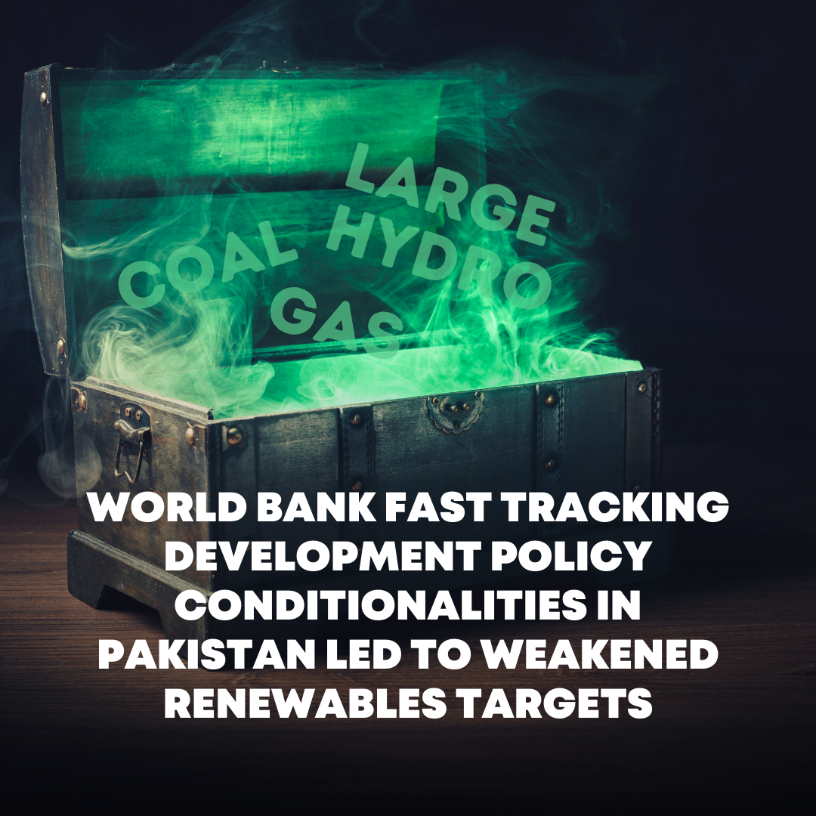
World Bank Development Policy Finance, 2015 – 2021: Stuck in a carbon instensive rut
Title 1

Slide 3

What is World Bank Development Policy Finance (DPF)?
DPF supports governments through non-earmarked general budget financing
The World Bank Group (WBG) is in the process of preparing a new Country Partnership Framework (CPF) for Pakistan that will outline its strategy, including plans for DPF and other forms of finance and technical assistance.
The basis for the Country partnership Framework is the Systematic Country Diagnostic
The World Bank’s website encourages us to contribute using #WBGinPakistan
DPF funds are made available to the client based on:
an adequate macroeconomic policy framework
satisfactory implementation of the overall reform program
completion Prior Actions agreed between the Bank and the client.
Prior Actions are legally binding policy and institutional actions deemed critical to achieving the objectives of a DPF. Prior Actions are available publicly in a database
www.re-course.org

Slide 4
World Bank DPF for Energy Sector Reform
In 2021, the Government of Pakistan (GoP) was completing its second year of foundational reforms to comply with Prior Actions for three DPLs amounting to $1.4bn
The aim was to restore financial viability of the power sector and lock in the transition to a low carbon footprint (Program for Affordable and Clean Energy, PACE), improve fiscal management and competitiveness (Resilient Institutions for Sustainable Economy, RISE) and accelerate human capital accumulation (Securing Human Investment to Foster Transformation, SHIFT).
Collectively, the PACE, RISE, and SHIFT reforms are expected by the World Bank to help Pakistan break out of boom-and-bust macroeconomic cycles and get on a sustainable growth path.
www.re-course.org

Slide 5
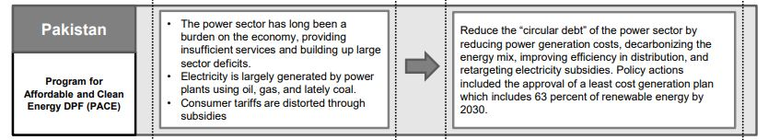
World Bank DPF:
PACE Prior Action
www.re-course.org

Slide 6
Power Sector Reforms
Pressure by the World Bank to accelerate power sector reforms ahead of the approval of the PACE loan had a destabilising effect
World Bank Vice President for South Asia, Hartwig Schafer:
“We urge the government to accelerate the pace of power sector reforms as these are critical for Pakistan to achieve higher economic growth and resilient recovery from the COVID-19 pandemic”
This contributed to the hasty approval a revised energy plan that abandoned the target of 30% Variable Renewable Energy (VRE) by 2030.
Today it only reaches 17% of the generation mix by 2030.
The generation mix in this revised scenario is dominated by expensive and dirty fossil fuels, with additions of around 8.5 GW of coal, and 10 GW of LNG and gas to be made in the next 10 years.
www.re-course.org

Slide 7
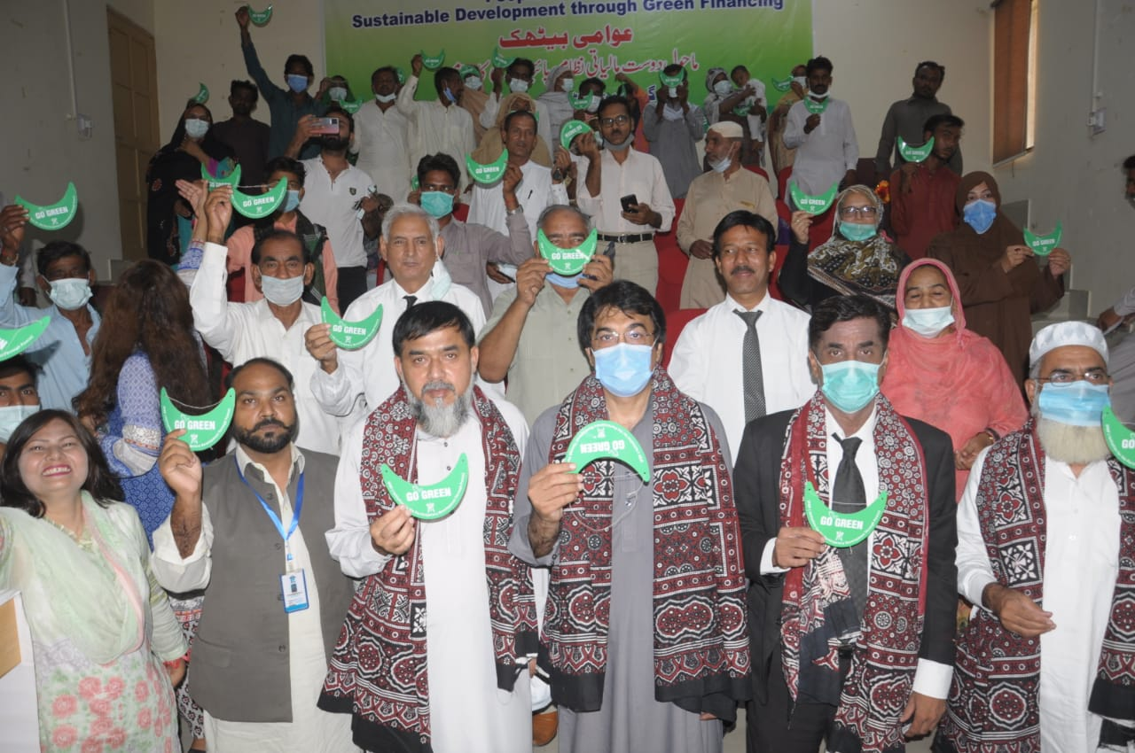
Public Finance for the Energy Transition
DPF can influence investment decisions towards either carbon-intensive development, such as oil, gas or coal, or low-carbon development.
However, the World Bank’s 2021 Climate Action Plan still identifies gas as a transition fuel.
The World Bank’s own analysis: a large and sustained expansion of solar PV and wind power, alongside hydropower and substantial investments in the grid, would be both achievable and desirable in Pakistan.
Sustainable renewable energy would provide long-term economic, supply security, and environmental benefits.
www.re-course.org

Slide 8
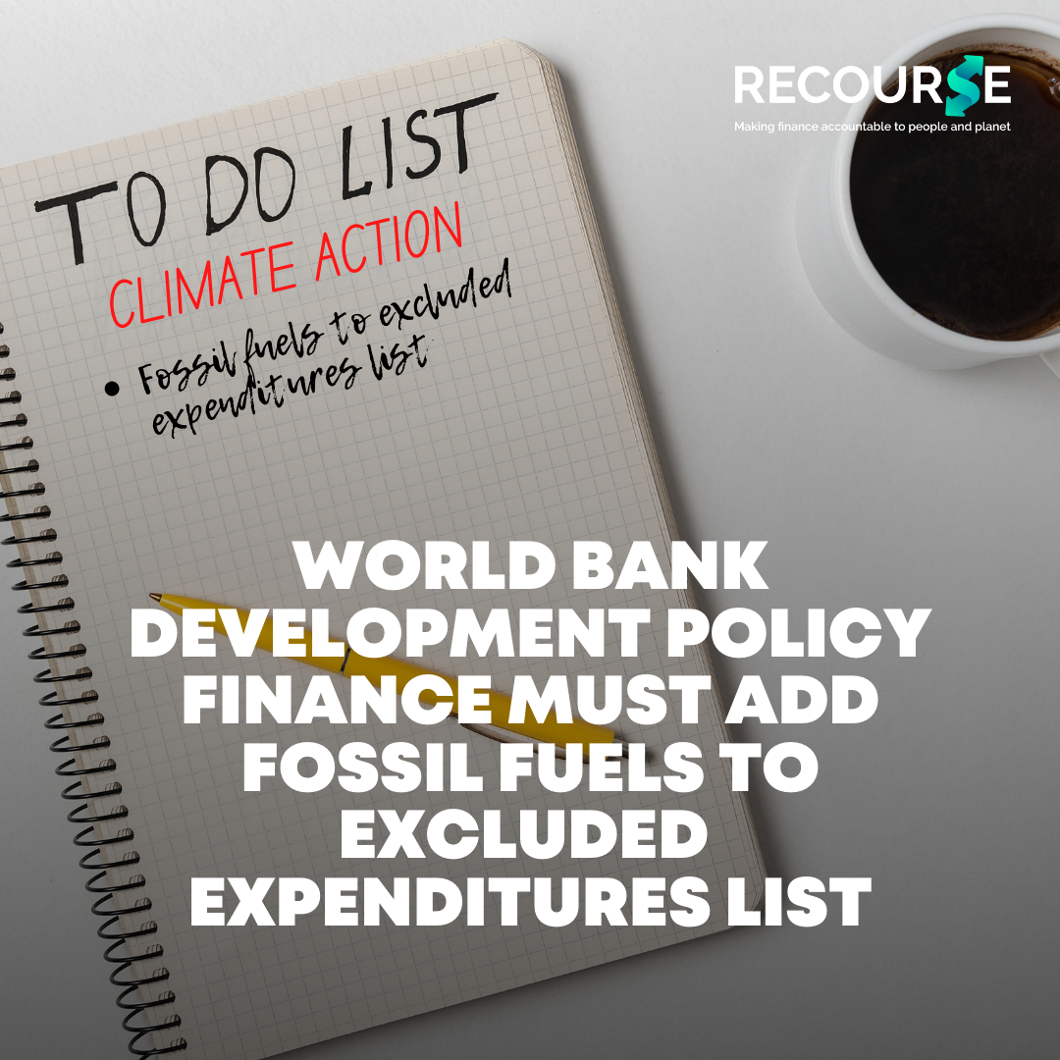
Recommendations
Ensure that all DPF explicitly supports Pakistan to benefit from the global transition to sustainable renewable energy and does not support the expansion of coal, oil and gas through the back door.
Finance disbursed through its DPF instrument must be aligned with existing exclusions that apply to project finance around coal and upstream oil and gas.
This must be verified by ensuring that the Government of Pakistan does not increase budget expenditures for fossil fuels post receiving DPF support.
DPF support to the Government of Pakistan should enable the country not to rely on expensive imports of coal or LNG, but instead to build its own energy security drawn from the country's own sustainable renewable energy sources.
www.re-course.org

