Slide 1
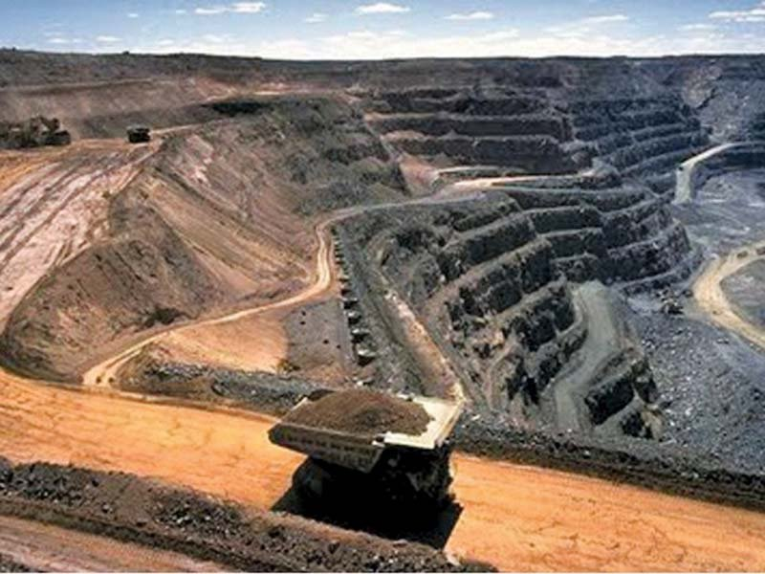
IMPACT of the WORLD Bank’s projects on Pakistan’s energy policies and planning process
AN Environmental and legal Perspective

Slide 2
Constitutional Background to Pakistan’s Planned energy transition
Electricity as a constitutional subject -- Principle of cooperative federalism i.e. balancing provincial needs and interests
Article 153 and 154 of the Constitution of Pakistan provide for the Council of Common Interest (CCI) as the relevant forum for making and regulating policies in relation to electricity
“The Council shall formulate and regulate policies in relation to… the matter in entry 34 (electricity) and shall exercise supervision and control over related institutions.”
In August 2020, the CCI reached a decision on Pakistan’s roadmap for Greening the Energy Mix in the shape of the Alternative and Renewable Energy, 2019 Policy (AREP).
AREP considered one of a “portfolio of policies together comprising the National Electricity Policy (NEP).” The NEP also requires all generation source additions to be made on “least-cost principles.” Under S.14A of the NEPRA Act, the power regulatory authority is bound by the NEP.
The ARE Policy includes wind, solar, hydrogen, biogas etc., as renewables, Then power minister (federal office) had attempted to include hydro in ARE category with a 60pc of power generation by 2030.
BUT AREP EXPLICITLY EXCLUDES HYDRO on account of its ecologically disastrous history. No large hydro in the AREP, in fact it states that a “separate policy is under consideration for small hydro.”
ARE Policy requires: that the on-grid generation capacity for renewables will be at least 20% by 2025 and at least 30% by 2030 AND that in addition to capacity expansion, renewables shall also be “solicited for displacing fossil fuels

Slide 3
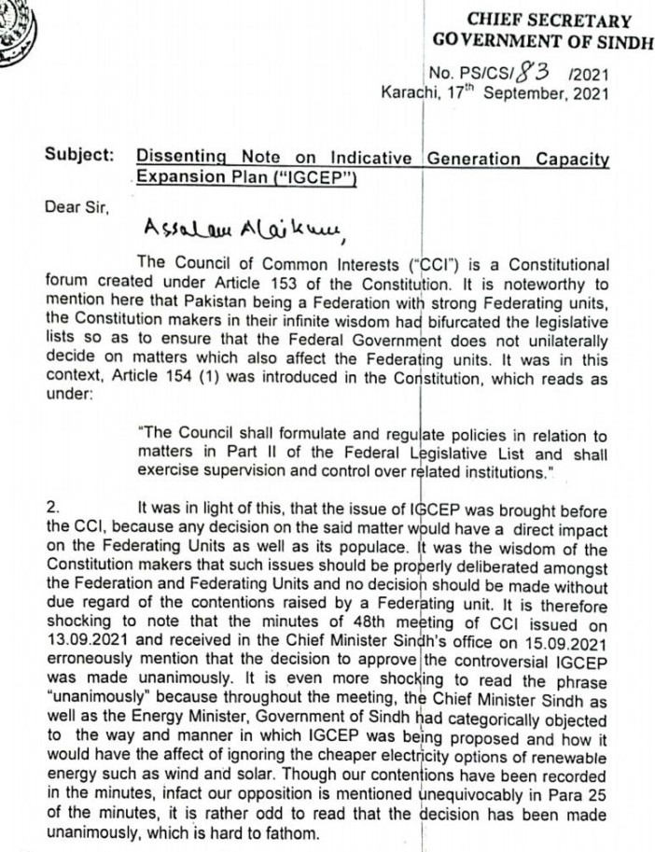
How the Pace program derailed the energy transition: the story behind the igcep 2021
In April 2021 NTDC submitted the 10 year generation capacity expansion plan (IGCEP) to NEPRA with an energy mix concentrated around hydropower ( ~ 50% ) and fossil fuels (~ 25%) with renewables such as wind and solar at no more than 17%.
Rejected by NEPRA after public consultation and provincial objections. Approval withheld owing to inclusion of non-competitive projects under the guise of “committed” projects, “concentration of hydro projects” and “contradiction with ARE targets” – NTDC directed to amend plan in line with policies.
Subsequently, despite these serious flaws, a near identical plan is given a hasty approval first by CCoE in August and then NEPRA in Sept. The approval bulldozed through on account of a ‘prior action’ condition requiring an IGCEP to be in place prior to disbursement of the first $400 million tranche under PACE which was due soon.
Chairman NEPRA admits publicly that “88% of the committed projects do not fulfill the least-cost criterion.”

Slide 4

Tracing the IGCEP and PACE connection: THE World BANk RE-engineering Pakistan’s Energy policy through the backdoor:
PACE loan documents claims that the ARE policy and its own VRE Integration and Planning study constitute the “analytical underpinnings” of its prior action conditions.
Loan Condition: NEPRA has approved a least cost generation plan “that meets requirements for increased share of variable renewable energy in the generation mix.” i.e. 30% wind and solar in the ARE, and 33% according to the Bank’s own study → VIOLATED!
Loan Condition: “NTDC has developed and submitted to NEPRA a least cost generation plan based on criteria approved by the Cabinet, which includes 63 percent of renewable energy (solar, wind, hydropower) by 2030. → VIOLATES THE CONSTITUTION AND THE AREP!
The Bank states: “The RE Policy stipulates that the major expansion of installed generation capacity over the next 10 years should be from RE (solar, wind, hydropower, and bagasse)” → BLATANTLY MISREPRESENTS THE ARE

Slide 5
WEIGHING the impact on Pakistan’s political stability and Energy & environmental GOALS
This Backdoor manipulation and inclusion of hydro comes at a time of heightened Climate Change Stress and Water Conflicts between the lower riparian province (Sindh) and upper riparian (KPK and Punjab). WB stoking climate disaster and inter-provincial conflict through meddling in substantive energy policies, constitutional procedures, and planning process.
Of “committed projects” 23 projects include hydropower (mostly large dams) that will generate 13,161 MW. There is no environmental costing method in place, no re-settlement plan for displaced persons, and no adequate consideration of expected delays and cost-overruns
Additions of around 8.5 GW of expensive coal locking Pakistan into expensive capacity payments and 10 GW of LNG including highly expensive imported gas.
Thar Coal power plants and mines to become largest air pollutant, mercury and CO2 emissions hotspots in South Asia. Responsible for a projected 29,000 air pollution related deaths, 40,000 asthma emergency room visits, 19,900 new cases of asthma in children, 32,000 preterm births, 20 million days of work absence (sick leave) and 57,000 years lived with disability related to chronic obstructive pulmonary disease, diabetes and stroke. No attention to these impacts in assessing the cost of coal.
These outcomes defeat the key goal of the NEPRA Act: “to make special provisions for the development of renewable electricity markets in accordance with the international commitments of Pakistan as well as the responsibility of Pakistan to support and encourage measures to effectively mitigate adverse climate change and to effectively manage conflict of interest of the State in relation to development of the electric power markets of Pakistan

Slide 6
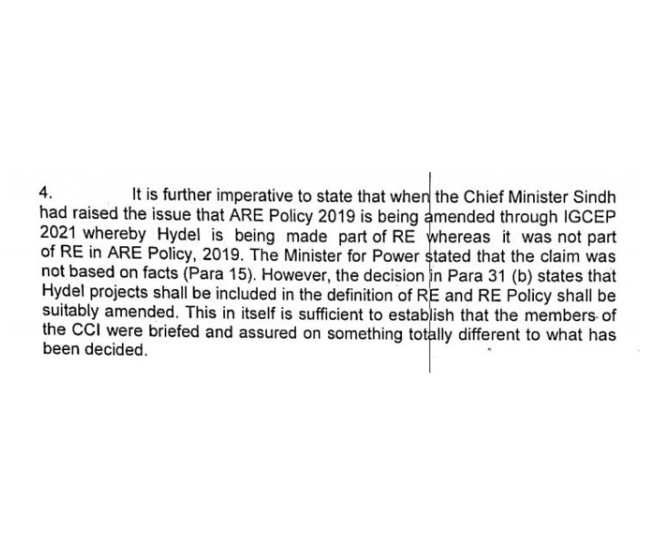
Imposing policies from up high
World Bank as the de facto legislator

Slide 7

The way forward:
These toxic policy outcomes are the result of contradictory and duplicitous policies of the WB and the distortive effects of its lending practices.
WB’s 2021 Climate Change Action Plan claims to have ended support for environmentally harmful projects in favor of “green” and “inclusive” development → Green Washing
No JUST energy transition without the Bank’s ACCOUNTABILITY.
WHO does the Bank truly serve? → private profiteers and lenders
Review of PACE and related energy projects →The Bank must ensure INTERNAL REFORMS!
Loan programs, technical assistance, lending through intermediaries etc., → Must be transparent, non-insular, and representative: Consultations with vulnerable groups as well as independent reviews of it programs are needed
Paris Agreement’s goal is to make “finance flows consistent with a pathway towards low greenhouse gas emissions and climate-resilient development” WB needs to develop socially just and green financing solutions for Pakistan to live up to its rhetoric
E,g. Debt-for-Nature Swaps and Loan Forgiveness Programs to break the poisonous debt cycle Pakistan is trapped in through years of WB interventions

