Slide 1
CPRE 4240 FINAL PROJECT
Parallel Image Processing using various Filters
OpenMP vs MPI Performance Analysis
Shared Memory
Distributed Memory
OpenMP
MPI
Aidan Perry
Iowa State University

Slide 2

The Problem
TEST PARAMETERS
Image sizes up to 2048x2048
Challenge
Image processing on large images is computationally expensive. Applying filters like blur and edge detection from 512 x 512 to 2048 × 2048 images takes significant time when processed serially as opposed to a brightness or grayscale filter which is very parallelized.
Image Resolution
Blur Filter
3×3 convolution kernel
Solution Approach
1–16 Cores
Parallelize using two paradigms: OpenMP for shared memory (a single node) and MPI for distributed memory (multiple nodes) to compare performance characteristics.
Scaling range
Nova Cluster
Iowa State HPC

Slide 3
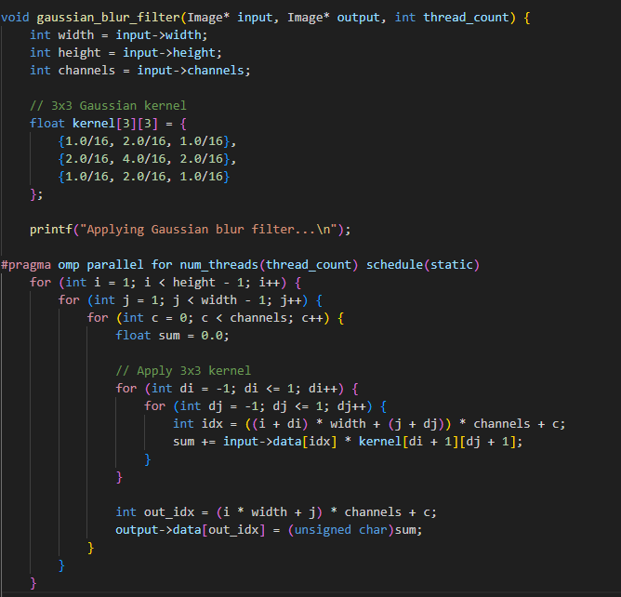
OpenMP Implementation
STRATEGY
KEY CODE
Row-wise Parallelization
Each thread processes a chunk of rows independently. No data exchange needed between threads.
Static Scheduling
Rows divided evenly at compile time. Predictable, low-overhead distribution.
Shared Memory Access
All threads read from same input array. Cache coherence handled by hardware.
~5×
8
Peak Speedup
Optimal Threads

Slide 4
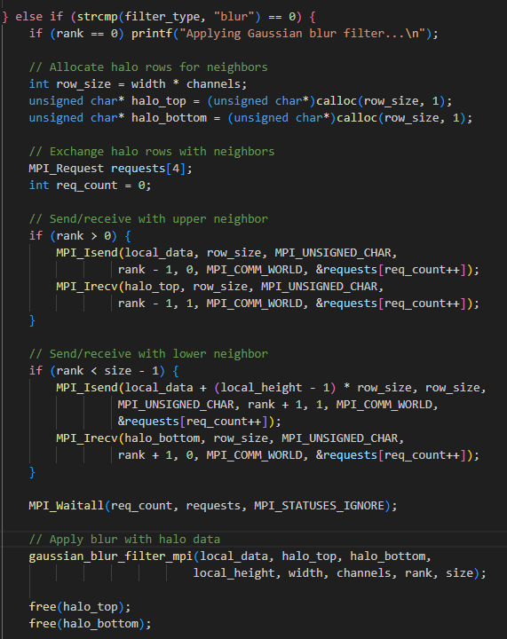

MPI Implementation
HALO EXCHANGE CODE
STRATEGY
Domain Decomposition
Image divided into horizontal strips. Each process owns a chunk of rows.
Halo Exchange (Critical!)
Boundary row data must be exchanged with neighbors for convolution. Uses MPI_Sendrecv for synchronization.
Scatter/Gather Pattern
Root distributes data via MPI_Scatterv, collects results via MPI_Gatherv.
Key Limitation: Communication Overhead
~3×
2 Nodes
Network latency dominates at high process counts
Peak Speedup
16 Total Processes

Slide 5
Performance Results: Speedup
KEY FINDINGS
OpenMP Wins
4.6× speedup at 8 threads. Shared memory eliminates communication overhead.
MPI Overhead
Network communication limits MPI to ~3× speedup for this problem size.
Scaling Limits
Both approaches show diminishing returns beyond 8 cores.
Image: 2048×2048 • Blur filter

Slide 6
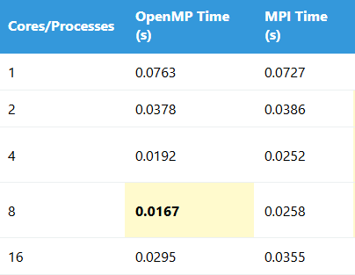

Execution Time Comparison
16 cores: Times INCREASE
Memory bandwidth saturates, overhead dominates

Slide 7
Parallel Efficiency Analysis
UNDERSTANDING EFFICIENCY
Efficiency = Speedup / Cores
Ideal efficiency is 100% (linear speedup). Real-world systems face overhead from synchronization, communication, and resource contention.
57.1%
35.2%
OpenMP @ 8 cores
MPI @ 8 cores
Why MPI Efficiency is Lower
Network latency (~1000× slower than shared memory), halo exchange synchronization, and scatter/gather overhead all reduce efficiency.

Slide 8
Bottleneck Analysis
OPENMP BOTTLENECKS
MPI BOTTLENECKS
Memory Bandwidth
Network Latency (Primary)
All cores share the same memory bus. At 16 cores, bandwidth saturates causing cache misses and stalls.
Each halo exchange requires network round-trip. Even fast networks add microseconds per operation.
False Sharing
Synchronization
Cache lines shared between threads cause unnecessary invalidations even with private data.
MPI_Sendrecv blocks until both send and receive complete. Processes wait for slowest neighbor.
NUMA Effects
Work per Process
Non-uniform memory access on multi-socket systems adds latency for remote memory access.
2048/16 = 128 rows per process. Too little work to be able to reduce communication costs.

Slide 9


OpenMP vs MPI: When to Use Each
OpenMP
Shared Memory
MPI
Distributed Memory
Best For:
Best For:
Single-node parallelism
Problems that fit in RAM
Rapid prototyping
Incremental parallelization
Multi-node clusters
Problems larger than RAM
Production HPC workloads
Massive parallelism (1000s cores)
VS
Limitations:
Limitations:
Limited to one machine
Memory bandwidth bound
Higher programming complexity
Communication overhead
Key Insight: For single-node image processing, OpenMP is ~2x faster due to eliminated communication overhead

Slide 10


Key Takeaways
FINAL RESULTS
OpenMP Peak
Right Tool for this scenario
4.6× speedup
OpenMP for single-node, MPI when you need multi-node scaling
Communication is Critical
MPI halo exchange dominates runtime at high process counts
MPI Peak
More Cores ≠ More Speed
2.9× speedup
Diminishing returns beyond 8 cores due to communication overhead
Problem Size Matters
2048×2048 may need larger images to benefit from more parallelism
Optimal Configuration
8 threads/processes
For 2048×2048 blur filter

Slide 11
THANK YOU
Questions?
Aidan Perry • CPRE 424
Iowa State University

