Slide 1
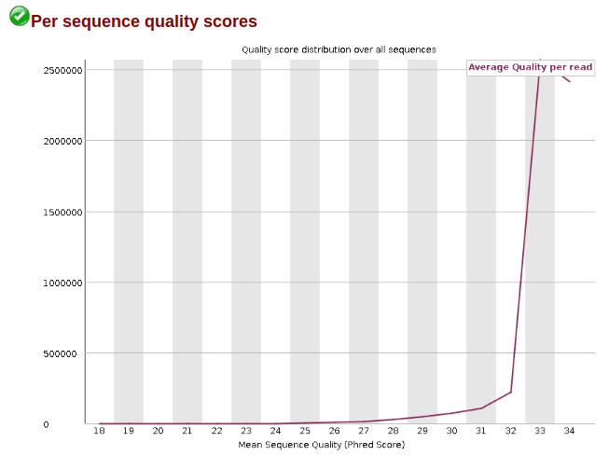
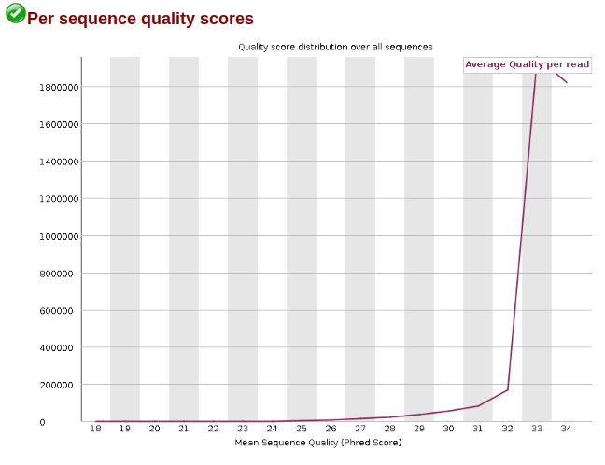
Filter sequences with a 2 bp window with quality <= 32
FASTQ size was reduced by 8 % on average
trimmomatic PE ... CROP:72 MINLEN:72 SLIDINGWINDOW:32:2

Slide 2
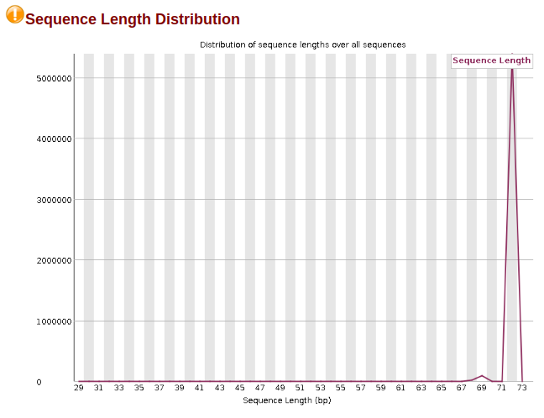
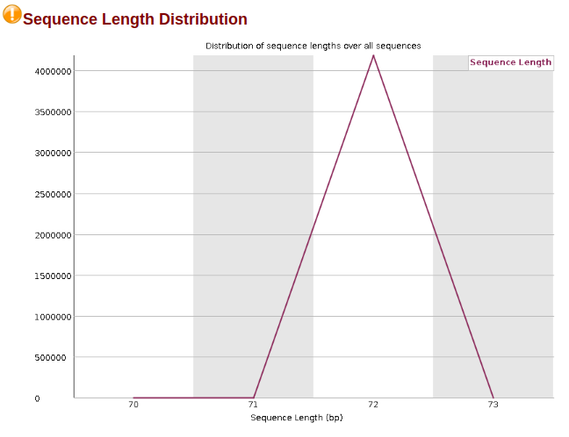
Crop reads to 72 bp and filter out reads < 72 bp
FASTQ size was reduced by 8 % on average
trimmomatic PE ... CROP:72 MINLEN:72 SLIDINGWINDOW:32:2

